Slide 1
Notes:
25th Anniversary Gala
Celebrating Our Success
April 7, 2013
[slide show]

Slide 2
The Baldrige Foundation and the Baldrige Performance Excellence Program gratefully acknowledge the contributions of the thousands of volunteer examiners who have contributed to the program, our U.S. and international partners, and the 93 recipients of the Baldrige Award:

Slide 3
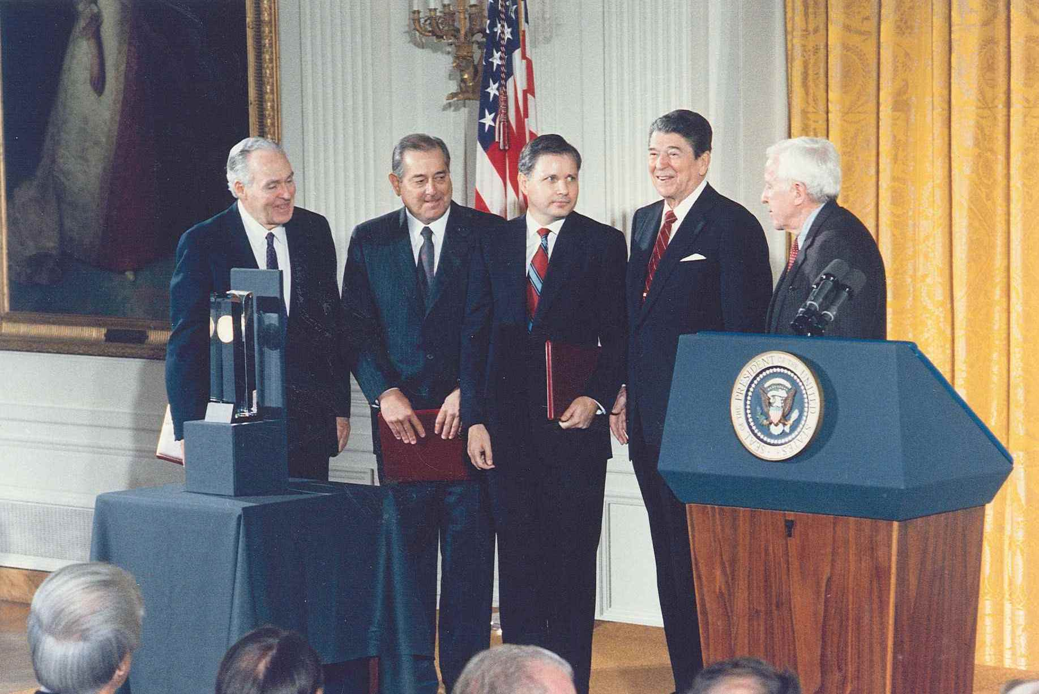
Baldrige Award Recipients 1988–2012
Motorola, Inc.
Westinghouse Electric Corporation, Commercial Nuclear Fuel Division
Globe Metallurgical, Inc. (now part of Globe Specialty Metals, Inc.)
Milliken & Company
Xerox Corporation, Business Products and Systems
Cadillac Motor Car Company
IBM Rochester
Notes:
Photo caption, from left to right:
1988: Robert W. Galvin, chairman of the board, Motorola Inc.; J.C. Marcus, chairman and CEO, Westinghouse Electric Corporation Commercial Nuclear Fuel Division; Arden C. Sims, president and CEO, Globe Metallurgical Inc.; President Ronald Reagan; and U.S. Secretary of Commerce William Verity.

Slide 4
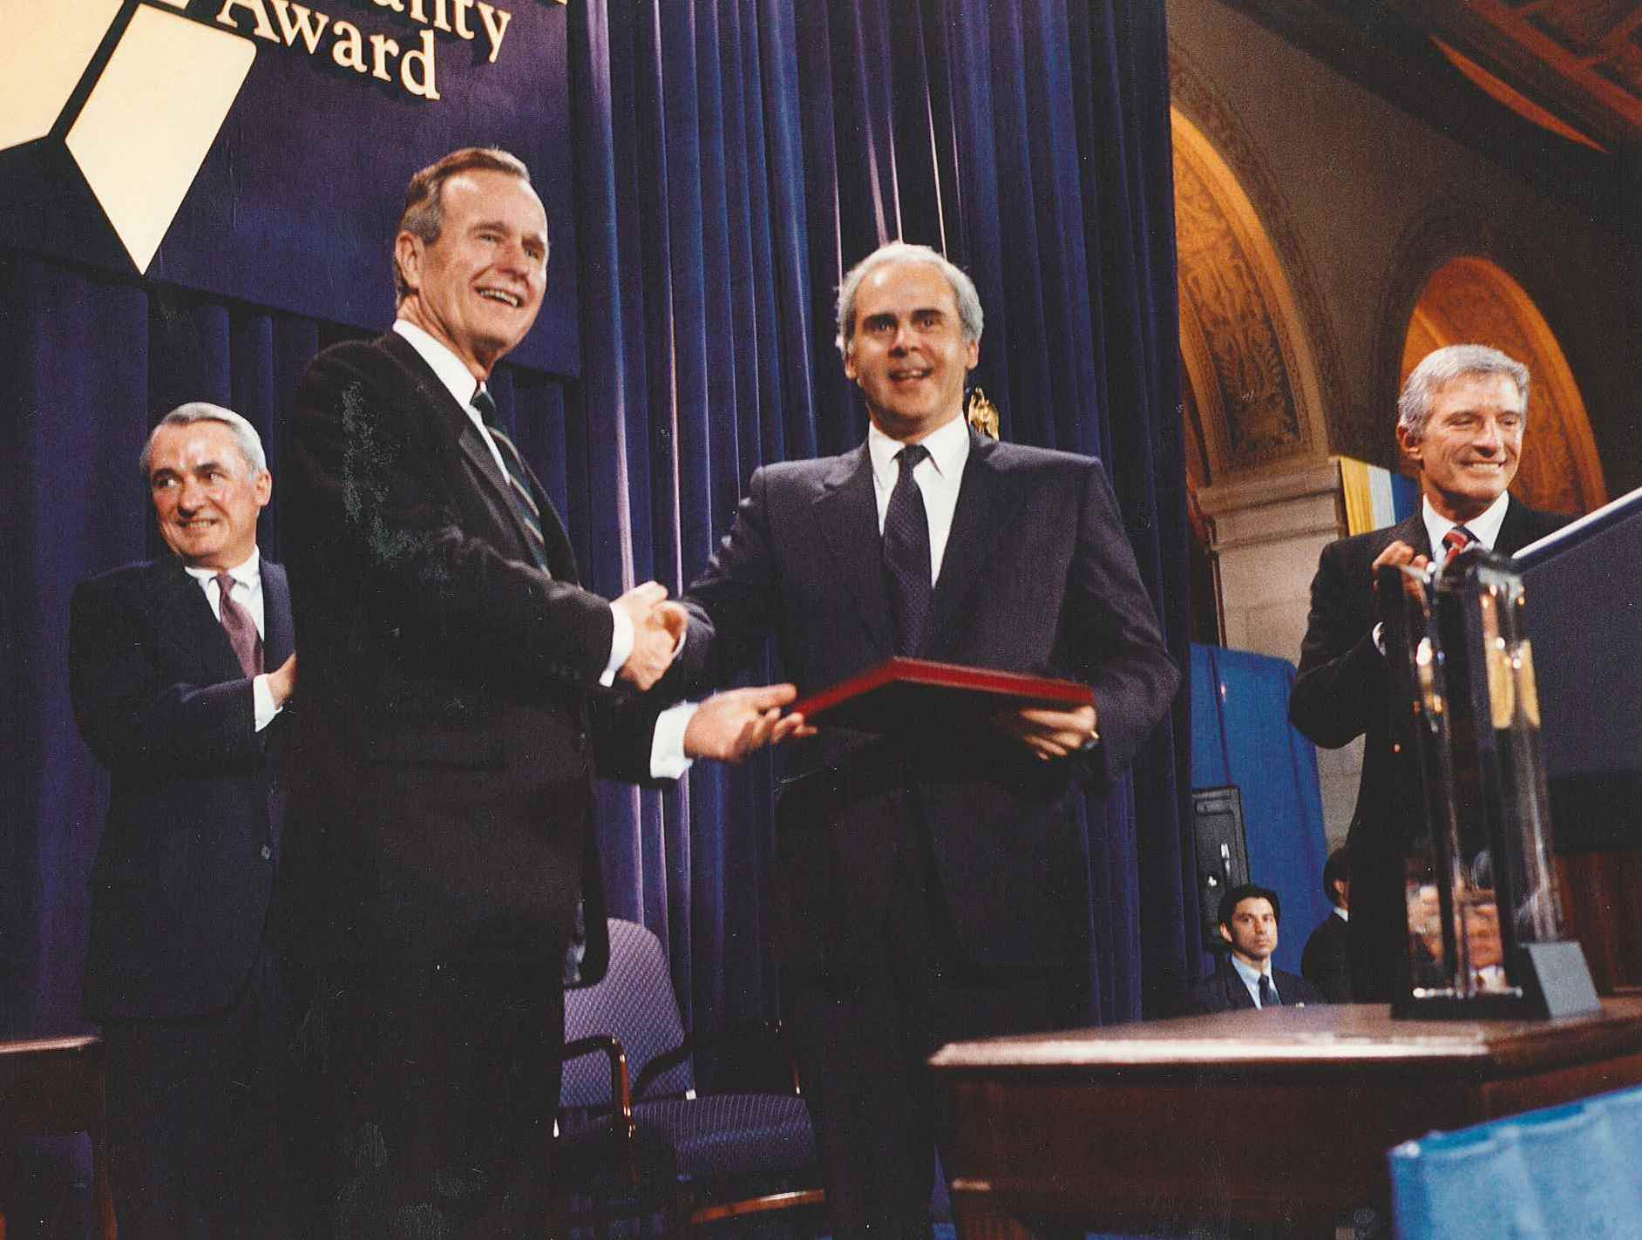
Federal Express Corporation
Wallace Co., Inc.
Solectron Corporation
Zytec Corporation (now part of Artesyn Technologies)
Marlow Industries, Inc.
AT&T Network Systems Group, Transmission Systems Business Unit (now part of Alcatel-Lucent)
Texas Instruments, Inc., Defense Systems & Electronics Group (now part of Raytheon Systems Co.)
Notes:
Photo Caption:
1990: President George H.W. Bush and U.S. Secretary of Commerce Robert Mosbacher congratulate Baldrige Award-winning CEOs.

Slide 5
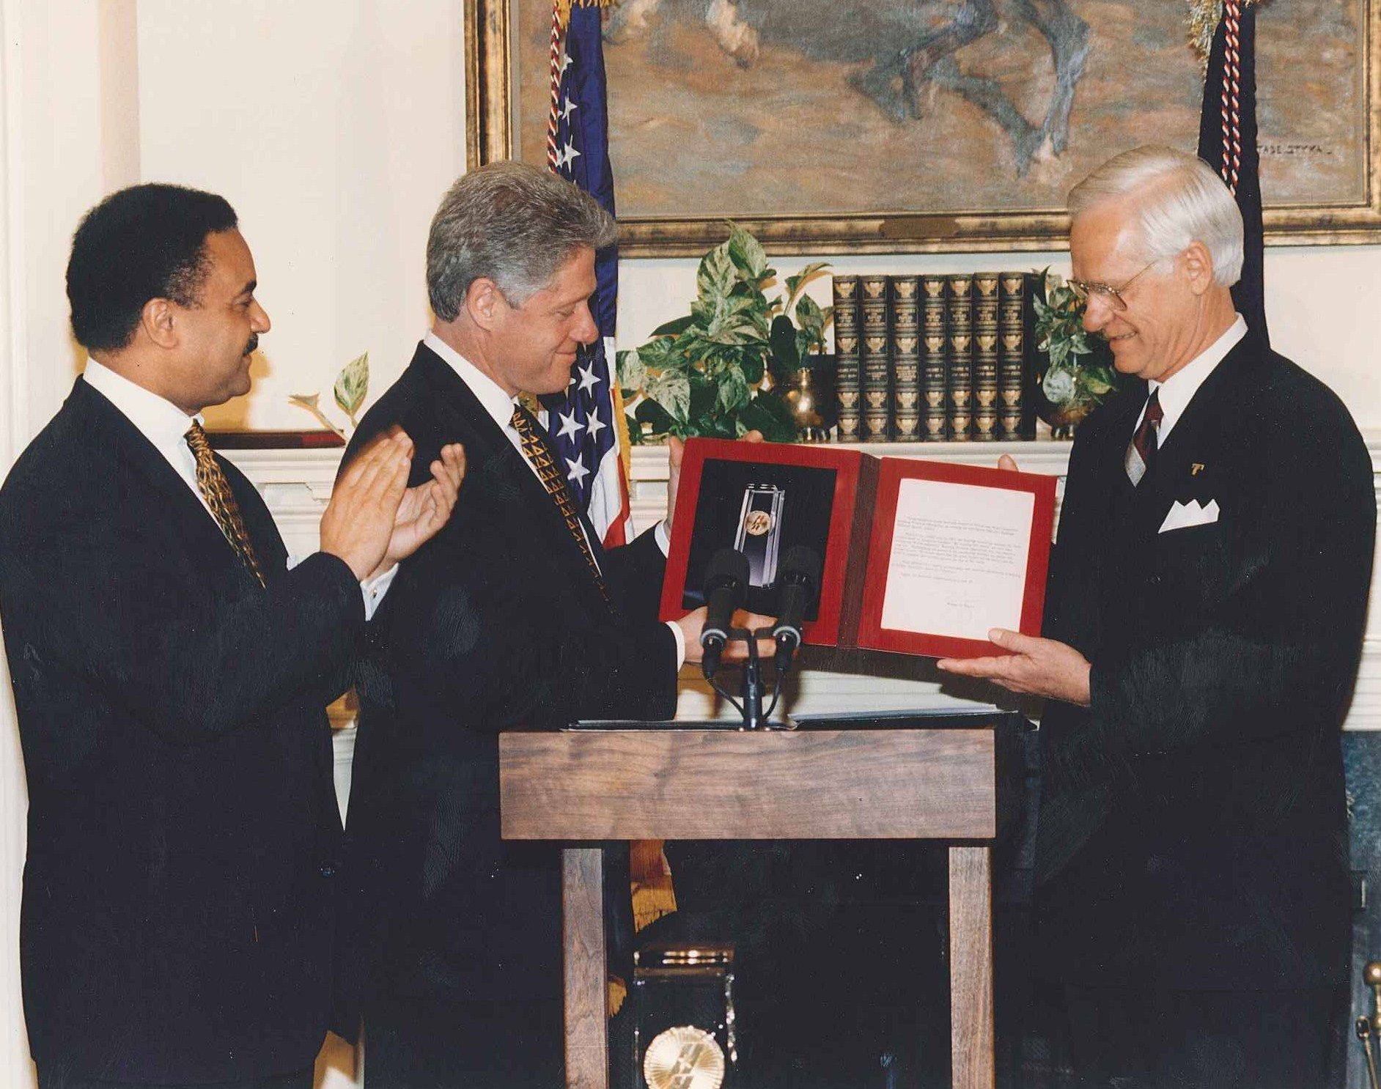
AT&T Universal Card Services (now part of Citigroup, Inc.)
The Ritz‑Carlton Hotel Company, L.L.C. (now part of Marriott International)
Granite Rock Co. (now Graniterock)
Eastman Chemical Company
Ames Rubber Corporation
AT&T Consumer Communications Services (now the Consumer Markets Division of AT&T)
Notes:
Photo Caption:
1995: President Bill Clinton and U.S. Secretary of Commerce Ron Brown recognize a Baldrige Award winner.

Slide 6
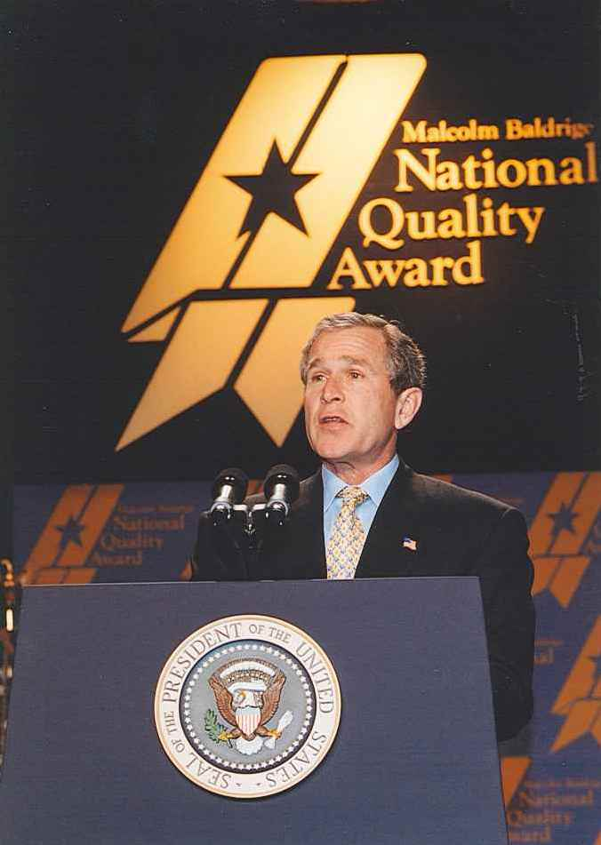
GTE Directories Corporation (now known as Verizon Information Services)
Wainwright Industries, Inc.
Armstrong World Industries, Inc., Building Products Operations
Corning, Inc., Telecommunications Products Division
ADAC Laboratories
Dana Commercial Credit Corporation (now part of Dana Holding Corp.)
Custom Research, Inc. (now GFK Customer Research, Inc.)
Notes:
Photo Caption:
2002: U.S. President George W. Bush speaks at the Baldrige Award ceremony.

Slide 7
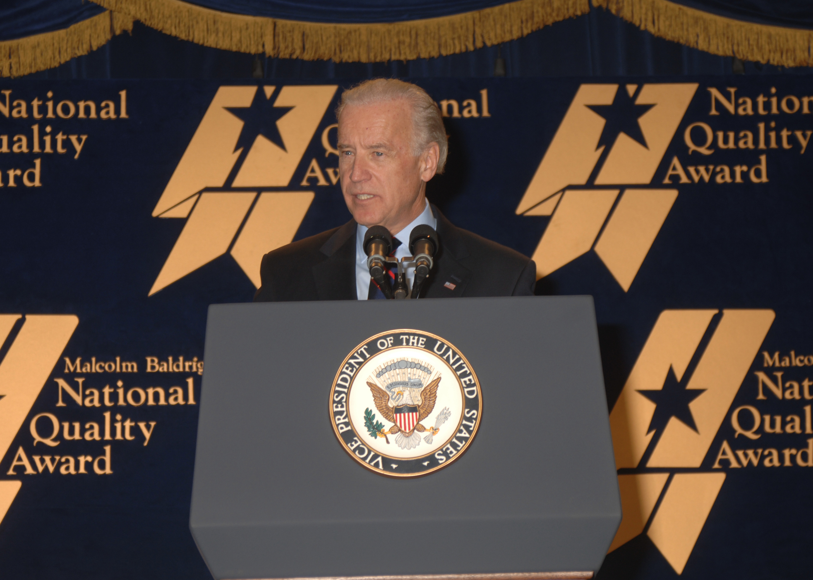
Trident Precision Manufacturing, Inc.
3M Dental Products Division (now 3M ESPE Dental Products)
Solectron Corporation
Merrill Lynch Credit Corporation
Xerox Business Services
Boeing Airlift and Tanker Programs (now Boeing Global Mobility Systems)
Solar Turbines Incorporated
Texas Nameplate Company, Inc.
BI
Notes:
Photo Caption:
2009: Vice President Joe Biden speaks at a Baldrige Award ceremony.

Slide 8
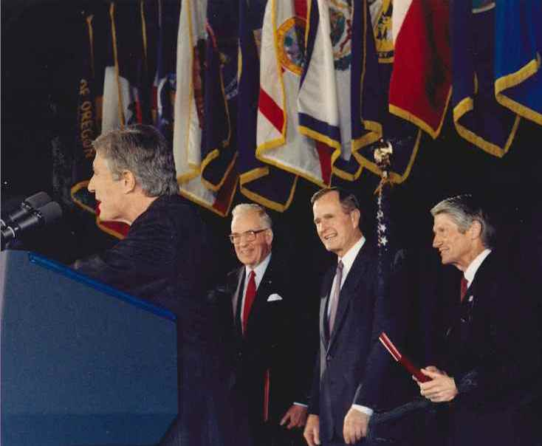
The Ritz‑Carlton Hotel Company, L.L.C. (now part of Marriott International)
STMicroelectronics, Inc.–Region Americas
Sunny Fresh Foods, Inc. (now Cargill Kitchen Solutions)
Dana Corporation–Spicer Driveshaft Division (now part of Dana Holding Corp. Torque-Traction Technologies, Inc.)
KARLEE Company, Inc.
Los Alamos National Bank
Notes:
Photo Caption:
1990: U.S. President George H.W. Bush and Baldrige Award recipients.

Slide 9
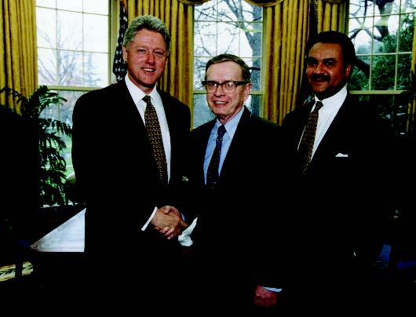
Operations Management International, Inc. (now CH2M Hill)
Clarke American Checks, Inc. (now Harland Clarke)
Pal's Sudden Service
Chugach School District
Pearl River School District
University of Wisconsin-Stout
Motorola Commercial, Government and Industrial Solutions Sector (now part of Motorola Government and Enterprise Mobility Solutions)
Branch-Smith Printing Division
Notes:
Photo Caption:
1995: President Bill Clinton and U.S. Secretary of Commerce Ron Brown pose with first Baldrige Director Curt Reimann.

Slide 10
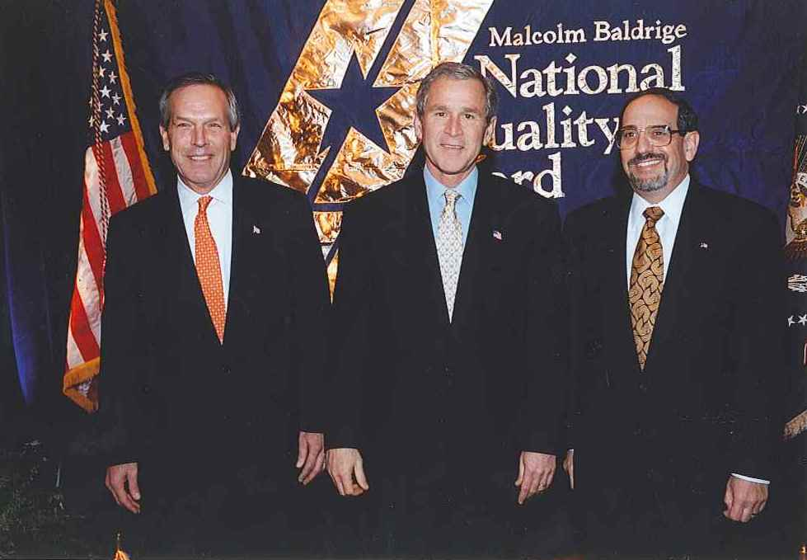
SSM Health Care
MEDRAD (now Bayer HealthCare Radiology & Interventional)
Boeing Aerospace Support (now Boeing Support Systems)
Caterpillar Financial Services Corporation (U.S.)
Stoner, Inc.
Community Consolidated School District 15
Baptist Hospital, Inc.
Saint Luke’s Hospital of Kansas City
Notes:
Photo Caption:
2002: U.S. Commerce Secretary Don Evans, U.S. President George W. Bush, and Baldrige Director Harry Hertz pose for a photo.

Slide 11
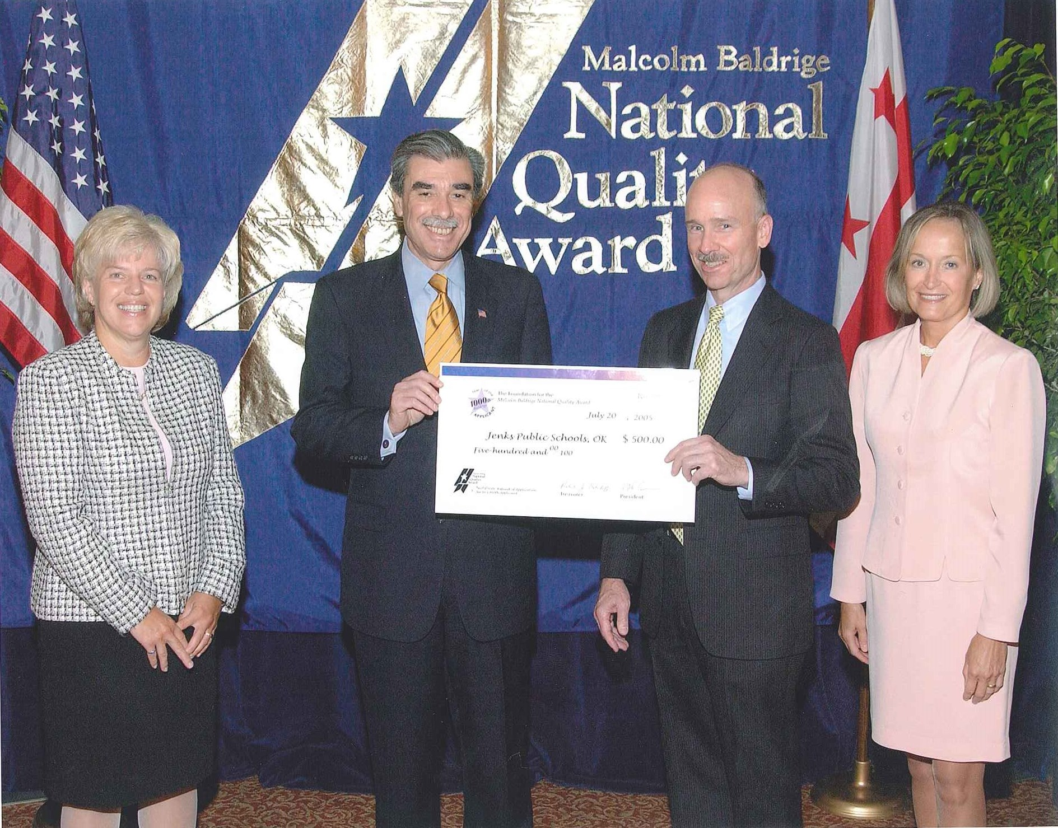
The Bama Companies, Inc.
Texas Nameplate Company, Inc.
Kenneth W. Monfort College of Business
Robert Wood Johnson University Hospital Hamilton
Sunny Fresh Foods, Inc. (now Cargill Kitchen Solutions)
DynMcDermott Petroleum Operations Company (now DM Petroleum Operations Company)
Park Place Lexus
Jenks Public Schools
Notes:
Photo Caption:
2005: U.S. Commerce Secretary Carlos Gutierrez presents a certificate naming Jenks Public Schools the 1,000th applicant for the Baldrige Award.

Slide 12
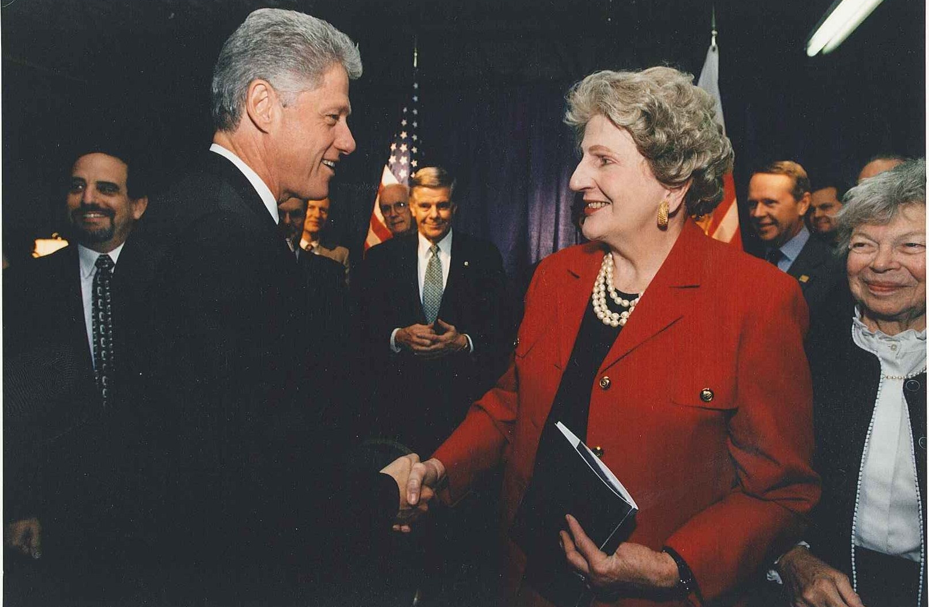
Richland College
Bronson Methodist Hospital
Premier Inc.
MESA
North Mississippi Medical Center
PRO-TEC Coating Company
Mercy Health System
Sharp HealthCare
City of Coral Springs
U.S. Army Armament Research, Development and Engineering Center (ARDEC)
Notes:
Photo Caption:
1997: President Bill Clinton shakes Letitia Baldrige’s hand.

Slide 13
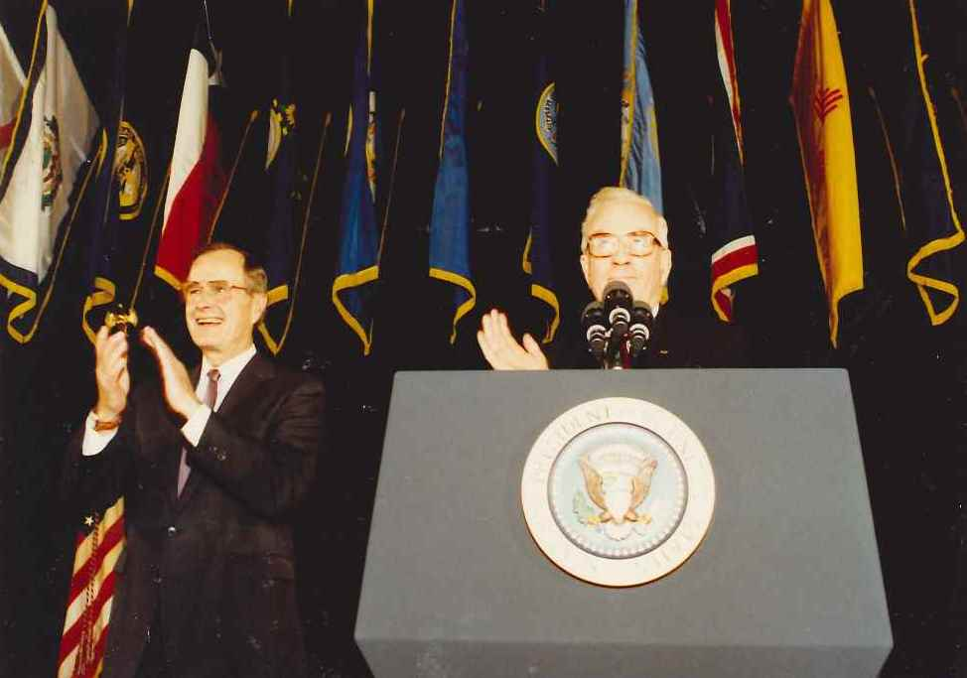
Cargill Corn Milling North America
Poudre Valley Health System (now part of University of Colorado Health)
Iredell-Statesville Schools
Honeywell Federal Manufacturing & Technologies, L.L.C.
MidwayUSA
AtlantiCare
Heartland Health
Notes:
Photo Caption:
1990: U.S. President George H.W. Bush applauds for Baldrige Award recipients.

Slide 14
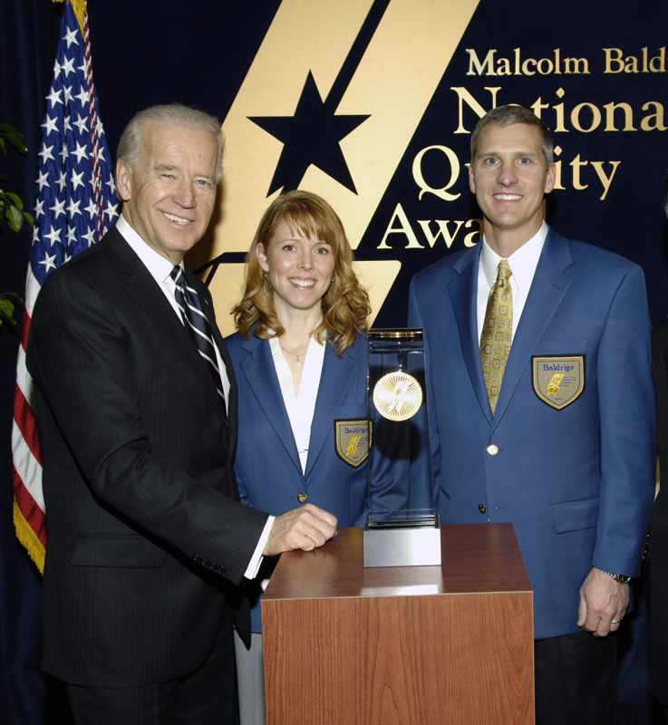
VA Cooperative Studies Program Clinical Research Pharmacy Coordinating Center
MEDRAD (now Bayer HealthCare Radiology & Interventional)
Nestlé Purina PetCare Company
Freese and Nichols, Inc.
K&N Management
Studer Group
Montgomery County Public Schools
Advocate Good Samaritan Hospital
Concordia Publishing House
Henry Ford Health System
Schneck Medical Center
Notes:
Photo Caption:
2009: U.S. Vice President Joe Biden poses with Baldrige Award recipients.

Slide 15
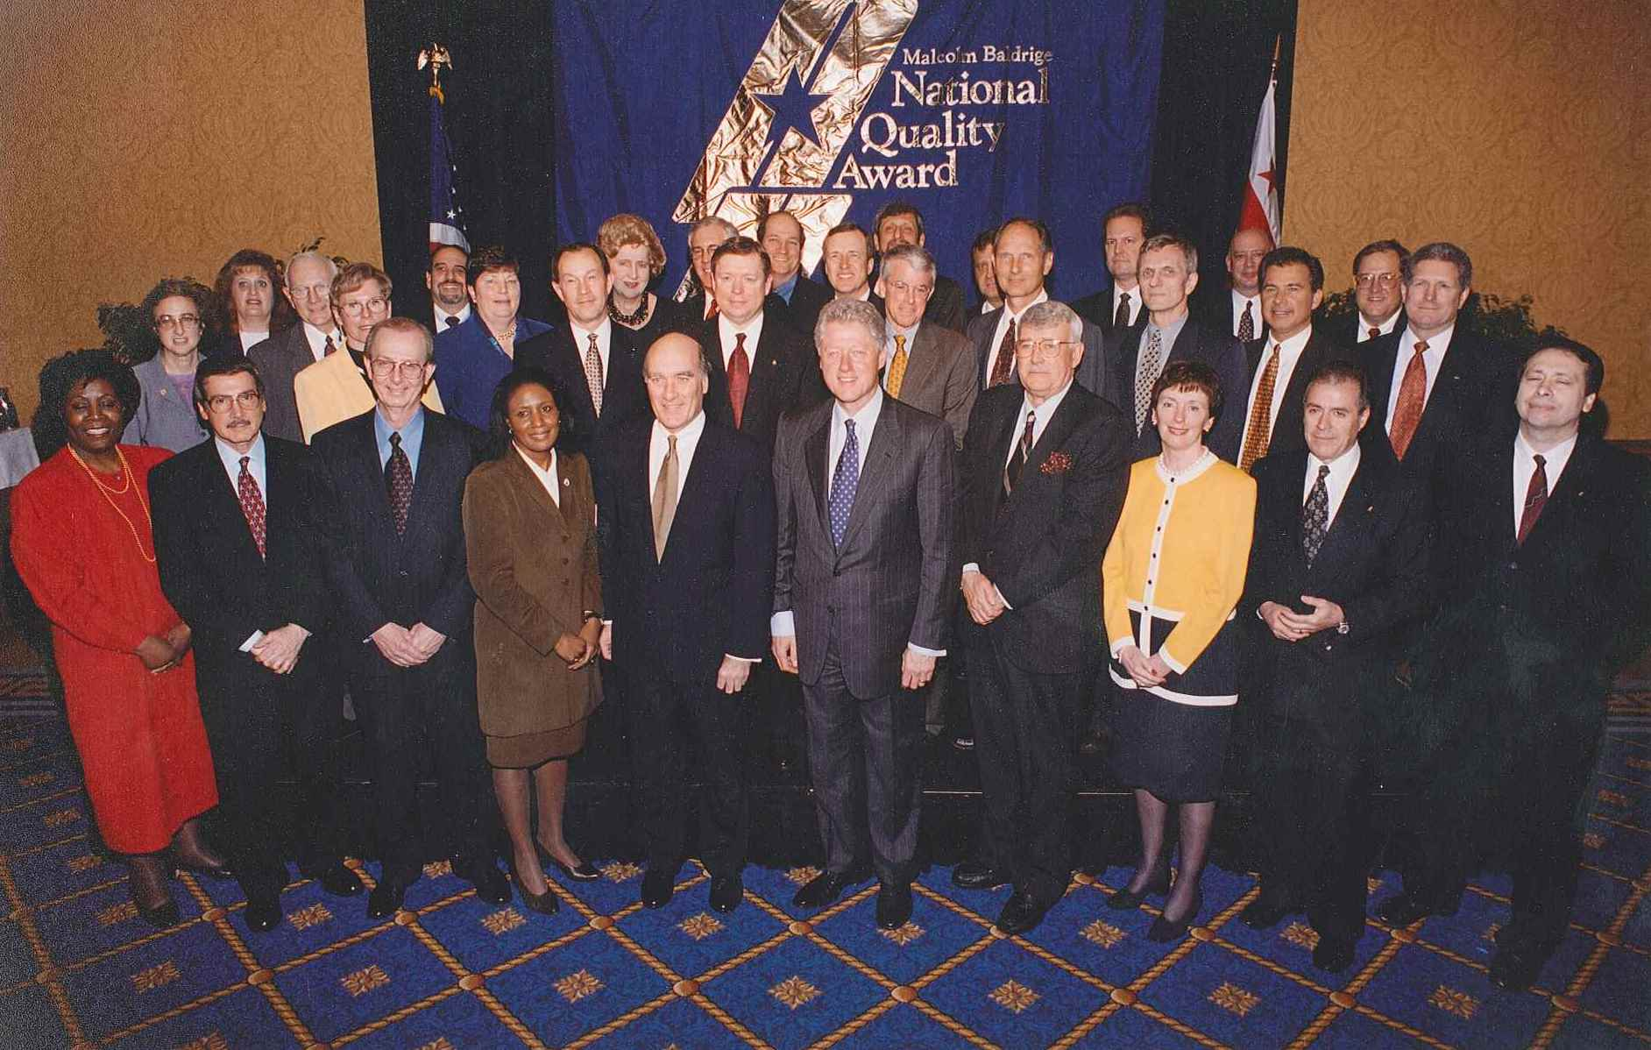
Southcentral Foundation
Lockheed Missiles and Fire Control
MESA
North Mississippi Health Services
City of Irving, Texas
Notes:
Photo Caption:
1997: President Bill Clinton poses with Baldrige Award recipients, NIST staff, and Baldrige family members.

Slide 16
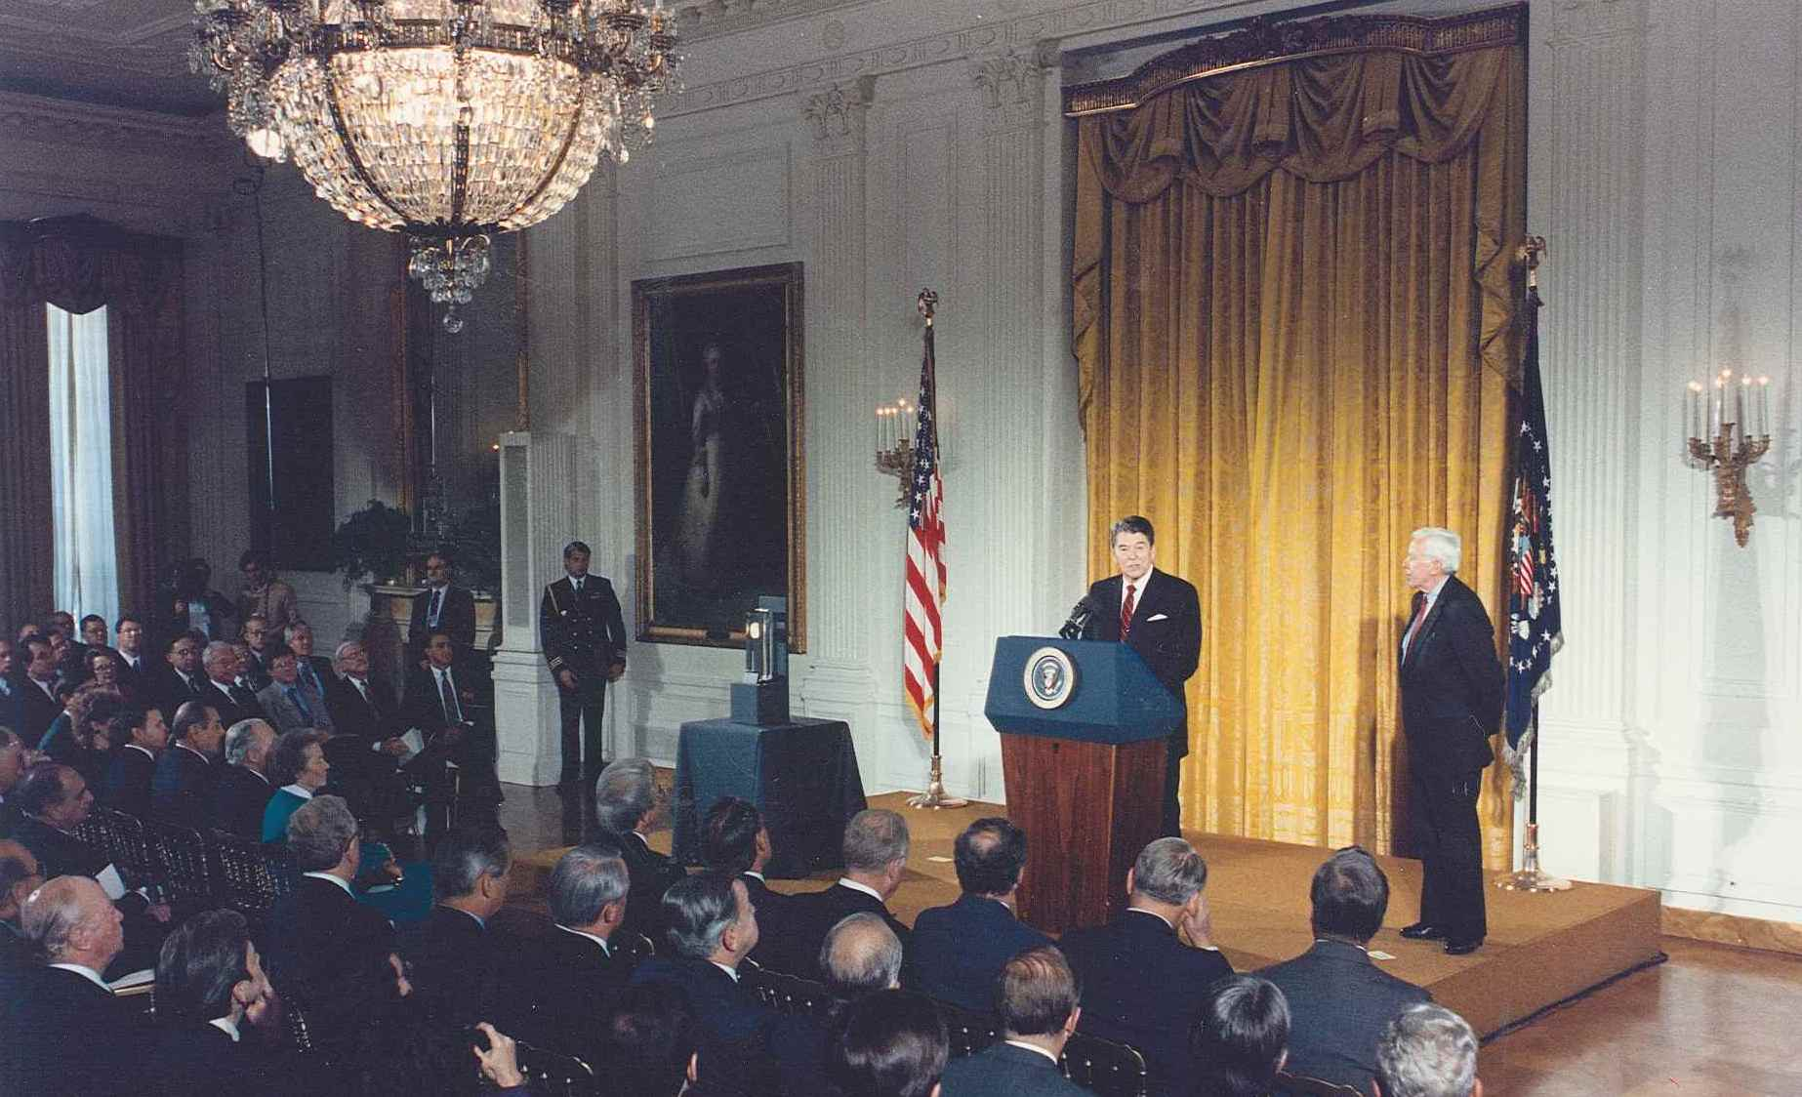
Notes:
Photo Caption:
1988: President Ronald Reagan presents at the first Baldrige Award ceremony in Crystal City, Virginia, with U.S. Secretary of Commerce William Verity looking on.

Slide 17
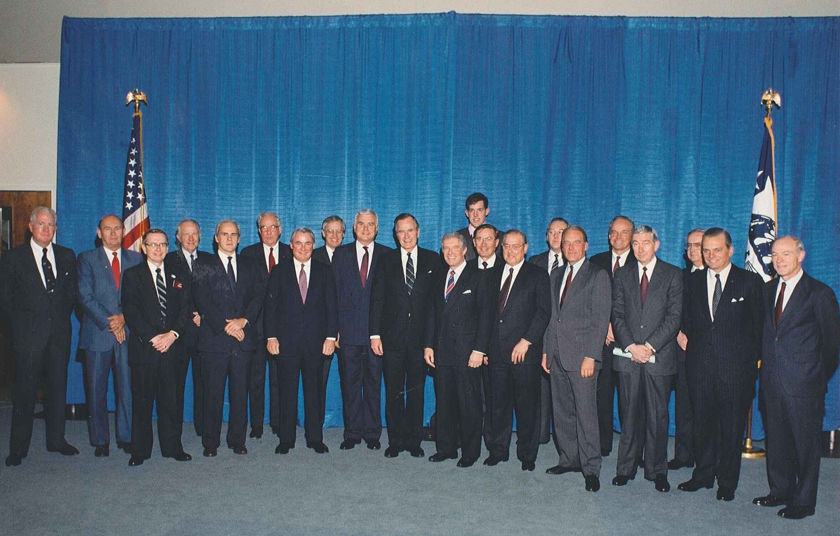
Notes:
Photo Caption:
1990: President George H. W. Bush, U.S. Secretary of Commerce Robert Mosbacher, Baldrige family, and NIST staff pose with Baldrige Award recipients.

Slide 18
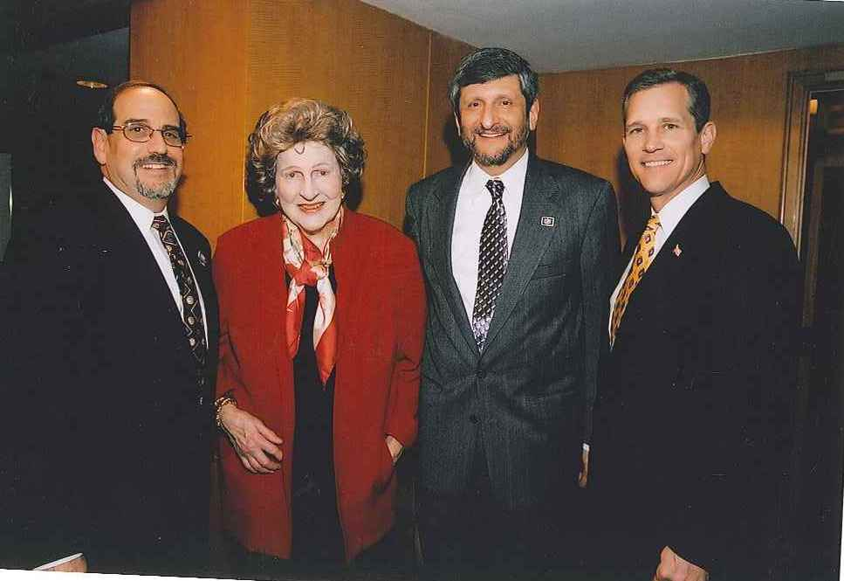
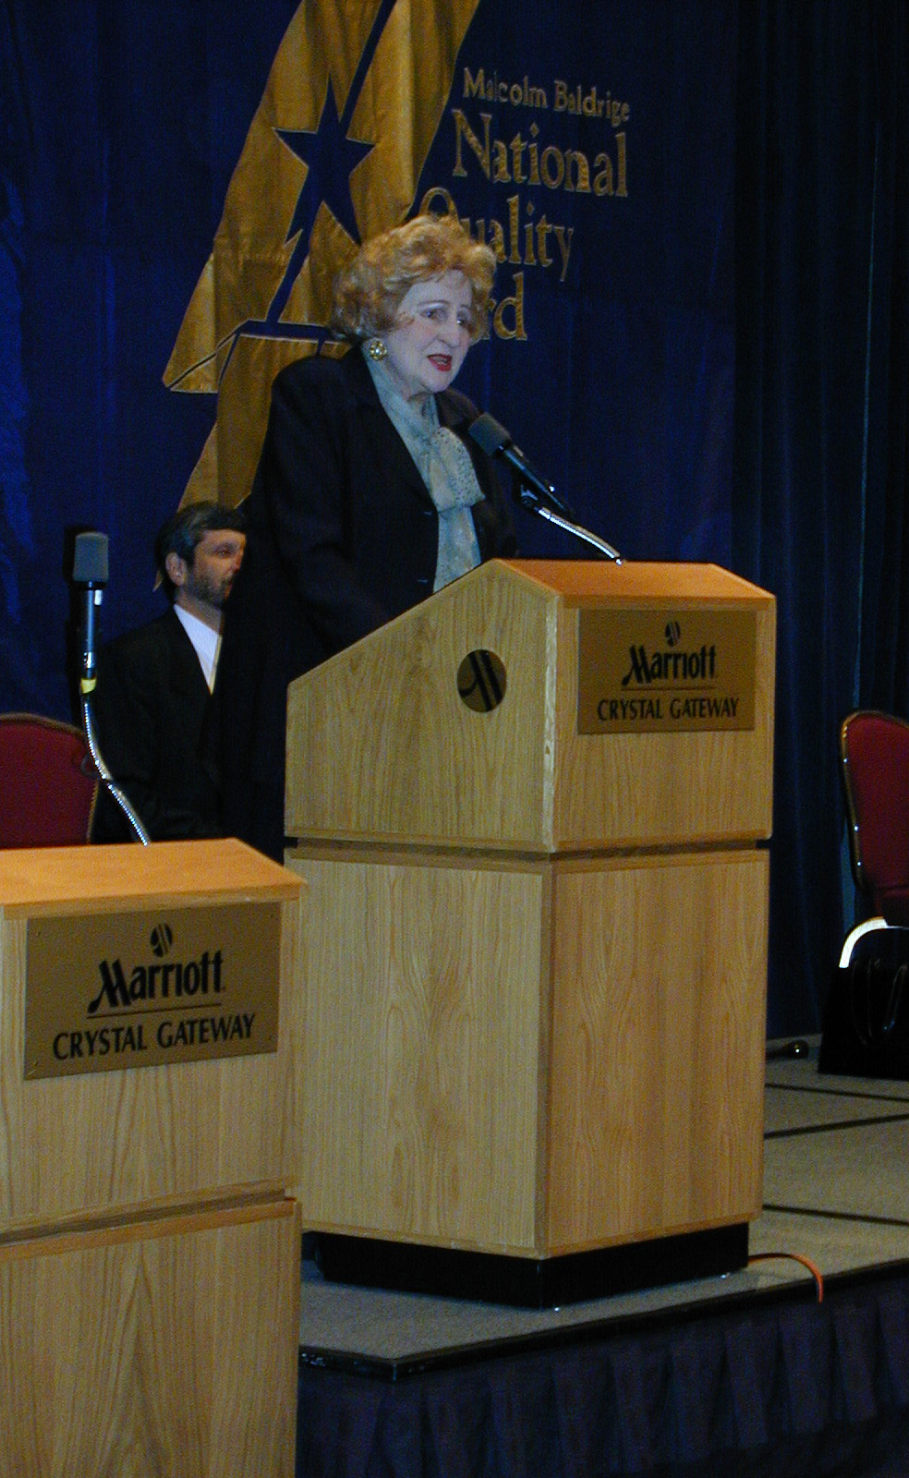
Notes:
Photo Captions:
2001: Letitia Baldrige speaks at an examiner recognition ceremony as part of the Baldrige Award Ceremony.
2004: Baldrige Director Harry Hertz, Letitia Baldrige, Baldrige Deputy Director Barry Diamondstone, and U.S. Undersecretary for Technology Phillip Bond pose for a photo.

Slide 19
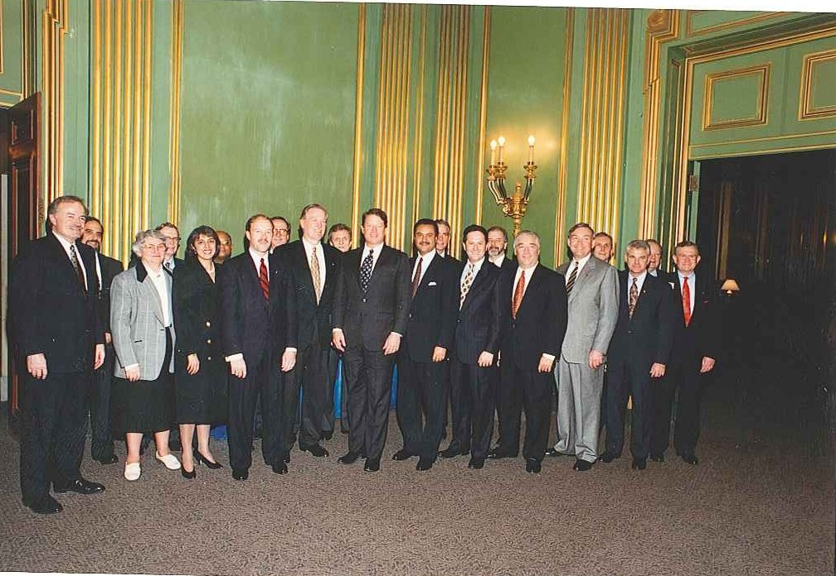
Notes:
Photo Caption:
1994: Vice President Al Gore and U.S. Secretary of Commerce Ron Brown pose with Baldrige Award recipients and NIST staff.

Slide 20
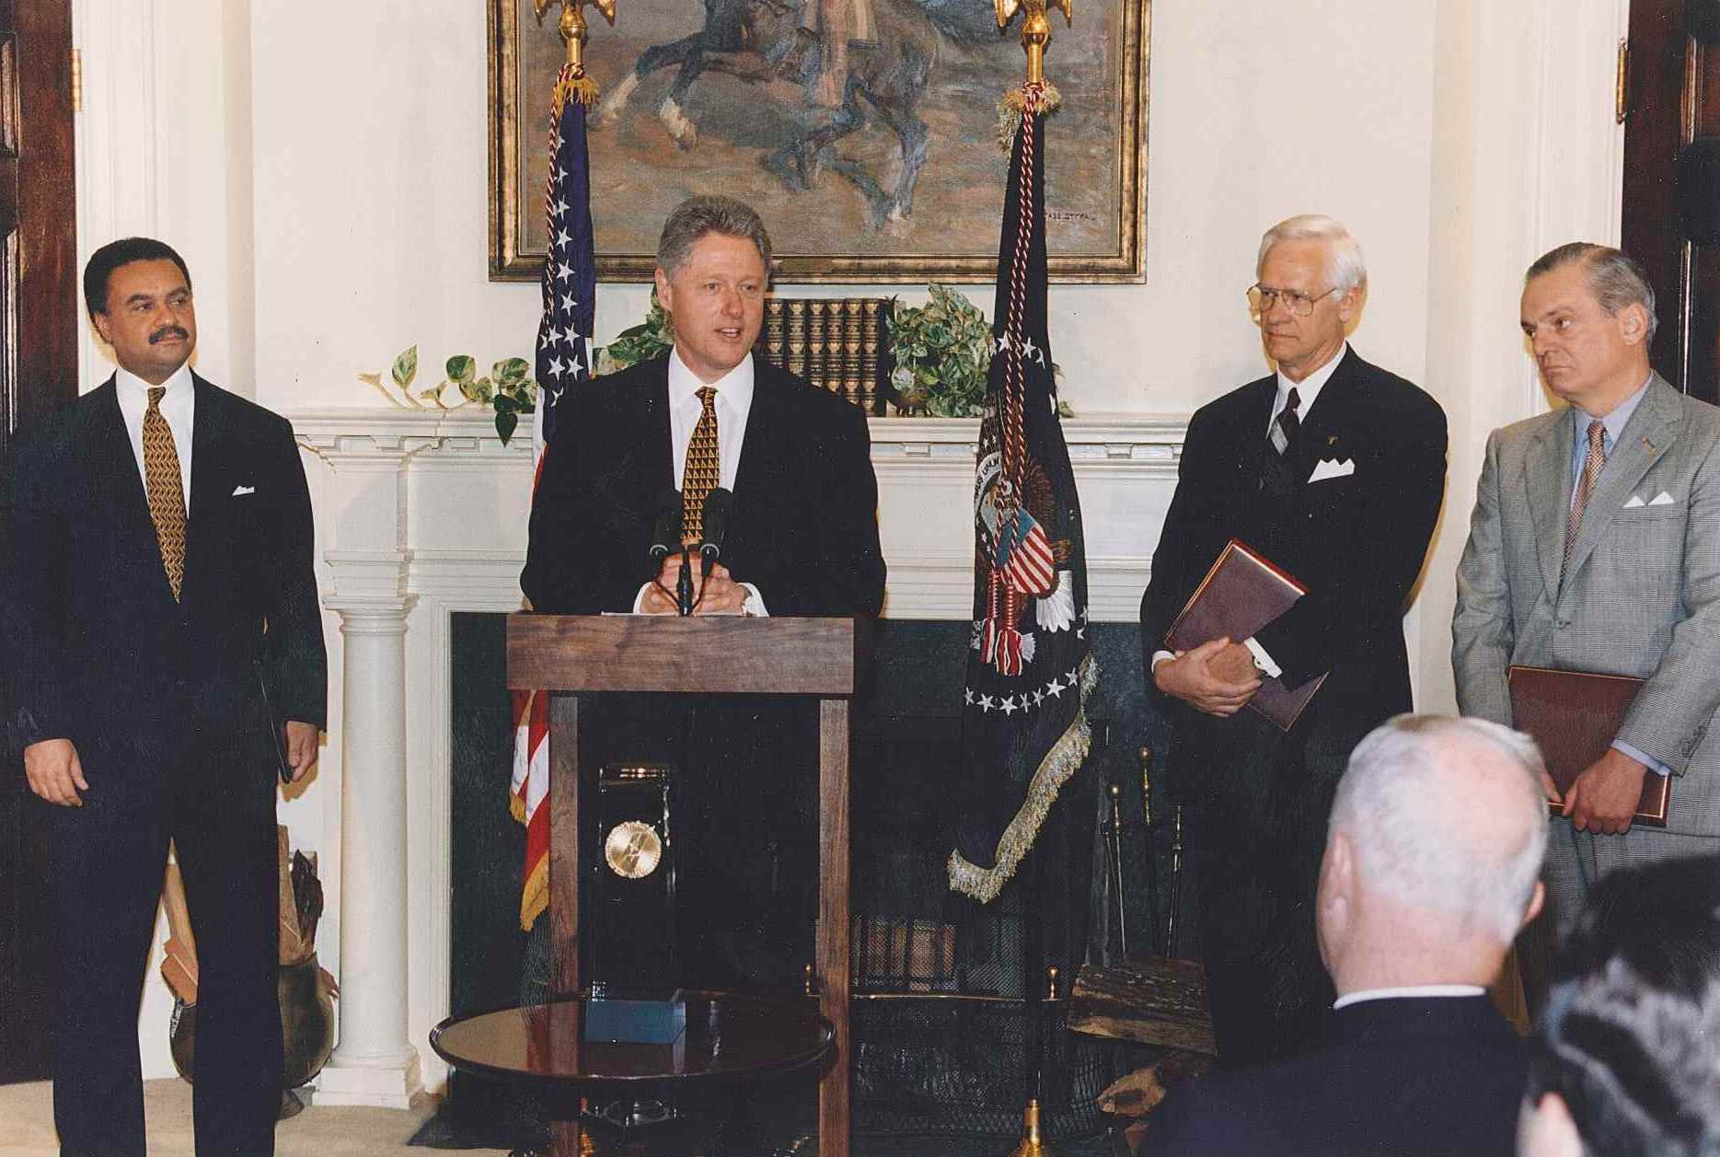
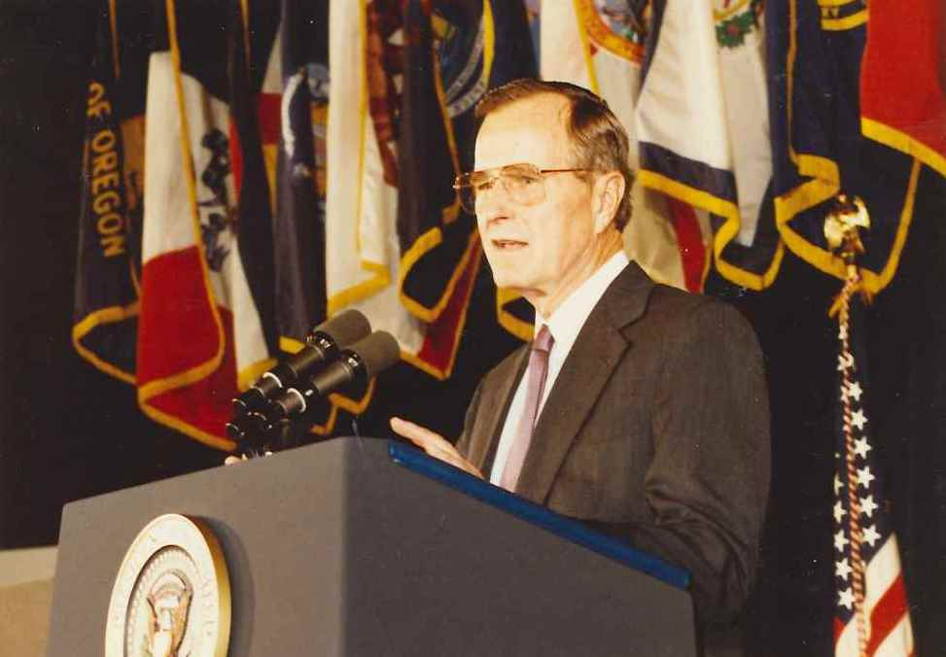
Notes:
Photo Captions, from left to right:
1995: President Bill Clinton speaks at the Baldrige Award ceremony, with U.S. Secretary of Commerce Ron Brown and leaders from Baldrige Award recipients standing by.
1989: President George H. W. Bush speaks at the Baldrige Award ceremony.

Slide 21
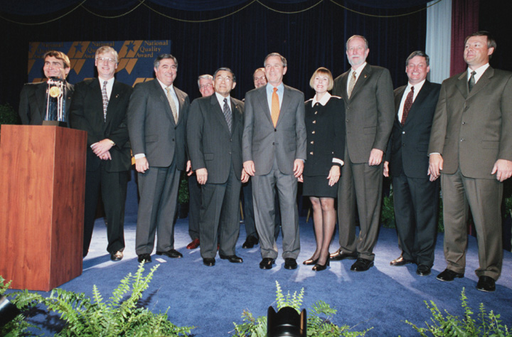
Notes:
Photo Caption:
2001: President George W. Bush poses with Baldrige Award recipients.

Slide 22
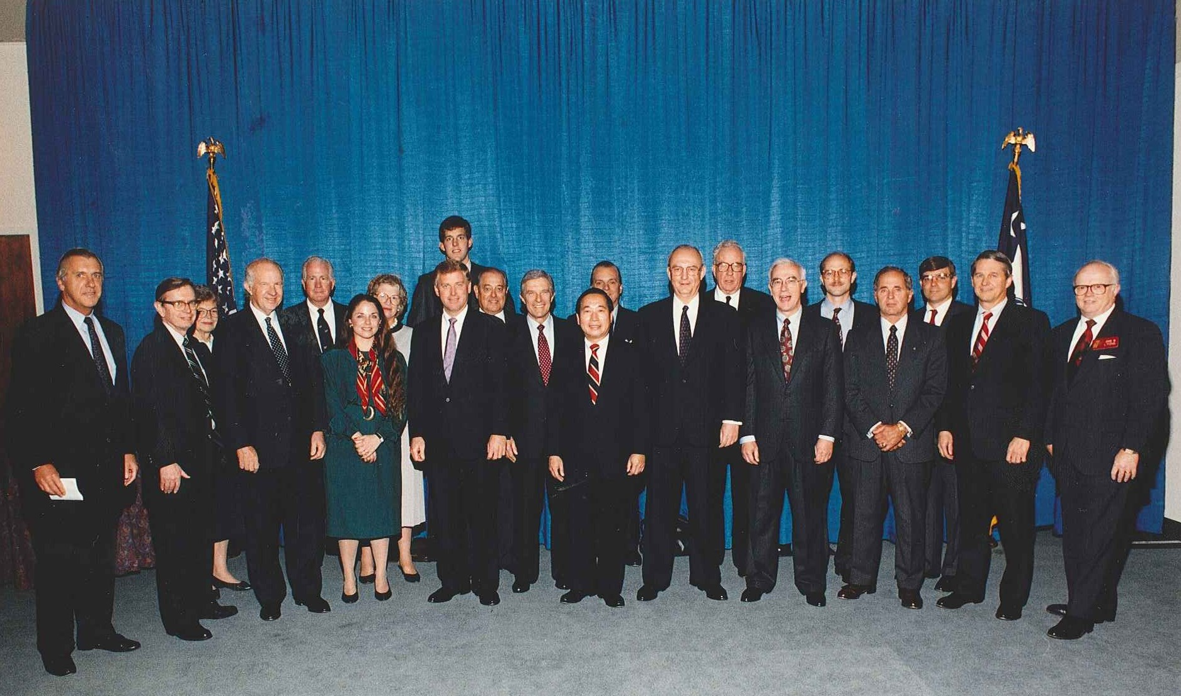
Notes:
Photo Caption:
1991: Staff of Baldrige Award-winning organizations pose with Vice President Dan Quayle, U.S. Commerce Secretary Robert Mosbacher, and members of the Baldrige family.

Slide 23
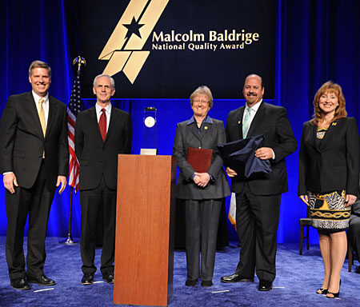
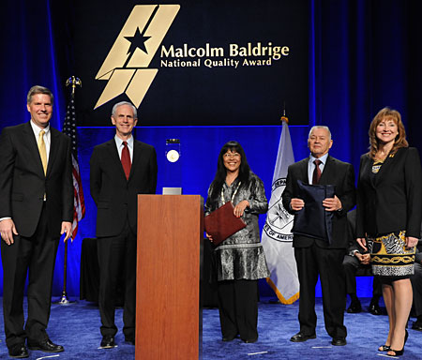
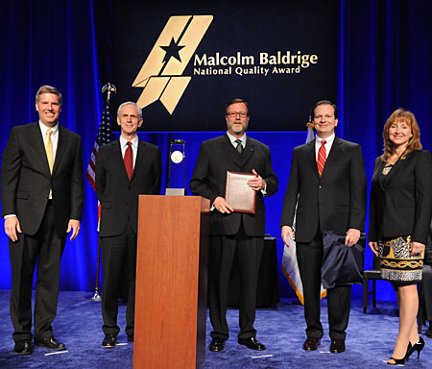
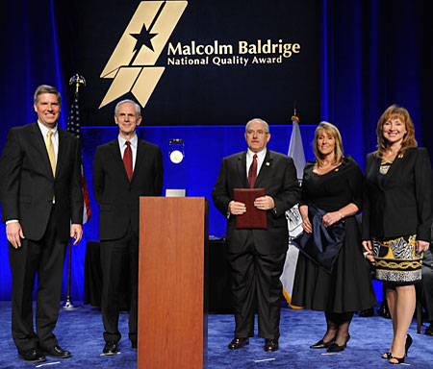
Notes:
Photo Captions, clockwise, from left to right:
2012: NIST Director Patrick Gallagher, U.S. Commerce Secretary John Bryson, Foundation Chair Debbie Collard pose with Baldrige Award recipient seniors leaders from Henry Ford Health Center.
2012: NIST Director Patrick Gallagher, U.S. Commerce Secretary John Bryson, Foundation Chair Debbie Collard pose with Baldrige Award recipient seniors leaders from Southcentral Foundation.
2012: NIST Director Patrick Gallagher, U.S. Commerce Secretary John Bryson, Foundation Chair Debbie Collard pose with Baldrige Award recipient seniors leaders from Schneck Medical Center.
2012: NIST Director Patrick Gallagher, U.S. Commerce Secretary John Bryson, Foundation Chair Debbie Collard pose with Baldrige Award recipient seniors leaders from Concordia Publishing House.

Slide 24
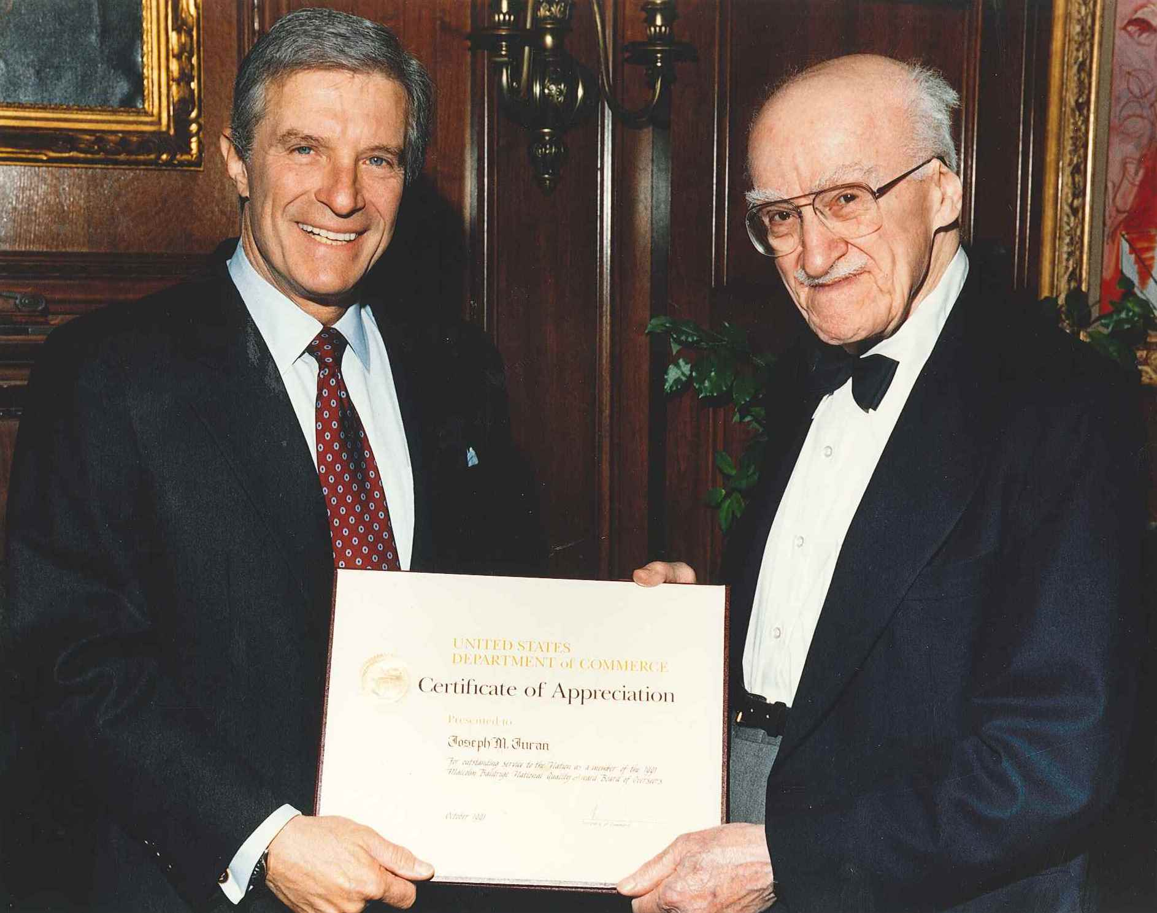
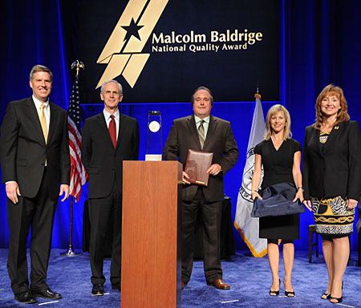
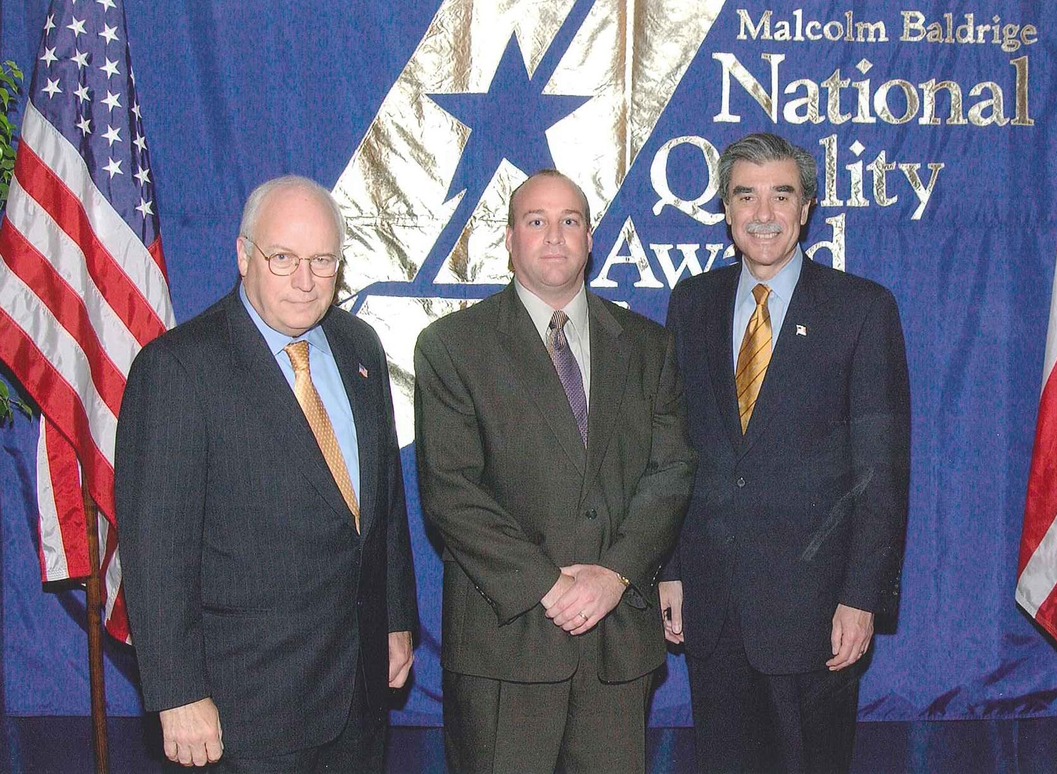
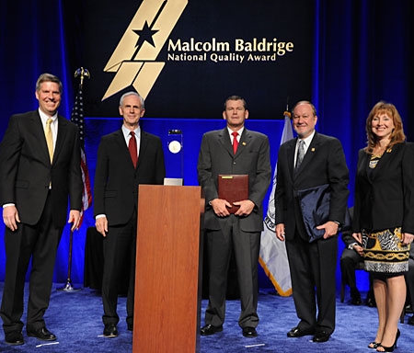
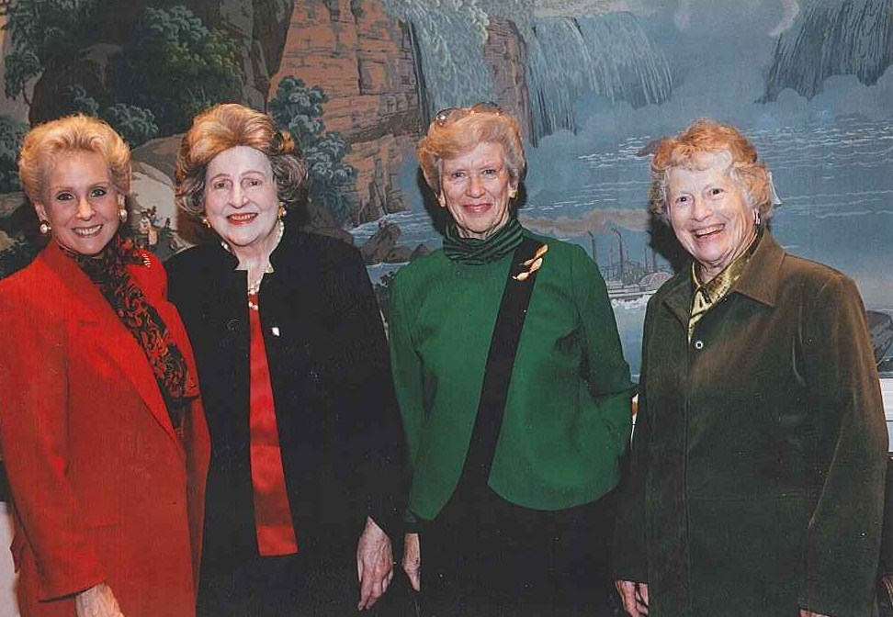
Notes:
Photo Captions, clockwise, from left to right:
1991: U.S. Secretary of Commerce Robert Mosbacher awards a certificate of appreciation to Joseph M. Juran.
2005: U.S. Vice President Richard Cheney and U.S. Commerce Secretary Carlos Gutierrez pose with a Baldrige Award winner.
2012: NIST Director Patrick Gallagher, U.S. Secretary of Commerce John Bryson, and Foundation Chair Debbie Collard pose with leaders of Baldrige Award winner K&N Management
2012: NIST Director Patrick Gallagher, U.S. Secretary of Commerce John Bryson, and Foundation Chair Debbie Collard pose with leaders of Baldrige Award winner Nestlé Purina PetCare.
2002: U.S. Secretary of Commerce Barbara Hackman Franklin, Letitia Baldrige, a friend of Midge Baldrige and Midge Baldrige (widow of Malcolm) pose for photos.

Slide 25
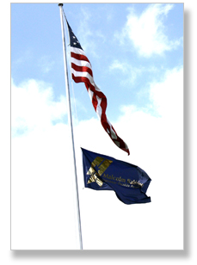
Notes:
The Malcolm Baldrige National Quality Award flag flies alongside the American flag at the National Institute of Standards and Technology on August 20, 2012. On that date in 1987, legislation was passed that created the bipartisan Baldrige Performance Excellence Program.

