Slide 1

Baldrige Performance Excellence Program | 2015
Introduction to the
Baldrige Program
Baldrige Performance Excellence Program | www.nist.gov/baldrige

Slide 2

  For 27 years:
  defining performance excellence
  recognizing performance excellence
  helping organizations improve
Public-private partnership
Presidential education and award program
Notes:
The Baldrige Program is the only public-private partnership and Presidential award and education program dedicated to improving U.S. organizations. Its mission is to define, recognize, and foster organizational excellence in every sector.

Slide 3
The Baldrige Program . . .
Authors the Baldrige Excellence Framework and its Criteria for Performance Excellence
Offers organizational assessments and self-assessment tools
Provides training, executive development, and conferences
Manages the Malcolm Baldrige National Quality Award
Notes:
In carrying out that mission, the Baldrige Program
authors the Baldrige Excellence Framework and its Criteria for Performance Excellence, an integrated management framework that serves as the basis for state, regional, sector, local, and many international performance excellence and business excellence awards and programs
offers Baldrige Award evaluations and Baldrige Collaborative Assessments of organizational strengths and opportunities for improvement by teams of trained experts
provides self-assessment tools for organizations
provides executive development, training, educational presentations, conferences, and workshops on proven best management practices and on using the Baldrige Criteria to improve
manages the Malcolm Baldrige National Quality Award, the highest award for performance excellence that a U.S. organization can receive

Slide 4
Program History
Malcolm Baldrige National Quality Improvement Act of 1987, Public Law 100-107
Created award program to
  identify/recognize role-model businesses
  establish criteria for evaluating improvement efforts
  disseminate/share best practices
Expanded to health care and education (1998) and to nonprofit sector (2005)
Notes:
In the early and mid-1980s, many industry and government leaders saw that an emphasis on quality was necessary for survival in the U.S. marketplace and for doing business in an ever-expanding, more demanding, highly competitive global market. The U.S. Congress responded by passing the Malcolm Baldrige National Quality Improvement Act of 1987. The goal of the act was to enhance the competitiveness of U.S. businesses.
The act established the Baldrige Performance Excellence Program, which aims to
— identify role-model organizations and recognize them as examples for others to emulate
— establish criteria for organizations to use in evaluating their improvement efforts
— encourage the sharing of organizational best practices
In 1998, the original legislation was expanded beyond business organizations to make education and health care organizations eligible to receive the Baldrige Award.
Congress passed legislation granting nonprofit organizations (including charities and government agencies) eligibility to apply for the Baldrige Award. Following a pilot program in the 2006 award cycle, all nonprofit organizations were fully integrated into the process in 2007.

Slide 5
Baldrige Community
Foundation for the
Malcolm Baldrige
National Quality Award
Board of
Overseers
Department of Commerce
Alliance for
Performance
Excellence
National
Institute of
Standards and
Technology
CV
Baldrige
Award
Recipients
Board of Examiners
Judges
Examiners
Cooperating Organizations
Professional Societies
Trade Associations
ASQ
(Contractor)
Notes:
The public-private partnership is fundamental to the program’s success. The program is managed by the National Institute of Standards and Technology, an agency of the U.S. Department of Commerce. It is funded by product and service fees and by a gift to the Department of Commerce from the Foundation for the Malcolm Baldrige National Quality Award.
The following are the program’s key partners.
The Baldrige Foundation, composed of leaders from prominent U.S. organizations, is responsible for raising funds to endow the program permanently, overseeing the investment of endowed funds, and disbursing funds to the National Institute of Standards and Technology (NIST).
The Alliance for Performance Excellence is a nonprofit national network of local, state, regional, and sector Baldrige-based programs. Alliance member programs serve as a feeder system for the national Baldrige Award.
ASQ provides logistical support to the program in administering the award process under a contract with NIST.
— The Board of Overseers, composed of distinguished leaders from all sectors of the U.S. economy, is appointed by the U.S. Secretary of Commerce to evaluate the program, provide policy guidance, and assess how well the award is serving the national interest.
— The Board of Examiners is a group of about 500 recognized experts who volunteer to assess award applications and assist in the program’s outreach and educational activities.
— Baldrige Award recipients share information on their best management practices and performance results.

Slide 6
Performance Excellence
An integrated approach to organizational performance management that results in
  delivery of ever-improving value to customers and stakeholders, contributing to organizational sustainability
  improvement of overall organizational effectiveness and capabilities
  organizational and personal learning
Notes:
As mentioned previously, the Baldrige Program aims to identify and recognize organizations that demonstrate performance excellence, to disseminate best practices, and to help organizations achieve performance excellence.
Performance excellence refers to an integrated approach to organizational performance management. This approach results in (1) delivery of ever-improving value to customers and stakeholders, contributing to organizational sustainability and marketplace success (an external focus); (2) improvement of overall organizational effectiveness and capabilities (an operational focus); and (3) organizational and personal learning (a learning focus).

Slide 7
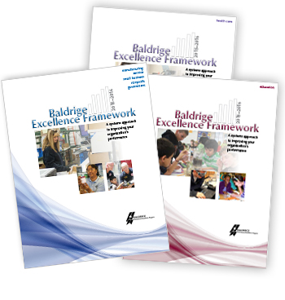
Baldrige Excellence Framework and Criteria for Performance Excellence
Define performance excellence
Organizational Profile and seven categories—an integrated management framework
Used by diverse organizations in all sectors of the economy
Used to identify award recipients
Updated every two years
Notes:
The Baldrige Excellence Framework has two uses: (1) to help organizations improve and (2) to identify Baldrige Award recipients to serve as role models of performance excellence. The Criteria are a de facto definition of performance excellence. They are a set of questions that focus on critical factors contributing to performance excellence. The questions are organized into an Organizational Profile and seven categories. The questions in the Organizational Profile focus on the key influences on how your organization operates and the key challenges it faces. The remaining questions ask about an organization’s processes relating to leadership, strategic planning, customers and the workforce, operations, information systems, and results. The seven categories are designed to work as an integrated framework for managing an organization.
In keeping with the continuous improvement philosophy of the Baldrige Program, the Baldrige framework is updated every two years through a consensus process to stay at the leading edge of validated leadership and performance practice.
Three versions of the Criteria represent each of the Baldrige Program’s main customer groups: business/nonprofit, education, and health care organizations. The primary differences are the use of language appropriate for each sector and integration of sector-specific themes. For education, these themes focus on student learning. For health care, the themes include a focus on patient care and patient health care outcomes.
Since their inception in 1988, the Baldrige Criteria for Performance Excellence have accelerated in acceptance and importance. Organizations of all sizes and types use the Criteria for improvement and self-assessment, including large and small manufacturers; banks and other service providers; small businesses from consulting firms to fast-food restaurants; K–12 school systems, universities, and proprietary education organizations; hospitals, long-term care facilities, and other health care organizations; nonprofit organizations, and local, state, and federal government agencies.

Slide 8
Program Achievements
Created a national and international standard for performance excellence
Produced role models
Shared best management practices
Generated award programs
Raised U.S. competitiveness
Established outreach and education systems
Notes:
Accomplishments:
The Baldrige Excellence Framework and its Criteria for Performance Excellence are accepted in the United States and worldwide as the primary standard for performance excellence. In addition to U.S. organizations that apply for the award, thousands more use the Baldrige framework for internal assessments.
Award recipients serve as role models. They actively share information and effectively demonstrate the importance of engaging in a continuous improvement process and of using assessment to gain a better understanding of customers, internal processes, and corporate culture.
State and local Baldrige-based award programs have grown from 8 in 1991 to around 30 today, covering nearly every U.S. state and territory.
Award recipients and other organizations that have used the Criteria see the benefits, such as increased customer engagement, improved cycle time, and increased sales/market share. Although the program is small, it has leveraged its influence to make a nationwide (and even global) impact and has promoted nationwide learning about the value of performance excellence.

Slide 9
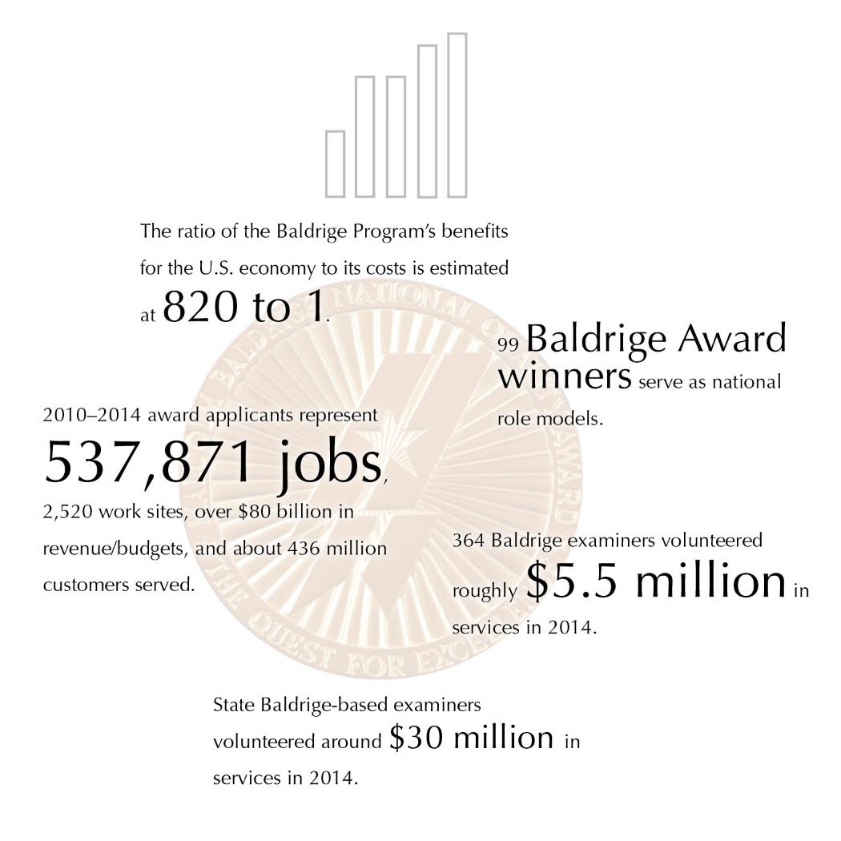
Notes:
The ratio of the Baldrige Program’s benefits for the U.S. economy to its costs is estimated at 820 to 1.
99 Baldrige Award winners serve as national role models.
2010-–2014 award applicants represent 537,871 jobs, 2,520 work sites, over $80 billion in revenue/budgets, and about 436 million customers served.
464 Baldrige examiners volunteered roughly $5.5 million in services in 2014.
State Baldrige-based examiners volunteered around $30 million in services in 2014.

Slide 10
Start Improving Your Organization
Purchase the Baldrige Excellence Framework or download free content.
Become a Baldrige examiner, or
attend examiner training.
Attend a national or regional Baldrige conference.
Do a Baldrige self-assessment.
Notes:
You can take a number of steps to start using Baldrige to improve your organization’s performance.
Visit the Baldrige website for Baldrige Excellence Framework booklets and free content.
Become an examiner. Examiners at the state/local and the national levels receive valuable training and experience in understanding and applying the Criteria, and they strengthen their ability to use the Criteria within their own organizations. For a fee, you can also attend examiner training without serving as an examiner.
Attend a conference. Annually, Baldrige sponsors The Quest for Excellence® conference in Washington, D.C., every spring, as well as regional conferences, to showcase the award recipients. Conferences give you an opportunity to learn about recipients’ best practices and to network with other organizations.
Consider self-assessing your organization against the Baldrige Criteria. See the Baldrige website for tools and information.

Slide 11
Start Improving Your Organization
Contact your state or local Baldrige-based program.
Consider the Baldrige Executive Fellows Program for a senior leader.
Contact a Baldrige Award recipient.
Apply for a Baldrige-based award, or
consider a Baldrige Collaborative Assessment.
Notes:
Contact your state or local Baldrige-based program. These programs’ training and assessment offerings are a good way to begin learning about the Baldrige framework. Information on these programs is linked from the Baldrige website.
Ask your CEO or another senior leader to consider the Baldrige Executive Fellows Program. This executive development program centers on forming relationships with and learning from Baldrige Award recipients and their senior executives.
Most Baldrige Award recipients offer events focused on sharing role-model practices with other U.S. organizations. See the Baldrige website for contact information.
Consider applying for a Baldrige-based award. If you are not ready to apply at the national level, consider contacting your state, regional, or sector Baldrige-based program. Or consider a Baldrige Collaborative Assessment, in which team of Baldrige examiners works with your staff to assess your organization.

Slide 12
For More Information
Baldrige Excellence Framework booklets and free content
Self-assessment tools
Organizational assessments
Training, conferences, and executive education
Award recipient profiles
Case studies
Connections to the Baldrige community
www.nist.gov/baldrige
baldrige@nist.gov
(301) 975-2036
Baldrige Performance Excellence Program | www.nist.gov/baldrige

