Slide 2
Standardization/Harmonizing Quantitative Single Cell Analysis
Sample Handling
Panel Design for Optimal Labeling and Necessary Controls
Instrument Set Up
Data Analysis
Optimized Multiparametric Immunophenotype Panels (OMIPs)
Minimal Information about a Flow Cytometry Experiment
(MIFlowCyt)
3. Minimal Information about T-cell Assays (MIATA)

Slide 3
Standardization/Harmonizing Quantitative Single Cell Analysis
Sample Handling
Panel Design for optimum labeling and Necessary Controls
Instrument Set Up
Data Analysis

Slide 4
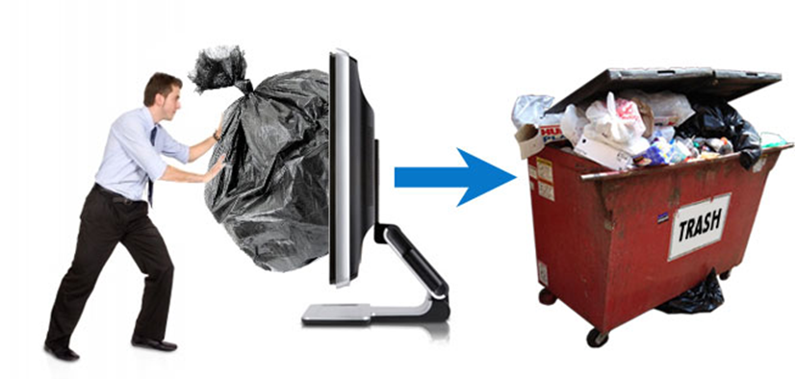
Key Features of High Quality Samples
Homogeneously Suspended Particles- minimize cell clumping
High Cell Viability
Optimal Labelling (Signal to Noise Ratio)
Cell Counts for Optimal Analysis
Significant Number of Events

Slide 5
Whole Blood Sampling
• Select Anticoagulant Appropriate for Experiments- influent phenotype and
Function of PBMCs e.g serum cytokine production
Note: EDTA may not be suitable for analysis of CD41, CD44, CD49d
• Time and Condition of blood draw- circadian variation, staining of labile markers, preserve
key functions.
• Whole Blood should be shipped at ambient temperature
(higher PMBC recovery at 30⁰C compared with 4⁰C)
• Handle with CARE- avoid mechanical stress, shaking, and store at RT, on shaker
Avoid platelet activation by shear stress or temperature changes
• Fresh Blood is always preferred e.g. Ficoll Processing.

Slide 6
Whole Blood Processing (1)
• Process Blood As Soon As Possible
• Important to Understand the Markers on All Cell Types
e.g. CD59 stains RBCs and Leukocytes, so higher levels of Ab required- titrate all reagents
• It may be necessary to remove interfering substances in plasma.
e.g. If staining B-cells for surface Immunoglobulins, wash cells to remove
soluble Immunoglobulins in preparation
• Donor Selection- right donor for the application
• Cryo-preservation- sample batching & deferred analysis, but can change labile
markers, phenotypic markers and subset distribution.

Slide 7
Whole Blood Processing (2)
Density Gradient e.g. Ficoll for Removal of Erythrocytes, Platelets and Grans
Time
Cell Loss
Cell Enrichment and Recovery Influenced by Age of Blood
2. Hypotonic Cell Lysis (NH₄CL, Diethylene glycol, etc)
Time
Cell Loss
May be incompatible for certain epitopes or
affect WBC plasma membrane integrity.
3. Whole Blood Analysis without lysis
Label for CD45⁺, set threshold on CD45⁺, eliminate RBC analysis.

Slide 8
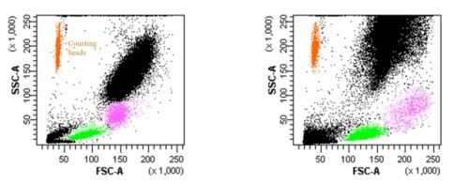
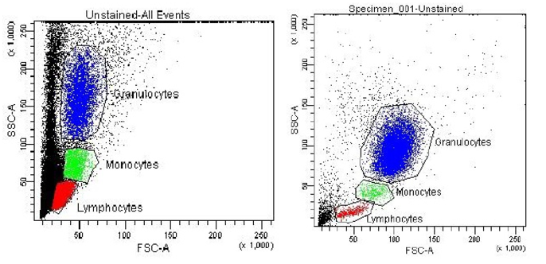
Lysis Solutions and Washing
Selection of Lysis Buffer- Range of Commercial Lysis Buffers With and Without Fixatives
Fixation May Increase Recovery
of Lymphocytes And monocytes
With Fixative Without Fixative
Pre- post lysis staining
Time/Temp
Fluorochrome conjugate Titer/Lot #
Incomplete Complete

Slide 9
Cell Lines
• Freeze/Thaw Protocols- Rapidly Thaw 37⁰C, Remove DMSO,
Recovery Overnight may Improve Epitope Expression
• Suspension Cell Recovery Relatively Easy- Centrifuge, Wash, Resuspend
to Required Cell Density for labeling
• Adherent Cells - require dislodging from culture flask using Trypsin or EDTA
- Trypsin use may damage epitope or reduced viability
- DNA release leading to cell clumping.
• Important to optimize and standardize for all treatment protocols for cell
line harvesting for flow cytometry applications

Slide 10
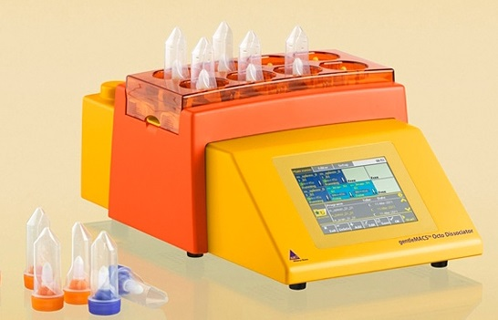
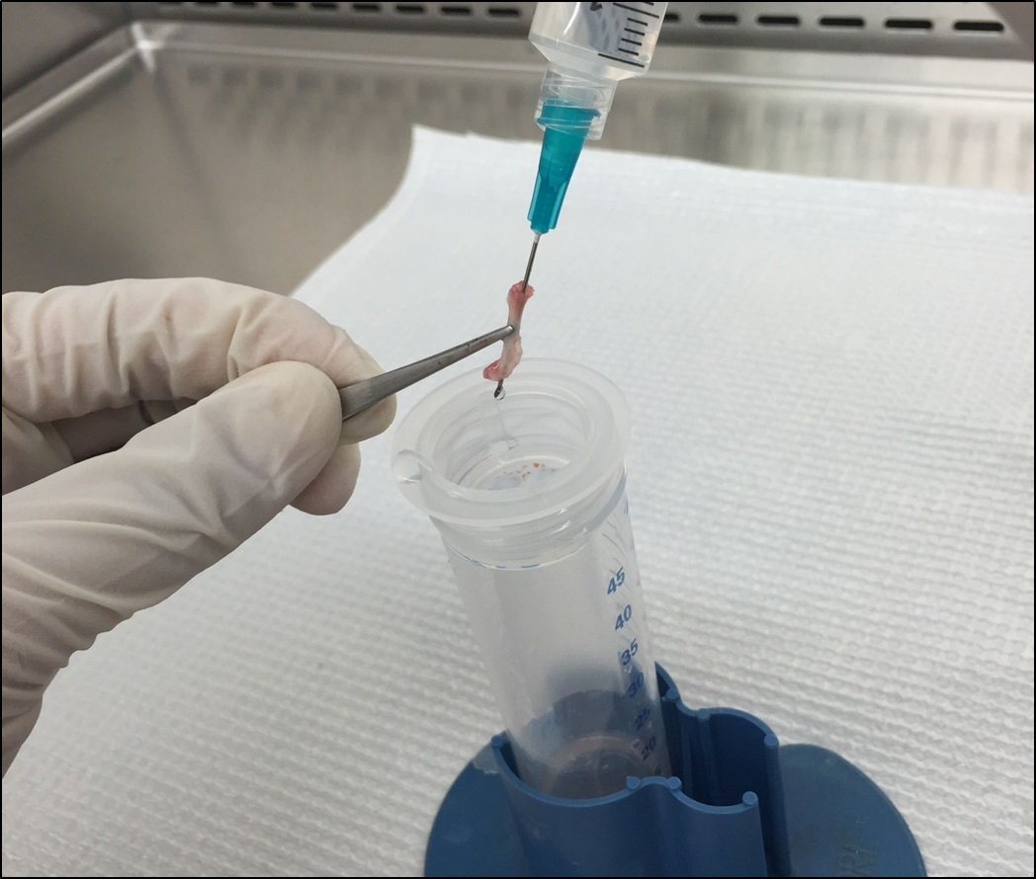
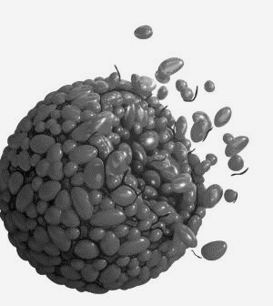
Solid Tissue Dissociation
Three Options for Tissue Preparation
1. Mechanical Disruption (spleen, Note: F4/80 ⁺ macrophages within spleen)
2. Enzymatic Disruption (tumors)
3. Combination of Enzymatic Processes- proteases, DNAses, filtration
Factors: Surgery (clean cut), temperature during transport, storage buffer quality

Slide 11
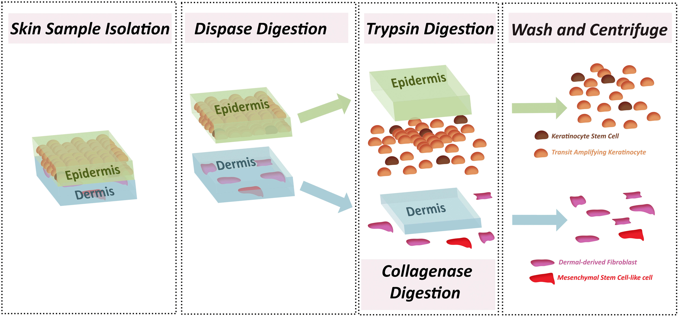
Example of Tissue Dissociation
Complex Structure of
Multi-Cell Population
Understand the Tissue
Structure to understand
The enzymatic tools
required
More and More Optimized
& Standardized Commercial
Kits
Goal: High Cell Yield,
High Cell Viability
Minimal epitope loss
Dispase – separates dermis and epidermis
Collagenase – breaks down extracellular matrix
Trypsin - disperses tightly associated cells

Slide 12
Dissociation of Neural Tissue
• Enzymatic Digestion (Collagenase –protease and phospholipase)
• Strain through 40µM filter
• High levels of Myelin may block epitope binding
Myelin removal methods
1. 30% Percoll, centrifuged for 10 minutes at 700 g.
2. Cells washed in 0.9 mol/L sucrose and processed on Percoll gradient.
3. Anti-myelin beads
Cells resuspended with magnetic myelin removal beads and incubated
for 15 minutes. Myelin removed by magnetic separation (Miltenyi Biotec).

Slide 13
Standardization/Harmonizing Quantitative Single Cell Analysis
Sample Handling
Panel Design for optimal labelling and Necessary Controls
Instrument Set Up
Data Analysis

Slide 14
Labelling
Extra-Cellular Epitopes
• Typically Stain First. Use a Small Volume for Efficient Staining
• Antibody Clone for Available / Accessible Epitope
• Fluorophore Used Optimal for Target Epitope
• Select Fluorophores based on Epitope Expression Level and Cell Type
Minimize Comp Requirements
• Time-course of Activation for Activation Epitopes,
activation optimization

Slide 15
Fixation- alcohol, aldehyde
• For Optimal Panel Design, Be Aware of Incompatible Fluorophores:
PE and APC are large protein molecules NOT compatible with Ethanol Fixation
APC-Cy7 and PE-Cy7 degrade upon fixation, emit in parent dye detector
Small Fluorophores AlexaFluor488 and FITC work well with all fixatives
• Use Minimum fixation time, temp, or employ stabilizing fixatives formulated for APC-Cy7
Or Substitute for Formamide-Stable Fluorophore e.g. APC-H7
• Avoid long-term storage in formamide to reduce auto-fluorescence

Slide 16
Labelling
Intra-Cellular Epitopes (e.g. cytokines, phosphorylation of secondary messengers)
• Be Aware That Fixation May Increase Non-Specific Binding (employ controls)
• Fluorophore Used Optimal for Target Epitope
-PE and APC large
-extensive washing, small targets may wash out
• Select Fluorophores based on Epitope Expression Level and Cell Type
Minimize Comp Requirements
• Suboptimal panel design- negative effect on quality of data (fluorophore
to dim for particular markers excessive spill over)

Slide 17
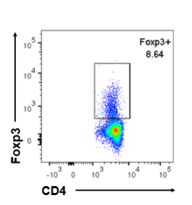
Labelling
Intra-Nuclear Epitopes (e.g. DNA content, transcription factors FoxP3)
• Consider Differences Due to Cell Cycle
• Select Fluorophores based on Epitope Expression Level and Cell Type
Minimize Comp Requirements
• Fixation, Permeabilization - compatibility with epitope and fluorophore
- optimize signal : noise
Thorough Understanding of System:
Cells, Epitopes, Fluorophore and Instrument

Slide 18
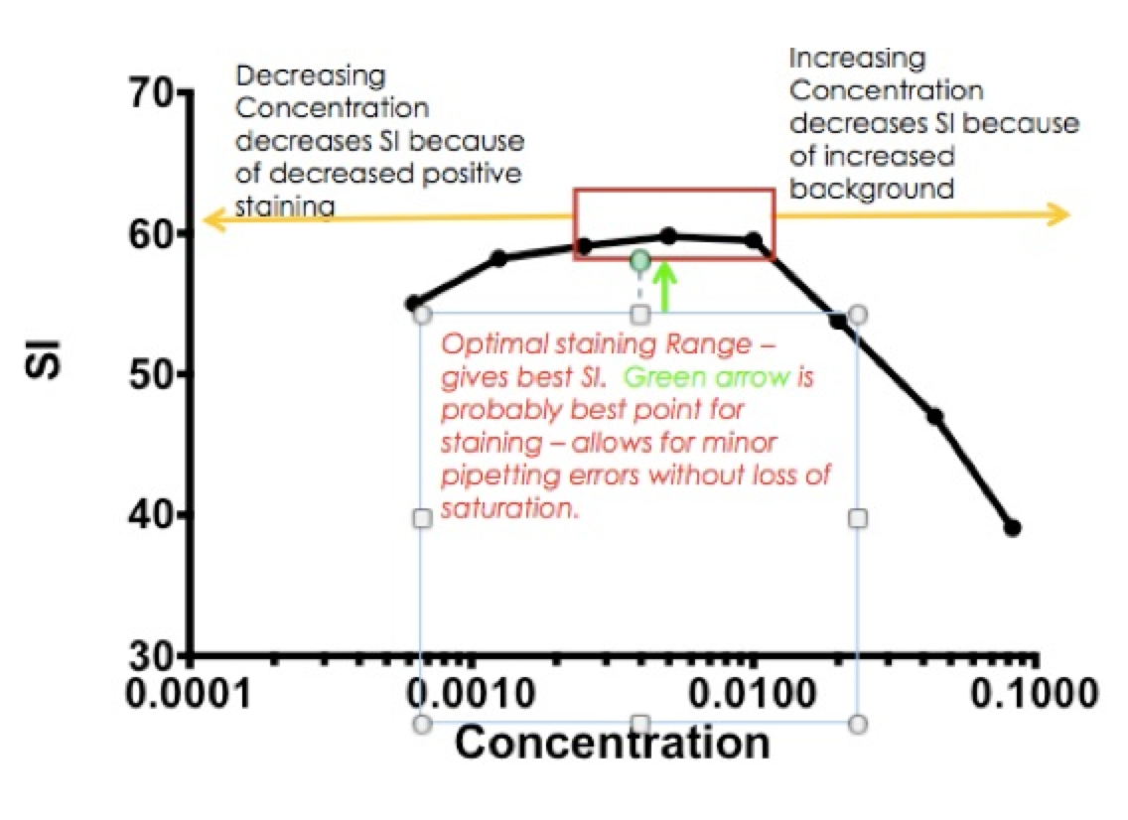
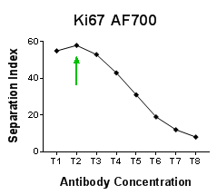
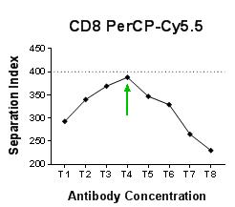
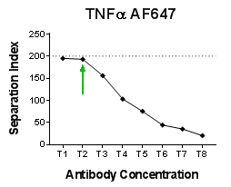
Optimizing Signal to Noise Ratio
Problem 1. Optimal Antibody Concentration
Solution: Titrate All Antibodies.
Never Rely on Manufacture’s Recommended
Use
Problem 2. Dead Cells
Solution: Viability Dye
Problem 3. Fc Receptor Binding (CD16, CD32)
Solution: Appropriate blocking
Notes:
If an antibody cannot bind to the primary target, it will bind to low affinity targets. The non-specific binding increases background and thus reduces the S/N of the antibody. This is especially true when targeting intracellular proteins.
2. The Problem: Dead Cells
Dead cells will non-specifically uptake all the antibodies in the mix. These antibodies enter the cell and bind to the low-affinity targets inside the cell (e.g. cell matrix), masquerading as live cells.
The Solution: Viability Dyes
Elimination of dead cells using a viability dye will eliminate these false positives. If the cells are not fixed, then a cell impermeant dye like PI, 7AAD or DAPI can be used. These cannot enter cells with intact membranes, and are colorless until bound to DNA. If performing an intracellular stain, then consider using the various Amine reactive dyes. These dyes work by binding the amine groups present on proteins. Dead cells will bind much more of these dyes, identifying the cells that were dead at the start of the experiment.
3. The Problem: Fc Receptor Binding
The Fc receptor (such as CD16 and CD32) are found on the surface of many different immune cells. The role of the FcR is to bind the constant region of an antibody that has bound to a target identified for elimination. The Fc receptor is a specific binding that can reduce the S/N by binding all the antibodies in the staining mixture.
The Solution: Proper Blocking
Blocking of the cells before labeling with antibodies will reduce this problem. One can use specific FcR antibodies, but those can interfere with downstream assays. It is often better to use 5-10% normal serum of the animal that your target antibodies were raised in (i.e. use normal mouse serum for mouse Ab’s). Incubate the cells for 10 minutes before labeling is all it usually takes to block the FcR binding.

Slide 19
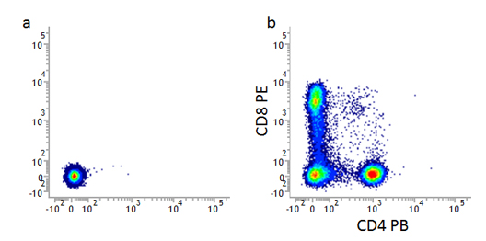
Controls
UNSTAINED and INTERNAL NEGATIVE CONTROL
• Compare Median Intensity of the Unstained Control with Internal Negative
• Good Estimate of the Level of Non-Specific Antibody Binding.
• Examine FS and SS to Determine Auto-fluorescence of Unstained Samples
Used to Maximize Dynamic Range of Signal.
• Set Negative Gates (may change over experiment and clinical samples)
Unstained lymphocytes are used to set the
negative population (a),
allowing the positive populations
(b) stained with CD8 and CD4 to be
visualized.

Slide 20
Controls
ISOTYPE:
• Indicates if There Is an Fc-receptor Binding Requiring Use of Blocking Agent
• Useful for demonstrating that there was poor blocking of the cells
• Measure ‘stickiness’ of cells, and need for blocking agent
Limitation of Isotype Controls:
• Really Only Useful for Surface Staining
• Should NOT be Used to Determine Compensation Levels or Negative Populations
• Can NOT be used to Set Gates
• Can NOT be used to separate low expressing cells from negatives
• ALWAYS Use Other Controls

Slide 21
Controls
Requirements of Isotype Controls
• Antibody to a Target That Closely Matches Your Target,
• Same Host Species
• Same Ig-Subclass -heavy chain (IgA, IgG, IgD, IgE, or IgM) and light chain (κ or λ)
• Same Fluorophore
• Ideally Purchased from Same Supplier
• Use at the Same Concentration
• Same F:P Ratio 1. Determine Antibody Protein Concentration (Ab 280nm)
2. Determine Fluorophore Concentration by Measuring Absorbance
at Maximum Excitation Wavelength (FITC 495nm)
3. Divide this value by protein molar extinction co-efficient (IgG 210,000M⁻¹ cm⁻¹)
A_{max} of labeled Antibody
Mole of Dye per Mole Protein =
ᶓ’ x Protein Concentration (M)

Slide 22
Controls
Intra-cellular Staining
• Isotype Control NOT Suitable
• Secondary Antibody Alone
• Use Cells Lacking Antigen To Measure Background Staining
• Stain without Permeabilization
Biological Controls
• Stain known Positive and Negative Populations
• Cell lines
• Knock Out of Down Regulated (CRISPR, siRNA)
• Cytokine Stimulation –
Unstimulated vs. Fully Stimulated e.g. T-cells +PMA Ionomycin
or anti CD3, anti CD28 Stimulation

Slide 23
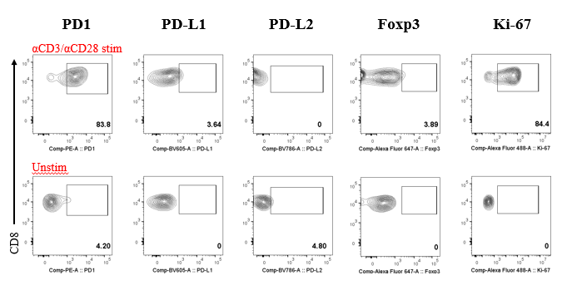
Biological Controls
Anti-CD3 Anti-CD28 Stimulation
Unstimulated

Slide 24
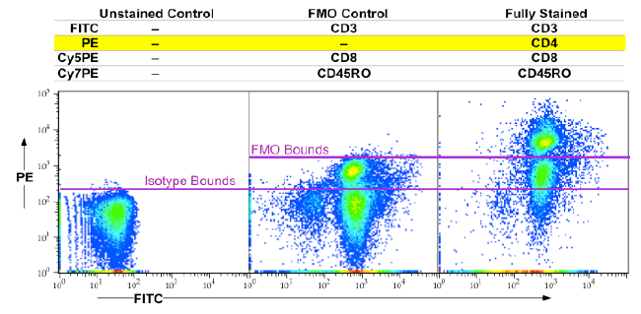
Controls
FMO Full (panel) Minus One (antibody) Fluorescence Minus One
• Used to identify and gate cells in
the context of data spread due to the
multiple fluorochromes in a given panel.
• Shows the increase in Fluorescence
intensity of an internal negative
population due to the combination of
non-specific binding and data spread
through spectral compensation.
Notes:
When running any multicolor flow cytometry experiment, there is a spread in the data that quickly becomes apparent when you compensate your data. Due to the physics of fluorescence and the exponential scales used to display flow cytometry data, this spread is unavoidable. However, using FMO controls in your flow cytometry experiments can remove all ambiguity from your compensated multicolor plots.
When antigens are dim or variably expressed, the use of FMO controls is critical. This is especially true when analyzing cell activation markers on immune cells. (Don’t forget those unstimulated biological controls here either!)
Do NOT add isotype antibodies to your FMO controls. These antibodies do NOT add any useful information to the FMO. If you are working with myeloid cells and think you need an isotype control, prepare it separately.
If you are unsure of the levels of expression you are dealing with in your samples or the sensitivity of your antibodies or samples, use FMO controls. It’s better to prepare a few controls you may not need than lose money, time, publications or grant funding by being stingy.
Fluorescence Minus One, or FMO controls are critical for any scientist who wants back up his or her drawing of flow cytometry gates. When you use FMO controls, you establish scientific evidence as to why the gates you drew are drawn correctly. This is true for any multicolor flow cytometry experiment. FMO controls will give you, as well as those who view your work with a critical eye, confidence in the degree of accuracy of your measurements.

Slide 25
Standardization/Harmonizing Quantitative Single Cell Analysis
Sample Handling
Panel Design and Controls
Instrument Set Up
Data Analysis

Slide 26
Embrace Your Instrument Controls
Instrument Controls
Quality Control Beads: Alignment, sensitivity, and fluidic quality control beads should be
run at least daily to ensure that with the same wattage on the laser and the same voltage
applied to the detector you return the same median fluorescence (MFI).
2. Compensation Beads: Using compensation capture beads is especially important when
using tandem dyes as lot-to-lot variability and time-dependent changes in storage can
change the spectral properties of these dyes. Limitations for rare cell populations.
3. Counting Beads: Absolute cell counts.
4. Compensation Controls: Worth the work

Slide 27
Harmonization of Instruments
Gold Standard is Rainbow Beads- easy, effective, time-saving
8 bead mixture, beads differ only in the amount of fluorophore.
Peak 1 unlabeled, 2-8 have increasing amounts of fluorophore.
Designed to fluoresce in all channels of most FC
Used to measure/calibrate
1. fluorescence sensitivity and resolution by measuring the position of the unlabeled peak and separation between all of the peaks
2. linearity of fluorescence detection channels by correlating the amount of fluorophore on each population of bead which differs in a linear fashion.

Slide 28
Example of Rainbow Bead Readout
Harmonization
Run beads on instrument 1 (reference) and compare with instrument 2 (practice).
PMT voltages are adjusted so
MFIs for each peak is equivalent.
SOPs for BD instruments
More challenging between instruments from different manufactures
8 peak bead in channel with 525/15
Bandpass filter (FITC, GFP)
Notes:
Usually works well, may not work well with fluorophore with narrow spectral emission on instruments with different filter configurations.

Slide 29
Standardization/Harmonizing Quantitative Single Cell Analysis
Sample Handling
Panel Design and Controls
Instrument Set Up
Data Analysis

Slide 30
Optimizing Gating Strategies
Required Controls
Automated Gating
Requirements Advantages
Fluorescent minus one
Internal Negative Control
Unstimulated Control
Isotype
CST Beads (daily)
Computational Efficiency
Ability to identify cell populations regardless of shape & true population no.
Ability to detect and account for outliers
Robustness towards different antigen & marker expression patterns and densities.
Removes Subjectivity
Reduces Variability
Increases speed of analysis
Offers potential to discover new biologically relevant cell populations
Notes:
Manual gating requires prior knowledge and result biased.

Slide 31
Optimizing Gating Strategies
Required Controls
Automated Gating
Requirements Advantages
Fluorescent minus one
Internal Negative Control
Unstimulated Control
Isotype
CST Beads (daily)
Computational Efficiency
Ability to identify cell populations regardless of shape & true population no.
Ability to detect and account for outliers
Robustness towards different antigen & marker expression patterns and densities.
Removes Subjectivity
Reduces Variability
Increases speed of analysis
Offers potential to discover new biologically relevant cell populations
Limitations: most computational methods are unable to distinguish
between true fluorescence due to biomarker expression and
artificial fluorescence due to cellular auto-fluorescence and
fluorescent spill-over

Slide 32
Automated Gating Strategies
Algorithms
K means clustering - number of clusters are defined by user, center of each cluster (initially assigned randomly) is refined until each cluster encompasses a unique set of data points, each closest to one cluster center. (e.g. of software: FlowMeans, flowPeaks)
Limitation: user must define ‘K’ & cluster spherical shaped population.
Advantage: fast, low computational cost,
Gaussian is most common – requires normal distribution, however, there are alternatives t-, Skew-t (e.g. FLAME, FlowVB), which are more flexible.
Hierarchical clustering methods partition the objects without predetermined number of clusters into a tree of nodes, with each node representing a cluster
(e.g. SPADE,)

Slide 33
Computational Assistance Software
There is no one-size-ﬁt-all solution to clustering and the choice of a suitable approach depends both on the type of data and on the particular purpose of the study.
Best outcome employs FMO controls (rare cell populations and smear)
FlowCap Consortium
highest success with programs employing multiple algorithms,
ensemble clustering in which multiple software packages were coupled resulted in the highest ƒ-scores

Slide 34
Requirements for Quality in Flow Cytometry Testing
Validation is “to demonstrate that the analytical method is suitable for its intended purpose”
ICH Guideline, validation of analytical procedures: text and methodology q2(r1) 2005
Validated Assay Requirements
Validation Considerations
Specificity
Precision
Range
Linearity
Limits of Detection
Quantification Limits
Robustness
Synchronization of instrumentation
Multisite Standardization
Access to Reference Samples
Standardization of Sample Preparation
Automated Liquid Handling
Automated Gating

Slide 36
Ensuring QC
So what does all of this effort mean?
• Ensures the reproducibility and scientific rigor of your data!
• Allows the work to ultimately be reproduced across time, locales and researchers
• Ensures consistency in studies programs
• Ultimately a bigger impact than just your experiment

Slide 37
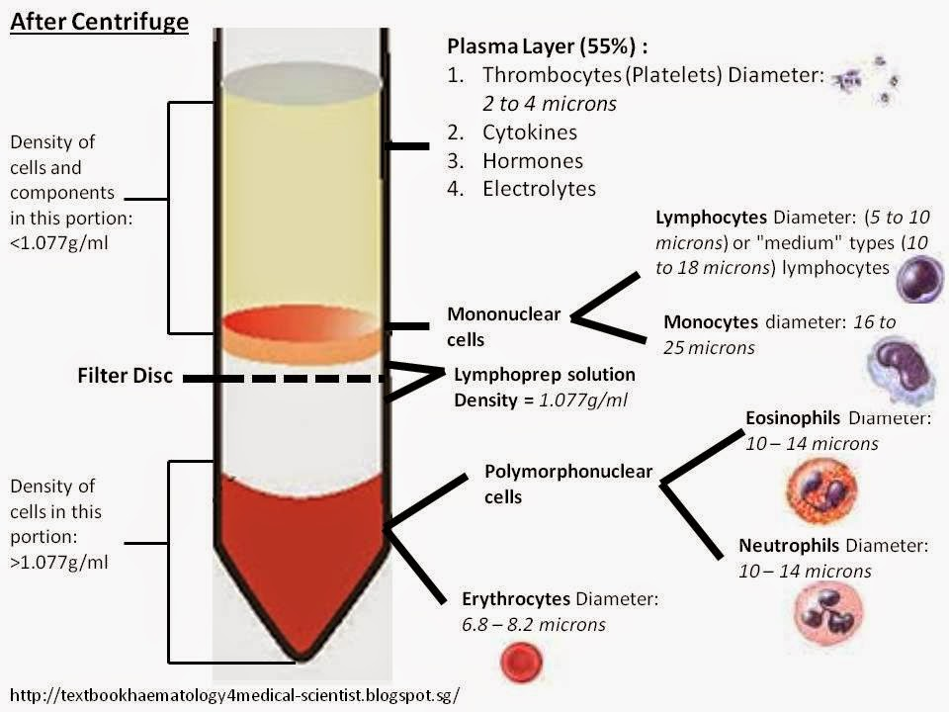
Peripheral Blood Mononuclear Cells PBMCs
• Dilute Whole Blood
1:2 or 1:4 with PBS
• Layer on Ficoll
• Centrifuge 20 mins, break off
• Recover MNC
AGE OF BLOOD
As blood ages, the density of
Granulocytes may change and
may contaminate MNS layer
Post Centrifugation

Slide 38
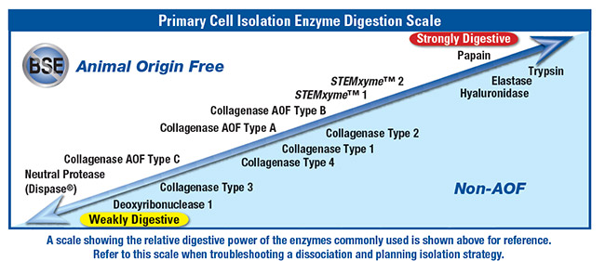
Selection of Protease for Tissue Dissociation
Maximize Cell Yields
Maximize Cell Viability
Reduce Epitope Loss through Side Activities
RESOURCE: Worthington –Biochem.com

Slide 39
Fixation
Why Fix Samples?
1. Allows Us to Run Samples Whenever Cytometer is Available
2. Added safety net: Cells Are Preserved
3. Convenient and Easy
4. Enables Intra-Cellular Staining
Two Mechanisms: Alcohol (denatures proteins) May Lose Epitope
Aldehydes (cross-links lysine) Superior Epitope Preservation
Combine Fixatives: First fix with Formamide- locks everything in place
Secondly, fix with methanol – makes larger holes for Ab access
Thirdly, permeabilize with Triton X-100, Tween-20
Always Vortex while adding fixative- ensures good penetration, reduced cell clumping.
Recommend ~1mL fixative/cell pellet.

Slide 40
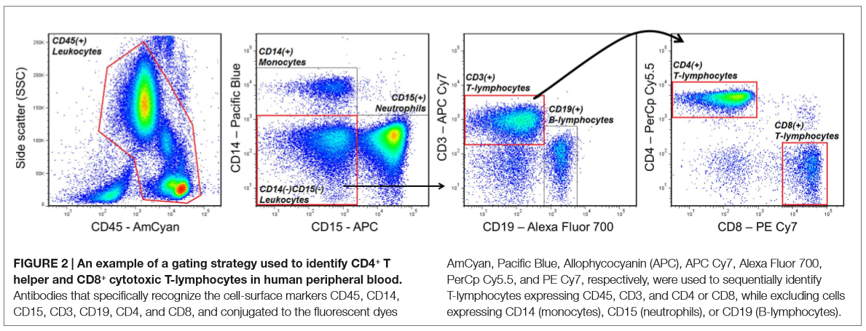
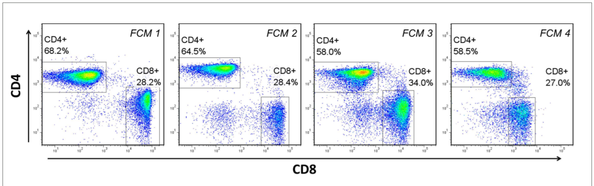
Example Typical clinical Panel- Gating

