Slide 1
Gambling Equipment Testing
Paul Dasaro
Washington State Gambling Commission
Electronic Gambling Lab
“protect the public by ensuring that gambling is legal and honest”
Notes:
Good morning,
My name is Paul Dasaro. I am the Administrator of the Electronic Gambling Lab. I am grateful to be asked to come before you this morning and speak a little bit about the Lab and the work that we do. Although I realize that gambling equipment is definitely not the same thing as elections and voting systems, I suspect there are some similarities in terms of technology and approval processes between them. I hope my talk will be informative to you.
A little background about me, I’ve been Lab Administrator for 7 years. Prior to that I was the Lab’s Senior Engineer for about 8 years. In all I’ve been with the unit almost since the inception of electronic gambling in Washington state. Prior to state service I worked in the title insurance industry as an IT specialist and in the military as a Korean linguist.

Slide 2
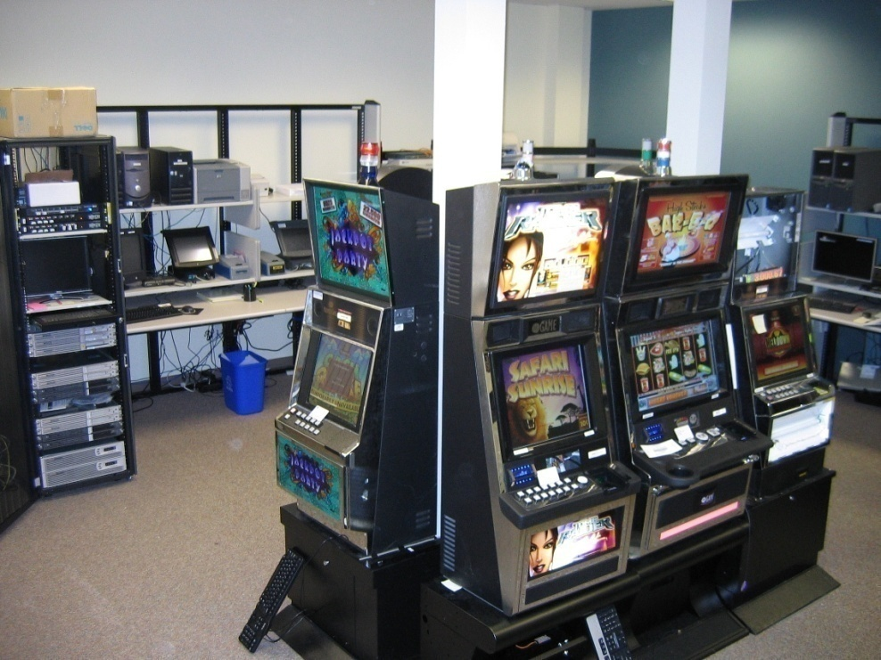
Electronic Gambling Lab
Notes:
The Electronic Gambling Lab is a sub-unit of the Washington State Gambling Commission’s IT department. The Lab is the Gambling Commission unit responsible for technical evaluation and analysis of electronic gambling equipment. We are the Agency's subject matter experts on electronic gaming.
We’re here in a support role to assist gaming agents and to enhance and improve the regulatory process. We accomplish that by performing highly technical evaluations of electronic gambling systems and associated components.

Slide 3
Regulatory Support
New technology evaluations
Investigations
Risk analysis
Training
Inspections
Internal controls
Security standards and practices
Technical standards
Notes:
The Lab’s primary mission is to support and assist tribal and state gambling regulators to effectively regulate electronic gambling. Though our primary role is testing, we also perform other duties.
As manufacturers develop new products for Washington, we advise them on our state’s unique compliance requirements. We also do preliminary analysis of their proposals and provide advice on regulatory issues they may face when it comes time for them to submit. This process helps reduce the frequency of non-compliance findings and speeds time to approval
Provide technical training to Tribal and State regulators at Basic, Intermediate, and Advanced levels
Working with gaming enforcement staff to develop and implement inspections of live gambling equipment. And to perform those inspections ourselves on occasion
We help enforcement staff in developing internal control recommendations
We establish and maintain standards relating to system security
We also provide technical advice to agency leadership for decision making and negotiations.

Slide 4
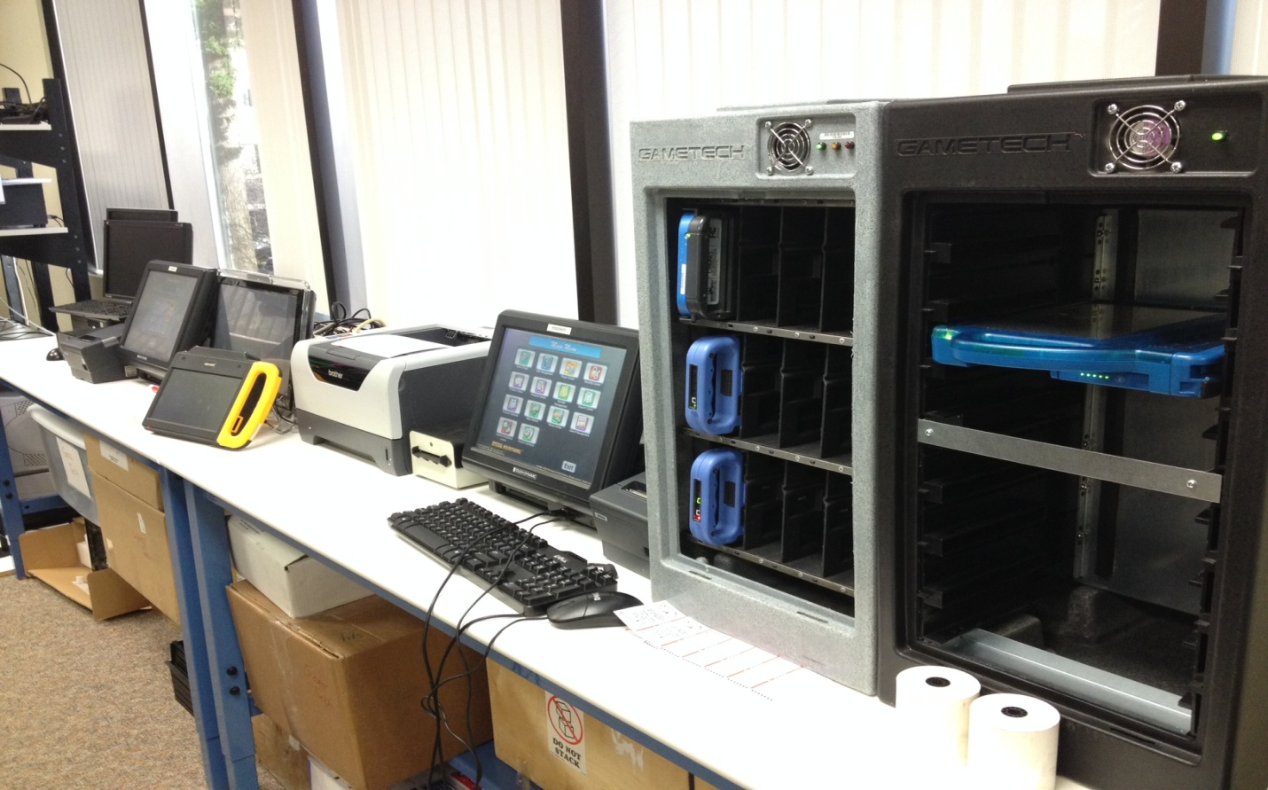
Gambling Equipment Testing
Tribal Lottery
Card shufflers
Bingo
Electronic table games
Electronic Pull Tabs
Progressive tracking
Keno
Roulette
Notes:
We test every kind of electronic gambling systems and devices currently allowed in Washington state. By far the most common technology we perform testing on is Tribal Lottery Systems which I’ll talk about a little later.
But this list includes many of the other types of components which we review on a regular basis

Slide 5
Independent Test Labs
Notes:
Required for some equipment types

Slide 6
Submission Process
Review documentation
Analyze device/system
Identify potential issues
Develop test script
Test
Approve or disapprove
Follow up
Implementation and regulation
Notes:
When licensed manufacturers submit equipment for us to review, our process is similar to most test labs. The assigned engineer reviews documentation, looking for red flags, getting a general idea of what the submission is and how it works.

Slide 7
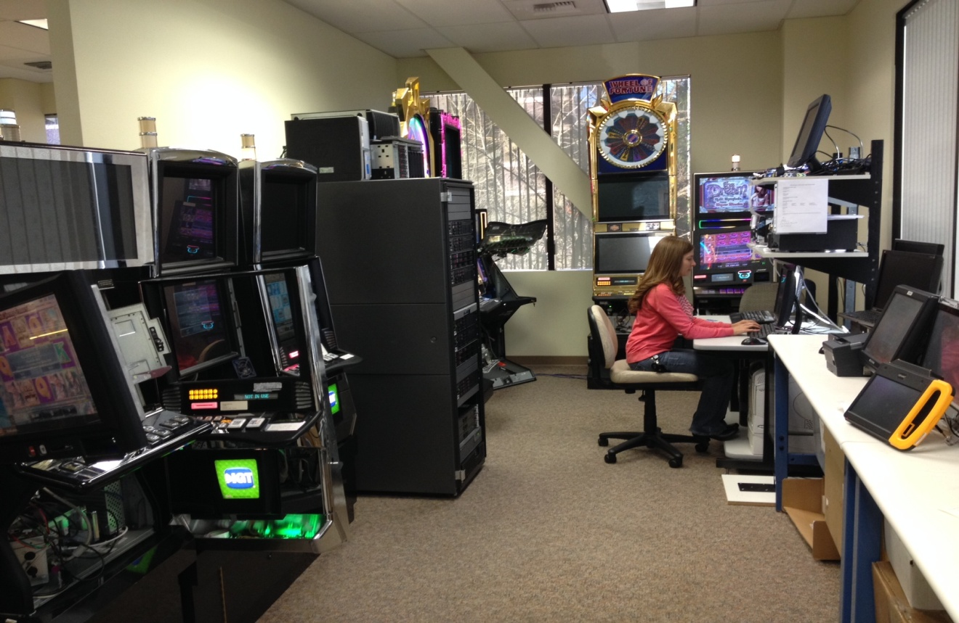
Testing Approaches
Functional
Grey-box
Regulator’s perspective
Regression
Integration
Notes:
Our testing is primarily focused on verifying that the submitted technology meets the various technical standards established in applicable statutes, rules, and tribal/state compacts.

Slide 8
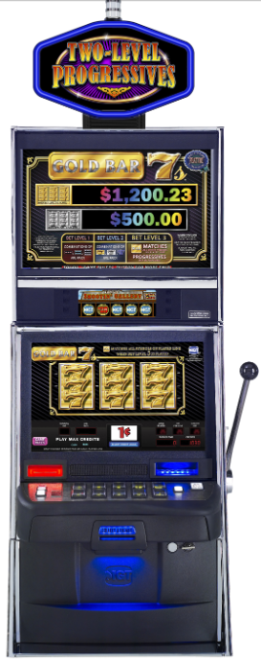
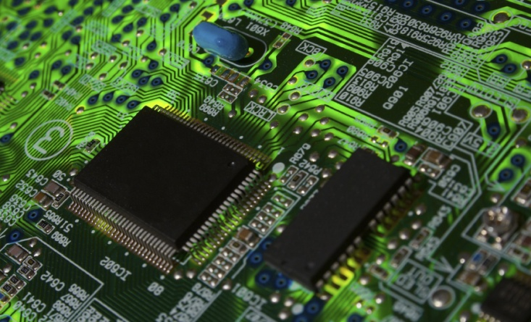
Slot Machine (Stand Alone)
Random Number Generator
$0
$1
$0
$0
$50

Slide 9
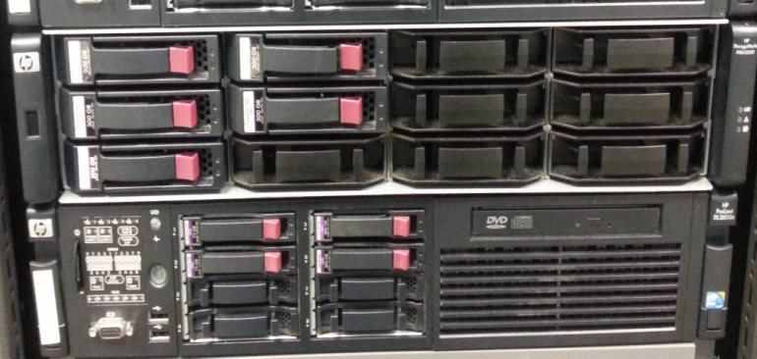
Tribal Lottery System
MANUFACTURING COMPUTER
CENTRAL COMPUTER
ELECTRONIC SCRATCH TICKETS
$0
$10
$5
ELECTRONIC SCRATCH TICKETS
PLAYER TERMINALS – CASINO FLOOR
Notes:
No slot machines in Washington. Explain TLS. Implications is that this equipment is significantly more complicated to regulate, especially from a technical perspective

Slide 10
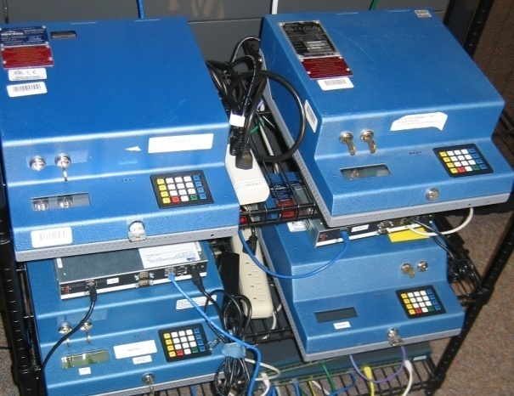
Common Findings
Reporting
Security
Encryption
Technical Standard Non-Compliance

Slide 11
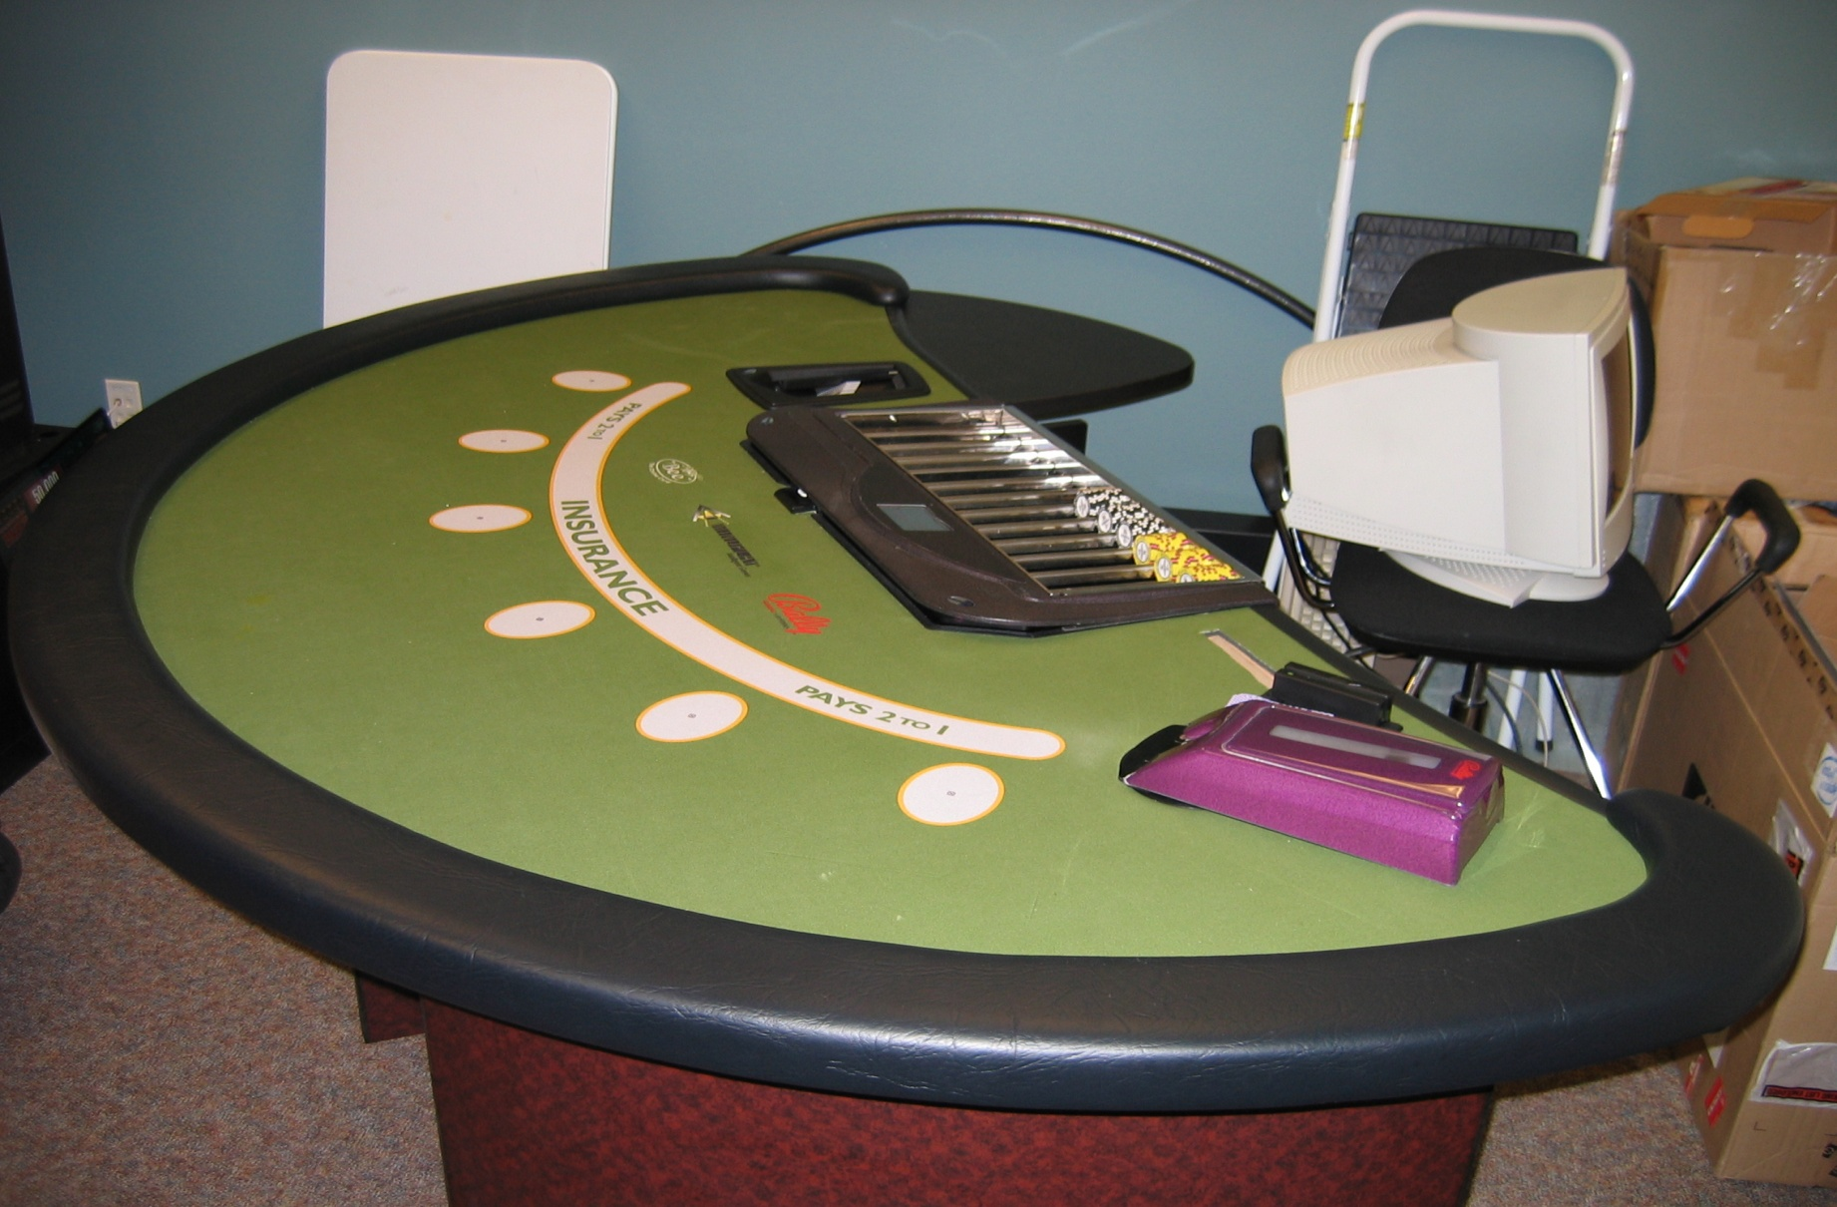
Example - Mindplay

Slide 12
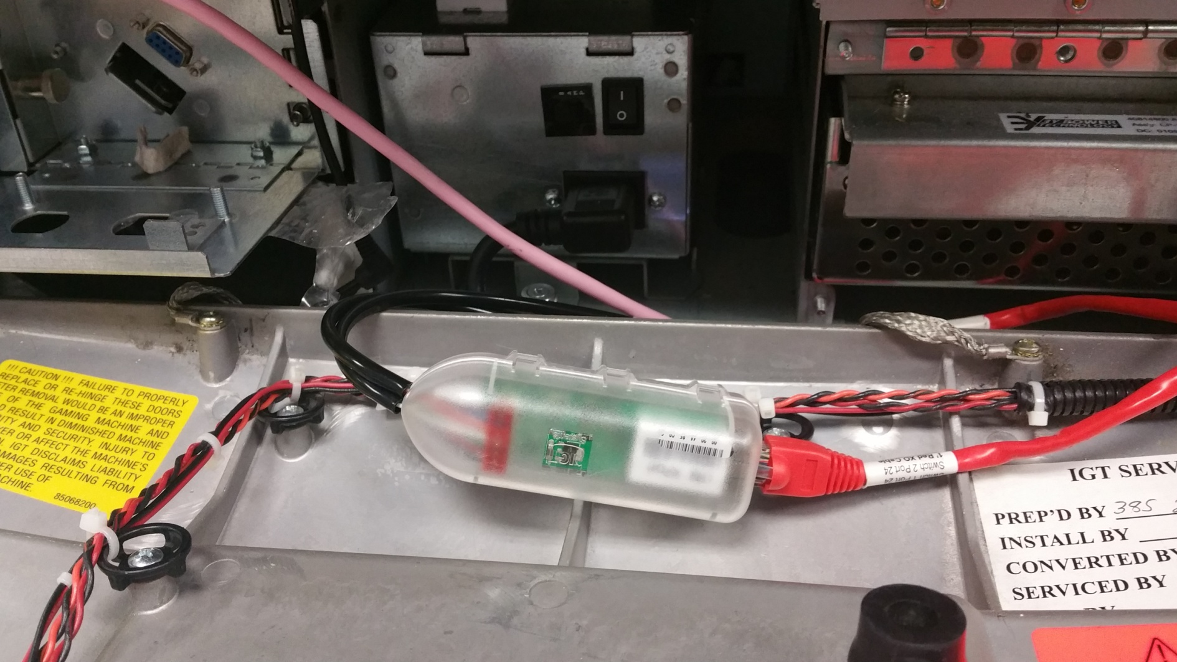
Example – “Twinkie”
Notes:
Encryption requireed

Slide 13
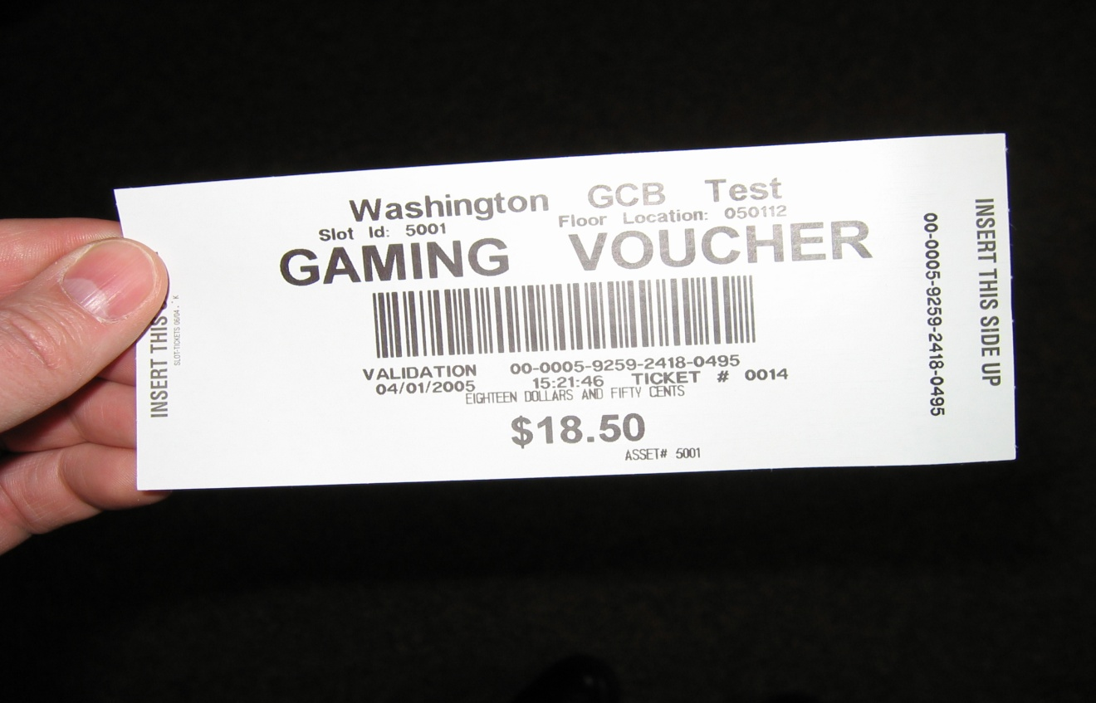
Example – TITO
Notes:
Risks – database access, duplication, redemption errors
Theft – dual ticket

Slide 14
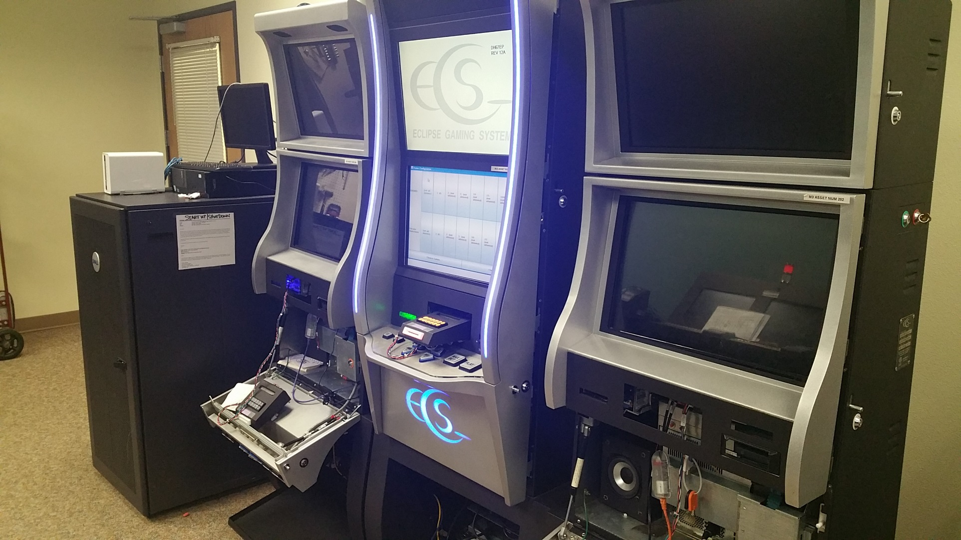
Example – ITL

Slide 15
Post Approval
Training
Pre-operational inspections
Manufacturer certification
Internal controls
Ongoing inspections
System incident reporting and investigation

Slide 16
Regulatory Challenges
Lab environment vs live environment
Vendors
Operators
Staff training
Management
Government to government relationships
Notes:
Manuf reps are IT people and IT people tend to be “lazy”.
Lack of training or capability

Slide 17
Thank you! Questions?
Notes:
Thank you

