Slide 1
ITIF Accessible Voting Technology Initiative
December 15, 2011 Technical Guidelines Development Committee
Whitney Quesenbery Project Coordinator, ITIF Consortium

Slide 2
The Accessible Voting Technology Initiative
Project Duration: 3 Years
Grant Award: $2.5M
Grant Recipient: Information Technology and
Innovation Foundation (ITIF)
Partners: National Federation of the Blind
University of Washington Center for Technology and Disability Studies
Georgia Tech Center for Assistive Technology and Environmental Access (CATEA) and GTRI
University of Colorado Assistive Technology Partners
University of Utah Department of Political Science
Notes:
Get through the basics early

Slide 3
A design-oriented approach to bring together the needs of voters, the potential of technology, and the requirements of elections.

Slide 4
The Problem
Americans with disabilities face many obstacles to voting including physical, cultural, economic, educational and political barriers.
Although much has been done to increase voting accessibility, more progress is needed.

Slide 5
Target Population
This project will include voters with disabilities:
Sensory disabilities (blindness, low vision, hearing loss, and deafness)
Cognitive disability
Motor mobility and dexterity disability,
Communication and language-related disability
Disabilities common among older adults.

Slide 6
Objective
To use a design-led innovation process to translate research, observations and insights into actionable steps to change voting system technologies and processes in ways that will improve the voting experience for people with disabilities.

Slide 7
Criteria for Success
Usable
Supporting all voters in marking their ballot accurately & efficiently
Accessible
Enabling people with disabilities to participate independently and privately
Flexible
Fits within election management practices from traditional polling places to vote centers and vote-by-mail
Secure and auditable
Making it possible to recount and audit elections
Affordable and robust
Within the means of even a small election district

Slide 8
We focus on the user experience, not just the technology.

Slide 9
Project Activities
Phase 1: Defining the Problem
Phase 2: Designing a Solution
Phase 3: Looking to the Future

Slide 10
Phase 1: Defining the Problem
Landscape Analysis
Social and environmental barriers to participation
Current election management practices for accessible voting
Current systems and promising technology
Innovative and mainstream assistive technologies
Demographic analysis of voters with disabilities

Slide 11
Phase 1: Defining the Problem
Innovation Workshops
Two design workshops that bring together people with disabilities and advocates, election officials and voting system experts, and space, product, digital, service, assistive technology designers to explore barriers and solutions.
OpenIDEO Innovation Challenge focusing a design community of over 20,000 people on this problem.
Graduate class project at Georgia Tech CATEA with industrial and HCI designers.

Slide 12
Phase 2: Designing a solution
Targeted sub-grants to research and develop promising concepts, prototypes or technologies, awarded in Spring 2012
Usability and accessibility testing of prototypes as the work on the subgrants progress.

Slide 13
Phase 3: Looking to the Future
Targeted sub-grants for under-researched issues. Possibilities include:
Under-researched disabilities
Review of state laws to examine implications of design
Accessible cryptographic voting systems
Development of training for voting system designers in creating accessible voting technology and election systems.
Summary of findings and public dissemination

Slide 14
“Design thinking is a human centered approach to innovation: [it] includes understanding people as inspiration, prototype building to think, using stories, having an inspired and inspiring culture.” - Tim Brown, CEO, IDEO

Slide 15
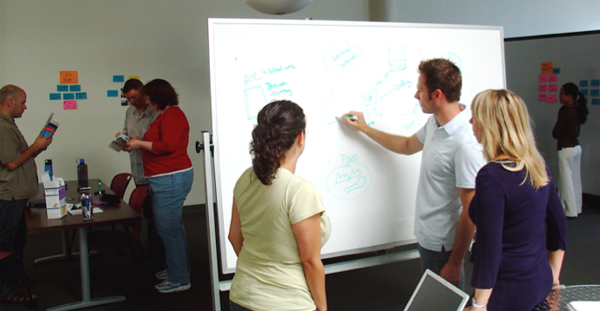
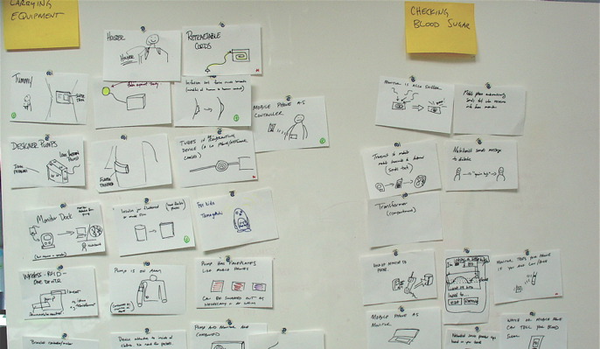
Collaborative approaches to problem solving
Brainstorm many ideas
Build from inspiration to concept to refinement
Encourage inclusive, open collaboration

Slide 16
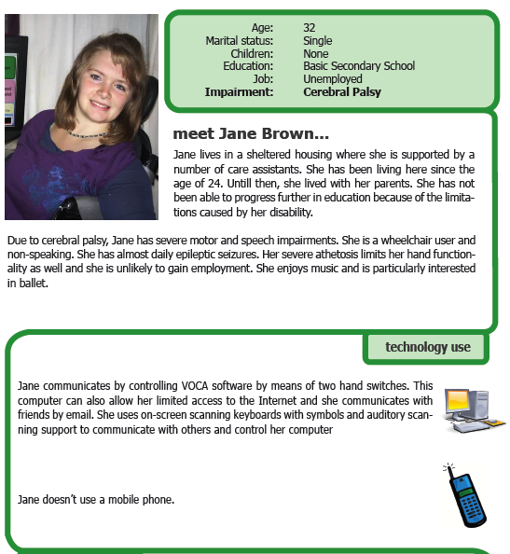
Focusing on people with personas
Personas:
Summarize quantiative and qualitative research
Connect human and technology needs
Show the journey through an election for people with disabilities
This persona is from AEGIS, an EU project promoting Open Accessibility Everywhere

Slide 17
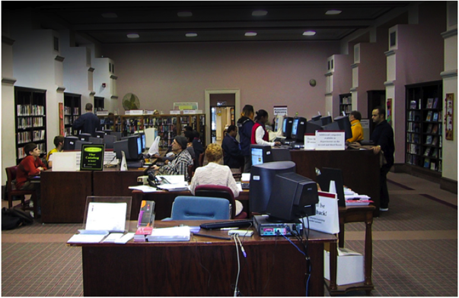
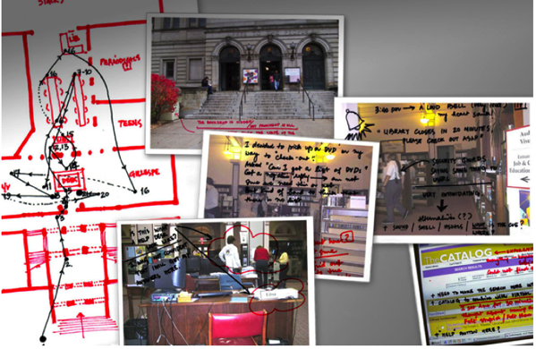
Reframe the question
BankSimple changed the question to “how can we help our customers manage their money?”
Carnegie Library changed the question to “how can a library be a place for both information and social interaction”

Slide 18
“Design is not just what it looks like and feels like. Design is how it works.” - Steve Jobs

Slide 19
Thank you!
Email: accessiblevoting@gmail.com
Twitter: @accessiblevote
Web: http://elections.itif.org

