Slide 1


Cybersecurity Career Week
#ChooseCyber
Notes:
Inform stakeholders about Cybersecurity Career Week and the multiple ways to get involved
Encourage others to make a commitment

Slide 2
Overview
Welcome
Cybersecurity Career Week (CCW) Overview
Getting Engaged in CCW
Q&A
Participation and Collaboration
Thank You
Goals
Resources

Slide 3

Save the date
October 14-19, 2024
nist.gov/nice/ccw
Notes:
Get the word out. MARK YOUR CALENDAR—always the third week in October

Slide 4

What is Cybersecurity Career Week?
Inspiring and promoting awareness and exploration of cybersecurity careers
Cybersecurity Career Week is a campaign to promote the discovery of cybersecurity careers and share resources that increase understanding of multiple learning pathways and credentials that lead to careers that are identified in the Workforce Framework for Cybersecurity (NICE Framework)
Notes:
Cybersecurity Career Week (CCW) aims to inspire, educate, and engage citizens to pursue careers in cybersecurity. The campaign was previously titled National Cybersecurity Career Awareness Week. Starting in 2021, CCW moved to the third week in October. This helps support the existing Cybersecurity Awareness Month and better align with our international partners/ planned events. [Previously it took place during November’s National Career Development Month. ]
Each day of the week-long campaign provides an opportunity to learn about the contributions and innovations of cybersecurity practitioners, and the plethora of job opportunities that can be found when exploring cybersecurity as a career choice.
During the week, learners of all ages, educators, parents, employers, and the community participate in a national recognition of how cybersecurity plays a vital role in a global society and --showcasing how building a nation’s cybersecurity workforce enhances each nation’s security and promotes economic prosperity.

Slide 5




Cy
Cybersecurity Career Week
Goals
Inspire, Engage, and Inform
Goal 1: Inspire, Engage, and Inform the Nation
Inspire, engage, and inform the public about the demand, opportunities, and multiple career options available within the area of cybersecurity
Goal 2: Demystify Careers Pathways in Cybersecurity
Raise awareness about pathways to prepare a highly skilled and diverse workforce for careers in cybersecurity to include expansion of knowledge and application of the NICE Framework
Demystify
Goal 3: Develop a Highly Skilled and Diverse Workforce
Support successful programs and showcase effective resources, especially those that increase participation of women, minorities, veterans, persons with disabilities, and other underrepresented populations
Develop
Notes:
Celebrate how the cybersecurity workforce makes a difference in our world
Increase public dialogue about the need for a cybersecurity workforce
Bring cybersecurity to life for kids, educators, and parents

Slide 6
#ChooseCyber
Objectives
Raise public awareness and increase engagement in building a strong cybersecurity workforce.
Emphasize the demand and opportunities in cybersecurity.
Why Cybersecurity?
Cybersecurity has something for everyone! Skills are needed from a diverse range of backgrounds.
Increase awareness around the multiple career options within the field of cybersecurity.
Cybersecurity is a dynamic field so you will never be bored. Cybersecurity evolves quickly so you will always be learning and developing new skills.
Highlight the multiple pathways to enter the cybersecurity career field.
There is a high demand for a talented cybersecurity workforce. Data predicts that IT and cybersecurity will be among the fastest growing and best paying jobs over the next decade.
Showcase resources and programs, including those that increase participation of women, minorities,
veterans, persons with disabilities, and other underrepresented populations in the cybersecurity workforce.
Cybersecurity plays a vital role in the lives of all global citizens and the cybersecurity workforce makes a difference in our world. Building a qualified cybersecurity workforce enhances national security and promotes economic prosperity.
Notes:
Cybersecurity Career Week aims to inspire, educate, and engage citizens to pursue careers in cybersecurity. Cybersecurity Career Week takes place during November’s National Career Development Month. Each day of the week-long campaign provides an opportunity to learn about the contributions and innovations of cybersecurity practitioners, and the plethora of job opportunities that can be found when exploring cybersecurity as a career choice.
During the week, learners of all ages, educators, parents, employers, and the community participate in a national recognition of how cybersecurity plays a vital role in the lives of Americans and how building a national cybersecurity workforce enhances America’s national security and promotes economic prosperity.
Celebrate how the cybersecurity workforce makes a difference in our world
Increase public dialogue about the need for cybersecurity workforce
Bring cybersecurity to life for kids, educators, and parents

Slide 7

Key
Messages
#ChooseCyber
Multiple Opportunities
Multiple Pathways
Need for Diversity
High Demand & Good Paying Job
Positive Contribution to Society
Notes:
The FIVE KEY POINTS are to inform the public about the
Multiple career opportunities (different industry/ technical and non-technical work roles)
Multiple pathways- 2 year / 4 year/ grad school / VTE/ certs / boot camps/apprenticeships –lots of ways to get there
We need a diverse workforce—not just for DEIA, but because we need diverse thoughts to look at problems through a different lens
Emphasize the high demand and opportunities in cybersecurity. Data (Dept. of Labor) predicts that IT and cybersecurity will be among the fastest-growing and best-paying jobs over the next decade.
Cybersecurity plays a vital role in the lives of all global citizens and the cybersecurity workforce makes a difference in our world. It enhances national security and promotes economic prosperity. Cybersecurity workers make a difference in society. Think: TECH FOR GOOD

Slide 8
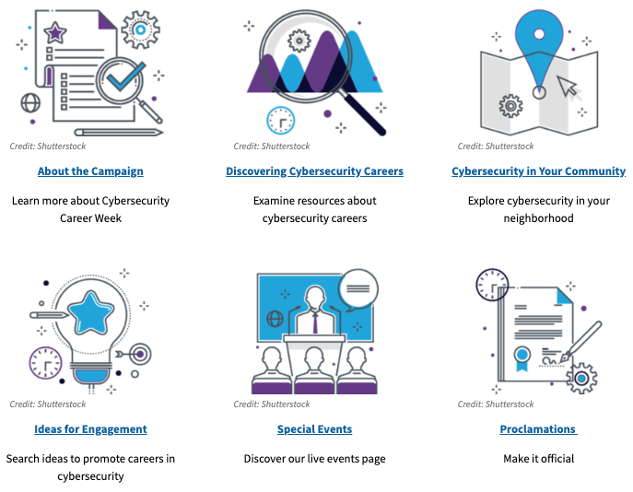
Resources
www.nist.gov/nice/ccw
Notes:
If you google NICE NIST CCW you will end up at the website or enter nist.gov/nice/ccw

Slide 9

Discovering Cybersecurity Careers
Career Briefs, Tools, and Resources
Work Role Videos
Posters and Infographics
Workforce Demand Data
Discovering Cybersecurity Careers
Notes:
https://www.nist.gov/itl/applied-cybersecurity/nice/events/cybersecurity-career-week/discovering-cybersecurity-careers

Slide 10








Ideas for Engagement
Downloadable graphics
Downloadable sample social media
Social Media
Host a twitter chat to answer questions about a cybersecurity related topic
Write a blog or news article
#ChooseCyber
#cybercareerweek
#mycyberjob
Acknowledge your hard-working cybersecurity co-workers or provide a social or potluck (virtual) to celebrate their contributions
Participate in office-wide cybersecurity related competitions, trainings, or special events.

Slide 11






More Ideas for Engagement
Encourage your cybersecurity workers/ colleagues to sign up for trainings or compete in a CtF competition
Bring your mini/future cybersecurity worker to your work
Host a career talk for employees or co-workers
Participate in the GLOBAL call to cybersecurity workers to visit a classroom and introduce K-12 students to careers in cybersecurity (visit the website for resources and ideas)
Explore cybersecurity resources in your neighborhood. Tour suggestions and virtual tours have been added to Cybersecurity In Your Community section of our website
Host a training or professional development activity for educators

Slide 12

Examples of Special Events and Activities
Partnership Asks
Make a commitment and add your commitment/s to the online portal
Get involved and share
  Cybersecurity Career Awareness Capture the Flag Competition
  Cybersecurity Career Awareness Scavenger Hunt
  Cybersecurity Careers Family Nights
  Cybersecurity Careers Story Time
  Social Media Competition
  Poster contest
Volunteer for a recorded webinar or podcast
Join others in sharing your short videos or stories on social media about what you love most about your cybersecurity career. Or, for fun, ask others to answer the question, “what does a cybersecurity worker do?”
#mycyberjob #cybercareerweek
@NISTcyber LinkedIn: nist-nice/
http://nist.gov/nice/ccw
#ChooseCyber

Slide 13

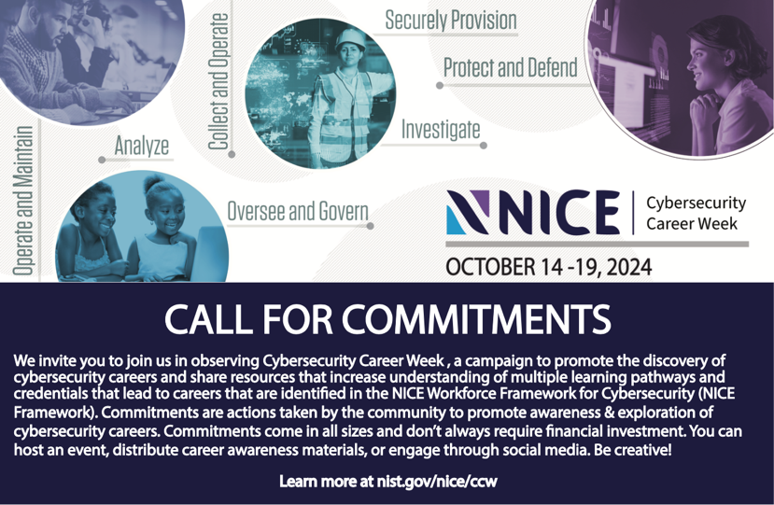
Commitments https://www.nist.gov/ccw-event-activity-portal
Notes:
Pause to see if any attendees can share (if they participated in past years) or can commit to doing something this year or share ideas they have.
Ask to see if others have career resources we can add to the toolkit.

Slide 14

New ideas and suggestions always welcome!
Resources: Do you have resources or activities you would like to share ?
Please email dpruitt@nist.gov if you have additional ideas or if you would like to join our planning group!
ChooseCyber
www.nist.gov/nice/ccw
Notes:
Shutterstock/izkes

