Slide 1
SANS BASICS
Boualem Hammouda
National Institute of Standards and Technology
Center for Neutron Research
hammouda@nist.gov

Slide 2
OUTLINE
1. The SANS Technique
2. SANS Data Analysis
Standard Plots (Guinier, Porod, Guinier-Porod)
SANS Models
Inverse Fourier Transform, Shape Reconstruction Method
3. SANS Research Topics
A- Core-Chain Model for PMMA-P3HT
B- Polymer Co-solvation and Co-nonsolvation
C- Single-Chain Conformations in PNIPAM Solutions
4. Final Points
USANS and VSANS
Final Words

Slide 3
1 – The SANS Technique

Slide 4
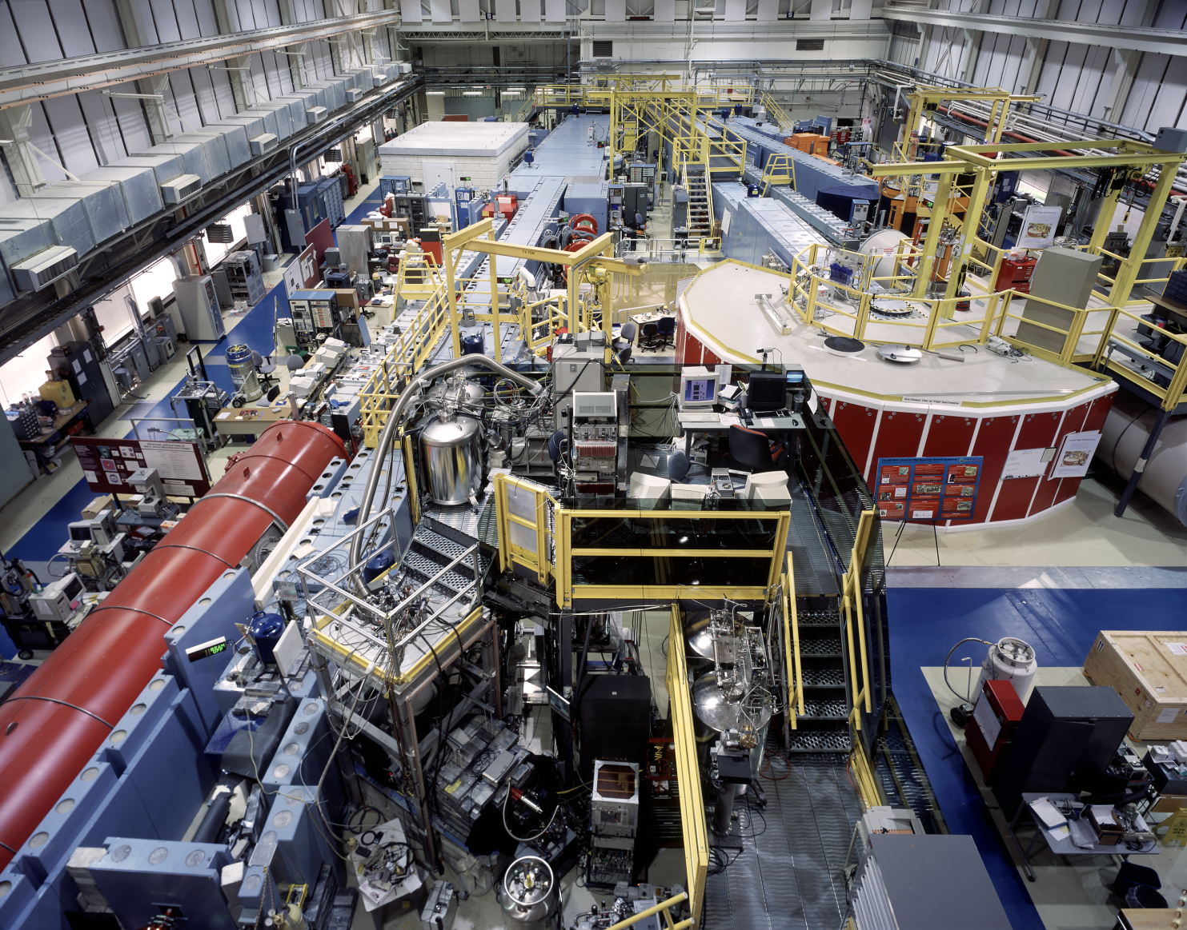
The NIST Old Guide Hall

Slide 5
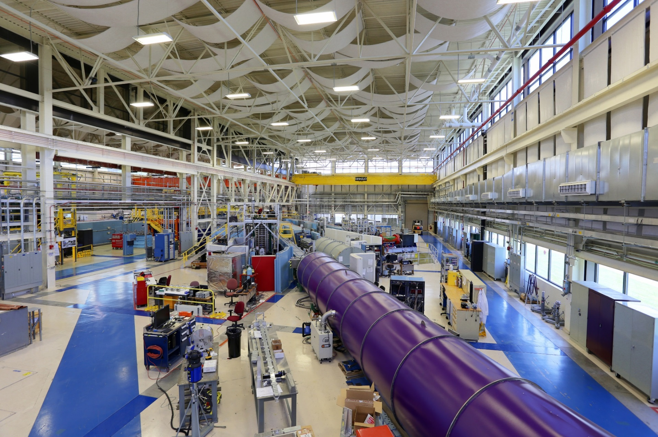
The NIST New Guide Hall

Slide 6
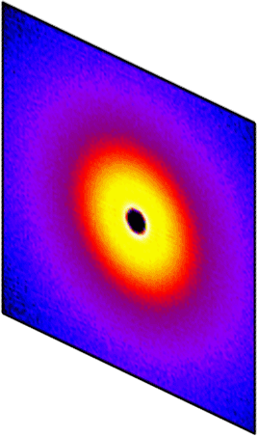
Small-Angle Neutron Scattering
scattering
angle
Area Detector
neutron
wavelength
Scattered
Beam
Sample
Q
Monochromatic
Neutron Beam
Incident Beam
Source
Aperture
Sample
Aperture
Monochromation
Collimation
Scattering
Detection

Slide 7
Nanoscale Structures
Length Scale (Å)
10⁶
10⁵
10⁴
1000
100
10
Polymers
Complex
Fluids
Biology
10⁻⁵
10⁻⁴
0.001
0.01
0.1
1
USANS
Scattering Variable Q (Å⁻¹)
SANS
VSANS

Slide 8
SANS Cross Sections
COHERENT
INCOHERENT
~ Contrast factor = (ρ_{A}-ρ_{B})²
- Info. about structure
Q-independent
no info. about structure
Scattering length density:

Slide 9
The Contrast Match Method
Finite contrast
Zero contrast
Multiple contrasts
Contrast match

Slide 10
2 –SANS Data Analysis

Slide 11
SANS Data Analysis
Standard Plots (Guinier Plot, Porod Plot, Guinier-Porod)
SANS Models
Inverse Fourier Transform, Shape Reconstruction Method

Slide 12
Guinier-Porod Regions
Guinier Plots

Slide 13
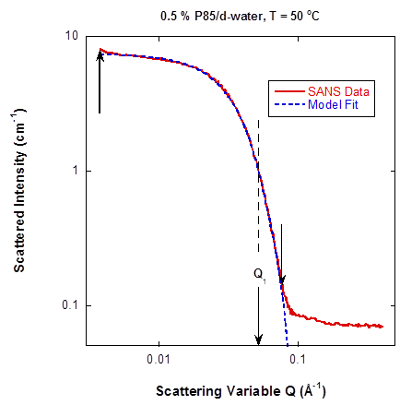
The Guinier-Porod Model
Continuous function
and derivative

Slide 14
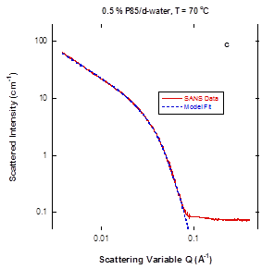
The Generalized Guinier-Porod Model
s = 0 sphere
s = 1 cylinder
s = 2 plates
Continuous function
and derivative

Slide 15
SANS Models
Macromolecules
Particles
Form
Factor
P(Q)
Structure
Factor
S_{I}(Q)
Form
Factor
P(Q)
Structure
Factor
S_{I}(Q)
Random Phase Approximation
Ornstein Zernike
cross
section
volume
fraction
contrast
factor
particle
volume
form
factor
structure
factor

Slide 16
Particle Structure Factor – The Ornstein-Zernike Equation
Hard Sphere
U(r)
Screened Coulomb
Square Well
r
Form
Factor
P(Q)
Structure
Factor
S_{I}(Q)

Slide 17
Fourier Transform
R
Density-density correlation function:
r
r’
Fourier transform:
Radial pair correlation function:

Slide 18
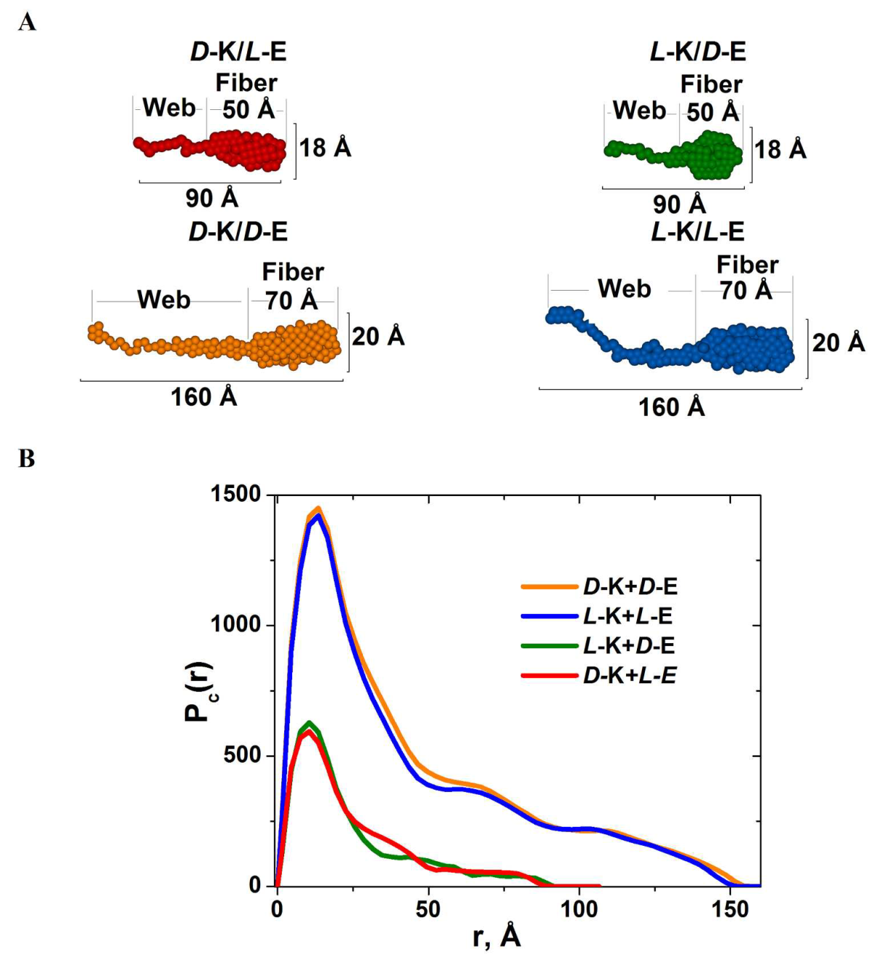
Shape Reconstruction and
Inverse Fourier Transform
Heterochiral
Shape Reconstruction
Fiber cross sections
Homochiral
Homochiral
Inverse Fourier
Transform
Heterochiral

Slide 19
3. SANS Research Topics
A- Core-Chain Model for PMMA-P3HT
B- Polymer Co-solvation and Co-nonsolvation
C- Single-Chain Conformations in PNIPAM Solutions

Slide 20
A- Core-Chain Model for PMMA-P3HT

Slide 21
The Core-Chain Model
Four contributions:
Core-core Term1
Chain-chain Term2
Core-chain Term3
Chain-core-chain Term4
Term3
Term2
uniform
core
grafted
polymer
chain
Term1
Term4
Note that one can recover the following limits: simple core, simple chain, and star-branched polymer.

Slide 22
Radius of Gyration for Core-Chain Structures
Guinier Law
Radius of gyration depends on the neutron scattering length densities.

Slide 23
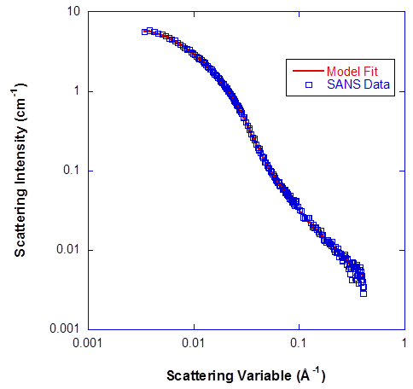
PMMA – P3HT Core-Chain Structure
Results:
R = 10.3 nm,
Np = 4
Nm = 216
a = 0.6 nm
= 0.78
Rg = 37.6 nm
PMMA
PMMA – P3HT Core-Chain
P3HT

Slide 24
The Empirical Core-Chain Model
Note that approximating the scattering by the sum of two functions for the core (Term1) and the chain (Term2) neglects the cross terms (Term3 and Term4).

Slide 25
B- Polymer Co-solvation and Co-nonsolvation

Slide 26
Polymer Demixing Phase Transitions
mixed phase
(1-phase)
phase
separated (2-phase)
UCST
T
e
m
p
T
e
m
p
phase
separated (2-phase)
LCST
mixed phase
(1-phase)
composition
composition
UCST
LCST
Ι(0)
Ι(0)
Temperature
Temperature
Upper Critical Solution Temp.
Lower Critical Solution Temp.

Slide 27
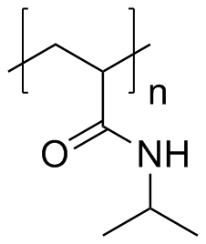
PNIPAM in d-ethanol/d-water Mixtures
UCST
LCST

Slide 28
PEO in d-ethanol/d-water Mixtures
LCST
UCST

Slide 29
PEO in d-ethanol/d-water Mixtures
MIX
ING
Z
O
N
E

Slide 30
Co-solvation and Co-nonsolvation
PEO
PNIPAM
M
I
X
I
N
G
Z
O
N
E
NO MIX
Z
O
N
E
T
e
m
p
T
e
m
p
UCST
LCST
LCST
UCST
d-ethanol
d-water
d-ethanol
d-water
Co-solvation
Co-nonsolvation

Slide 31
PNIPAM in d-ethanol/d-water Mixtures

Slide 32
PNIPAM in d-ethanol/d-water Mixtures
NO MIX
ZONE

Slide 33
Results
- Most polymers dissolve better in solvent mixtures (cosolvation)
- PNIPAM obeys a co-nonsolvation rule
- PEO is characterized by a “perfect” solvation window for 10 % d-water.
- PNIPAM is characterized by a non-solvation window for 60 % d-water.
- SANS is a valuable thermodynamic probe to study phase transitions as well as nanostructures

Slide 34
C- Single-Chain Conformations in PNIPAM Solutions

Slide 35
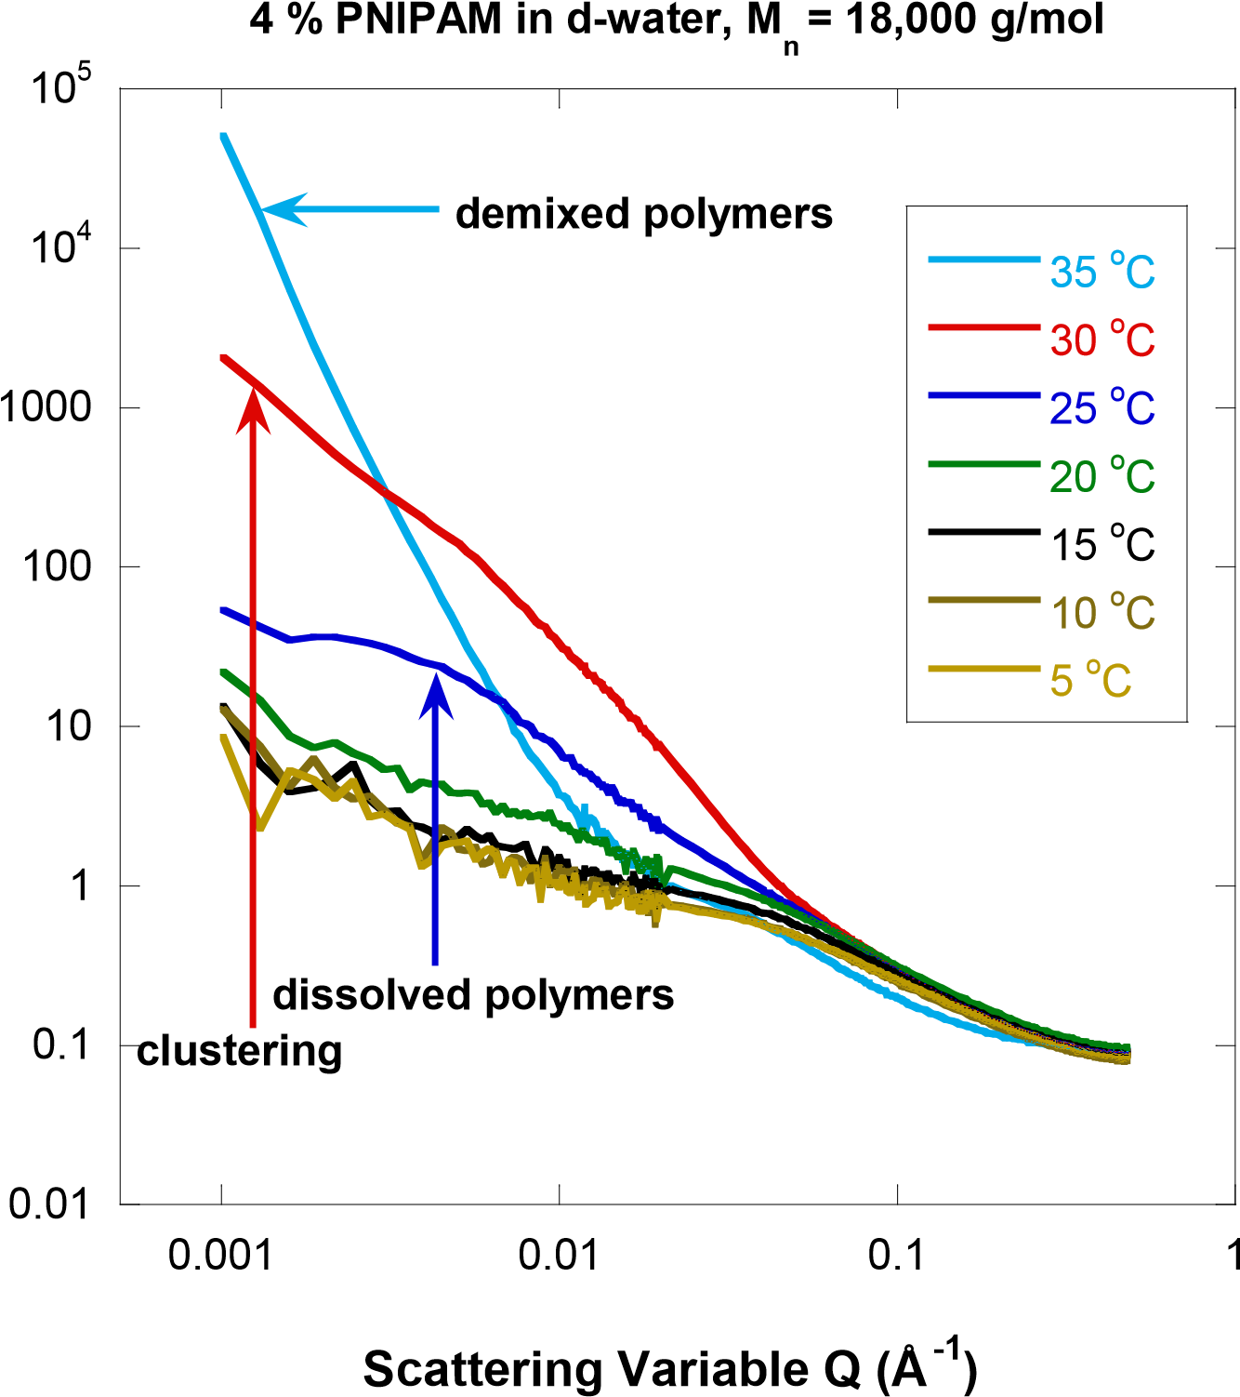
PNIPAM in d-Water
-1
)
Scattering Intensity (cm

Slide 36
The Zero Average Contrast Method
SANS is valuable for measurements of single-chain conformations even in non-dilute polymer samples
d/h polymers dissolved in d/h solvents
D₂O/H₂O contrast variation series yields the zero average contrast condition
The zero average contrast sample yields single-chain conformations (with no inter-chain contributions)

Slide 37
The Zero Average Contrast Method
SANS Scattering Cross Section
d polymer h polymer solvent
Equal degrees of polymerization for d and h polymers
zero average contrast
Single-chain
Contrast
Inter-chain
form factor
factor
contributions

Slide 38
4 % PNIPAM h/d Samples Prepared
hPNIPAM
13
16
4% PNIPAM in water
50
%/50%
1
2
3
4
5
6
7
8
9
10
11
12
Predicted
ZAC
dPNIPAM
14
15
d-water
h-water

Slide 39
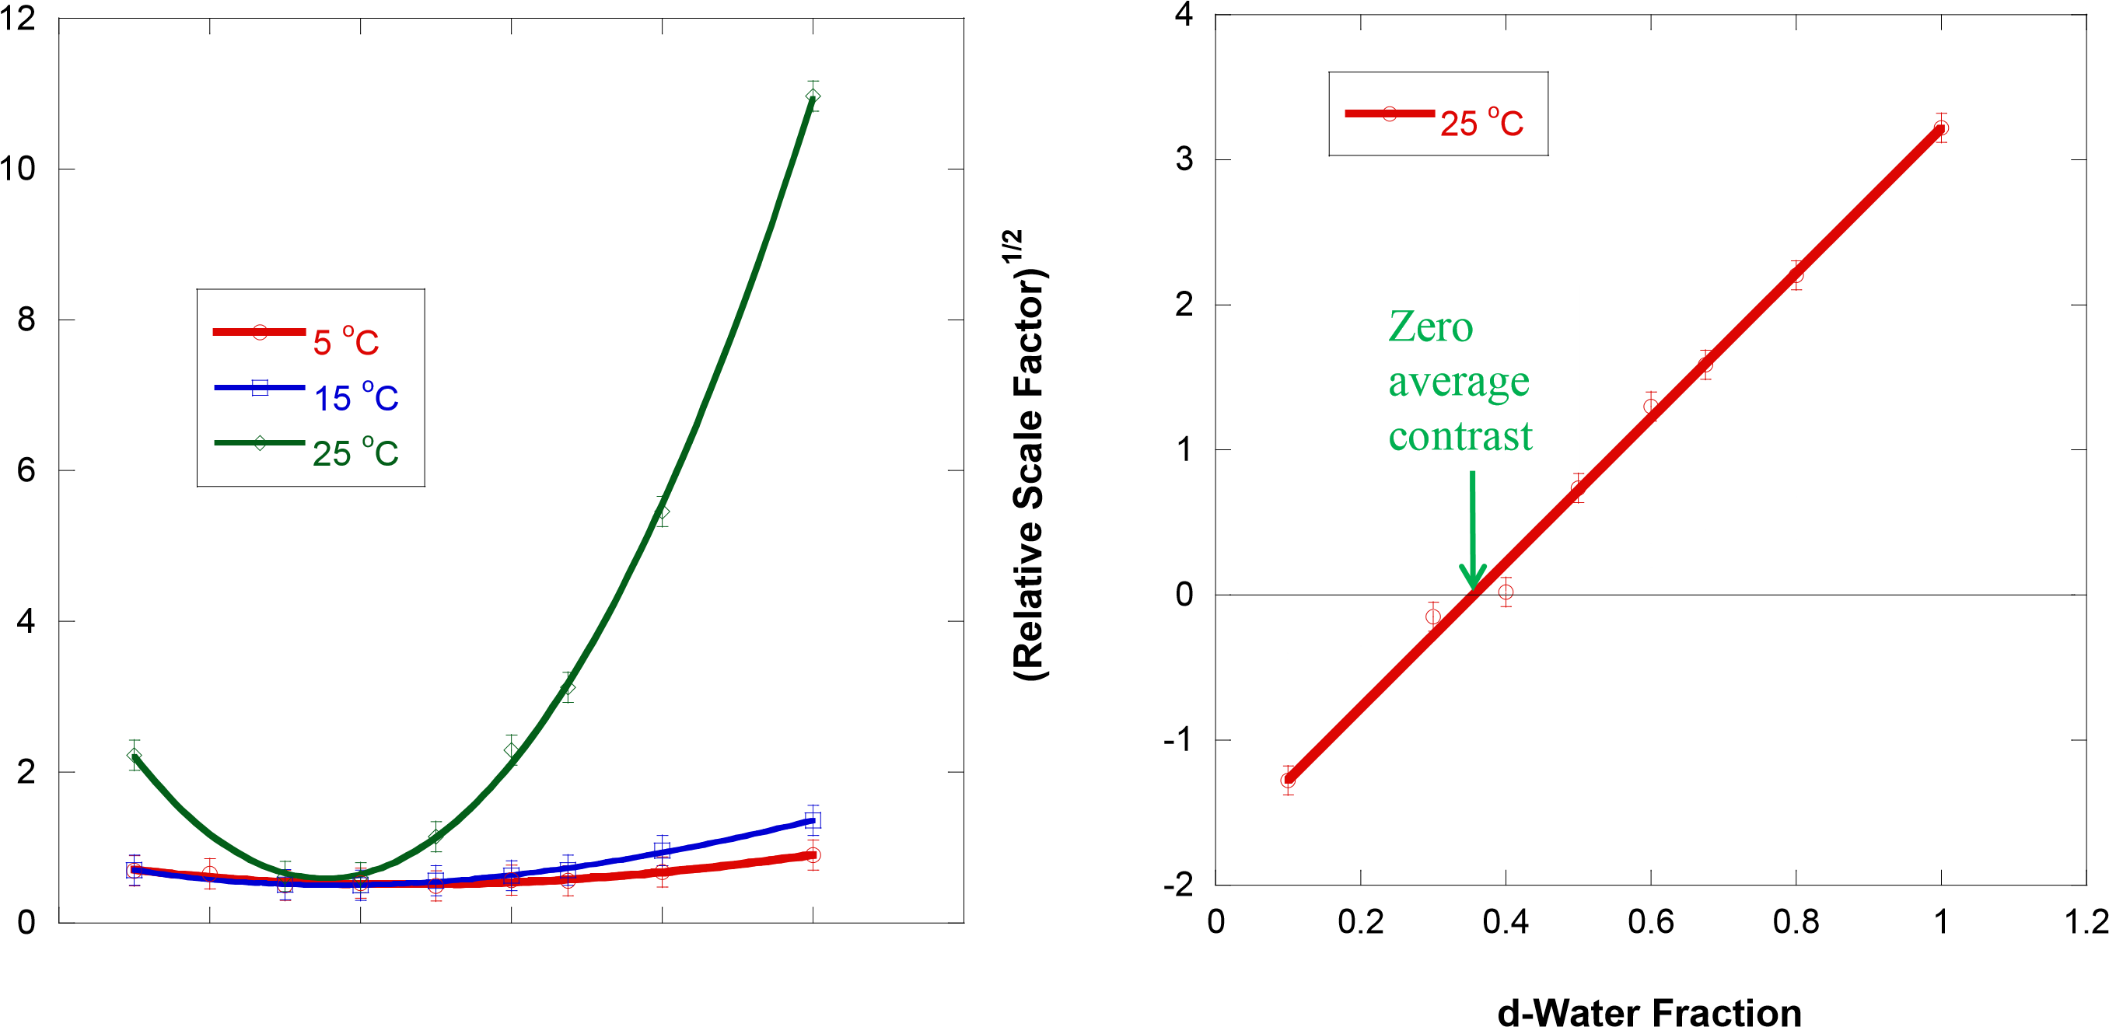
Contrast Variation Series
d-Water Fraction

Slide 40
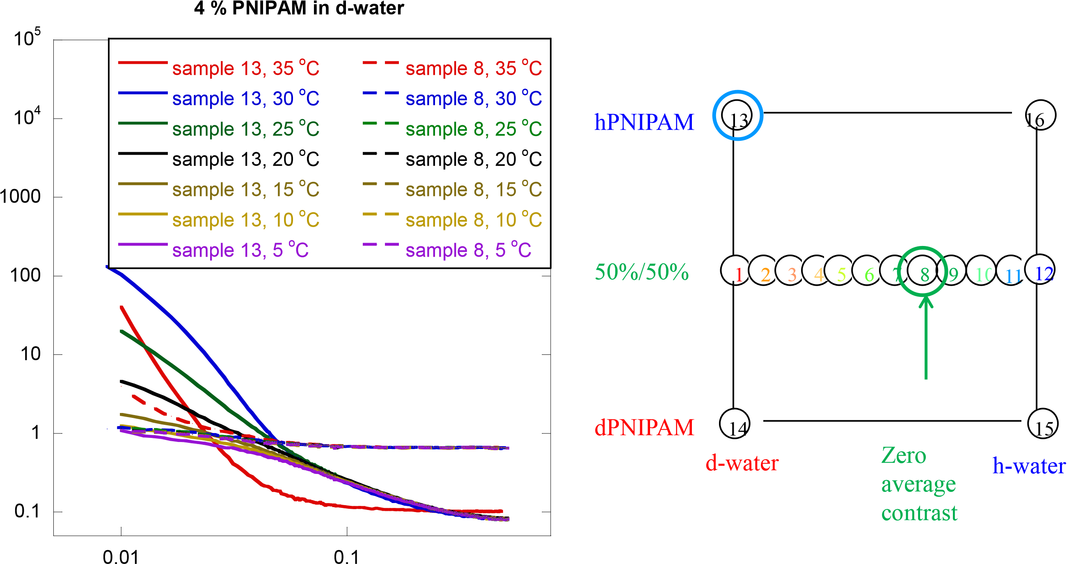
Zero Average Contrast Sample
-1
)
Scattering Intensity (cm
Scattering Variable Q (Å⁻¹)

Slide 41
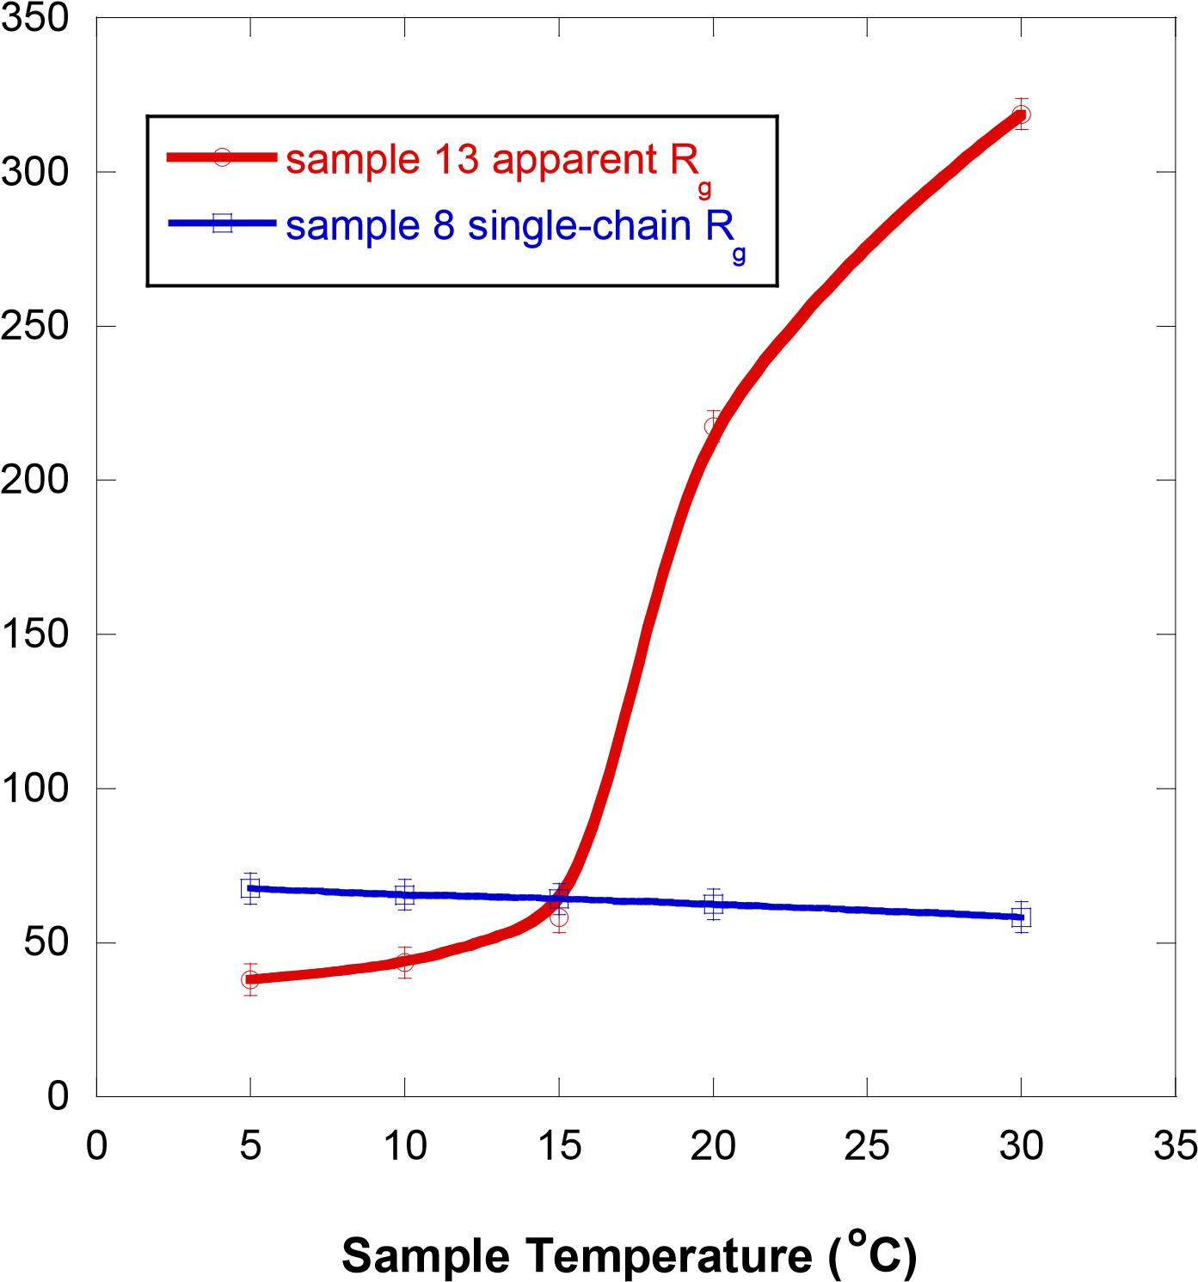
Apparent and Single-Chain R_{g}s
Radius of Gyration (Å)

Slide 42
Results
PNIPAM/water is characterized by two effects:
PNIPAM/water phase separates (LCST) (apparent R_{g} increases)
PNIPAM single-chains collapse (single-chain R_{g} decreases)

Slide 43
4. Final Points

Slide 44
Upgrade and VSANS
USANS Instrument
New Guide Hall
10 m SANS
30 m SANS
Old Guide Hall
Confinement
Building
40 m VSANS
USANS
30 m SANS

Slide 45
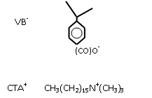
SANS, VSANS and USANS Ranges
USANS
VSANS
SANS

Slide 46
Final Words
THE SANS PROGRAM AT NIST
SANS Instruments: two 30 m, one 10 m, New 40 m VSANS
Collaborators: He Cheng, Man-Ho Kim and Mike Hore
http://www.ncnr.nist.gov/staff/hammouda/
SANS Q&A Kahoot
http://www.kahoot.it/
enter pin
first name

