Slide 1
Procedural Model Generators for RSoXS Simulation Suite
By Aaron Tian
Mentored by Dr. Peter Beaucage

Slide 2
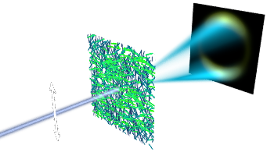
Resonant Soft X Ray Scattering
Small angle scattering technique
Similar to SAXS and SANS
Capable of determining orientation at nanoscale
Establish processing structure performance correlation
Cy-RSoXS Scattering Simulator
Voxel based forward scattering simulator
Analyze simulated scattering patterns

Slide 3
Simulation Suite and Programmatic Model Generation
Cy-RSoXS Scattering simulator
Many parameters means much data
Lack of abstraction
Must hard code each individual step in generating morphology
Voxel Placement
Voxel Alignment
Shape tiling
File serialization

Slide 4
Goals
Build software library to abstract morphology creation process
Individual morphology shape generation
Choosing points within space
Placing morphologies at those points
Serializing morphology to disk for simulation
Easy to use and maintain
Add extra point generation algorithms
Add extra preset morphologies to tile
Still provide option to create your own morphology

Slide 5
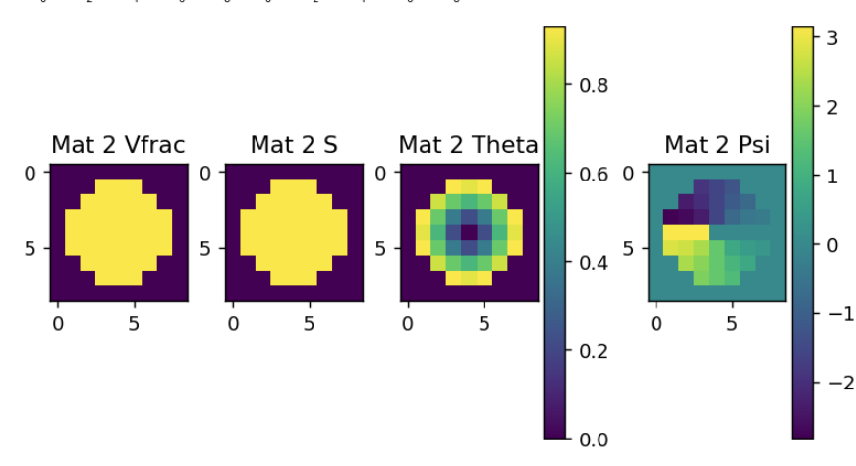
Morphology Structure
Shape Object
Euler
Volume Fraction (Vfrac)
Alignment Magnitude (S)
Theta
Psi
Euler object for each material in the shape

Slide 6
Individual Morphology Generation
Create Volume Array
Create Alignment Array
Calculate Angles
Theta: Inverse tangent y / x
Psi: Inverse tangent r / z
Apply rotation
Non-isotropic only

Slide 7
Default Shapes
Sphere
Core-Shell
Same or different material
Ellipsoid
Random generation
Create n shapes with randomized parameters

Slide 8
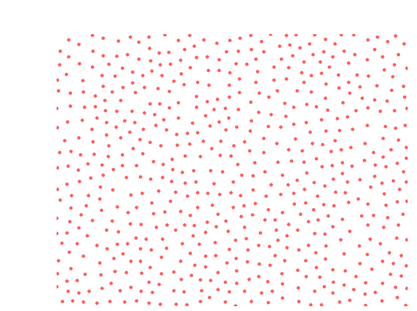
Point Generation
Poisson Disk Sampling
Random points but at least X distance away from all others
Uniform Grid
Point placed every X distance
Random Offset Grid
Uniform but with random offsets

Slide 9
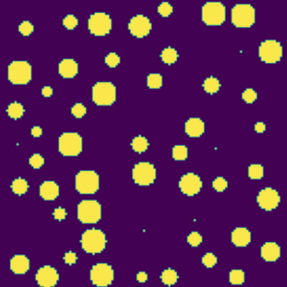
Morphology Tiling
Copy individual morphologies at points
On Collide
Overwrite
Skip

Slide 10
Collision Checking
Point generation and shapes know nothing about each other
Accelerated Spatial Partition
Bucket / Chunking System
Create arbitrarily sized buckets
Check which buckets bounding box is in
Perform axis aligned cube overlap with other shapes in the buckets

Slide 11
HDF5 Serialization
Provide file name, shape object, physical size
Everything is automatically created
Other optional parameters

Slide 12
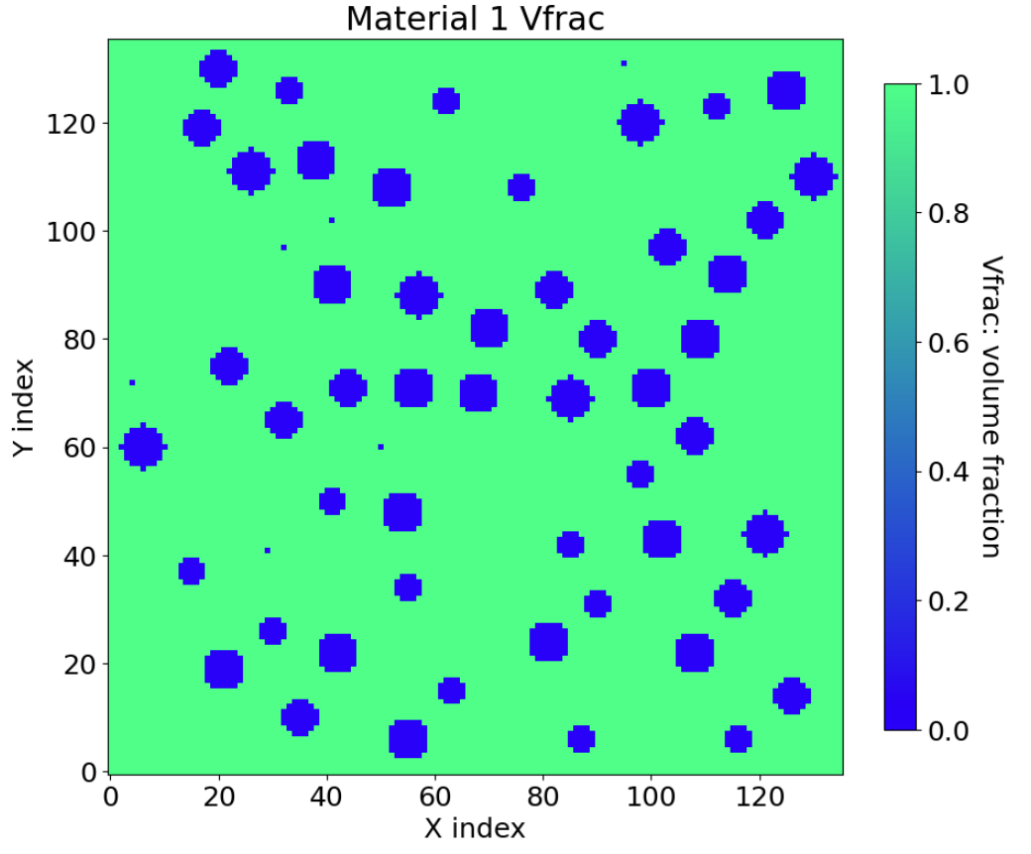
Example Use Case
CyRoXS 1.1 Tutorial
Core Shell Morphology
Random points
80% less code
Original: Over 40 lines
Library: 7 lines

Slide 13
Simulation Scattering Patterns (1 NM)

Slide 14
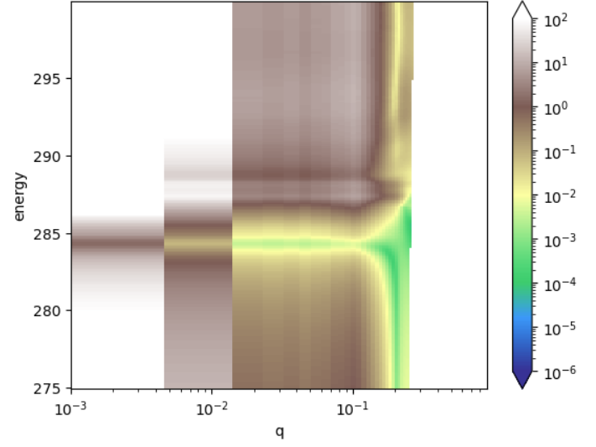
Vertical Projection Data

Slide 15
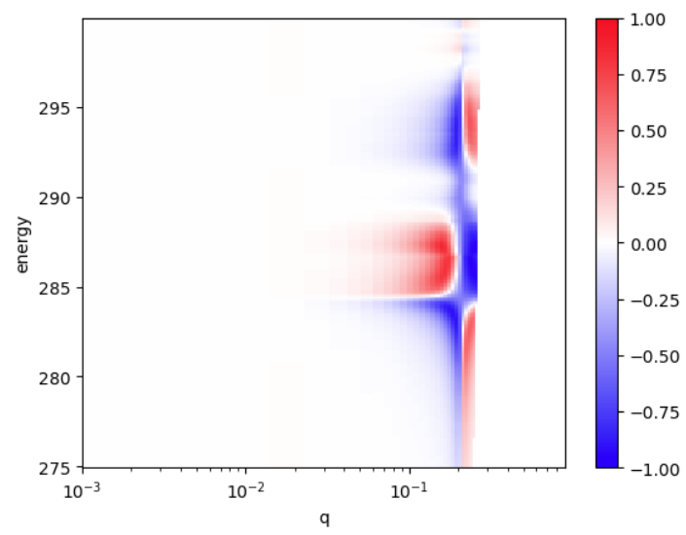
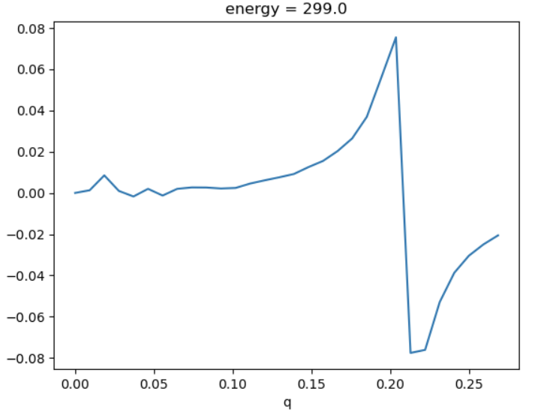
Anisotropy

Slide 16
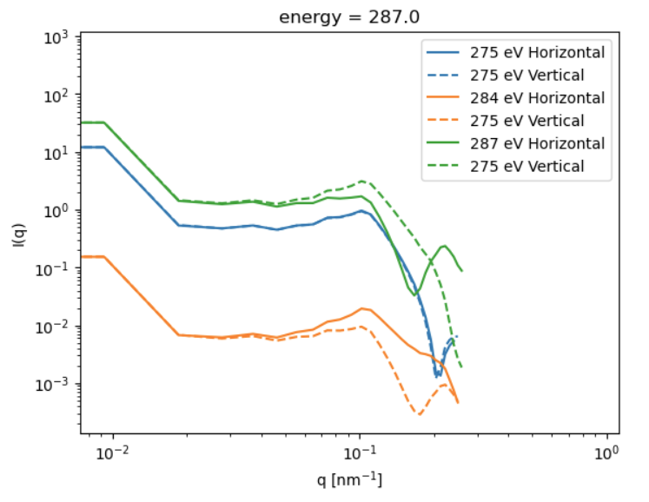
Horizontal and Vertical

Slide 17
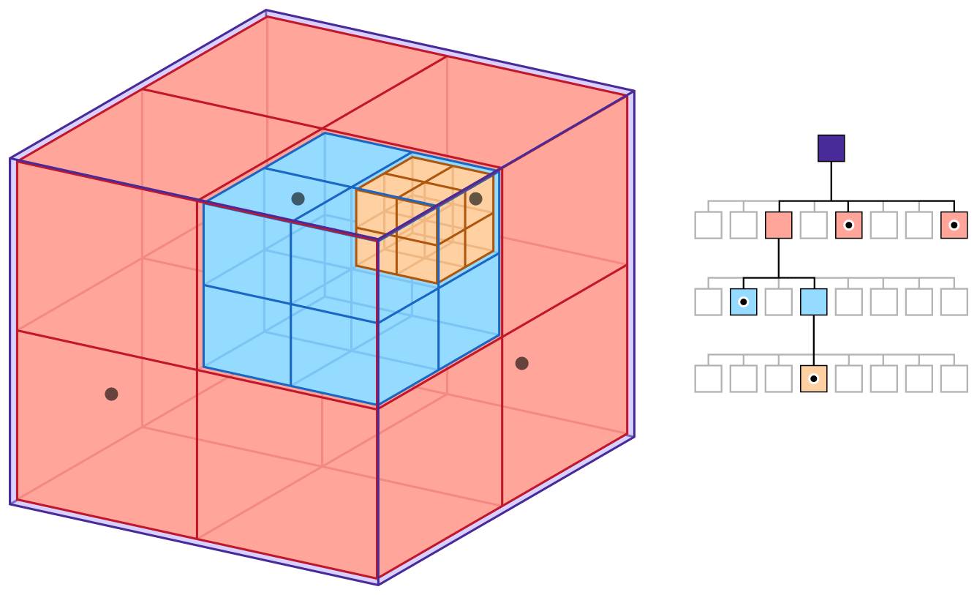
Possible Future Steps
More preset shapes
More non-isotropic morphologies
More point algorithms
Random sequential
Volume in space
More robust collision detection system
Octree

Slide 18
Acknowledgements
Dr. Peter Beaucage
Dr. Peter Dudenas
Dr. Dean DeLongchamp
CHRNS / NCNR
Internship directors Julie Borchers and Joe Dura

Slide 19
Questions?

