Slide 1
Advancing HL7 v2 to New Heights: 1) NIST HL7 v2 Test Tools 2) NIST HL7 v2 Platform Developing Specification, Test Plans, and Testing Tools
Telstra Health, Sydney
January 31st, 2020
Robert Snelick, NIST

Slide 2
NIST
U.S. Federal Agency under the Dept. of Commerce—”Standards and Measurement”
Developed the conformance test method (test procedures, test data, and test tools) for ONC 2011, 2014, and 2015 Edition certification
Developed conformance test tools for CDC, IHE, HL7, ONC, AIRA, ISDS, HIMSS, …)
Supports SDOs via guidance; and assessment and certification programs via tools, but does not perform certification

Slide 3
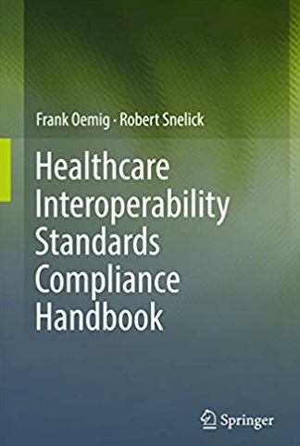
Speaker
Robert Snelick
Project Manager and System Architect - National Institute of Standards and Technology (NIST)
Co-chair – HL7 Conformance Working Group
Architect and lead of the NIST Testing Infrastructure for conformance test tools including those for the CDC, IHE, and ONC Certification
Co-author – Healthcare Interoperability Standards Compliance Handbook, Springer 2016
robert.snelick@nist.gov

Slide 4
Path to Interoperability
Specification of Requirements
Improved HL7 v2 Conformance Constructs
Best Practices
Example Specifications
Testing
Test Cases
Targeted
Meaningful
Comprehensive
Tools
Specification Authoring Tool
Test Case Authoring Tool
Validation Tools

Slide 5
Motivation and Overview

Slide 6
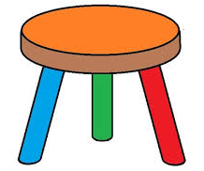
Foundation for Interoperability
Well-defined Standards
Testing
Implementation
Standards Development Lifecycle
Standards
Testing
Implementation
HIT Interoperability
Implementation
Well-defined Standards
Conformance Testing
Notes:
“well-defined standards” → having and using conformance constructs correctly.
Standards must be created and adopted
Not just standards, but well-defined standards (they must be understandable)
Standards must be specific (profiled for use)
Standards should/must be represented in a computable format
Send good acknowledgements
Implementations must be tested for conformance
Systems must be tested for interoperability

Slide 7
Why a Better Approach is Needed
Undocumented/Poorly Documented Interface Specifications
Ambiguous and inconsistent HL7 v2 IGs
Inadequate conformance mechanisms to specify requirements
Misuse and misunderstanding of conformance concepts
Limited/outdated tools to help in standards development
Lack of tools to create test cases and example messages
Example messages in IGs are always wrong
Conformance Testing bound to the quality of the IG
Conformance Testing tools are often not rigorous/complete
Conformance Testing Tools are expensive to build
Conformance Testing Tools are expensive to maintain
Lack of tools to assist in creating conformance tools
Testing Platform to meet the stages of testing
Lack of tooling to migrate from national IGs to local implementations easily
Lack of complete standards development life-cycle (tooling)

Slide 8
End-to-End Strategy
Specification of Requirements
Development of Specifications
Development of Test Cases
Testing Infrastructure
Platform to build and manage testing tools
NIST builds the platform—let domain experts create and maintain guides, test cases, and tool instances via productivity tools

Slide 9
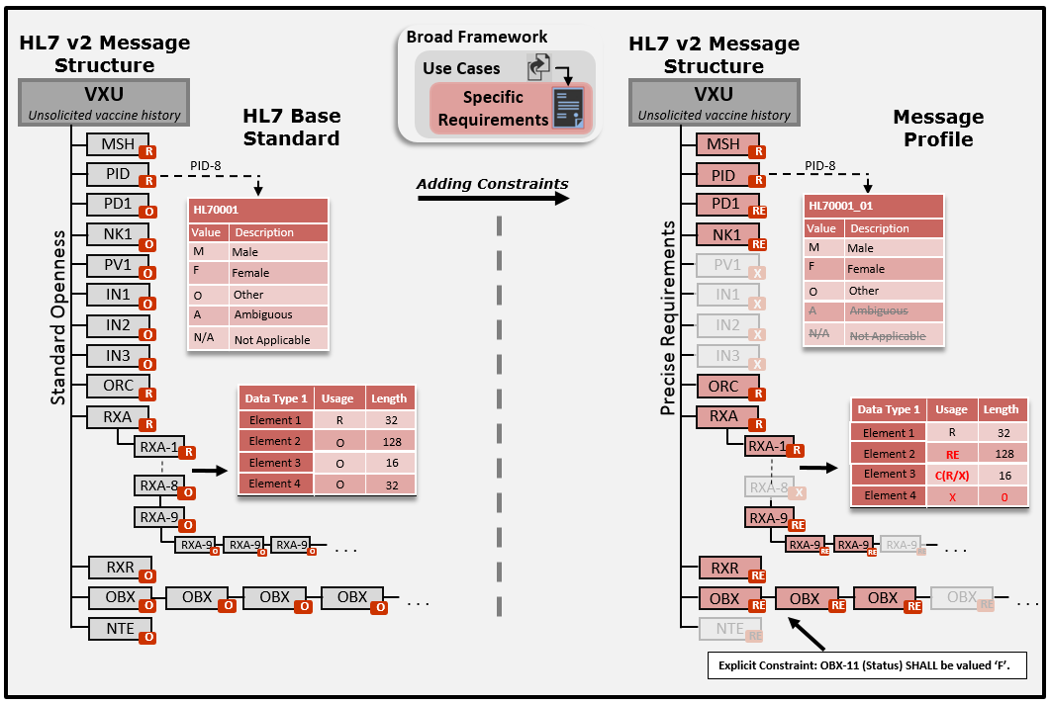
HL7 v2 Profiling Overview
1/30/2020

Slide 10
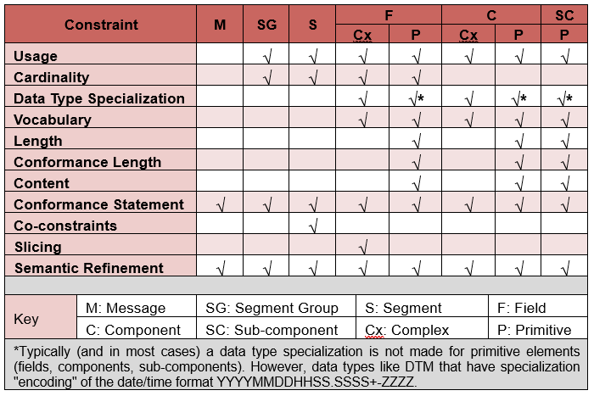
Conformance Constructs

Slide 11
v2 Conformance Methodology
Normative in Spring 2020—in ballot now
Comprehensive Vocabulary Definition Support
Data Type Flavors
Data Type Flavor Library
Segment Flavors
Profile Components/Composite Profiles
Explicit/Computable Conformance Statements
Explicit/Computable Condition Predicates
Expanded Conditional Usage T/F Outcomes
Co-Constraints

Slide 12
NIST HL7 v2 Platform Overview
IGAMT
TCAMT
Testing Infrastructure & Framework
Testing Tool
IGAMT – Implementation Guide Authoring and Management Tool → Specification
TCAMT – Test Case Authoring and Management Tool→ Test Plans
Testing Infrastructure and Framework
Testing Tool → Conformance Testing

Slide 13
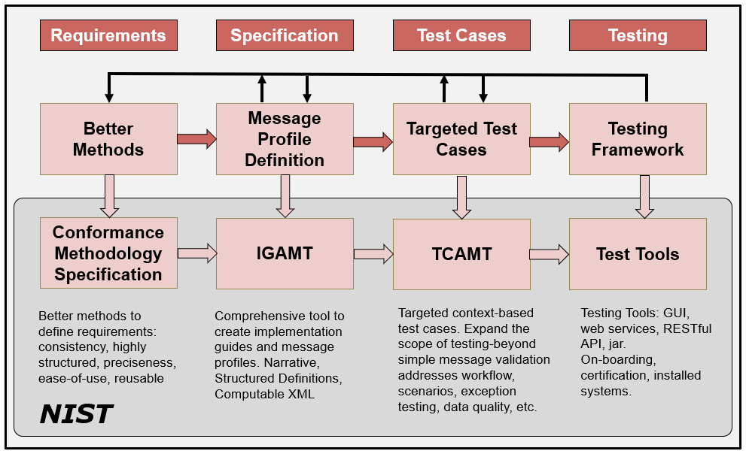
HL7 v2 Development Phases/Cycle

Slide 14
Customization
Easily support localization and “one-offs”
Customize specification of national profiles or other specifications in minutes/hours
Customize test cases minutes/hours
Customized test tool—automatically generated in minutes

Slide 15
NIST Productivity and Testing Tool Use

Slide 16
NIST Productivity Tool – IGAMT I
IGAMT – Implementation Guide Authoring and Management Tool
Standard | Developer | Use | HL7 Version
Immunization HL7 R1 | CDC | May 2017 HL7 Ballot – Re-balloted 2018 | HL7 v2.8.2
Immunization R1.5 | NIST | NIST Internal for ONC 2015 Ed. Certification | HL7 v2.5.1
Syndromic Surveillance HL7 R1 | CDC/ISDS | May 2019 HL7 Ballot – 2nd | HL7 v2.5.1
Syndromic Surveillance R2.0 | NIST | NIST Internal for ONC 2015 Ed. Certification | HL7 v2.5.1
Vital Records Birth Reporting | CDC | May 2017 HL7 Ballot | HL7 v2.6
Vital Records Death Reporting | CDC | May 2019 HL7 Ballot & May 2020 Ballot | HL7 v2.6
V2 Anesthesia Billing Support IG | HL7 | Planned May 2020 HL7 Ballot
Critical Congenital Heart Defects R1 | HL7 | February 2020 HL7 Ballot | HL7 v2.6
Early Hearing Detection & Intervention | HL7 | February 2020 HL7 Ballot | HL7 v2.6
LOI/LRI/eDOS R1 DSTU R2 | NIST | NIST Internal (for testing tools) | HL7 v2.5.1
ELR | APHL/NIST | APHL Testing-In Progress | HL7 v2.5.1
 |  |  | HL7 v2.5.1
Patient Care Devices (PCD) | NIST | IHE PCD Cycle 14 and 15 (2018-2020) | HL7 v2.6
Electronic Case Reporting | CDC | Local | HL7 v2.5.1
Pennsylvania State Immunization | State of PA | June 2019 – Published Local Tool | HL7 v2.5.1
Local Use | Vendors/States | Unknown | Unknown
= 280+ registrations IGAMT-generated implementation guides balloted by HL7

Slide 17
IGAMT-2
Beta Release for trial use

Slide 18
NIST Productivity Tool – TCAMT
TCAMT – Test Case Authoring and Management Tool
Standard | Developer | Use
Immunization R1.5 v2.5.1 | CDC/CNI/HIMSS | HIMSS Certification
Immunization R1.5 v2.5.1 | CDC/NIST | ONC 2015 Ed. Certification
Immunization HL7 R1.0 v2.8.2 | CDC/NIST | Test Cases for trial use
Immunization R1.5 v2.5.1 | AIRA | AIRA IIS Assessment Program
Syndromic Surveillance R2.0 | ISDS/NIST | ONC 2015 Ed. Certification
Vital Records Death Reporting | CDC/NIST | IHE Pre-connect-a-thon/Connect-a-thon, CDC
Vital Records Birth Reporting | CDC/NIST | IHE Pre-connect-a-thon/Connect-a-thon, CDC
LOI R1 DSTU R2 | NIST | NIST Internal-In Progress
LRI R1 DSTU R2 | NIST | NIST Internal-In Progress
eDOS R2 DSTU R2 | NIST | NIST Internal-In Progress
Patient Care Devices (PCD) | NIST | NIST Internal-In Progress for IHE
ePrescribing | NIST/NCPDP | Tool in development (Adapted)
TCAMT allows domain experts to develop test scenarios and test cases, with example messages—set in the foundation of the XML Profile created in IGAMT.
Scenarios can be created to test capabilities, workflow, functional requirements, and robustness via “negative” testing.

Slide 19
NIST HL7 v2 Tool Portfolio
Standard | Owner | Testing Program | Links
Immunization R1.4* | CDC | ONC 2014 Ed. Certification | http://hl7v2-iz-testing.nist.gov
Immunization R1.5* | CDC | ONC 2015 Ed. Certification AIRA IIS Assessment HIMSS/CDC EHR Certification | http://hl7v2-iz-r1.5-testing.nist.gov http://iztool-cdc.hit.icsl.net:8080/iztool
Syndromic Surveillance R1.1* | CDC/ISDS | ONC 2014 Ed. Certification | http://hl7v2-ss-testing.nist.gov
Syndromic Surveillance R2.0* | CDC/ISDS | ONC 2015 Ed. Certification | http://hl7v2-ss-r2-testing.nist.gov
LRI R1 DSTU R1 | HL7/ONC | ONC 2014 Ed. Certification | http://hl7v2-lab-testing.nist.gov
ELR (Reportable Labs) R1.0* | HL7 | ONC 2014/2015 Ed. Certification | http://hl7v2-elr-testing.nist.gov
General Validation Tool (GVT) | General | General Tool Portal | http://https://hl7v2.gvt.nist.gov
LRI/LOI/eDOS LAB STU R2 | HL7/ONC | ONC Pilot Testing | http://hl7v2-lab-r2-testing.nist.gov
Vital Records DR R1 | CDC/HL7/IHE | CDC IHE Connect-a-thon | http://https://hl7v2.gvt.nist.gov
Vital Records Birth Reporting | CDC/IHE | CDC IHE Connect-a-thon | http://https://hl7v2.gvt.nist.gov
Patient Care Devices (PCD) | IHE | IHE Pre-connect-a-thon IHE Connect-a-thon | http://ihe-pcd-precon.nist.gov http://ihe-pcd-con.nist.gov
PIX and PDQ | IHE | IHE Pre-connect-a-thon IHE Connect-a-thon | http://pixpdqtests.nist.gov http://hl7.connectathon-pixpdq.nist.gov/
*State Registries use for on-boarding
Unknown number of local installations

Slide 20
Tools and Validation
NIST HL7 v2 Platform
Authoring IGs and Profiles
Authoring Test Plans
Conformance Testing

Slide 21
HL7 v2 Development Phases/Cycle

Slide 22
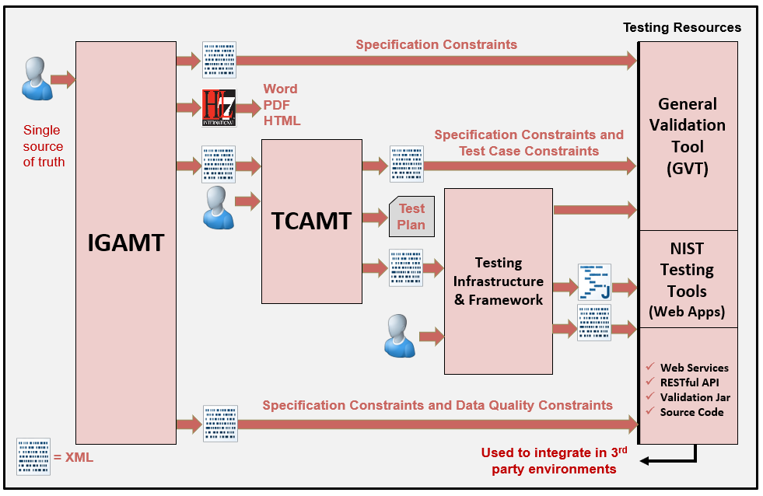
NIST HL7 v2 Platform

Slide 23
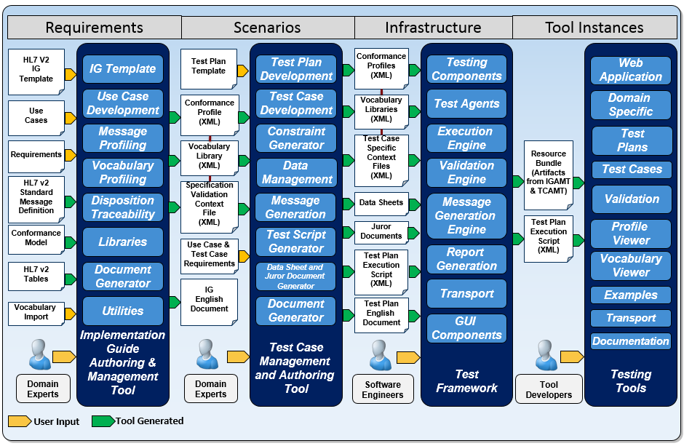
NIST HL7 v2 Platform Detail

Slide 24
IGAMT
Tool to create implementation guides
Narrative + Message Definition
Built-in template
Supports current conformance constructs
Enforces compliance rules
Promotes consistency in requirements
Single source of truth
New profile schema (for XML profile instances)
XML export is bridge to services (e.g.,validation)
Constraints for context-free testing

Slide 25
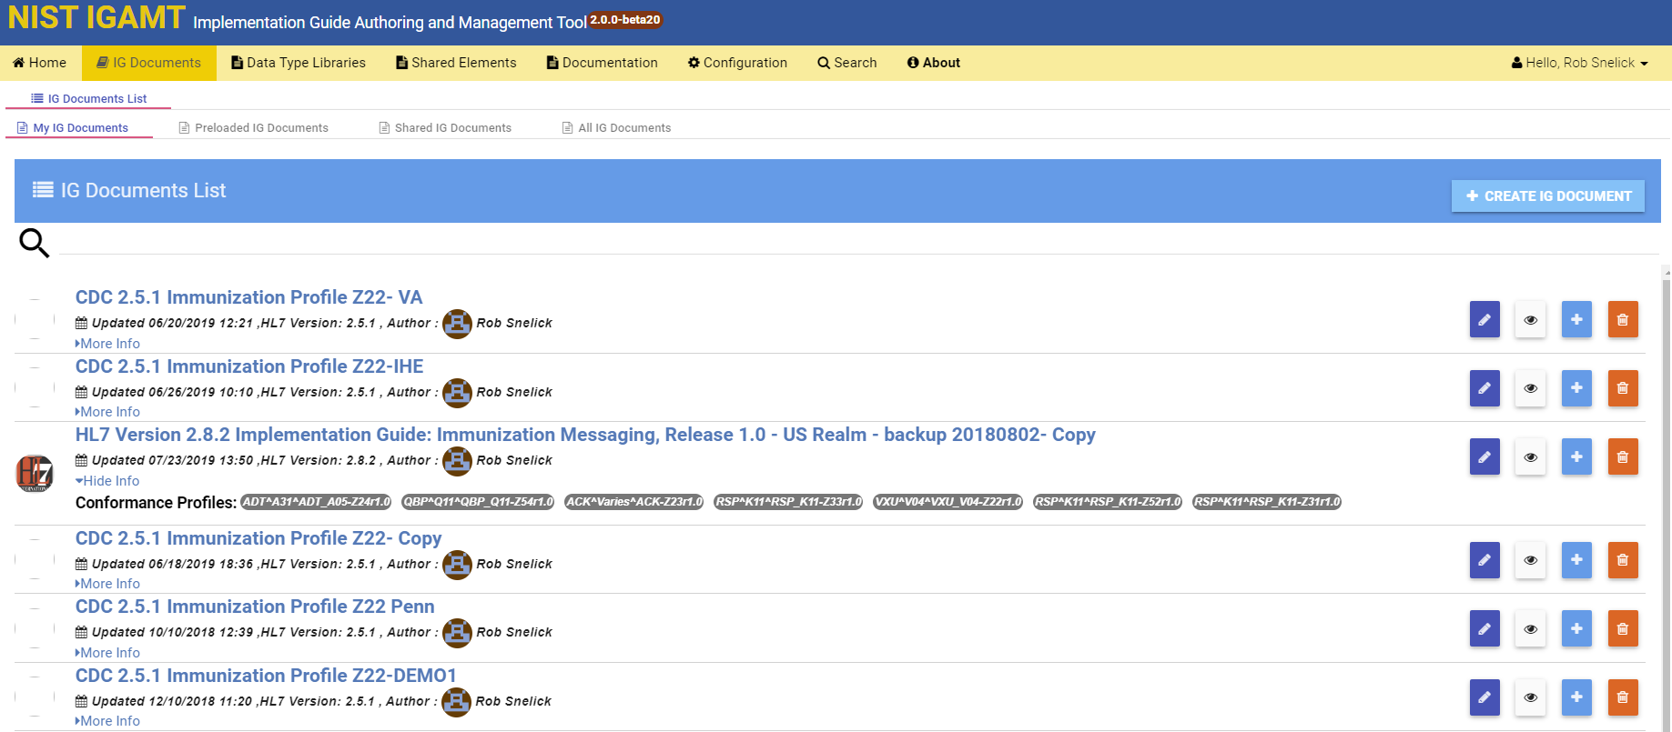
IGAMT: User’s Implementation Guide List
Create Implementation Guides
Shared Implementation Guides
Clone pre-loaded “National Level” Implementation guides for localization
Export as XML, HTML, or WORD
Testing Tool built directly from XML and Test Framework (immediately)

Slide 26
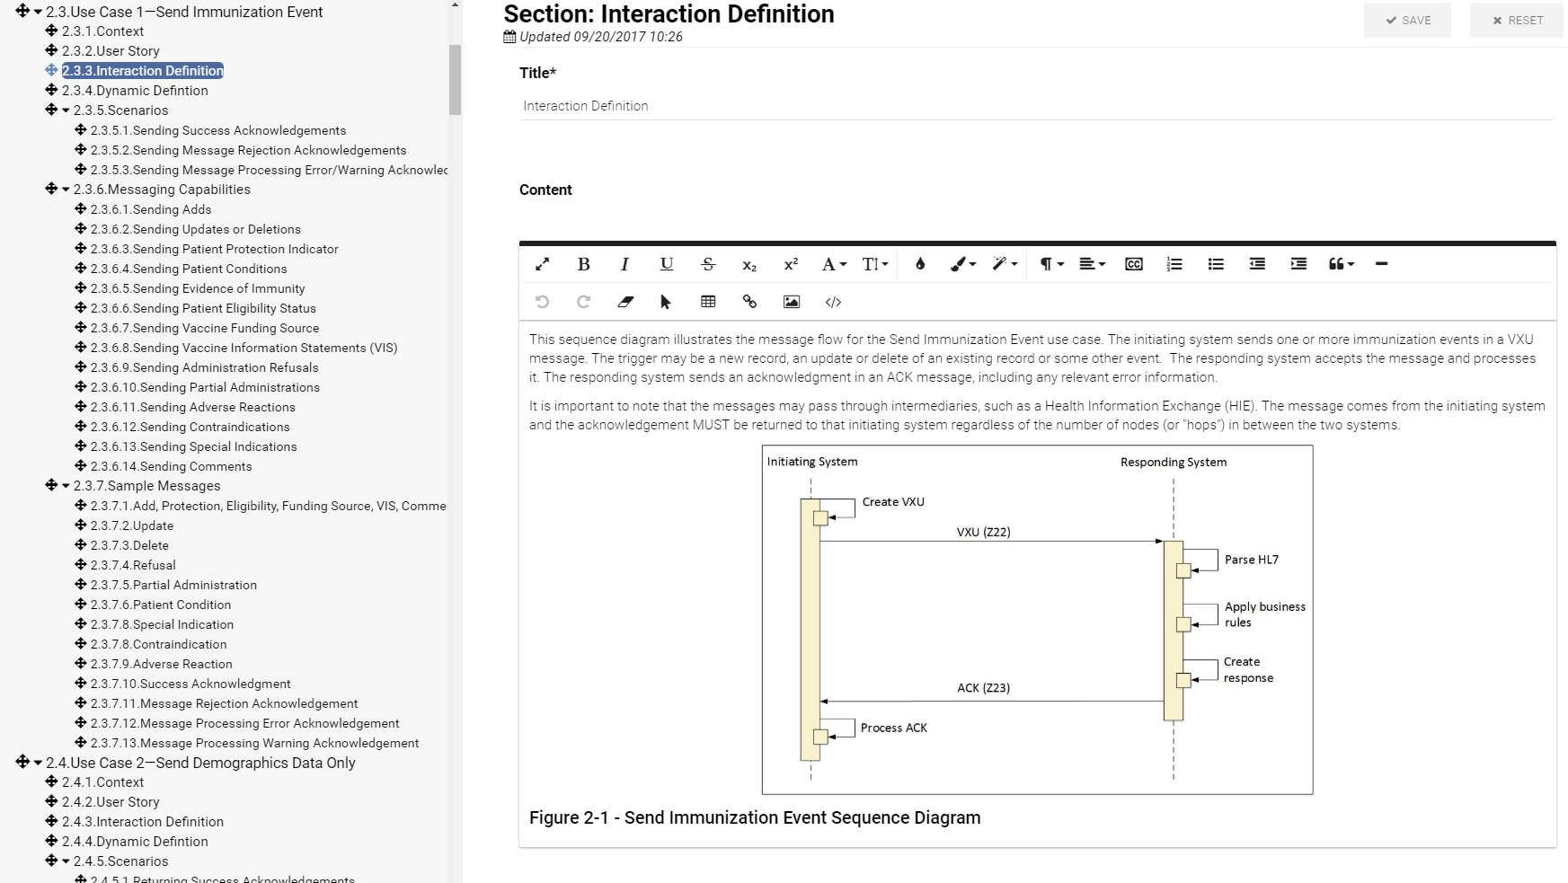
IGAMT: Narrative with Editing Capabilities

Slide 27
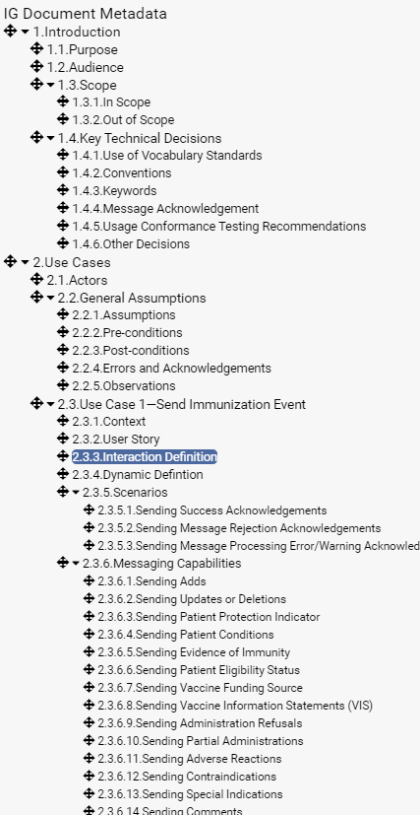
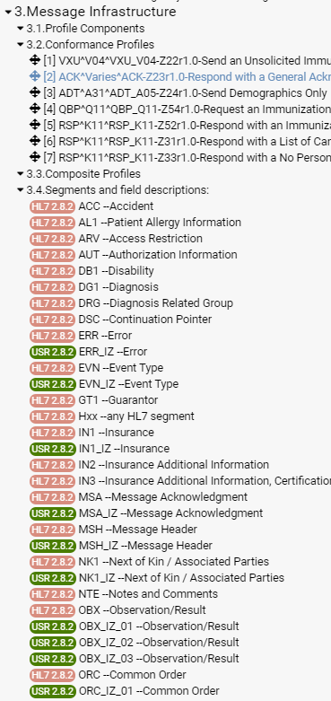
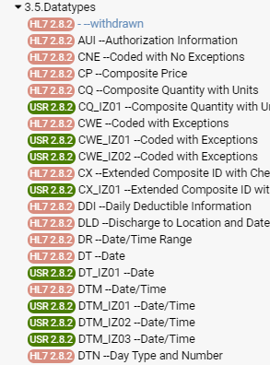
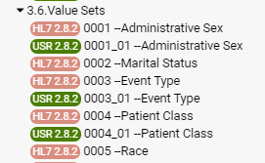
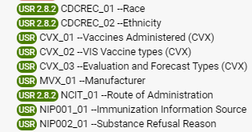
IGAMT: Table of Contents
Narrative
Profiles and Segments
Data Types
Value Sets

Slide 28
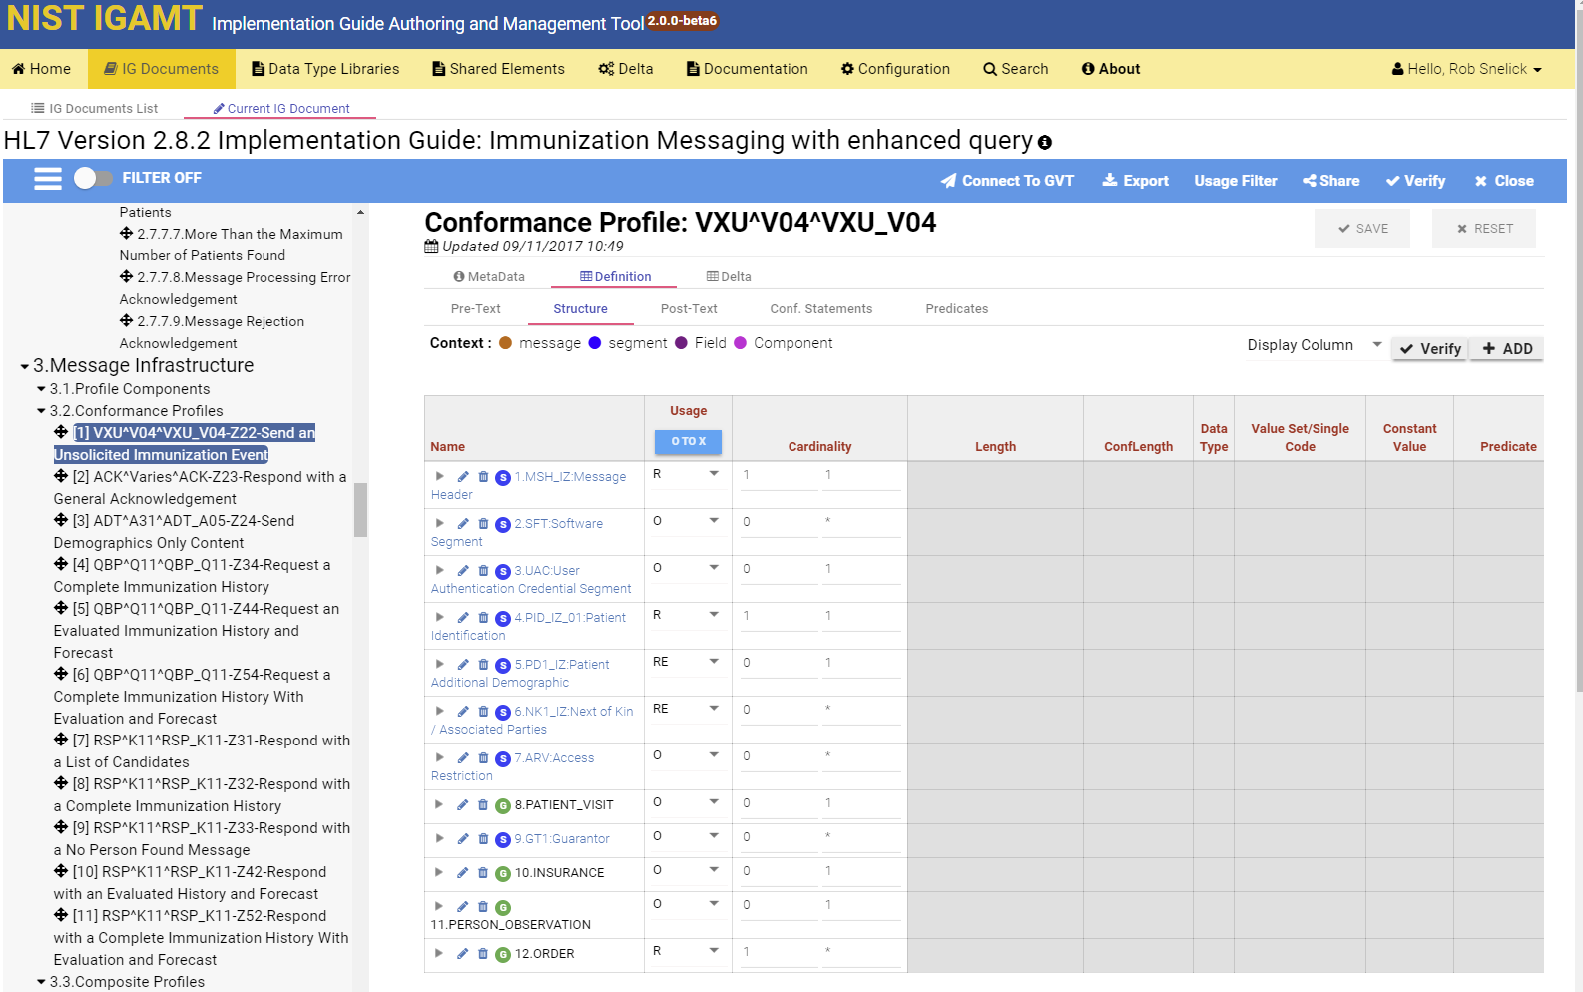
Message Level Profiling

Slide 29
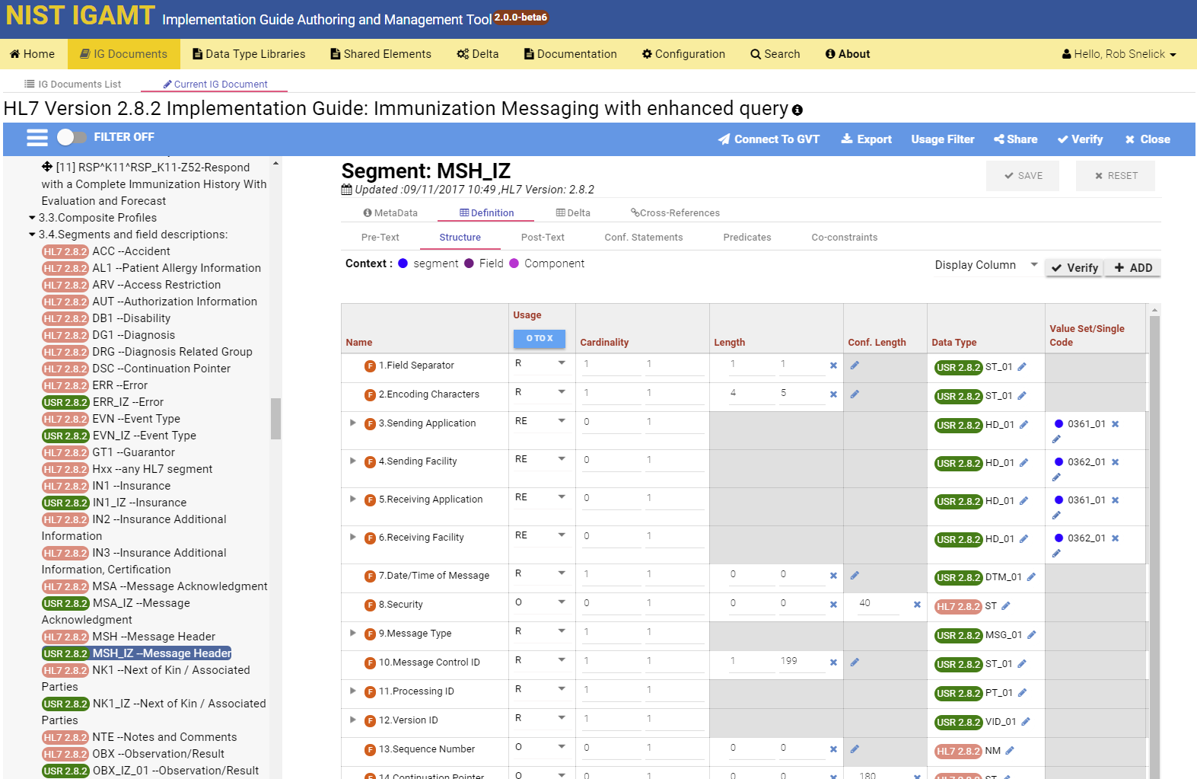
Segment Profiling

Slide 30
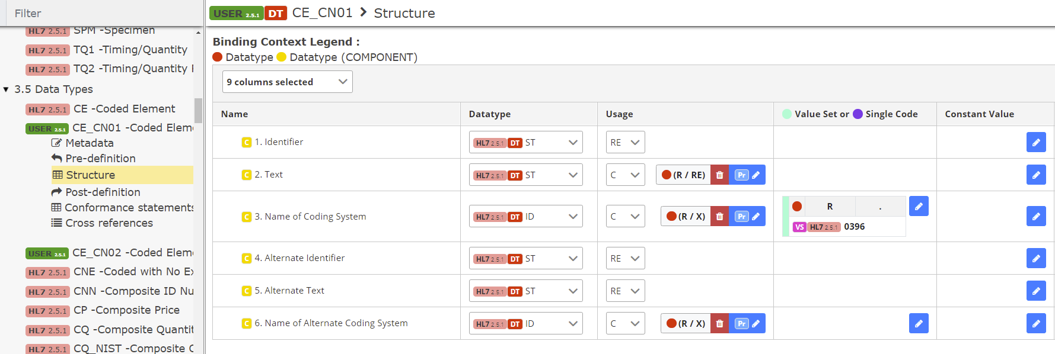
Data Type Flavor
1. Clone and constrain (Create CE_CN01 Data Type Flavor)
2. Bind to element (Bind to OBX-3 Field)

Slide 31
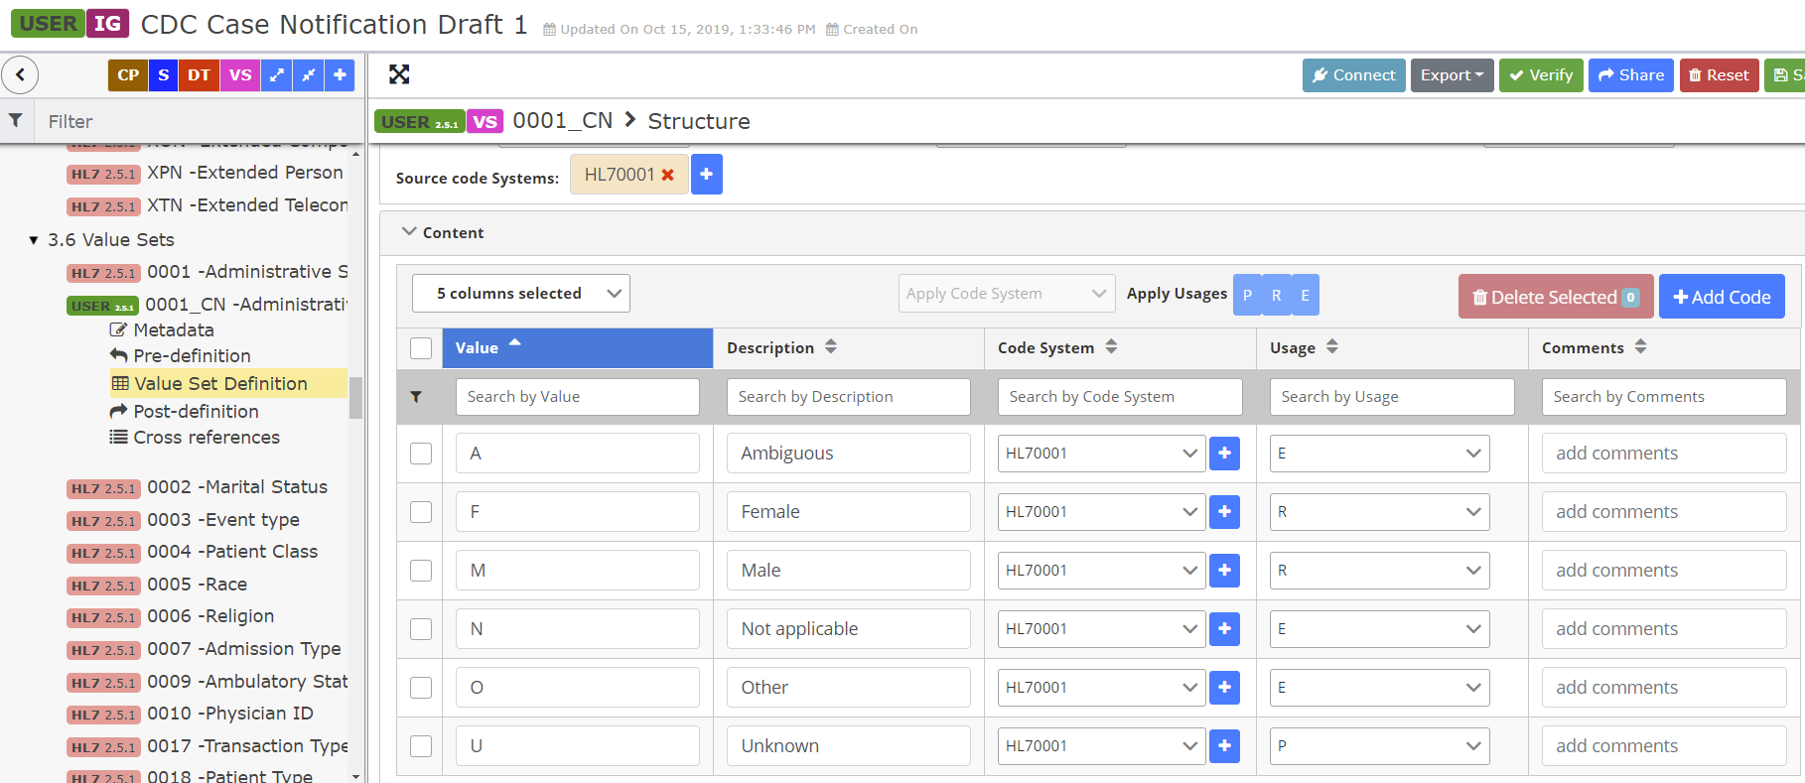
Value Set Profiling and Binding
1. Clone and constrain (Create Value Set HL70001_CN for Table HL70001)
2. Bind to element (Bind to PID-8 Field)

Slide 32
Co-Constraints

Slide 33
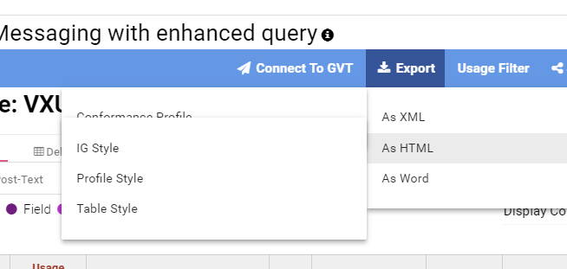
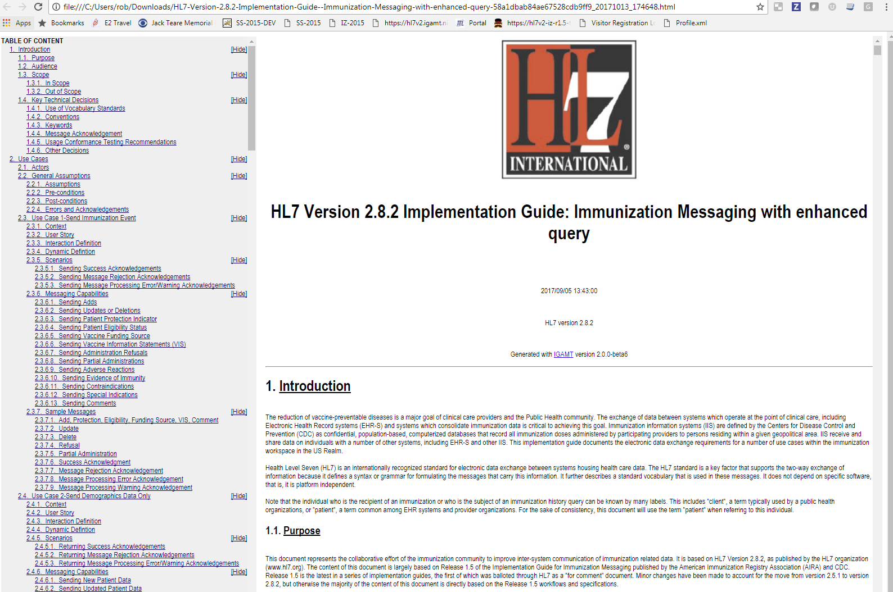
IGAMT: Export
Export in HTML, WORD, and XML
Multiple Styles

Slide 34
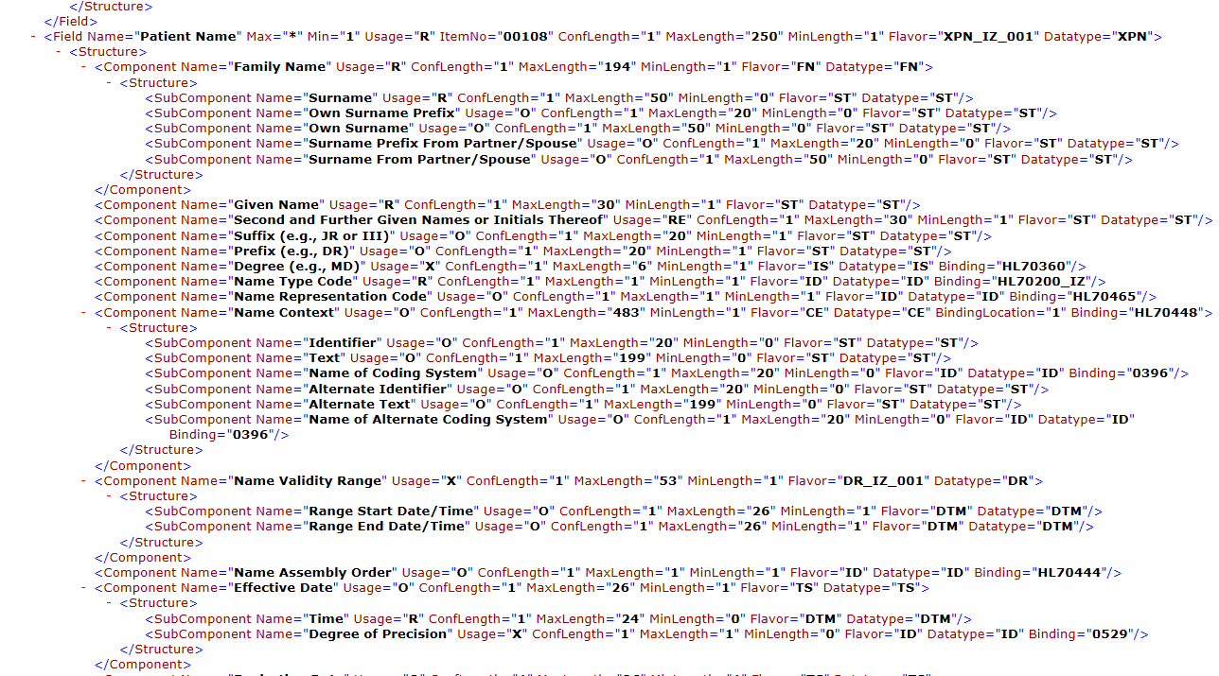
HL7 v2 Profile XML Format
Notes:
NIST HL7 v2 XML format. To be submitted to HL7 to standardize. The NIST format adds additional conformance constructs.

Slide 35
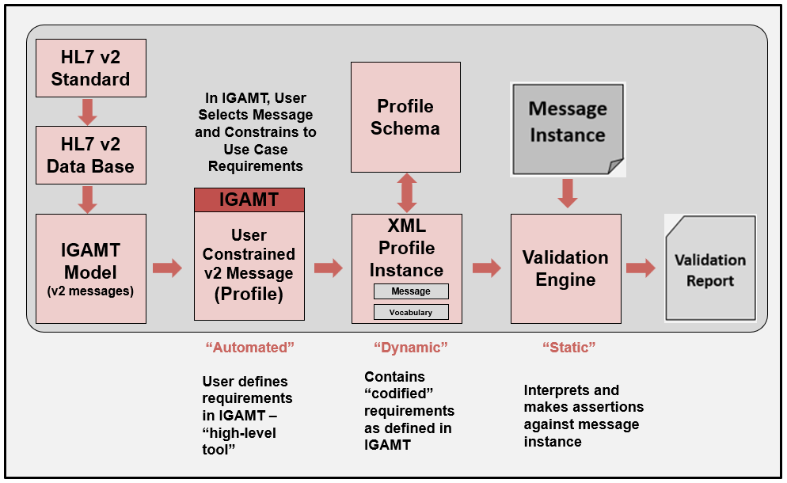
Validation Process

Slide 36
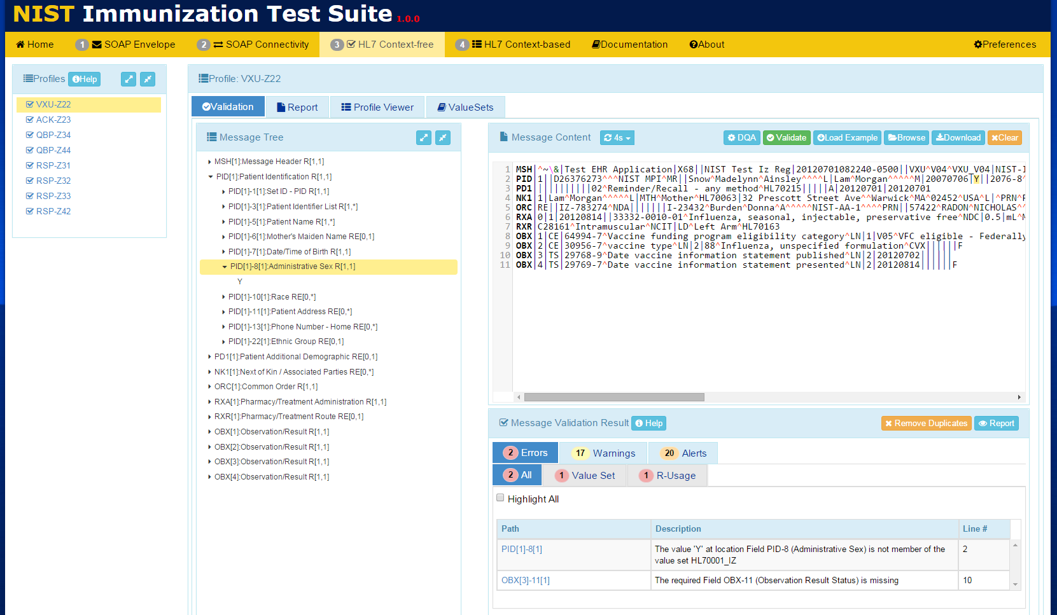
Context-free Validation

Slide 37
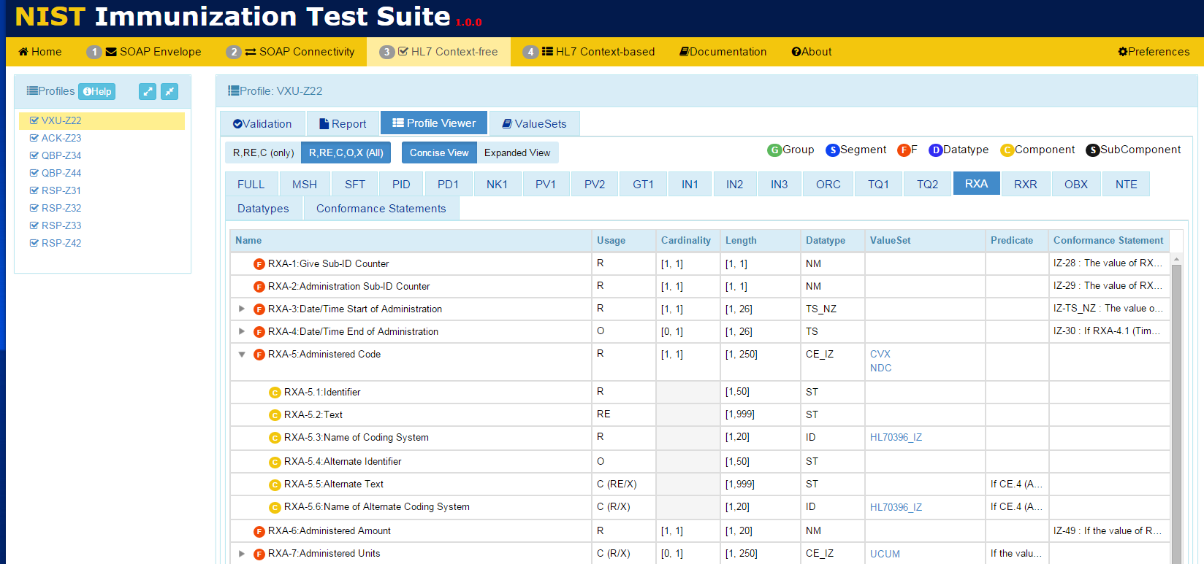
View Messaging Requirements

Slide 38
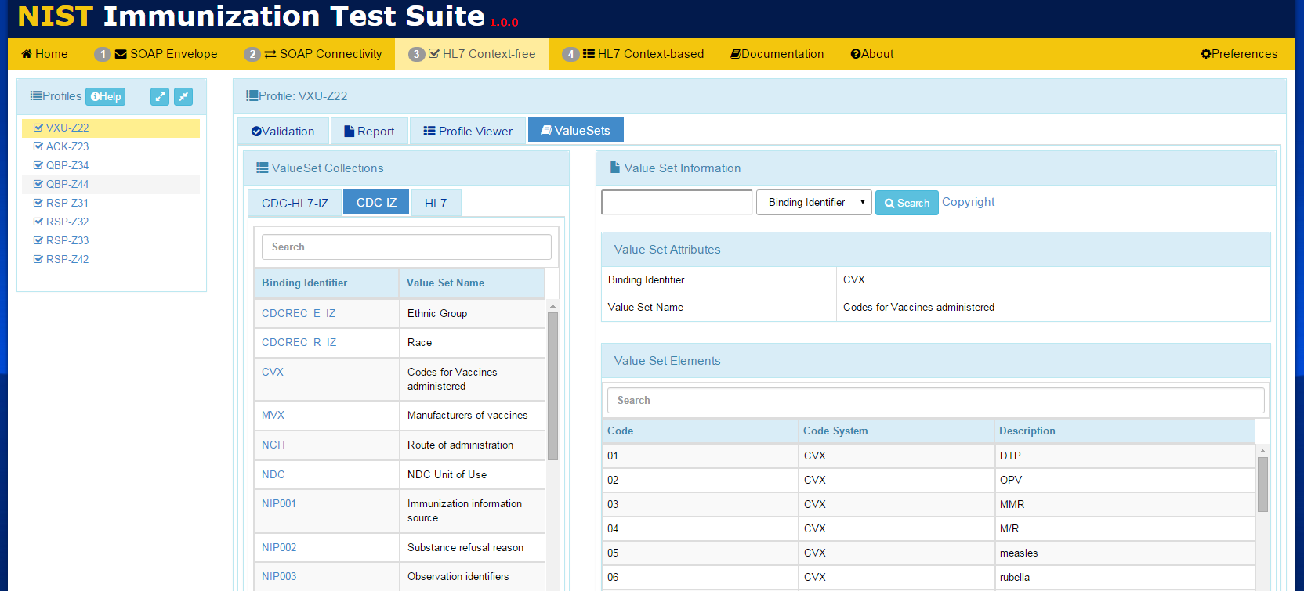
View Vocabulary Requirements

Slide 39
TCAMT
Tool Test Plans and Test Cases
Narrative + Test Case Definitions
Import XML profiles in IGAMT format
XML profiles provide underlying model
NIST-built constraint mechanism
Expands testing capabilities
Example/test messages ← Powerful notion
Single source of truth
XML export is gateway to other services
Constraints for context-based testing

Slide 40
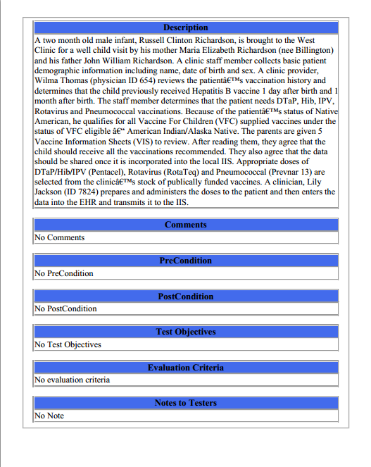
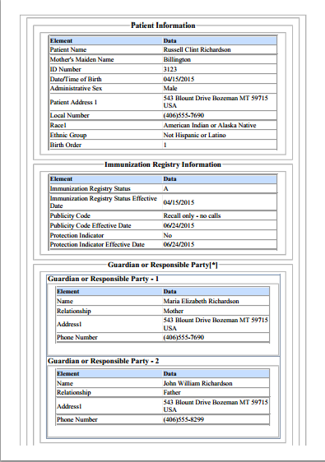
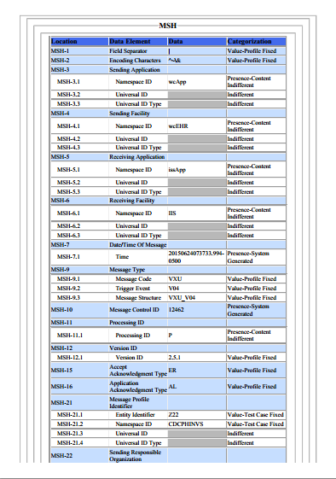
Context-based Testing
Test Story
Test Data
Content Assertions
Test Story gives the test scenario
Test Data indicates the real-world data
Content Assertions indicates how content will be validated

Slide 41
Context-based Testing
Example: Conformity Assessment for Context-based Testing
Element | Usage | Test Data | Test Category | Conformity Assessment | Data in Message | Validation Result
PID-5.3 (Middle Name)* | RE | Donna | Presence-Content-Indifferent | Required | <Empty> | Fail
PID-5.3 (Middle Name) | RE | Donna | Presence-Content-Indifferent | Required | Donna | Pass
PID-5.3 (Middle Name) | RE | Donna | Presence-Content-Indifferent | Required | Sue | Pass
PID-5.3 (Middle Name) | RE | Donna | Presence-Length-Content-Indifferent | Required Min Length = 5 | Victoria | Pass
PID-5.3 (Middle Name) | RE | Donna | Presence-Length-Content-Indifferent | Required Min Length = 5 | Sue | Fail
PID-5.3 (Middle Name) | RE | Donna | Value-Test Case Fixed | Required Value = Donna | Donna | Pass
PID-5.3 (Middle Name) | RE | Donna | Value-Test Case Fixed | Required Value = Donna | Sue | Fail
MSH-9.2 (Trigger Event) | R | V04 | Value-Profile Fixed | Required Value = V04 | V04 | Pass

Slide 42
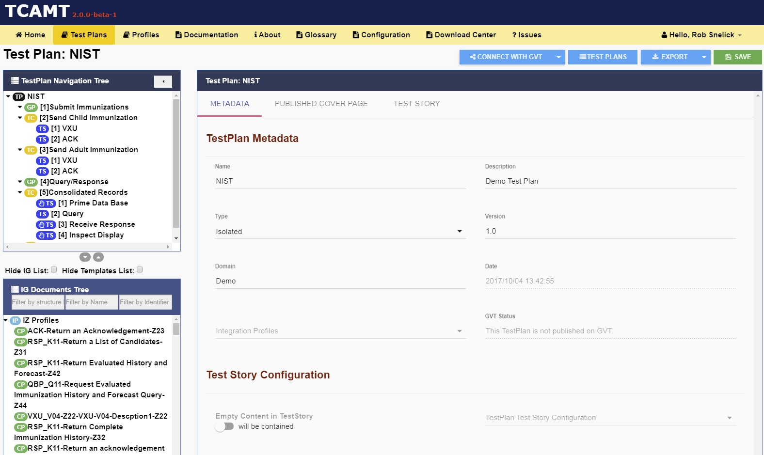
TCAMT: Creating Test Cases and Context-based Testing

Slide 43
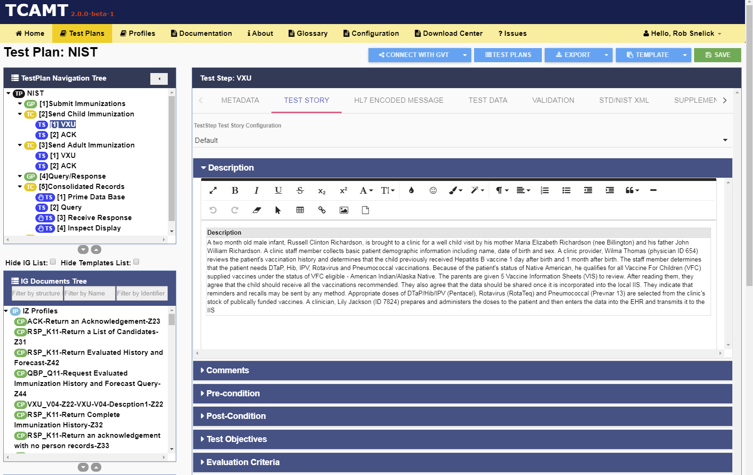
TCAMT: Creating Test Cases and Context-based Testing

Slide 44
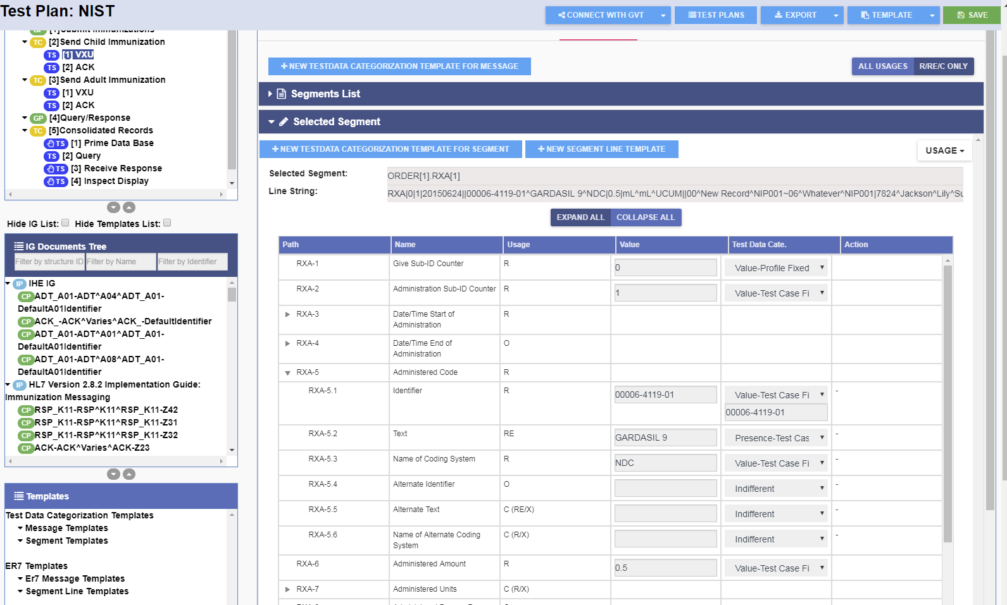
TCAMT: Creating Test Cases and Context-based Testing

Slide 45
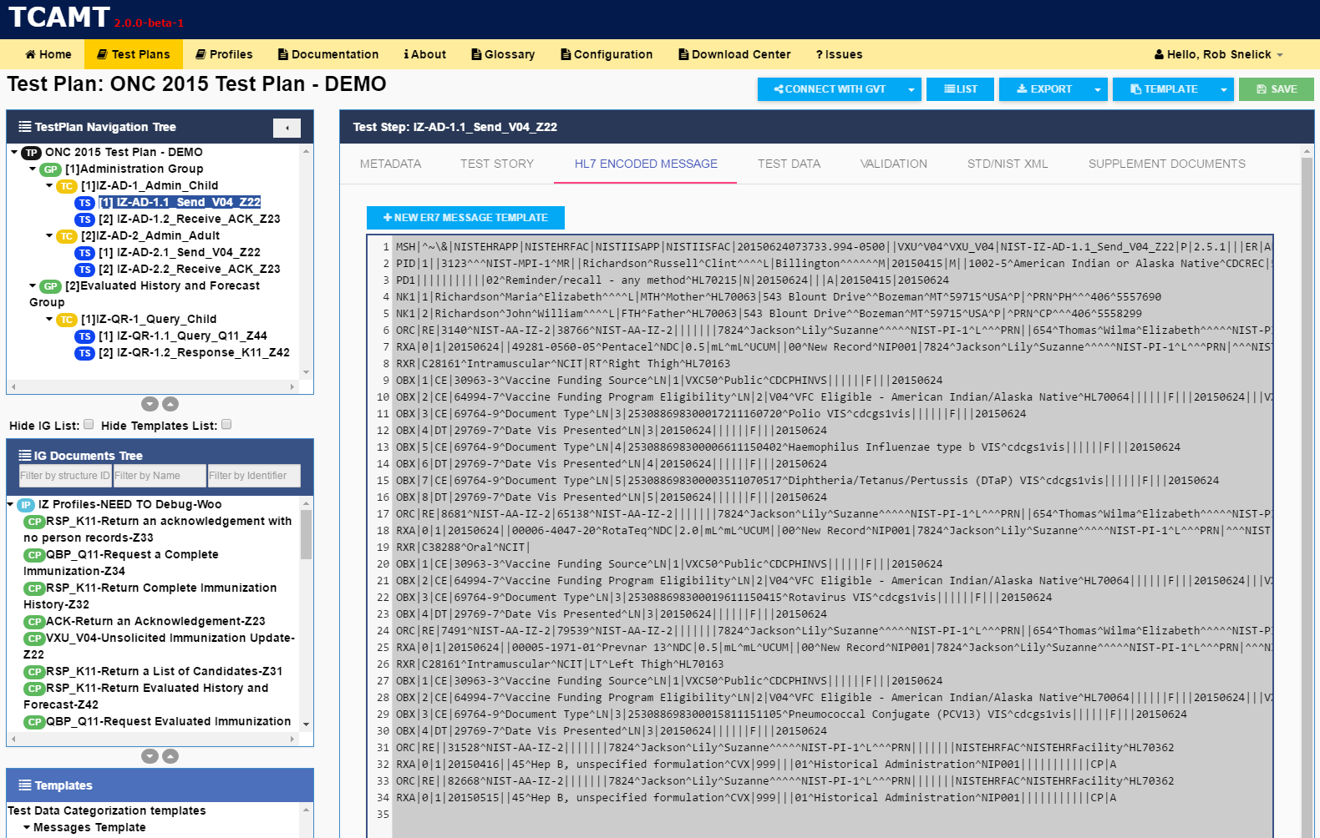
TCAMT

Slide 46
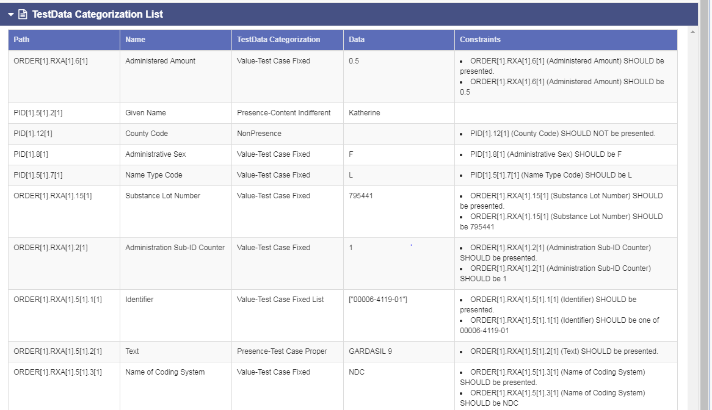
TCAMT: Creating Test Cases and Context-based Testing

Slide 47
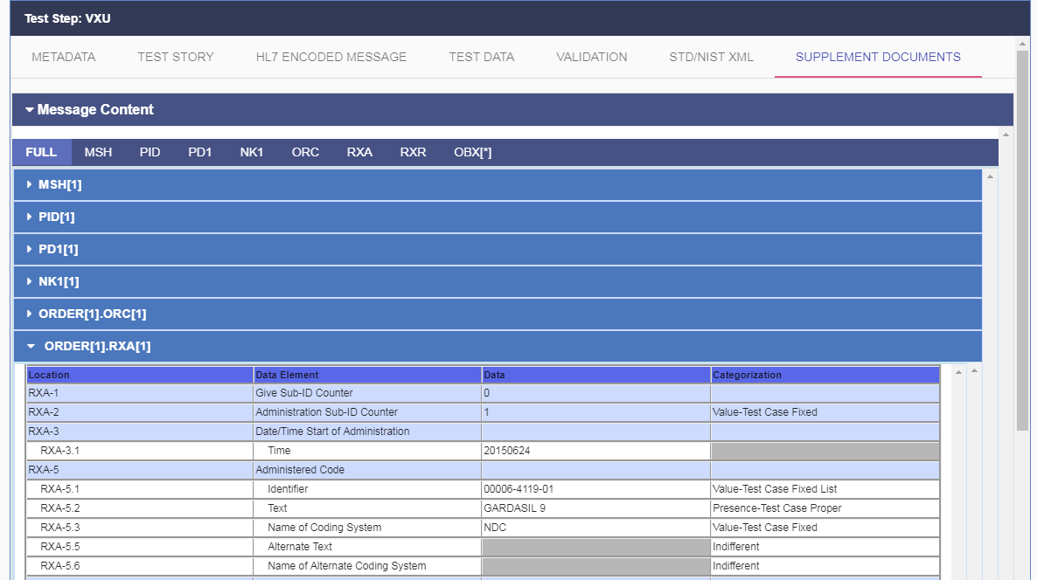
TCAMT: Creating Test Cases and Context-based Testing

Slide 48
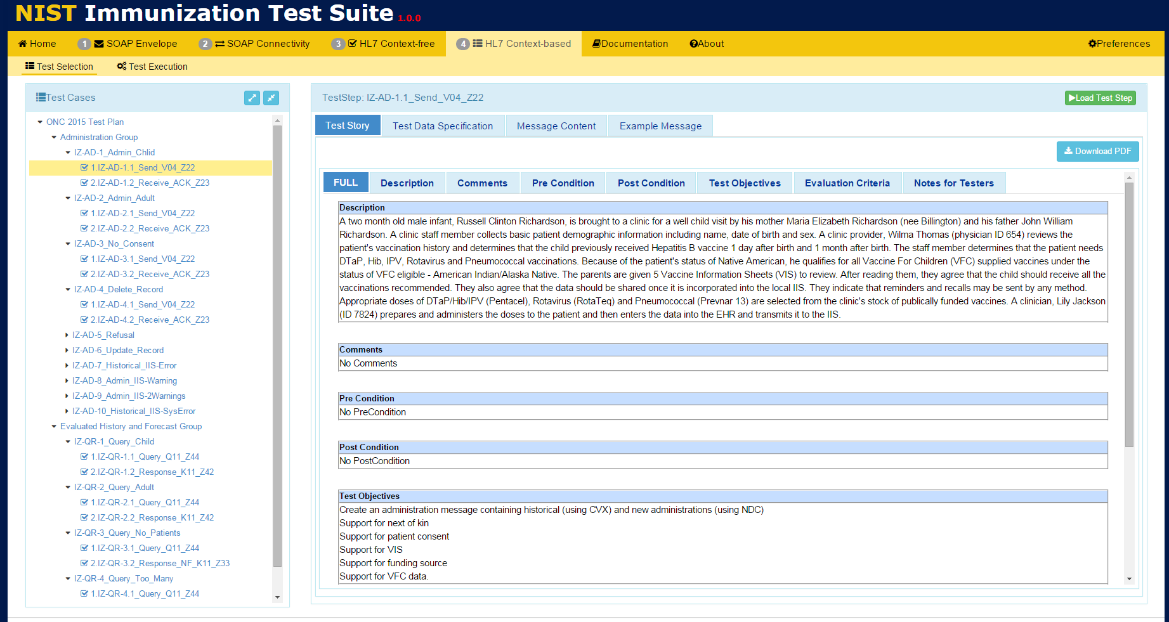
Context-based Validation

Slide 49
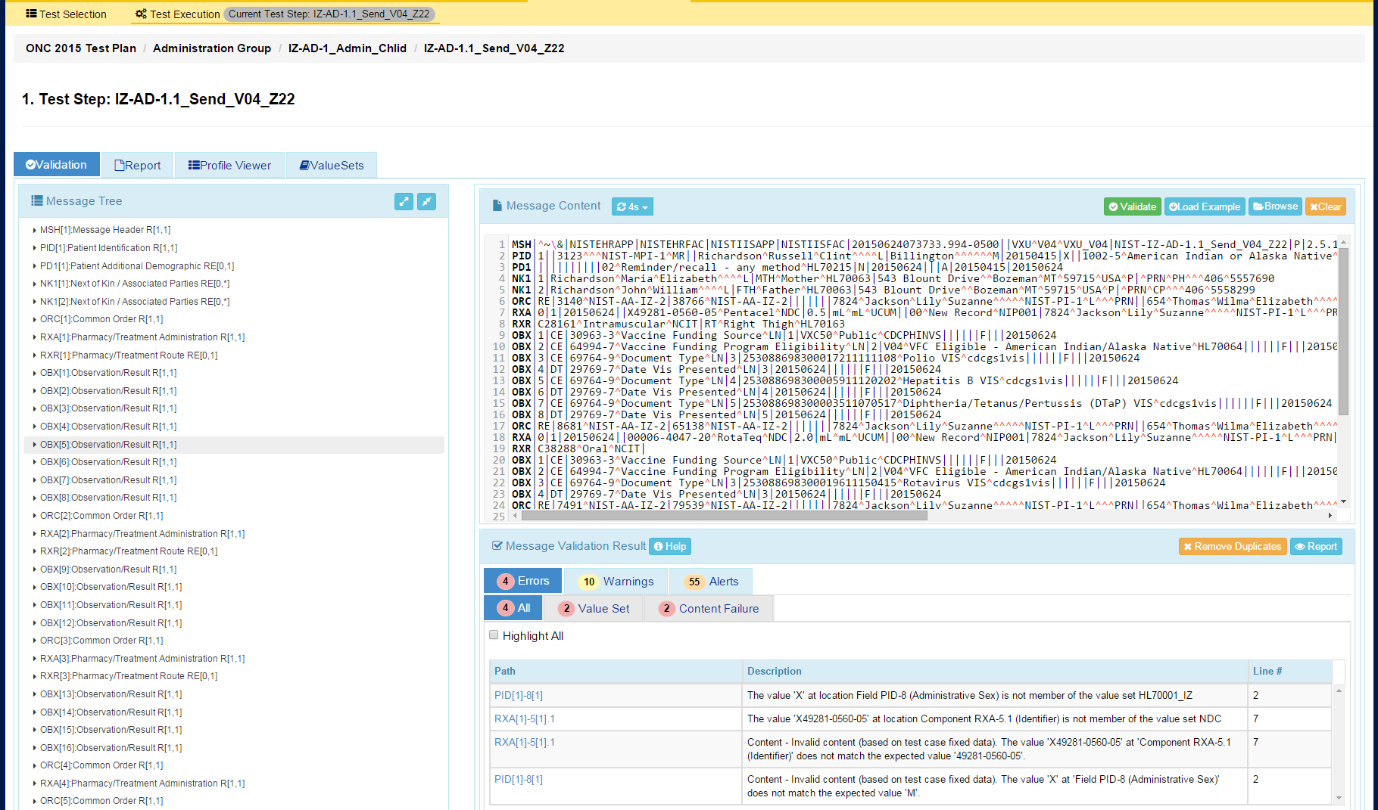
Context-based Validation

Slide 50
Platform Status
All tools in use for years
Public Domain—Free for use
Tools hosted by NIST
IGAMT-1
Used to ballot HL7 IGs, Local Use
IGAMT-2
Beta Testing—advanced features
TCAMT
Test Plans for ONC, CDC, HIMSS, etc.
Validation Tools
Specific (NIST Created) and General (User Created)
ONC, CDC, HIMSS, IHE, etc.

Slide 51
Real Success
Measures of Immunization Submissions and Acknowledgement Messages
Source: American Immunization Registry Association, August 2019
Notes:
Implementers/Specifiers can decide how far to go—profiling mechanisms should provide capabilities for a precise specification.
THERE ARE NO SHORT CUTS—YOU HAVE TO DO IT ONE WAY OR THE OTHER!
These tools help us manage and leverage/reuse existing models.
Think about now Trading Partner C with the same needs.
Improves Patient Safety
Better Data Sharing
Saves Time and Money
Reasonable confidence that the product meets the conformance requirements stated in the standard
Closer to achieving interoperability
Don’t expect “out-of-the-box” interoperability
Local adaptation and testing is necessary
Most likely each integration will still require translation
Reasonable scope
Based on what standards are part of the certification
E.g., if no usability standards, don’t set unrealistic expectations

Slide 52
Summary: Towards Interoperability
Use Cases
Trading Partner A
Trading Partner B
Reduced Negotiations &
Translations
Requirements
Requirements
Standards
Profiling
Implementation
Testing
Need quality data exchange standards
Be precise, and demand it from SDOs
Profile, Modularize, and Reuse
Use existing tools (profiling and testing)
Non-conformance should not prevent useful exchange of data
Plan for testing, and test (at all layers)
Notes:
Implementers/Specifiers can decide how far to go—profiling mechanisms should provide capabilities for a precise specification.
THERE ARE NO SHORT CUTS—YOU HAVE TO DO IT ONE WAY OR THE OTHER!
These tools help us manage and leverage/reuse existing models.
Think about now Trading Partner C with the same needs.
Improves Patient Safety
Better Data Sharing
Saves Time and Money
Reasonable confidence that the product meets the conformance requirements stated in the standard
Closer to achieving interoperability
Don’t expect “out-of-the-box” interoperability
Local adaptation and testing is necessary
Most likely each integration will still require translation
Reasonable scope
Based on what standards are part of the certification
E.g., if no usability standards, don’t set unrealistic expectations

Slide 53
Thank You Questions
Contact: robert.snelick@nist.gov
https://hl7v2tools.nist.gov

