Slide 1
Recent Cybersecurity Framework-Based Guidance
The Cybersecurity Framework “Next Up!” Webcast Series
October 2018

Slide 2
Notes to Viewers The Cybersecurity Framework “Next Up!” Webcast Series
In case you missed it, check out our last Next Up! Webcast at https://www.nist.gov/news-events/events/2018/07/cybersecurity-framework-webcast-next
Pre-registration is appreciated, but not necessary. Additional viewers are welcome at https://www.nist.gov/news-events/events/2018/10/cybersecurity-framework-webcast-next-series-critical-sector-check
The presentation will be recorded for future playback. Those videos will be available with closed captioning in mid November 2018.
Questions can be send throughout the session to cyberframework@nist.gov or Twitter #CyberFramework

Slide 3
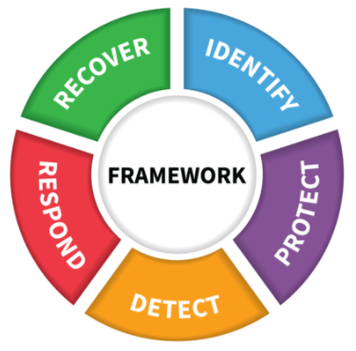
Objective and Agenda The Cybersecurity Framework “Next Up!” Webcast Series
Objective: Understand more about recent work products that are based on the Cybersecurity Framework
Cybersecurity Framework Basics
The Financial Services Sector Cybersecurity Profile Version 1.0
Health Industry Cybersecurity Practices: Managing Threats and Protecting Patients
Distributed Denial-of-Service and Botnet Cybersecurity Framework Profiles
Discussion and Question-Answer Time

Slide 4
Our Guests The Cybersecurity Framework “Next Up!” Webcast Series
Josh Magri
Senior Vice President, Counsel for Regulation and Developing Technologies
Bank Policy Institute
Erik Decker
Chief Security and Privacy Officer
University of Chicago Medicine
Ari Schwartz
Executive Coordinator
Coalition for Cybersecurity Policy and Law

Slide 5
Resources The Cybersecurity Framework “Next Up!” Webcast Series
The Financial Services Sector Cybersecurity Profile Version 1.0
https://www.fsscc.org/Financial-Sector-Cybersecurity-Profile
Health Industry Cybersecurity Practices: Managing Threats and Protecting Patients
soon to be published
Distributed Denial-of-Service and Botnet Cybersecurity Framework Profiles
https://www.cybersecuritycoalition.org/threat-profile-ddos-nist-framework
Notes:
The Financial Services Sector Cybersecurity Profile is a harmonized approach to cybersecurity that recognizes the multiple, often overlapping, regulations and supervisory/examining agency approaches, while fostering an efficient, results-oriented approach to cybersecurity for institutions of all sizes and complexity.
The Cybersecurity Act of 2015 (CSA) 405(d) Guidance aligns healthcare cybersecurity approaches by identifying the current most prevalent threats facing the industry, and establishing cybersecurity practices to mitigate them.
The Cybersecurity Coalition Distributed Denial-of-Service (DDoS) & BotNet Profiles are used to assist in identifying opportunities to improve DDoS or BotNet threat mitigations and aids in cybersecurity prioritization by comparing current state with the desired target state.

Slide 6
Cybersecurity Framework Outcomes The Cybersecurity Framework “Next Up!” Webcast Series
 | Function
Understand risks | Identify | Understandable by everyone Applies to any type of risk management Defines the entire breadth of cybersecurity Spans both prevention and reaction
Determine safeguards | Protect
Identify events | Detect
Address incidents | Respond
Restore capabilities | Recover

Slide 7
Customizing Framework with Profiles The Cybersecurity Framework “Next Up!” Webcast Series
Ways to think about a Profile:
A customization of the Core for a given sector, subsector, or organization
A fusion of business/mission logic and cybersecurity outcomes
Identify
Protect
Detect
Respond
Recover
An alignment of cybersecurity requirements with operational methodologies
A basis for assessment and expressing target state
A decision support tool for cybersecurity risk management

Slide 8
Panelist Presentations

Slide 9
Ways to Share Framework Best Practices The Cybersecurity Framework “Next Up!” Webcast Series
In coordination with NIST:
Share your Resources with others
Publish Success Stories of your Framework implementation
cyberframework@nist.gov for all NIST
coordination and communication

Slide 10
NIST Cybersecurity Risk Management Conference
https://www.nist.gov/news-events/events/2018/11/nist-cybersecurity-risk-management-conference

Slide 11
@
NIST.gov/cyberframework
cyberframework@nist.gov
CSRC.NIST.gov
NCCoE.NIST.gov
NIST.gov/topics/cybersecurity
@NISTcyber

