Slide 1
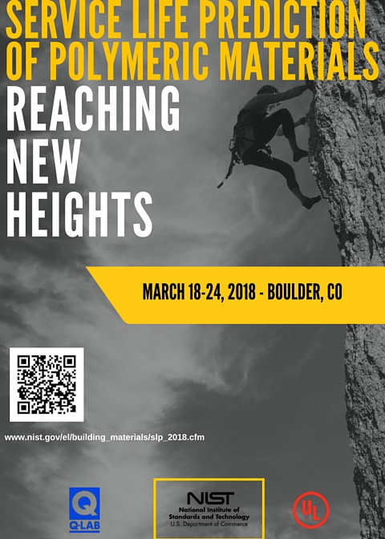
Announcing The Seventh International Conference on the Service Life Prediction of Polymeric Materials.
March 18-24th, 2018
Boulder, Colorado, USA.
http://www.nist.gov/el/building_materials/slp_2018.cfm

