Slide 1
Tool Validation: Was That Supposed to Happen?
NIST Perspective and Programs
Jim Lyle
CFTT@NIST.GOV
Notes:
Hi I’m Jim Lyle with NIST we’ve been doing forensic tool validation for about 18 years now. Thank you very much for inviting me to talk to you.

Slide 2
Disclaimer
Certain trade names and company products are mentioned in the text or identified. In no case does such identification imply recommendation or endorsement by the National Institute of Standards and Technology, nor does it imply that the products are necessarily the best available for the purpose. No financial interest.
Notes:
Just because I mention a company name does not mean that I endorse a product. I don’t endorse any product.

Slide 3
NIST & CFTT
CFTT – Computer Forensics Tool Testing project
Established in 2000 to provide a methodology for testing computer forensic software tools
Develop . . .
Tool Requirements
Methods to test tools against tool requirements
Test data sets (CFReDS) and tools to generate test data sets
Federated Testing – Test plan in a box: select test data, run tests, record results, generate standard format test report and share results.
Notes:
The computer forensics tool testing project at NIST has been developing methods for testing computer forensic software. Forensic tools come in a variety of designs. Some tools are special-purpose they do a single task other tools are like a Swiss Army knife and have a variety of features. What we do is look at specific forensic tasks in isolation and develop methods for testing that task. For a given task we produce a requirements document or specification document that has a list of what we expect that sort of forensic tool to do. We also produce a second document called a test assertions and test plan. The test assertions are simple testable tasks that a tool can attempt and we can easily evaluate the success or failure of the tool. The test plan is a list of test cases in this context test case is a run of a tool that attempts to evaluate a specific assertion or set of test assertions. The third thing that we produce is a test data set for a given test method. The test data set may be an actual tangible Data file or it may be a plan to generate Data to be used in the test. For example to test string searching we have a pair of DD files with strings they can be searched for embedded throughout the DD files. For disk imaging we have a program that writes known data to a hard drive. To test disk imaging we first write known data to a hard drive and then we apply the imaging tool to acquire the hard drive. We also have federated testing, This is a downloadable bootable DVD that allows the user to select a forensic task for testing and guides the user through the steps of running the tests and then generates a draft test report that can be finished off with local customizations for the lab running the test. We think is the big win for everyone. After you have completed a test report it can be submitted to NIST to post on the web making the test report available to the entire community.

Slide 4
CFTT Testing
There are CFTT test methodologies (requirements and test plans) & Test Reports for:
Digital Data Acquisition
Write Blocking
Drive Wiping
Deleted File Recovery (Meta-data based)
Registry Forensics
String Search
Mobile Devices
File Carving
Notes:
String search is the latest addition to our test methodologies. Our federated testing CD currently includes disk imaging write blocking Mobile device tools and will soon include string search and drive wiping. Next year we hope to add file carving and deleted file recovery to federated testing and possibly registry forensics.

Slide 5
Characterizing Reliability
Daubert – criteria to help assess reliability admissibility of scientific testimony
Tested
Peer review
Error rate
Standards & controls
General acceptance
Daubert, Kuhmo Tire & GE v. Joiner.
FRE 702
Notes:
How reliable is your forensic tool? Can you trust the results? It’s not just your tool it’s your entire forensic process that needs to be evaluated for reliability. Any forensics tools you use should be tested in the context of your process. you may be asked to provide an error rate for your tools or for that matter your whole forensic process.

Slide 6
Are the Results of a Forensic Exam Reliable?
The court wants to know if results are reliable.
Digital & Multimedia Forensic practitioners are confident that tools and methods are reliable, but . . .
Saying “I know it works” is just not acceptable. There needs to be some objective support to the claim.
How to characterize and communicate tool reliability?
Other forensic disciplines use error rates to describe chance of false positive, false negative or otherwise inaccurate results.
Why not Digital?
Notes:
I used my tool for years. I know it works. I’ve never ever seen it do anything weird. Well there was that one time last month where it uh, but I figured it out. Oh yeah and there was that other time too. Maybe I need to document some of the stuff that I have seen the tool do. I hear error rates mentioned a lot. But no one has shown one to me for a digital forensic tool.

Slide 7
Addressing Daubert
Error Rate works great to characterize matching two items –
Examples:
Using hashes to see if two files match or if a file has changed
DNA
Error Rate is not so great on characterizing software tools because of the way software fails
Examples:
Might systematically omit something – Partial acquire
Might put unrelated items together – recover a file with data from multiple sources
Testing is a dark art – studied since the 1950’s, but software is still buggy
Notes:
Two of the relevant aspects of Daubert is error rate and tool testing. Error rates arise naturally with statistical hypothesis testing usually answering the questions such as are these two DNA samples from the same person. In digital forensics cryptographic hashes have a natural error rate. If the computed cryptographic hash say MD5, for two files is different then the two files are different the chance of two identical files having different MD5 is zero so the error rate for that type of error is a zero. The other type of error you could have is two files that are different having the same identical cryptographic hash value. This is called a hash collision. The chance of this is very small. For MD5 the chance is one in 2 raised to the 128th power. For a SHA1 hash the chance of the collision is one in 2 raised to the 160th power. these are unimaginably small numbers.

Slide 8
Algorithms vs Implementation
Daubert is all about “are you following a scientific process to examine evidence and produce a reliable conclusion?”
Two of the suggested criteria are “error rate” and “tested technique”
You don’t have to use both.

Slide 9
Error Rates
Error rates are usually statistical in nature or there is some kind of random variable from a population
Usual way to compute an error rate for a method is to study a large population and count the number of times the method gives wrong answers.
With digital data the technology changes rapidly and new technology often changes the proportion of right and wrong answers.
For deleted file recovery the file system format: matters: FAT, NTFS, ExFAT, HFS+, APFS, ext4
Need different deleted file recovery algorithms for each
Fat only points to first block, NTFS has pointers to all blocks, HFS+ clears all block pointers
Notes:
This is simple. Just try the method a few times and count the number of times it gets the answer wrong. How many times do I need to do this though? You need to talk to the statistician to find out how many trials you need. But it’s not going to be a small number. You need lots. Not only do you need lots of trials, but you may need multiple error rates. For example, the type of filesystem matters for deleted file recovery. You in essence use a different method for each type of filesystem and you get different behavior. You would need to calculate a new error rate when a new filesystem type is introduced. The underlying storage technology can also have an impact. Spinning disk versus solid state drive. Small memory card highly fragmented versus three Terra byte Drive with plenty of unused space and no fragmentation.

Slide 10
Algorithm vs Implementation
Error rate for Hash algorithms is based on the math in the algorithm, but actual performance is based on the implementation.
Are two files the same – The probability two file hashes match is a very very very very very small number that is close to zero.
An implementation may have an error rate quite different from the algorithm
It depends on how software can fail . . .
Notes:
Daubert is really about basing a forensic exam on sound scientific principles. You must use a technique that will work. Using a cryptographic hash to determine if two files are the same is scientifically sound, however casting a horoscope, a water witch using a forked stick or I picked a few spots and it looked the same and it feels like they are the same just doesn’t cut it. There is another forensic project at NIST called the national software reference library (NSRL). This is a library of hashes. I implemented the first program to compute hashes for them. Tested my program on my UNIX computer. It worked. Gave the source file to the folks that were going to run it. They came back to me and said it doesn’t work. Some of the hashes are good some of them are not. We looked at the results and noticed that the files with an incorrect hash were all text files. Binary files had a correctly computed hash. You are not running this on a Windows box are you? Yes we are. Wait a few minutes I’ll give you a new version. Windows helps you out and unless you say a file is binary or if the file looks like it’s text, Windows adds an extra character at the end of each line. I modified the open statement to specify binary file. Now it works. What would I do to define an error rate for the faulty program. Oh it’s simple, the error rate is the proportion of text files in the universe.

Slide 11
How Does Software Fail?
Software failure is not statistical in nature . . .
Software (usually) does the same thing (wanted or not) with the same input. – systematic errors
But wait, you often see the question “What is the error rate of this or that tool?”
For software this is the wrong question. It is possible to derive an error rate from observation of a large number of trials, but the rate is an average and not relevant to any specific case
Need to ask what limitations have been revealed by testing?
Keep in mind that technology changes steadily

Slide 12
Forensic Tool Failure Examples
Acquire Digital Data
Fail to acquire last few sectors of a device
Report incorrect digital device size
Treatment of bad sectors
Write Block
Fail to block all write commands on all interfaces
Block some read commands too.
Mobile Devices
Partial acquire of some artifacts
Get the phone’s number wrong
Different failures for different devices
Notes:
These are some examples of things we’ve observed testing forensic tools over the years.

Slide 13
More Tool Failures
String Search
Strings missed in specific combinations of parameters, e.g., UTF-8 Chinese found, but not if UTF-16
Latin based character string (English, French, German, Italian, etc.) reported twice for UTF-16, reported once for UTF-8.
ASCII strings not found in unallocated space.
File Carving for JPG, GIF, TIFF, etc . . .
Tool reported lots of false positives
Tool confused by file fragmentation
Color map corrupted
Carved file has elements from more than one source
Notes:
At first string search seems to be very easy and not very complicated. Like I don’t need to fool with Unicode, everybody is doing stuff in English. That's all ASCII, right? However, Word files may be stored in Unicode eight bit or Unicode 16-bit. Windows metadata is often Unicode 16 bit. And of course, you will never see a Russian hacker or Chinese. Yeah maybe we better test Unicode searching. I’m also certain there are no pictures in this big chunk of unallocated space that looks like somebody just reformatted their hard drive. After testing these tools, we think the most useful information is just to try to characterize what conditions trigger a failure.

Slide 14
V vs V – Terminology
Verification is the same as Validation, Right?
Lots of confusion – NIST/CFTT just uses “tool testing”
Usual English definition of verification*: the process of establishing the truth, accuracy, or validity of something.
Usual English definition of validation*: the action of checking or proving the validity or accuracy of something.
In the Software Engineering context, a subtle distinction:
Validation: Check if building the right tool – testing & design review
Verification: Check if the tool is built right – software testing
* Definitions from Mac Dictionary app
Notes:
At NIST we talk about tool testing. If you look at 17025, say for Laboratory accreditation you will see one of the V words. We avoid them they are confusing. Note that the English definitions are identical. However in the software engineering world they mean different things. Consider the leaning Tower of Pisa. The architect had a plan. The engineer implemented the plan. The tower leans. Who is to blame. The engineer followed the plan correctly, the tower verifies. The plan failed to consider soil conditions. The plan does not validate.

Slide 15
Software V&V
Software Validation: The process of evaluating software during or at the end of the development process to determine whether it satisfies specified requirements. [IEEE-STD-610]
Software Verification: The process of evaluating software to determine whether the products of a given development phase satisfy the conditions imposed at the start of that phase. [IEEE-STD-610]
Software validation ensures that "you built the right thing" and confirms that the product, as provided, fulfills the intended use and goals of the stakeholders.
Software verification ensures that "you built it right" and confirms that the product, as provided, fulfills the plans of the developers.
Notes:
Validation is all about the needs of the user. In other words is this the right thing to Build. Verification is all about the tool that was created. Is it a correct implementation of the design? When you test a tool you are evaluating both the design and the implementation.

Slide 16
To Do List for Testing
You need three things:
Decide what the tool or process needs to do – write requirements
Decide on a method (algorithm) to meet the requirements
Implement the selected algorithm (Write software)
Validation is checking if the algorithm meets the requirements
Verification is checking that the software correctly implements the algorithm
Notes:
How do you test software? Make a list of what the software is supposed to do. These are your requirements. If you’re going to build a tool yourself you need to decide how to meet the requirements. This may mean selecting an algorithm. For example if you want to do cryptographic hashes you would have to select from CRC-16, CRC-32, MD5, SHA-1, SHA-2 or SHA-3. At this point you probably should reflect on your chosen algorithm to see if it would meet your requirements. Meet your needs. The CRC algorithms do not meet your needs. I doubt if very many of you will implement software, but you might design a process to accomplish some forensic task that uses existing components such as some software tool. You should still evaluate your process to see if it fits your requirements. Fit for use. If you’re going to use a tool you purchase or download from the Internet you still should do testing on the tool.

Slide 17
How to Test Software
As many different methods as there are programmers
Lots of general approaches – details differ – in general it’s all about failure
Start with requirements
Make a list of items that can be tested (i.e., you can create a test case that can fail)
Create test data sets
You need to have tight control of everything
You need to know what results the tool should report
It’s tempting to use the data from the last several investigations with multiple tools to try and establish what a tool should report, but this is not reliable and you don’t know if it contains data elements you need
Run the test cases
Notes:
From your requirements you can develop a list of things to be tested. Testing is all about failure. A test that runs doesn’t tell you anything. Well maybe a little. A test should be designed so that it is likely to fail if the implementation or design has a problem. A test should be different from all the other tests. Remember my faulty hash program? If I had tested 1 million binary files I would not have uncovered the fault with text files. You need to be creative. You need to think outside the box. You need to be oriented toward how can I make this tool fail. I once saw someone test I deleted file recovery by creating a file immediately deleting the file then imaging the drive. Surprisingly the tool recovered hundred percent of the file every time. On my test data the tool got about, well most of the time it didn’t get much. But, I could see the conditions and situations where it worked and where it had shortcomings. I am not a fan of the “you can only use realistic data” school. I want to know what is in the test set before hand not try to figured it out from something I’m given.

Slide 18
Testing Example – File Carving
Many file types have recognizable signatures in the file data
Graphic – jpeg, gif, png, bmp & tiff
Video – mp4, wmv, 3gp, ogv, mov, avi
Document – doc, docx, xls, xlsx, pdf, ppt & pptx
Archive – zip, rar, 7z, gz & tar
Others -- ???
Can’t test all at once
Notes:
Let's look at an example. Not all file types have recognizable signatures for example a plaintext file doesn’t have a signature, but might be identified by analysis of byte frequencies. However other files specifically pictures, videos and MS Office documents have a very definite structure that's easy to recognize. It would be rather daunting to try to test in one test report all these different types of files being carved so rather than try to test all of them at once we decided to break testing up into groups. These groups seem rather natural to use. For example with the graphics files we can test all of the tools that carve that kind of file once and not worry about other types of objects.

Slide 19
Testing Issues -- Identify Requirements
Dozens of parameters that might affect tool behavior
Focus on most important parameters
Completeness
Fragmentation
Embedded pictures (thumbnails)
Tool option settings (use default values)
Be aware of other issues like . . .
File type specific characteristics
Compression level
Thumbnails
EXIF data
Audio track
Notes:
Constructing test data for software is always a challenge. You have to put in enough features to reveal any interesting tool behaviors but you have to balance that with not trying to do too much at once. You want to have some easy things, like complete contiguous files, for the tool to do. This calibrates that you got the tool working and it's doing some basic recovery operations. Then you can add on some more interesting features to the data so that you can see how good the tool is with more challenging data sets like fragmented files or incomplete files.
Tool options are another challenge, trying every possible option and combination of options is not feasible. We could wind up with a large number of test runs. So we just hope that the vendor puts his best set of options as the default and we then use the default. Of course this isn't always going to be true but it gives us a uniform way to treat all the tools.
There are other issues that we are aware of but we didn't include in this set of test data. We may come back in a later version of the test data and add some of these things in. These can be important, for example for one tool, if the first data in the dd file is exif data, like in a JPEG file, the tool doesn't carve any thing.

Slide 20
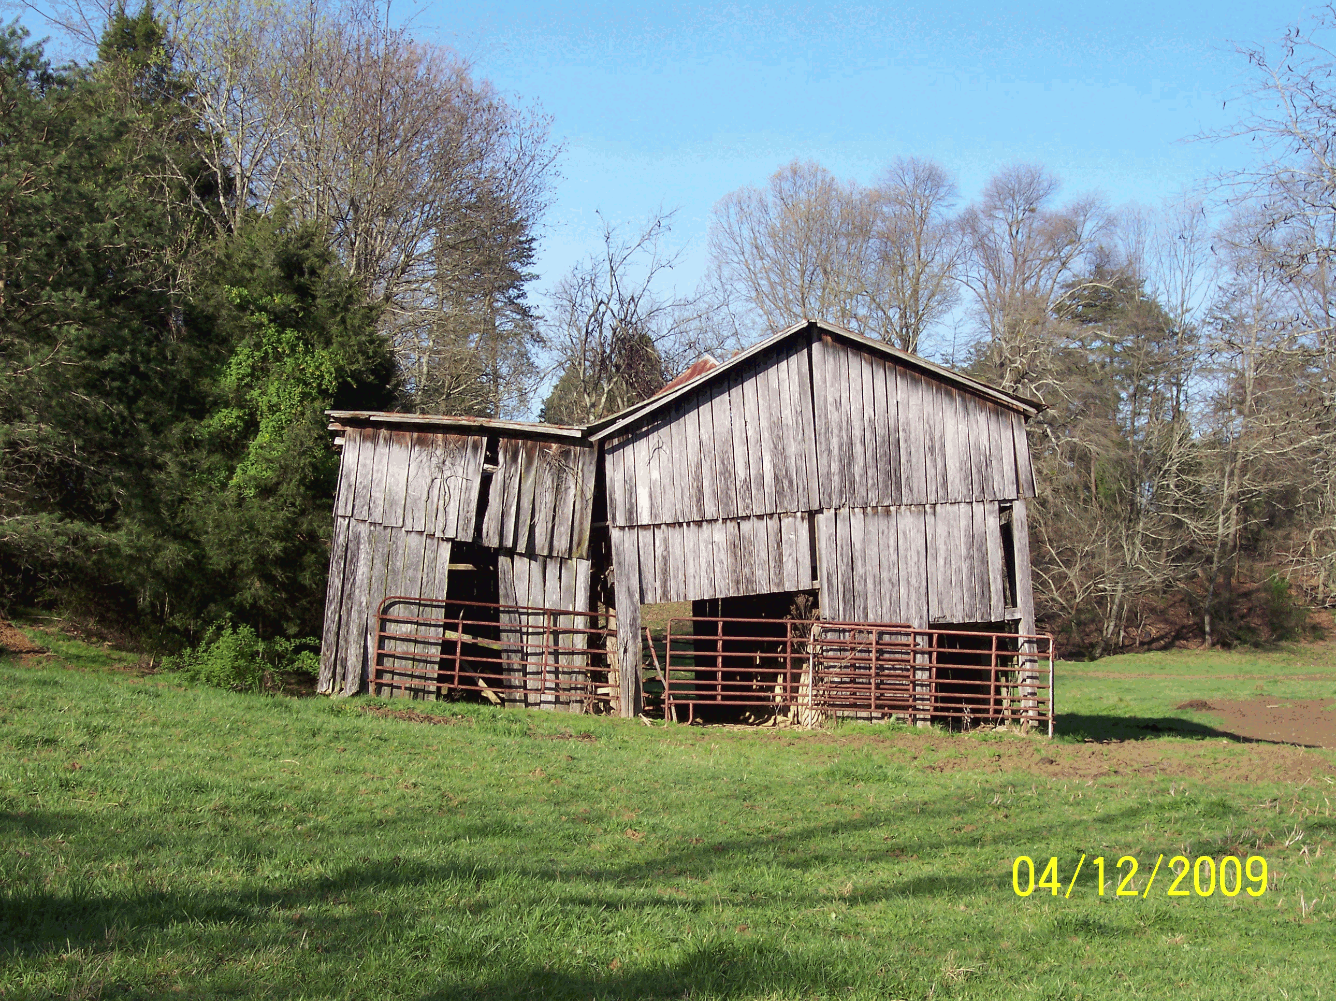
Data Sets for Graphic Files
Collection of separate graphic files:
Barn.gif
Winter.tiff
River.png
Oak.jpg
Also bmp
Eight files of each type
Can construct “dd disk image file”
Notes:
The test data we are using is a set of dd disk image files that might be created by capturing the unallocated space from the hard drive. The source data for the DD files is a set of 40 graphics files, five file types, eight files of each type. To avoid confusion I will try to refer to disk image files that you might get by acquiring a hard drive as dd files and picture image files as graphics files or by file type, like jpeg.

Slide 21
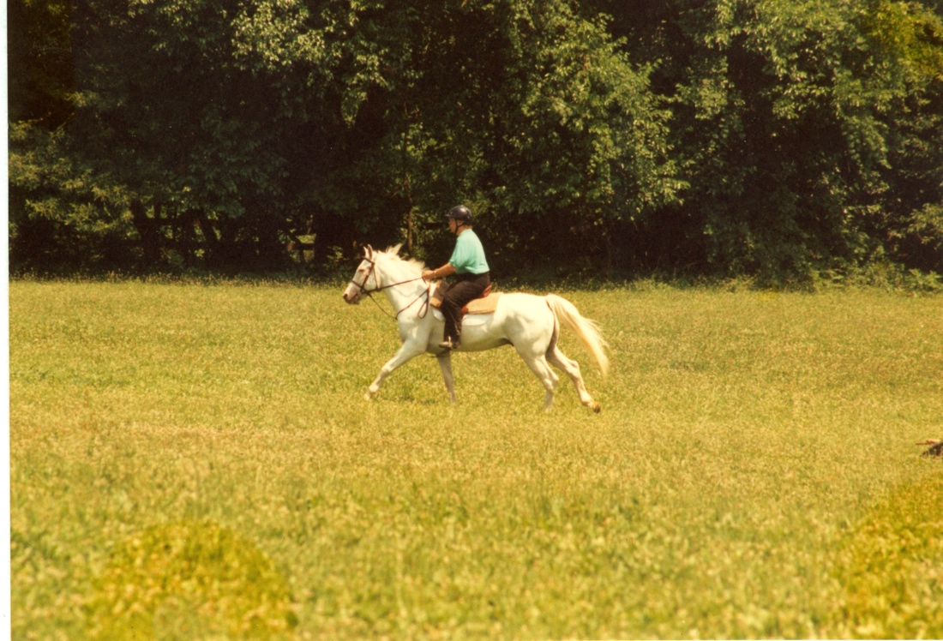
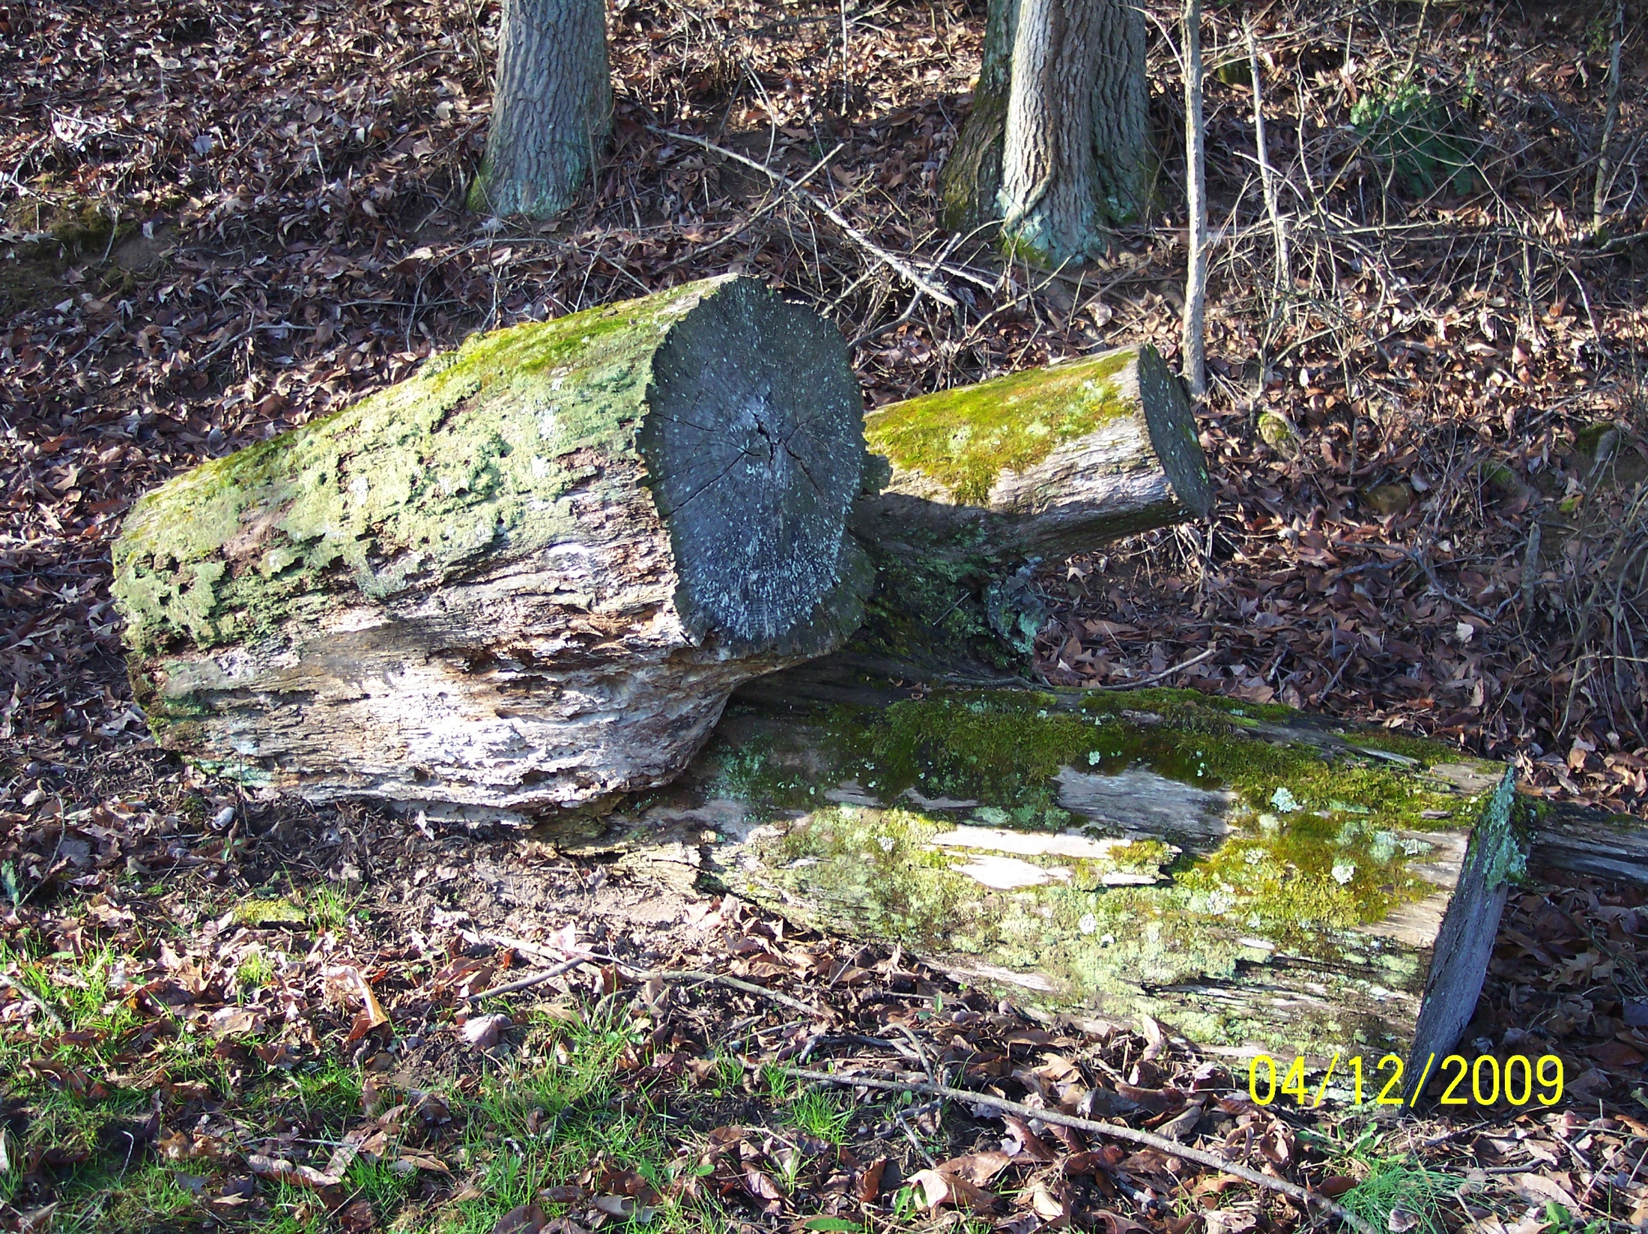
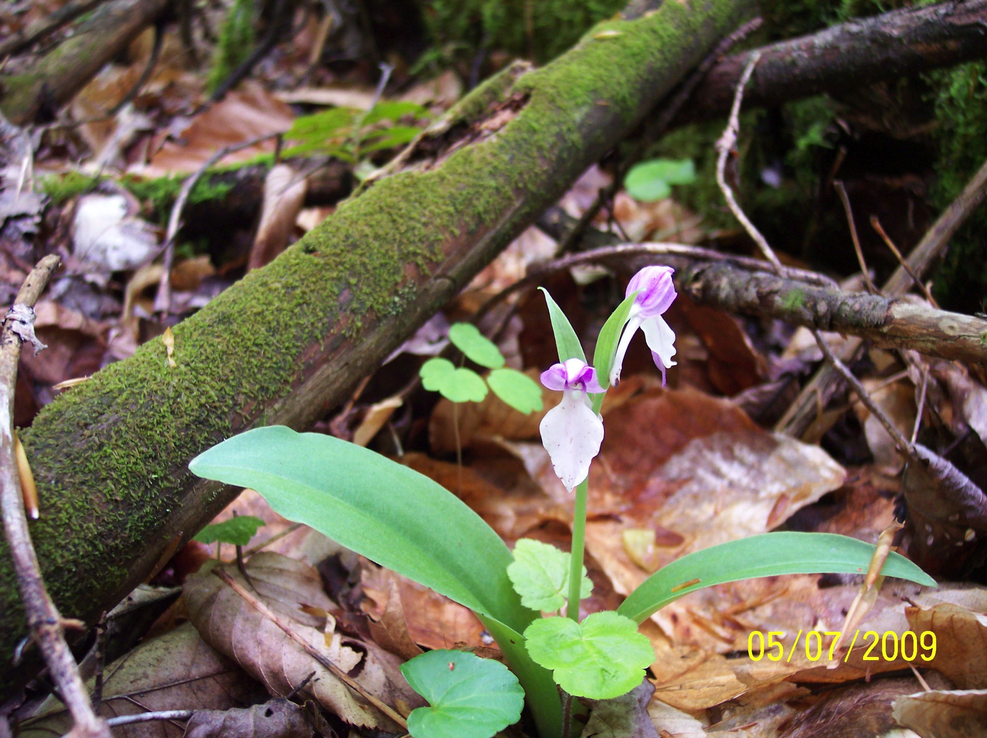
Base dd file – Complete & Contiguous Picture Files
dd
horse
orchid
Leaf
log
Zero fill to end of last sector
Notes:
We don't actually image unallocated space. What we really do is concatenate all 40 files together into one file and that is our first DD file. We also want to ensure that all files begin on a sector boundary. If the last sector doesn’t take up 512 bytes we add zero value bytes to make the file not have any file slack. This gives us a base image with complete contiguous files starting on sector boundaries that should be the easiest task for a file carver to work on.

Slide 22
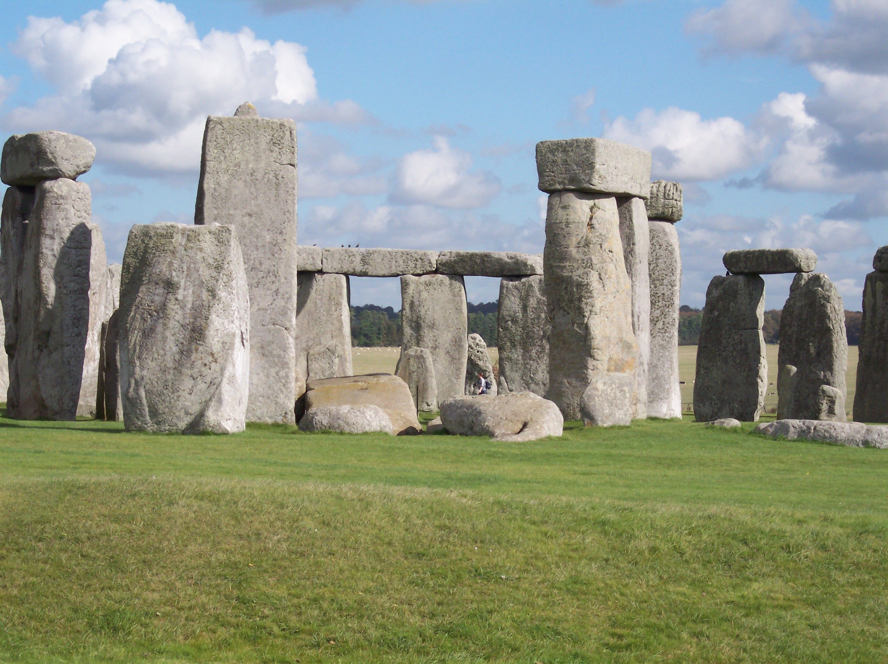
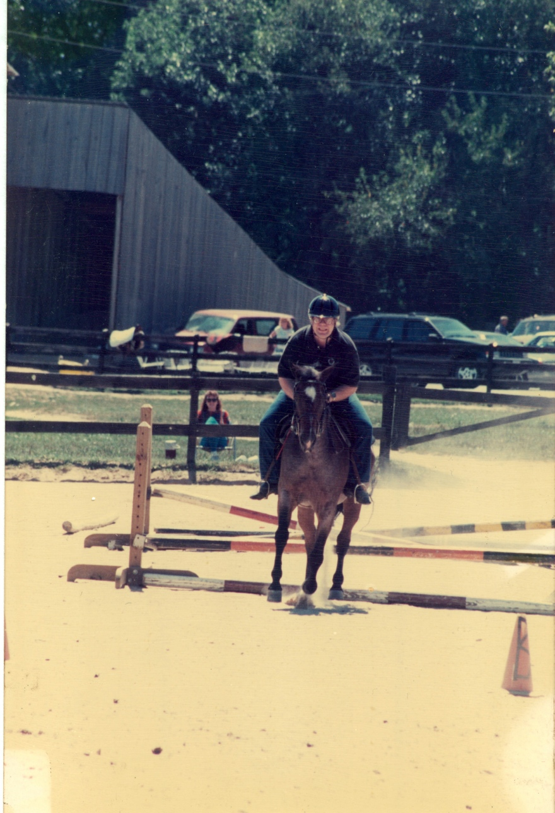
Constructing Other Images
Padded with cluster sized blocks of non-English text between pictures
Fragmented (in order)
美国
Ч
а
Й
سلام
美国
Other dd images
Fragmented (out of order)
Braided (two files intertwined)
Incomplete files
Non-aligned to sectors
Notes:
For other DD files we do the following: complete contiguous files with cluster size padding between each file. The content of the padding varies. Some padding is just zero bytes, other padding is random bytes, we also use text. Some of the text is English ASCII other text is foreign-language text and Unicode UTF-8 Unicode 16 ASCII upper bit standards for languages like Arabic and Russian and also text encoded in base 64 and uuencode.

Slide 23
Carving Test Images
Base -- no padding
Cluster Padded
Byte Shifted
Fragmented in order
Reorder fragments
Delete one fragment
Braid fragments from pair of files
Notes:
Here are our current image files. Starting with the base file of just images concatenated together. Then we have one image where the graphic files are separated as if there's other text files between. We separate the graphic files with cluster sized chunks. The second image has padding of just a few bytes so that the graphic file signatures are not aligned on sector boundaries. The other four images are variations on fragmentation and completeness.

Slide 24
Measuring Results
Two approaches –
Visibility driven – does the tool produce usable (viewable) results
Data driven – See what the tool actually does in relation to ground truth
Measure fraction of returned data that belongs
Measure fraction of possible data returned
Methods are complementary
Notes:
Now that we have our DD files we are ready to run some tests. We run the tool we want to test. We attach the DD test file we want to use. Then we see what the tool does. After the tool finishes carving we export all the files that are carved. So how do we measure what the tool has done? We know all the ground truth of what could be recovered and we have what was recovered so it is easy to look through the data and see if we miss anything or if we get something extra. But the practitioner really cares the most about if the tool produces visible graphic files that can be used as evidence. We use two measures of tool behavior. First we look at the visibility of the return files and second we look at the actual data returned so in addition to knowing how much we can see, we know how much data is actually returned and how much is missed.

Slide 25
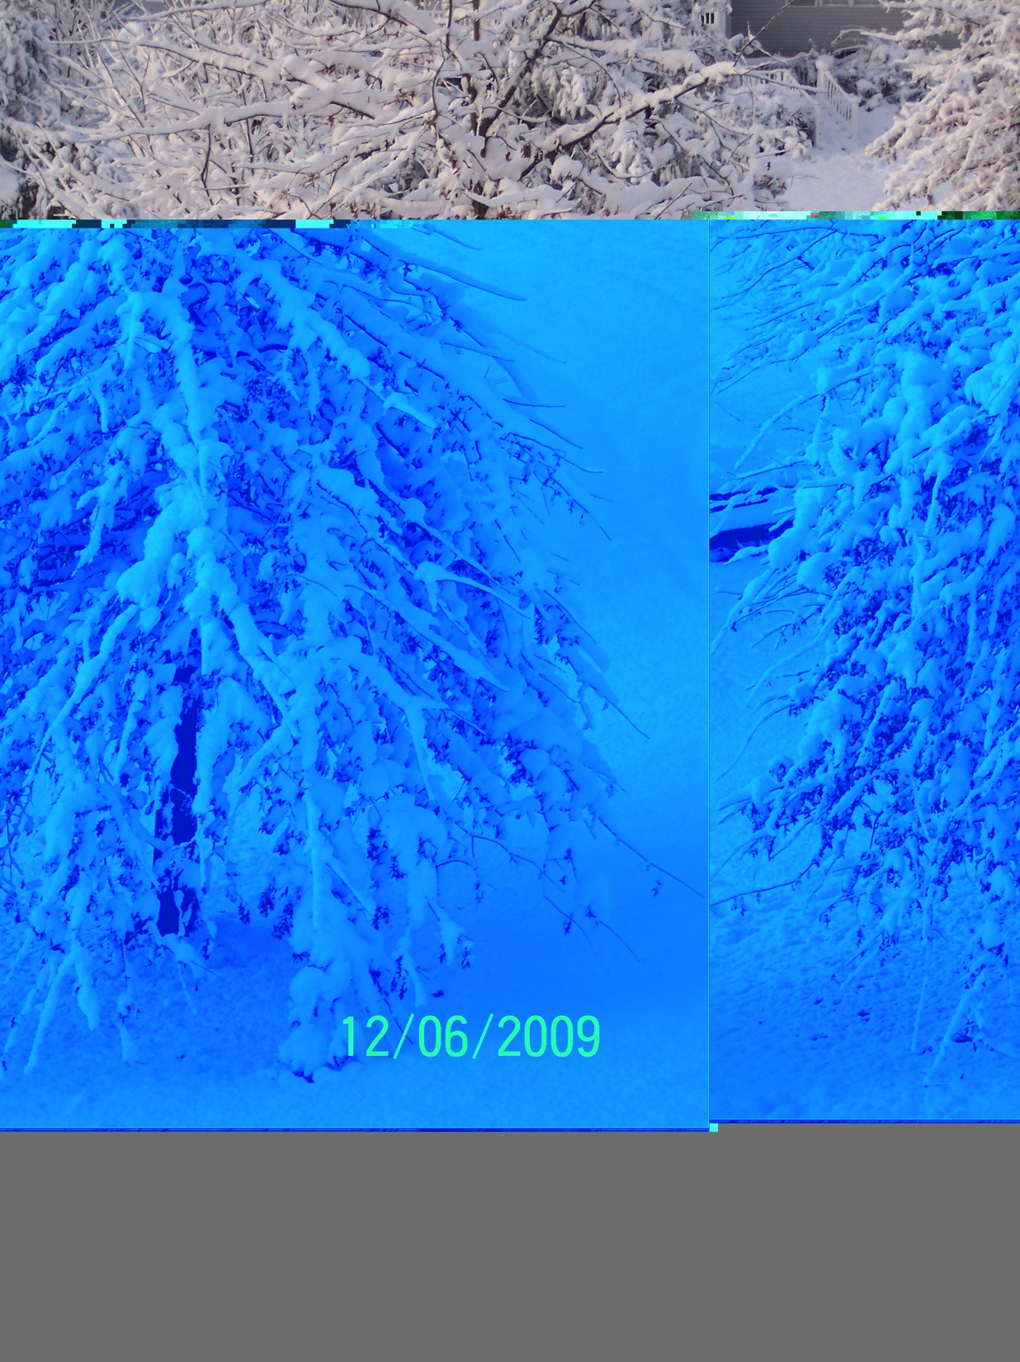
Visibility Driven Measurement
Each file checked for visibility by two independent observers
Resolve differences if disagreement
Category | Visibility
Viewable Complete | Flaws – minor or none
Viewable Incomplete | Flaws – partial, multiple files
Not viewable | Data matches file type, Flaw prevents display
False Positive | Data doesn’t match file type
Notes:
We thought of lots of ways to classify the visual results. We decided to go with a very simple classification of basically four categories. Did we get most of the file such that you can figure out what the file is. We call that visible complete. Sometimes we get a chunk of a graphic file and we can tell a little bit about the file but we don't see the whole picture. Third category is for files that we can't tell what it is or maybe it doesn't even display at all. The fourth category is for files that when we look at the file extension like a JPEG but then the content doesn't come from a JPEG file it's something else. The tool decided to declare this is a JPEG file even though it may be from a tiff file.

Slide 26
Data-driven Measurement
We know the ground truth
Based on sectors present in carved files and information retrieval based statistics – evaluate returned data
Relevant – sector comes from a source file in dd file
Retrieved – sector returned in a carved file
P = (relevant ∧ retrieved)/retrieved -- fraction of retrieved sectors from a source file -- how much noise returned
R = (relevant ∧ retrieved)/relevant – fraction of relevant sectors retrieved – how much stuff missed
F = 2 x (P x R)/(P + R) – average of P & R
Notes:
A data driven measure gives us a good idea about how much data is missed and how much stuff is actually noise coming from somewhere else that doesn't really belong in the graphic image file. I'm not going to say more on this but you can see it's based on information retrieval type metrics.

Slide 27
A Rabbit-hole of Interesting Behavior
One tool (A) recovered 8 tiff files from the unpadded dd file
F score for tiff files was 1.00
But, only one file was viewable, seven were not viewable
Examination of the eight files – last sector of tiff file replaced by noise in the carved file
That last sector is critical to having a displayable file
Other tools on same data –
Tool B Carved 4 with 3 viewable
Tool C Carved 10, none viewable
Tool D Carved 8, all viewable
Without both measures we wouldn’t know how close the tool was. Maybe an investigator can repair the file and extract a critical piece of evidence
Notes:
There are lots of rabbits that can be chased down. For the tool I’ll call A we noticed that for the data-driven measurement of tool behavior we got great results. our measure was 1.00 which pretty much means perfect behavior no noise all the data is recovered. But, only one file was viewable. Something’s interesting here, maybe we made a mistake. On a closer examination of what was returned it turned out that the last sector was missing from the TIF files. This is where having two complementary measures really helps. If we only looked at file visibility we would conclude of this tool doesn't give us anything. But after we looked at the data that was recovered and see the last sector is missing this gives us the potential for trying to repair that last sector or maybe go into the original file was carved from and manually pull out that last sector and attach it and then you got everything.
Three other tools gave rather mixed results I like tool D it looks like my favorite for carving TIF files.

Slide 28
Other Resources
www.SWGDE.org
CFTT & CFReDS:
www.cftt.nist.gov -- Test Requirements, Test Plans & Tool Test Reports
www.cfreds.nist.gov – Test Data Sets
UK Forensic Science Regulator:
https://www.gov.uk/government/organisations/forensic-science-regulator
https://www.gov.uk/government/publications/method-validation-in-digital-forensics
Notes:
Here are some places you can look for useful information. I assume everybody knows about SWGDE since there are so many members here. The CFTT website has requirements test plans and test reports for everything we have tested. The CFReDS website has some test data sets that are interesting and the final carving test data sets that I talked about are there. The UK forensic science regulator has lots of good thoughtful information on a variety of topics including tool validation. Actually they focus on validating the method not just a tool.

Slide 29
Summary
Most tasks not likely to have an error rate (except for some tasks like matching)
Even if you have an error rate it can be misleading or obsolete
Use tool testing to uncover tool limitations
Work from a list of requirements
Design Test Data to try to get the tool to fail sidetracked
Look at SWGDE ”Error Mitigation Document” for guidance on reporting on tool limitations
Notes:
Don’t get distracted trying to come up with an error rate. The key to testing is start with a list of requirements. Otherwise you’re just throwing spaghetti at the wall. Remember your test data should be designed to make the tool mess up. If an idea comes to you in the night of I bet this tool of mine would really freak out if it had to do this, write that down it’s going to be a good test case

Slide 30
Contacts
Jim Lyle JLYLE@NIST.GOV | Rick Ayers RICHARD.AYERS@NIST.GOV
Barbara Guttman BARBARA.GUTTMAN@NIST.GOV
http://www.cfreds.nist.gov | Test Data Sets
http://www.cftt.nist.gov | Test Reports
Notes:
Thank you guys. Questions?

