Slide 1
Conformance, Interoperability, and Testing of Healthcare IT Standards: An overview of conformance, specification development, testing strategies, and tools
Flinder’s University, Adelaide Australia
February 11th, 2020
Robert Snelick, NIST

Slide 2
NIST
U.S. Federal Agency under the Dept. of Commerce—”Standards and Measurement”
Developed the conformance test method (test procedures, test data, and test tools) for ONC 2011, 2014, and 2015 Edition certification
Developed conformance test tools for CDC, IHE, HL7, ONC, AIRA, ISDS, HIMSS, …)
Supports SDOs via guidance; and assessment and certification programs via tools, but does not perform certification

Slide 3
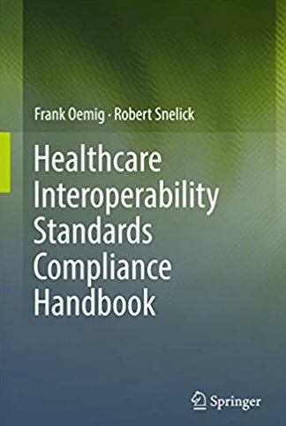
Speaker
Robert Snelick
Project Manager and System Architect - National Institute of Standards and Technology (NIST)
Co-chair – HL7 Conformance Working Group
Architect and lead of the NIST Testing Infrastructure for conformance test tools including those for the CDC, IHE, and ONC Certification
Co-author – Healthcare Interoperability Standards Compliance Handbook, Springer 2016
robert.snelick@nist.gov

Slide 4
Outline
Standards and Interoperability
Fundamental Concepts
Implementation Guides and Profiling
Conformance and Interoperability Testing
NIST HL7 v2 Tooling Platform Overview
Medical Device Profile and Testing

Slide 5
Standards and Interoperability

Slide 6
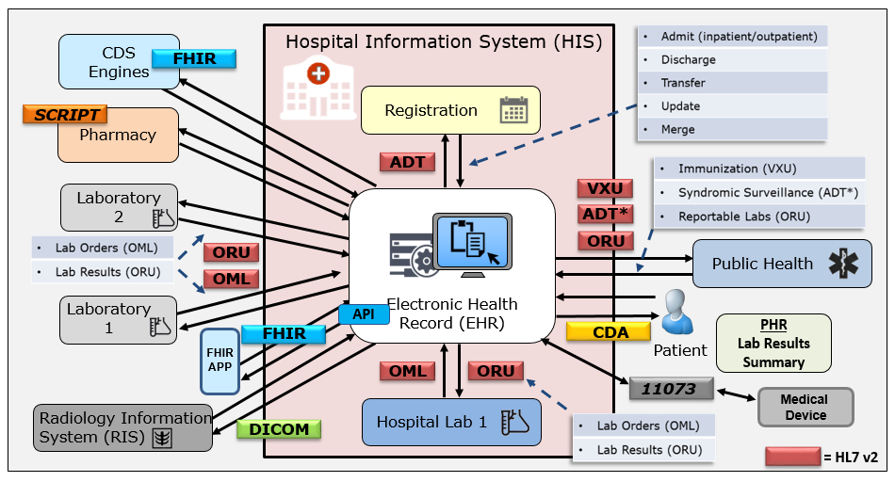
Standards Landscape
Variety and volume of data exchange is daunting
100s of million of exchanges performed in single a organization per year
Provide a common language and set of expectations that enable interoperability
Fundamental building blocks for developing and deploying technology products
Establish consistent protocols that can be universally understood and adopted
Allow for systems to be verified—thus offering credibility
Give customers a choice, thus enabling competition
Notes:
I show this slide to illustrate the complexity many Health IT systems need to contend with. Systems needs to communicate with many different systems using different standards. These standards include v2 messaging, Clinical Documents Architecture (CDA), 11073 for devices, and more recently FHIR. It is important that there is a common understanding of the data that is being exchanged. Standards and information models playa critical role to data understanding.
IMPORTANT POINT FOR TUTORIAL GOAL: Implementers will have to deal with many standards and will have to map from one standard to another. So understanding the differences in the conformance constructs across the standards is important for achieving this.
Healthcare delivery systems employ many different information systems from different vendors, both within a single organization and across multiple organizations using different standards—there is a need exchange and use data seamlessly.

Slide 7
Why do we need Standards?
Combinatorial explosion of the number of interfaces needed
The more interconnected systems, the greater the benefit of using standards
Multiple point-to-point non-standard solution
Single standard solution
But can we really get a “one-size” fits all standard?
In most cases, NO, but we can significantly reduce the number of translations needed and site-specific details
If standards are underspecified or not specific, there can be multiple interpretations of the standard—which pushes us back to where we started
Conformance, profiling, and precise documentation puts us back on track
Diagram Source: Numerous HL7 publications (adapted)
Notes:
Without standards we are forced into to many point-to-point custom solutions. With standards we can reduced the number of interfaces significantly.
Formula: I = (N^2-N)/2 N= systems, I = interfaces N=6 → I = ((6*6)-6)/2 = 15

Slide 8
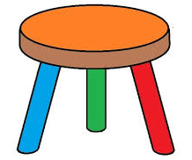
Foundation for Interoperability
Well-defined Standards
Testing
Implementation
Standards Development Lifecycle
Standards
Testing
Implementation
HIT Interoperability
Implementation
Well-defined Standards
Conformance Testing
Notes:
“well-defined standards” → having and using conformance constructs correctly.
Single method to specify a requirements
Computable
Requirements specific for use case
Codes that are only relevant for use case
MORE…..
Standards must be created and adopted
Not just standards, but well-defined standards (they must be understandable)
Standards must be specific (profiled for use)
Standards should/must be represented in a computable format
Send good acknowledgements
Implementations must be tested for conformance
Systems must be tested for interoperability

Slide 9
Failure happens when:
One or more components are omitted or are not sufficient
Standards
Testing
Implementation
HIT
ability
Inter
oper
Implementation
Well-defined Standards
X
Conformance Testing

Slide 10
Lessons Learned: Standards
Ambiguous
Inadequate investment
Not specific enough for use cases
Lack of verification (Implementations and Testing)
Not written to a desired state
Complex
Evolving
Timeliness
Not complete
Too many
Impact
Standards Investment
Notes:
Ambiguous—a factor is that standards are written natural languages
Evolving—new versions, like, IHE for some every year. Some terminologies constantly changed.
Because they are consensus based, often will be written to a current—inadequate state, not to a desired state—I’ve actually standard include multiple solutions because of competing vendors products implemented a capability differently.
HL7 v2 IGs, but different
Ambiguous
Not the responsibility of testers to fill in the gaps—testers can and should request clarification, SDO needs to respond
Is FHIR heading in same direction?
The use of APIs and RESTful services in FHIR is a powerful paradigm, but it does not and cant not mask the inherent complexity in healthcare data exchange. We must still pay attention to how we specify requirements in FHIR, we can’t make the same mistakes we have made in the past, or we will only make incremental change instead of transformative change.
Under specified
Multiple solutions
Conflation of requirements (requirement scoping)
Document current state—not desired state
Not specific enough—e.g., code system binding
Too specific
Poor documentation and typos
Lack of a consistency
Incomplete Use Cases
Absence of harmonized requirement specification methodology
Insufficient requirement specification mechanisms
Lack of reference and pilot implementations
Lack of testing
Improper scoping

Slide 11
Ambiguous Specifications
Either the usage of ‘CE’ is incorrect or condition predicate of “required” is incorrect.
Conflict: Condition Predicates “Required (R)” Usage, but usage is CE.
If XON.10 (Organization Identifier) is valued.
Missing Condition Predicate for “Lab Result Sender” Profile
If XON.10 (Organization Identifier) is valued.
Unconstrained value set, HL7 Table 0203 (which codes actually apply?). Most likely only a few of the 100+ given in table 0203. Can local codes be added? Is the table static or dynamic?
Better
Always provide an explicit condition predicate for conditional usage
Provide consistent condition predicate specification
Provide explicit condition usage, e.g., C(R/X). Capability added in HL7 v2.7.1
Don’t conflate condition predicate with usage requirements e.g., “required if …” (i.e., be direct to what the condition predicate is)
Provide explicit value set binding and definition
Notes:
Source HL7 v2 ELR Feb. 2010 (Used in ONC 2014 and 2015 Edition Certification Testing)
NIST with CDC and AHPL created 42 page clarification document so that adequate testing could be performed.
Don’t want to be too critical of SDOs, but we need clear and concise requirements. If implementers don’t interpret the requirements in the same way, interoperability is hindered.
Implementers need to invest time and effort to ensure better specifications, make sure they participate in ballots and demand clear and concise requirements.
Better understanding of the conformance, how to write requirements, more powerful conformance constructs can aid in this effort. This is the main point to pointing out the poor specifications.

Slide 12
Lessons Learned: Realities of Testing
Bound to the quality of the standards
Tolerance for comprehensiveness
Time
Budgets
Inadequate Investments
What to Test?
Boundless instances
Adequate test coverage
What are the priorities?
Test Cases (Value is providing use examples)
Realistic
Data
“Getting it right”
Impact
Testing Investment
Notes:
Computability

Slide 13
Fundamental Concepts

Slide 14
Fundamental Terms
Conformance
Interoperability
Compliance
Compatibility
Alert: Not everyone will agree on these definitions
Alert: Some use these terms interchangeably
Alert: Terms are overloaded in use

Slide 15
Conformance
Defined as the fulfillment of a product, process, or service of specified requirements [1,2].
The concept of conformance is essential to any standard for providing an objective measure of how closely implementations satisfy the requirements defined in the standard [1,2].
Specification
Does the system implement the requirements as stated in the specification?
Conformance
Implementation
[1] ISO Reference - ISO/IEC 17000 Conformity assessment - Vocabulary and general principles, first edition 2004-11-02.
[2] Glossary of Conformance Terminology, Interoperability and Conformance Technical Committee, OASIS. http://www.oasis-open.org/committees/ioc/glossary.htm
Notes:
Conformance is determined based on a claim of conformance to a particular specification (which can be a national implementation guide or a local specification).

Slide 16
Interoperability
“is the ability of two or more systems or components to exchange information and to use the information that has been exchanged.” [1]
Two Key Parts:
1) information must be exchanged, which refers to the technical/functional/syntactical characteristic;
2) but the more important part is the correct semantic interpretation allowing for use of the exchanged information [2].
Implementation
Implementation
Interoperability
Can two interconnected systems exchange data and use that data to perform a business function as both intended?
[1] [IEEE-1990] Institute of Electrical and Electronics Engineers. IEEE Standard Computer Dictionary: A Compilation of IEEE Standard Computer Glossaries. New York, NY: 1990.
[2] Benson T. Principles of Health Interoperability HL7 and SNOMED. Health Informatics Series, Springer-Verlag, London Limited 2010.

Slide 17
Compliance
Is the degree to which a derived specification adheres to the requirements defined in the foundational specification (standard)
In other words, are the rules for adding constraints or extending the specification faithfully followed
Specification
Does a derived specification apply constraints to a base specification in accordance to the constraint model?
Compliance
Derived Specification
Notes:
That is, is the derived specification a proper set of requirements on the base specification (If an element is Required in the base, a derived specification can’t change it to Optional and be considered compliant).
Compliance is often a term used in place of conformance—hard to argue that it is wrong, conformance is the better term for describing if systems implement requirements and we will put a stake in the ground and use these terms as defined here. We will use ISO’s definition of conformance.
In order to determine conformance of a system, complete documentation is necessary. This however is often not the case. Compliance of the complete documentation of the interface can be assessed with the higher level profile. Missing documentation hinders conformance and compliance assessment.

Slide 18
Compatibility
Declares whether two specifications define sets of requirements that are harmonized with each other, allowing systems that implement them to work together, i.e., interoperate
Compatibility is a prerequisite for interoperability
Specification
Compatibility
Specification
Do the specifications define a set of harmonized requirements?
Notes:
Compatibility is a concept that is determined from the receiver perspective. The receiver is the “party” that needs to perform a certain function with the data received. If data is not available to perform a function then the sending/receiving pair is non-compatible. Compatibility is a pre-requisite for interoperability. More on this topic later in this tutorial.

Slide 19
Relationships
Specification
Compliance
Derived
Specification
Compatibility
Derived
Specification
Conformance
Implementation
Implementation
Interoperability
Source: F. Oemig, R. Snelick [2016]
2/10/2020
Notes:
Key Terms (white boxes) as they related to specifications and implementations (rose boxes).
Specification is the standard that contain the requirements. Specifications can be profiled (i.e., constrained further) to meet the needs of a refined use case. The result is a derived specification.
Specifications are implemented.

Slide 20
How is Profiling Related?
We must profile in a consistent manner using “rich” conformance constructs.
Profiling
Profiling
Specification
Compliance
Derived
Specification
Compatibility
Derived
Specification
Conformance
Implementation
Implementation
Interoperability
Source: F. Oemig, R. Snelick [2016]
2/10/2020
Notes:
Profiling: Refinements of the standard via constraints and extension.
NOTE: Can implement to the same profiled standard (which is often the goal when the same expectations are the same for sender and receiver).
NOTE 2: A derived specification is a profile, but documentation of an interface is also considered a “derived specification”.

Slide 21
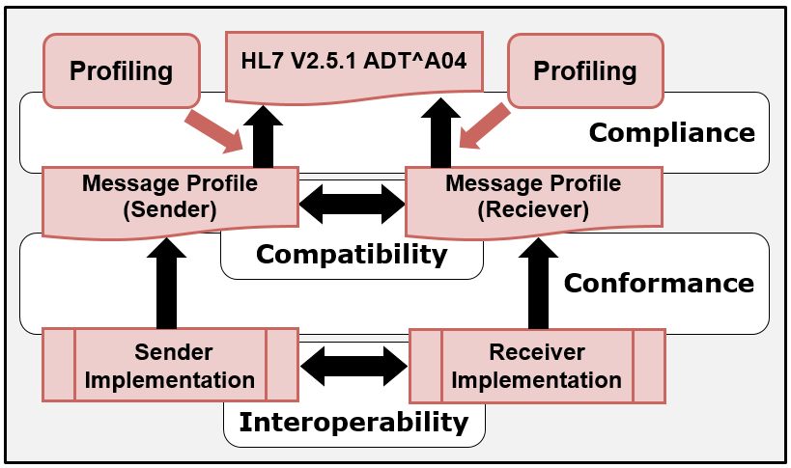
In the Context of HL7 v2
2/10/2020
Notes:
Profiling: Refinements of the standard via constraints and extension.
NOTE: Can implement to the same profiled standard (which is often the goal when the same expectations are the same for sender and receiver).
NOTE 2: A derived specification is a profile, but documentation of an interface is also considered a “derived specification”.

Slide 22
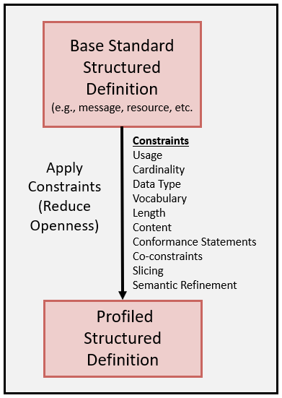
Profiling Overview
The base standard is a framework that contains many templates (starting point) that is intended to be constrained for a specific use and context.
Allows implementers to document an agreed-upon subset of the standard, and thus arrive at a common interpretation
Conformance Constructs provides the mechanisms to constraint in a consistent manner
2/10/2020

Slide 23
Layers of Interoperability
Organizational Interoperability
Standardized process (workflow) elements using business process modeling tools
Can we accomplish the clinical task? What we want!
Semantic Interoperability
Standardized meaning (model elements) and terms/vocabulary for data interpretation, e.g., LOINC, ICD-10CM
Common information model—an understanding
Syntactic Interoperability
Standardized data exchange formats, e.g., HL7 v2, CDA, XML
Domain independent data exchange—processing of the data at these level is agnostic to the meaning of the data
Structural Interoperability
Simple EDI, envelopes
Technical Interoperability
Signals using standard protocols for technically secure data transfer, e.g., TCP/IP
Standards
Standards provide the foundation for each layer
What’s important about the data exchange is how it is used in the clinical setting to affect care, change and automate processing workflow.
Interoperability Levels: Blobel B. Introduction into Advanced eHealth – The Personal Health Challenge (Adapted).
2/10/2020
Notes:
This is a common diagram (others are equally valid). The grouping of the interoperability layers will vary depending on perspective. The lower levels are taken more or less for granted.
Standards are necessary at each layer—the higher we go up the more complex we get; thus the harder it is to achieve “automated” interoperability.

Slide 24
Implementation Guides and Profiling
Conformance Constructs for Applying Constraints

Slide 25
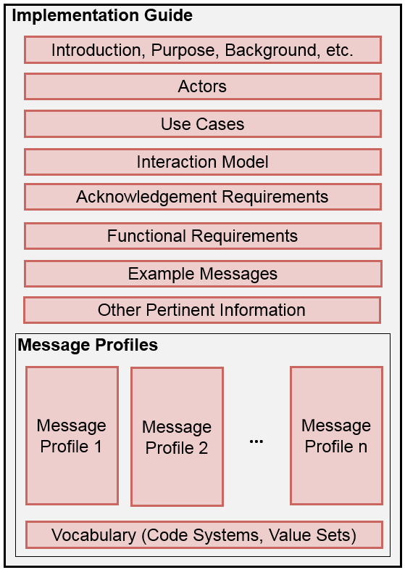
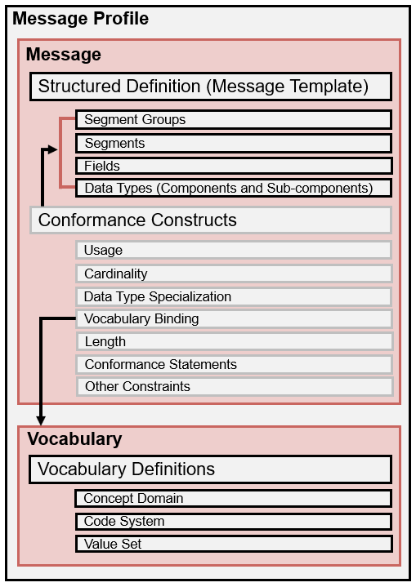
HL7 v2 Implementation Guide and Message Profiles

Slide 26
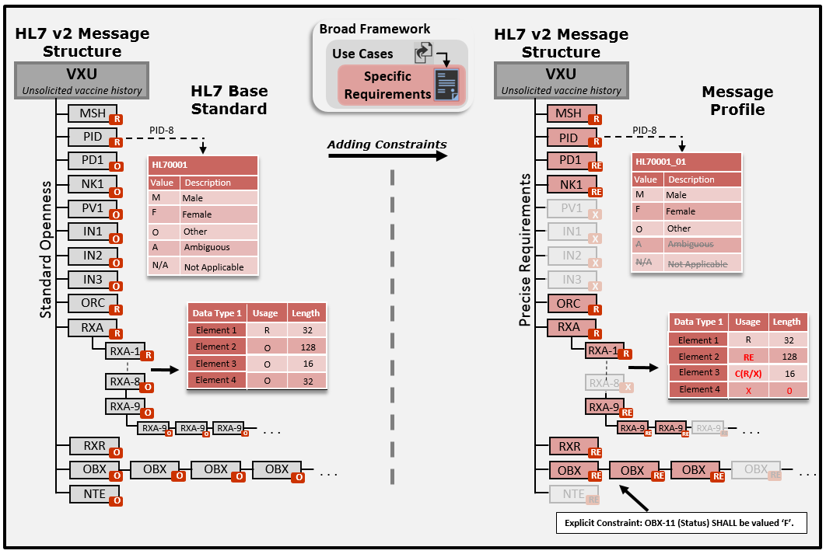
HL7 v2 Profiling Big Picture
2/10/2020

Slide 27
Conformance Constructs
A means in which to formally, unambiguously, and consistently define requirements (constraints)
Constructs provide a formal (“structured”) mechanism for specifying requirements
Provides a shorthand notation for expressing explicit statements of requirements
Key mechanism used for constraining a standard for a specific use case (= profiling)
The “richness” of conformance constructs varies across standards—v2 has a “rich” set
Notes:
For example, HL7 v2 has a very rich set of conformance constructs that allow for precise definition (although often they are not used to their full capacity in many implementation guides. On the other hand, NCPDP SCRIPT provides a limited set of conformance constructs.

Slide 28
Conformance Constructs Unraveled
SEQ | Element | Data Type | Usage | Card. | Value Set | Binding Strength | Comment
…
PID-8 | Adminis­trative Sex | IS | R | [1..1] | HL70001 | Required | For Room Assignmt
PID-9 | Patient Alias |  | X
PID-10 | Race | CWE | RE | [0..*] | HL70005 | Required | Patient’s Race
…
PID-8 Row Explicit List of Requirements
HL7 v2 Example for Sender
PID-8 (Administrative Sex) SHALL be used to communicate information about the administrative gender of the patient. [Data Semantics]
PID-8 (Administrative Sex) SHALL use the data type IS. [Structure] (i.e., a simple coded element)
PID-8 (Administrative Sex) SHALL be implemented (supported). [Usage]
A value for PID-8 (Administrative Sex) SHALL be present. [Usage]
One and only one instance of PID-8 (Administrative Sex) SHALL be supported. [Cardinality]
One and only one instance of PID-8 (Administrative Sex) SHALL be present. [Cardinality]
The implementation SHALL support all codes (concepts) in the HL70001 value set specification. [Value Set]
The implementation SHALL support only the codes (concepts) in the HL70001 value set specification*. [Value Set]
PID-8 (Administrative Sex) SHALL be valued with a code in the HL70001 value set. [Value Set]
Which do you prefer?
* Value Set assumed to be Closed and Static
Notes:
This slide is from the sender’s perspective.
Additional text is provided in the standard that describes the concept being conveyed by the element. Moreover, the implied requirement for the application is to support the concept of Administrative Gender (as a pre-condition), which is typically agnostic to the interface specification.
We assume that the value set specification indicates these requirements. Unfortunately, too often seen in practice value set specifications in implementation guides are underspecified and/or ambiguous.
Some liberties are taken here with this slide, v2 formally doesn’t have binding strength and this probably equates to more requirements than listed—but it is to convey the idea.

Slide 29
Conformance Constructs
Construct | Definition | Examples
Usage | Indicates requirements for element support and presence | Mandatory (M) Required (R)
Cardinality | Indicates the number of occurrences for an element by specifying the minimum and maximum bounds | [0..1] [1..1] [1..*]
Structure | Indicates the element structure and, at the primitive level, the type of data it may contain | NM-Numeric (v2) AD-Address (CDA) HumanName (FHIR)
Content | Indicates allowable values of an element | Value Set Fixed
Length | Indicates the number of characters(not bytes) that may be present in one occurrence of an element | [40] [3..5] [1..256]
Notes:
Data Types: NM (HL7 v2) and primitive, AD (CDA), and HumanName (FHIR).
NOTE: for length, it is the number of characters, not the number of bytes it takes to represent the data.

Slide 30
Profiling/Constraint Examples
Element Usage
Optional → Required (v2) [Support + Presence]
Optional → Capable (of supporting)
Restrict the content of a data element
Bind to a given set of code (concepts)
Address Type {H, M, O} → Data Element
Vaccine Codes (85, 88, 101, 102, 111, etc.)
Set the minimum and maximum numbers of times a data element may or must appear
[0..*] → [1..5]
Notes:
For example, HL7 v2 has a very rich set of conformance constructs that allow for precise definition (although often they are not used to their full capacity in many implementation guides. On the other hand, NCPDP SCRIPT provides a limited set of conformance constructs.

Slide 31
Support and must be Present
Implementation must support the element
Element must be present in the instance
Allowance for null-flavors (e.g. UNKNOWN) depends on the standard
HL7 v2
HL7 V3 and CDA
HL7 FHIR
NCPDP SCRIPT
ebXML
Support and Presence Usage
Required (R)
Mandatory (M)
Minimum Card. >= 1 & Must Support = true
Mandatory (M)
Required (R)
Element must be valued, but coded elements may include a null-flavor if the element is bound to a value set with null-flavors
Element must be valued; null-flavors are not-allowed OR Required (R), Minimum Cardinality = 1, and null-flavors allowed
Support and presence for an element is controlled by Cardinality (>= 1) and mustSupport = true
Element must be valued; no mention of null-flavors
Element must be valued; no mention of null-flavors

Slide 32
Vocabulary Relationships
Concept Domain
Code System
Value Set
Vocabulary
Postal Codes
US ZIP Codes
State of Alaska ZIP Codes
A specific set of codes is given for generally a broader use case. All US ZIP codes. Code → 15846 Concept → ZIP code for Kersey, PA
No specific codes given; the semantics of the concept is given. General postal code concept—the specifics are not given—could be for US, Germany, Canada, etc.
A specific set of codes is given for generally a specific use case. All Alaska ZIP codes. Code → 99829 Concept → ZIP code for Hoonah, AK
Levels of specificity and use—tied to specificity of the specification
Any levels can be bound to a data element
Profiling adds constraints which further defines the semantics of the bound data element
Notes:
Why you need profiling.
Note, US Postal code system could also be a value set.

Slide 33
Creating Value Sets
A value set “draws” codes from the code system for a specific use.
Code System
LOINC Code System
Code | Concept
… | …
27129-6 | Lead in Red Blood Cells
5671-3 | Lead in Blood
10368-9 | Lead in Capillary Blood
30424-6 | Macrocytes in Blood
19123-9 | Magnesium (Methodless)
… | …
30963-3 | Vaccine funding source
30956-7 | Vaccine type
38890-0 | Component vaccine type
31044-1 | Reaction
59785-6 | Indications to immunize
69764-9 | Document type
30979-9 | Vaccines due next
59781-5 | Dose validity
… | …
Pick only codes that are relevant for the use case and for the specific data element it is bound to
Value Set
NIP Observation Identifiers Value Set
Code | Concept | Code System
30963-3 | Vaccine funding source | LN
30956-7 | Vaccine type | LN
38890-0 | Component vaccine type | LN
31044-1 | Reaction | LN
59785-6 | Indications to immunize | LN
69764-9 | Document type | LN
30979-9 | Vaccines due next | LN
59781-5 | Dose validity | LN
NIP=National Immunization Program
Notes:
Note, description of LOINC code have been shorten for readability.
Value Set and Code System is referring to the entire table; Concept Domain is referring to the “NIP …” only.

Slide 34
Segment Level Profiling
RXA_IZ_01
SEQ | ELEMENT NAME | Data Type | Usage | Card. | Vocab | B.Str | LEN | C.L
1 | Give Sub-ID Counter | NM | R | 1..1 |  |  |  | 1
2 | Administration Sub-ID Counter | NM | R | 1..1 |  |  |  | 1
3 | Date/Time Start of Administration | DTM_IZ02 | R | 1..1
4 | Date/Time End of Administration | DTM_IZ02 | R | 1..1
5 | Administered Code | CWE_IZ01 | R | 1..1 | CVX_01 | R
6 | Administered Amount | NM | R | 1..1 |  |  | 1..16
7 | Administered Units | CWE_IZ01 | C(R/X) | 0..1 | UCUM_01 | R
8 | Administered Dosage Form | CWE | O | 0..1
9 | Administration Notes | CWE_IZ01 | C(R/O) | 0..1 | NIP001_01 | R
10 | Administering Provider | XCN_IZ01 | C(RE/O) | 0..1
11 | Administered-at Location |  | X | 0..0 |  |  | 0..0
12 | Administered Per (Time Unit) | ST | C | 0..1
13 | Administered Strength | NM | O | 0..1
14 | Administered Strength Units | CWE | O | 0..1 | 9999 | S
15 | Substance Lot Number | ST | C(R/O) | 0..* |  |  |  | 20=
16 | Substance Expiration Date | DTM_IZ03 | C(RE/O) | 0..1
17 | Substance Manufacturer Name | CWE_IZ01 | C(R/O) | 0..1 | MVX | R
18 | Substance/Treatment Refusal Reason | CWE_IZ01 | C(R/X) | 0..* | 9999 | R
19 | Indication | CWE | O | 0..1 | 9999 | S
20 | Completion Status | ID | RE | 0..1 | 0322 | R | 2..2
21 | Action Code – RXA | ID | C(R/X) | 0..1 | 0206 | R | 1..1
… | … | … | … | … | … |  | … | …

Slide 35
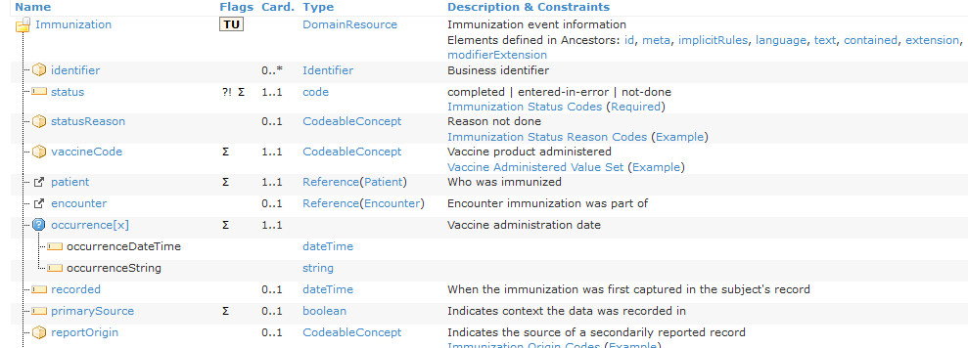
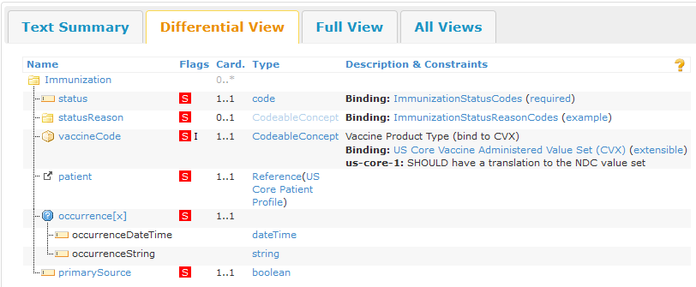
HL7 FHIR Profiling Overview
An explicit binding to a code system was made (CVX) with a binding strength of “extensible”.
Cardinality changed from 0..1 to 1..1
2/10/2020

Slide 36
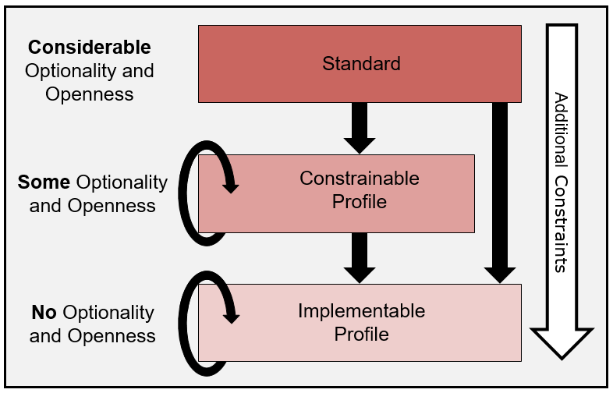
Basic Profile-Level Hierarchy
2/10/2020

Slide 37
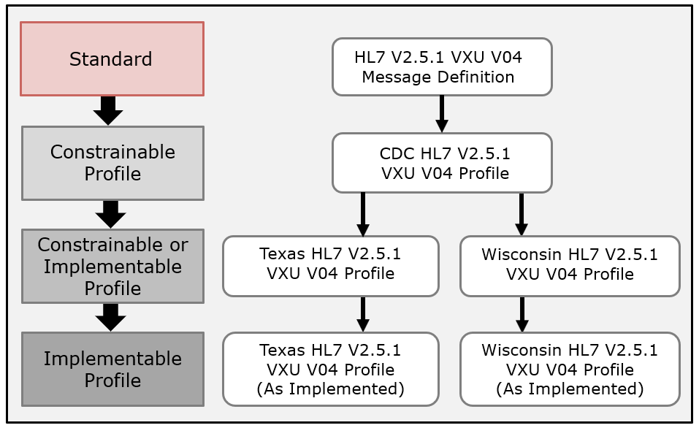
U.S. Immunization Profiles
2/10/2020

Slide 38
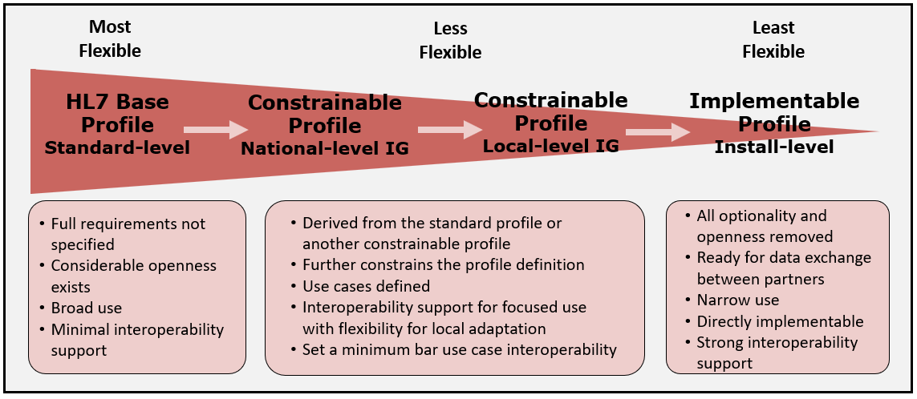
Profile Spectrum
Notes:
These are the common terms that we will start with. More will be added as we move along.

Slide 39
Conformance and Interoperability Testing

Slide 40
Testing Overview
Conformance Testing
Degree of confidence
Can’t be proven
Interoperability Testing
Two “conformant” systems doesn’t guarantee interoperability
Huge test space
Specification
Conformance
Implementation
Implementation
Implementation
Interoperability

Slide 41
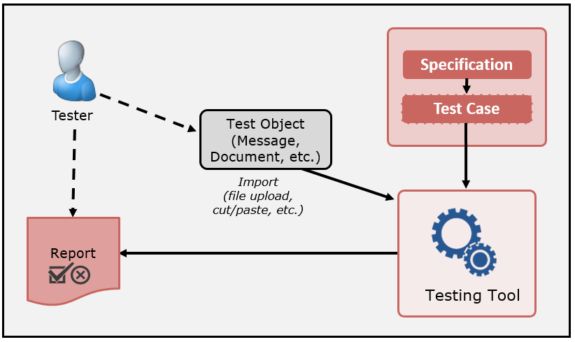
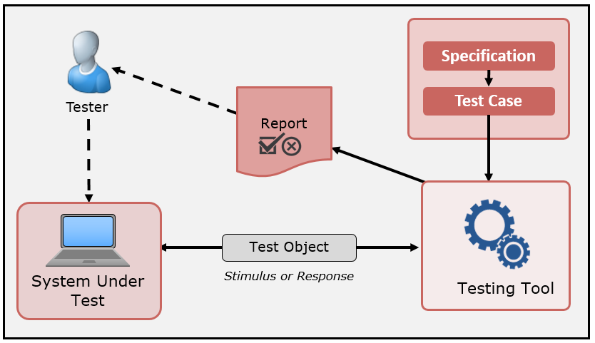
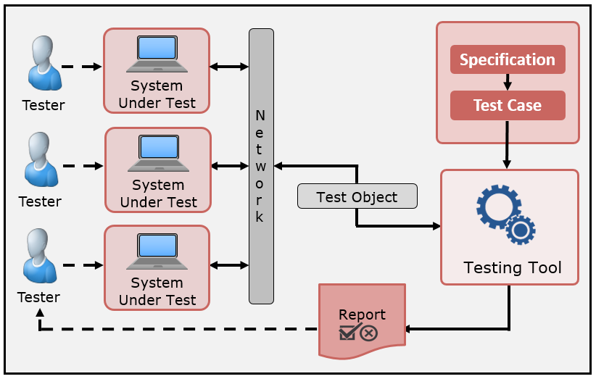
Testing Models
Data Instance Testing
Object ↔ Requirements
Conformance Testing
Isolated System Testing
System ↔ Requirements
Conformance Testing
Peer-to-peer System Testing
System ↔ Requirements ↔ System
Interoperability Testing

Slide 42
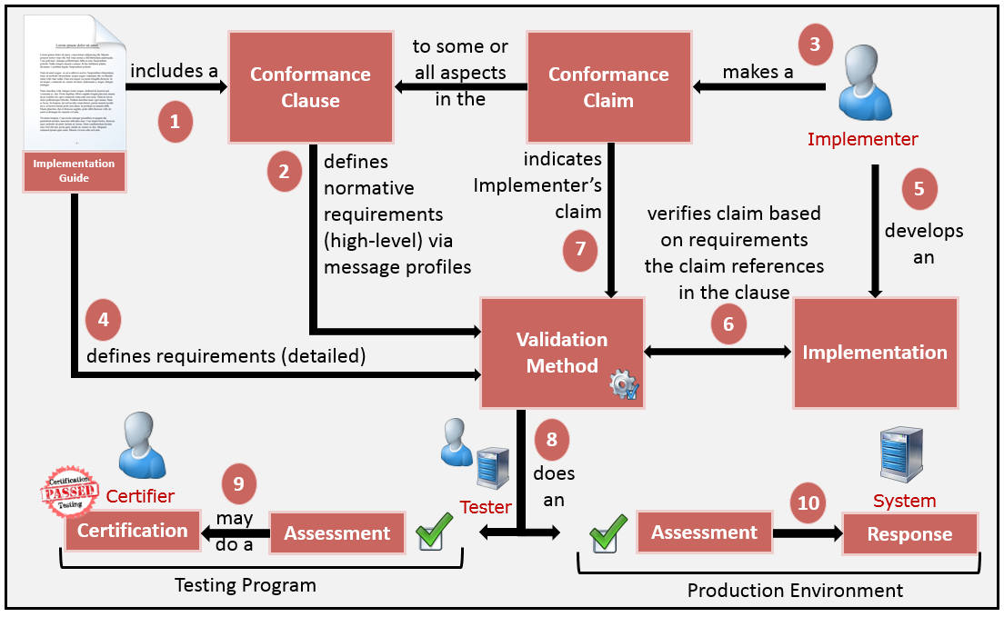
IGs in the Context of use
2/10/2020
Notes:
Comments for response to conformance violation of assessment in the production environment:
Should a receiver process a message, document, resource, etc., if a non-conformity is found? “It depends”
Non-conformity with valid data is better than no data at all
Partial data is most cases is better than no data at all
The severity of the non-conformity must be considered
Conformity assessment is not an end-all, it is a useful tool for initial assessment of data quality

Slide 43
Test Methods

Slide 44
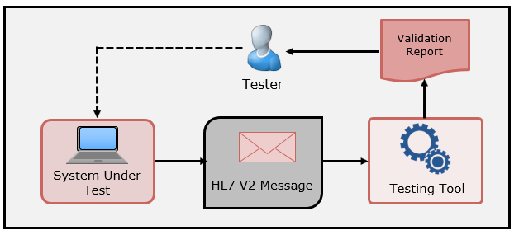
Context-free Testing
HL7 v2 message validation example
Sender-oriented testing
No Test Cases provided
Context (Test Scenario, etc.) is unknown to validation tool
May be used to test any message created by a system
Provides a simple and convenient method for testing message structure and most vocabulary

Slide 45
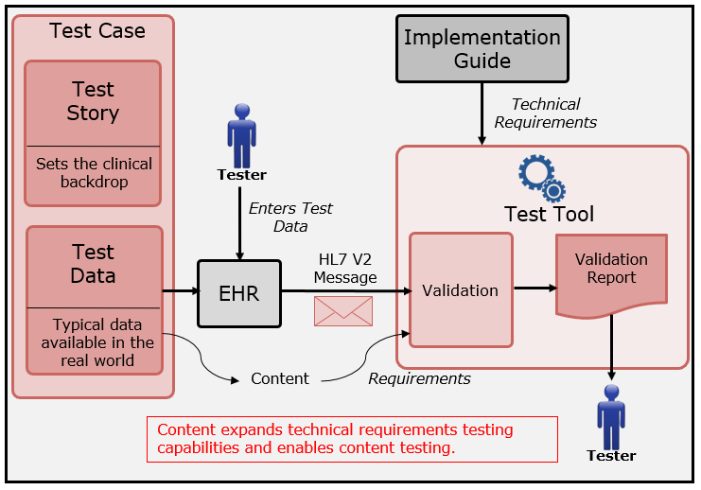
Context-based Testing
Test scenario and data given
Expands the scope of testing
Type of testing used in ONC EHR-S certification testing
Capability Testing (i.e., can test for “Support”)
Notes:
The context-based operational mode validates messages associated with a given test script that includes data for a specific test scenario
The EHR creates a message that corresponds to the test data provided in the test script – Supports different use cases (Administered, Refusal, etc.)
Testing will include the technical requirements and content-specific requirements specified in the test case
Context (specific Test Scenario, etc.) is known to validation tool
Provides a method for testing/assessing a message for all conformance requirements of an Implementation Guide
Is used for certifying EHR technologies for the ONC certification criteria
Significantly expands the scope of testing
Usage: Required, but may be empty (RE), Conditionals (C)
Cardinality: Ranges
Length: Ranges
Vocabulary
Helps Interpretation and Use of the Standards

Slide 46
Test Case
Purpose
Test Story (Description)
Pre-Condition
Test Steps
Test Data
Post-Condition
Test Objectives
Evaluation Criteria
Notes to the Test Administrators
General Comments

Slide 47
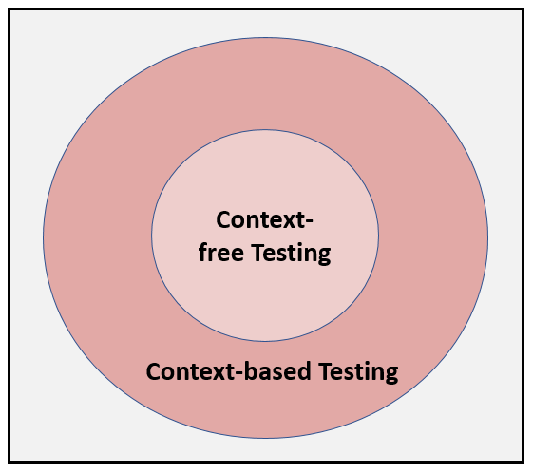
Context-free & based Testing
Context-based has expanded test scope
Scenarios
Targeted Test Cases
Data Driven
Black-box functional requirements testing

Slide 48
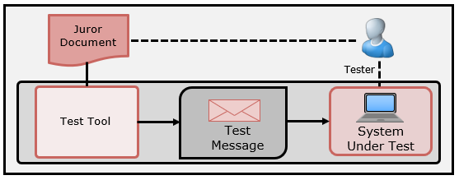
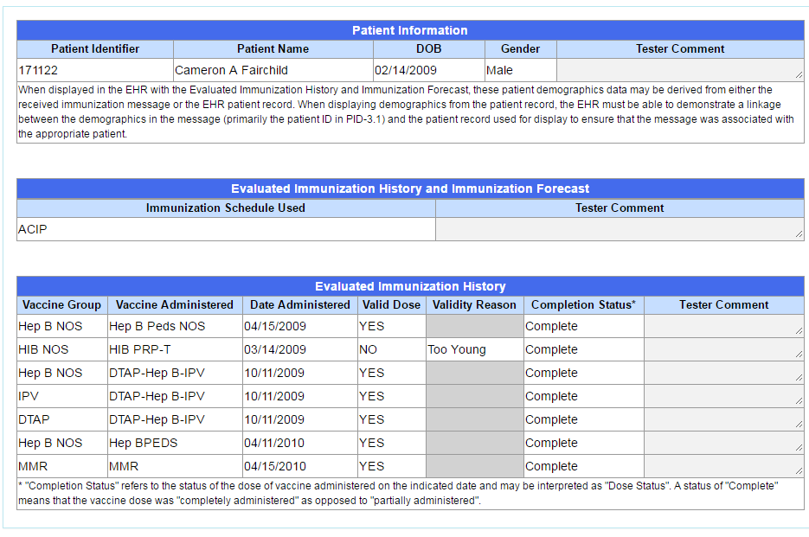
Inspection Testing
Receiver-oriented Testing
Use of an inspection (Juror) Document
Can be used for Incorporation and Display Testing
Test Tool provides the stimulus
Can have levels of storage requirements

Slide 49
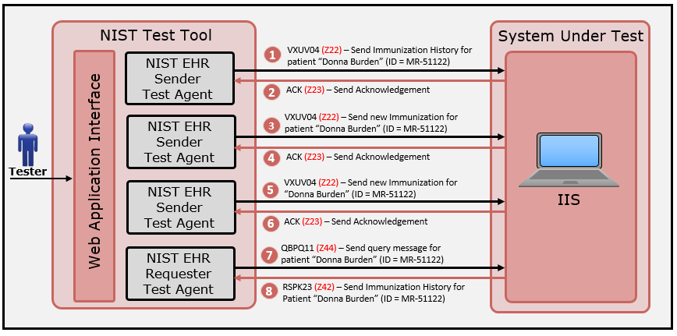
Testing Functional Requirements
Create scenarios to invoke a capability of the SUT
Use context-based testing to validate expected content in the response message

Slide 50
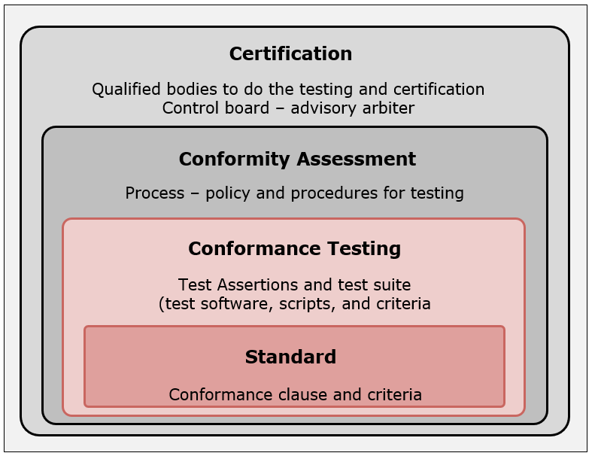
Certification Building Blocks
Certification can be thought of as the final step in the life-cycle of standards development and implementation
Relationship exists among the standard, conformance testing, conformity assessment, and certification
None of the outer-layers of blocks can be performed unless the inner-layers of blocks have been completed
Certification can only be accomplished when all of the three lower-level building blocks are in place; you can stop anywhere along this spectrum
Many standards exist without conformance testing or certification. Some standards have associated conformance tests but no certification regimen, while some standards incorporate all the components up to and including certification
Notes:
The relationship among the standard, conformance testing, conformity assessment, and certification is similar to that of a set of inter-connected building blocks. None of the outer-layers of blocks can be performed unless the inner-layers of blocks have been completed. Thus, conformance testing can not be performed unless the standard (with its conformance clauses and clear, testable requirements) has been completed. Conformity assessment (processes and policies for testing) can not be implemented until the standard and the conformance testing test suite are in place. Finally, certification can only be accomplished when all of the three lower-level building blocks are in place, and one can stop anywhere along this spectrum. Many standards exist without conformance testing or certification. Some standards have associated conformance tests but no certification regimen, while some standards incorporate all the components up to and including certification.

Slide 51
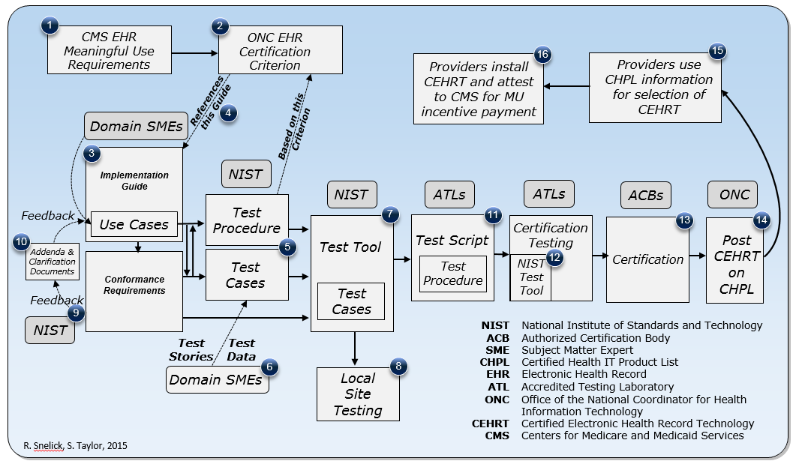
MU and Certification Testing Process
Process when a conformance test tool is part of the criteria
Specifically for NIST HL7v2 tools
Indicates the multiphase and iterative process
Often requires clarification of requirements and addendums to the standards
MU = Meaningful Use

Slide 52
Tools and Validation
NIST HL7 v2 Platform
Authoring IGs and Profiles
Authoring Test Plans
Conformance Testing

Slide 53
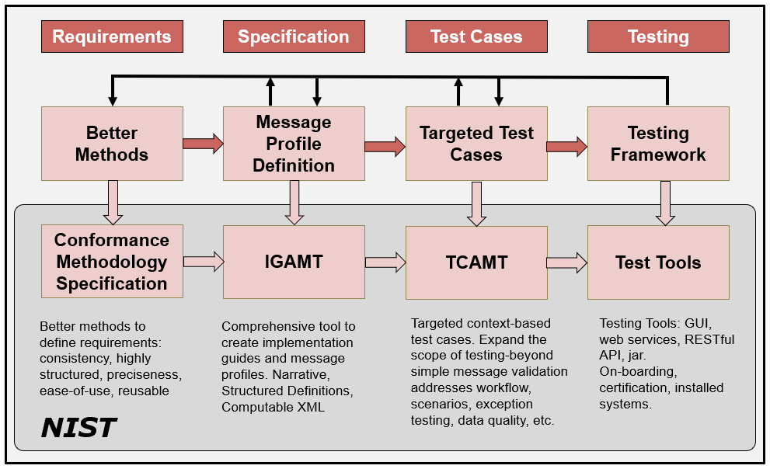
HL7 v2 Development Phases/Cycle
Notes:
Applicable to any standard product family.

Slide 54
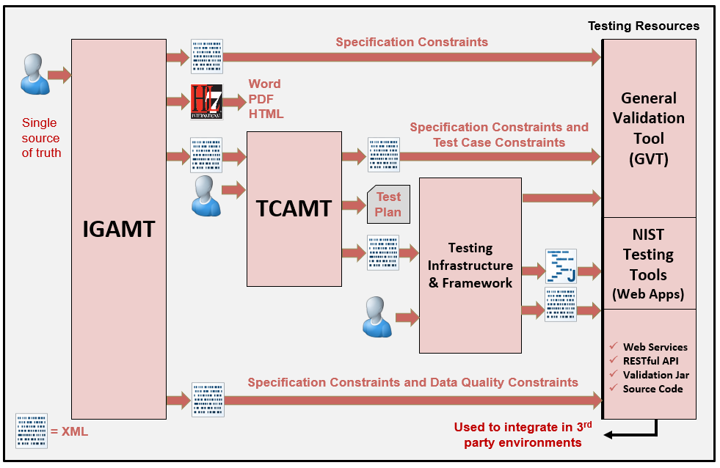
NIST HL7 v2 Platform

Slide 55
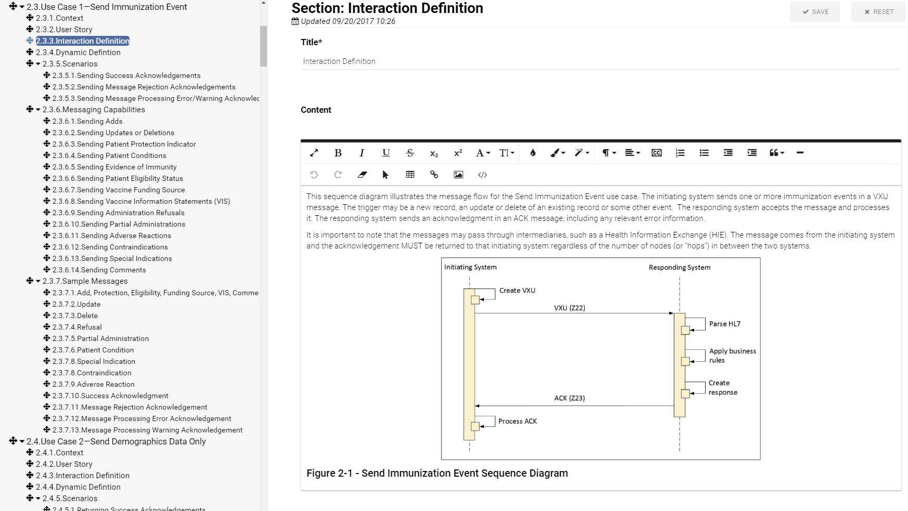
IGAMT: Narrative with Editing Capabilities

Slide 56
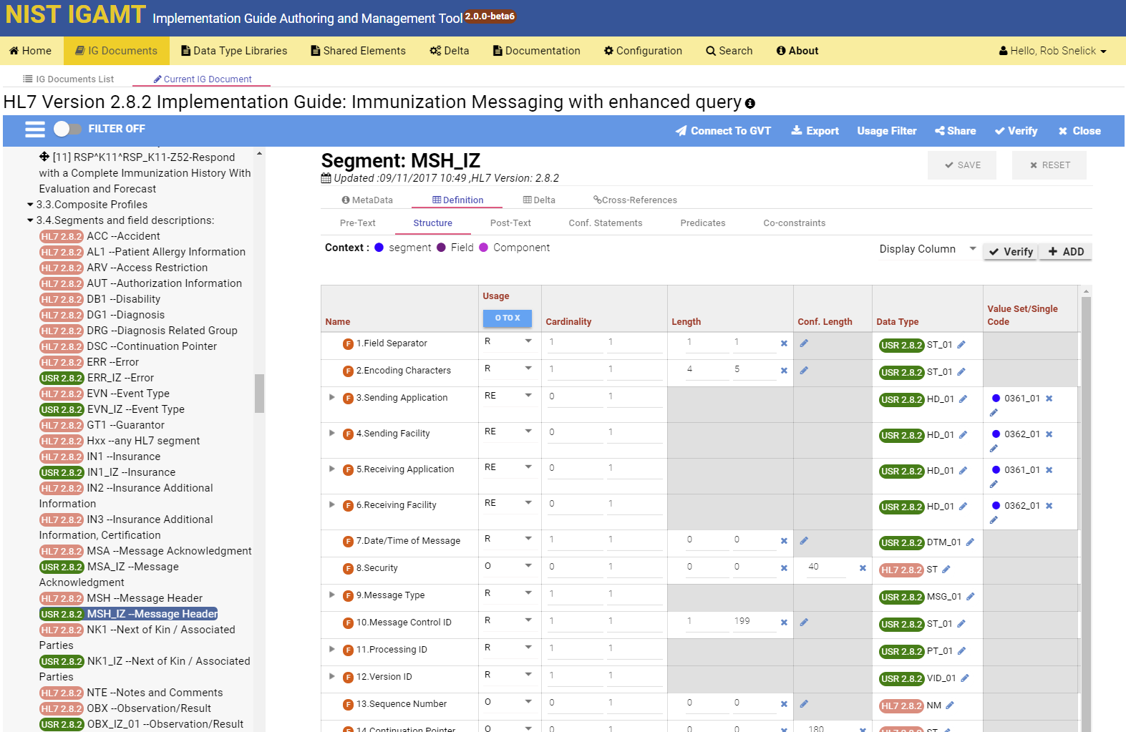
Segment Profiling

Slide 57
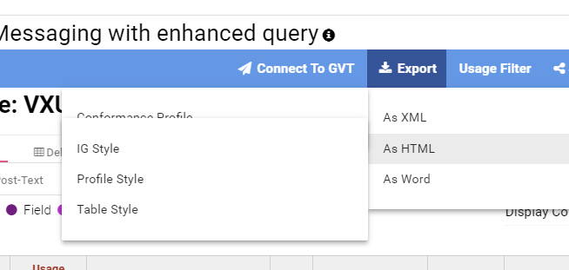
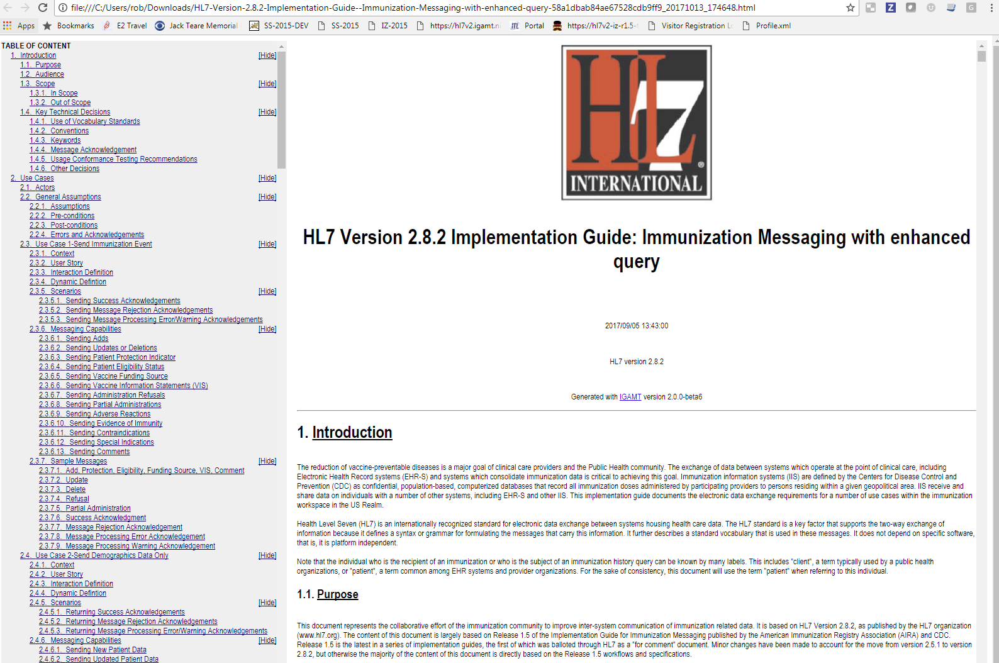
IGAMT: Export
Export in HTML, WORD, and XML
Multiple Styles

Slide 58
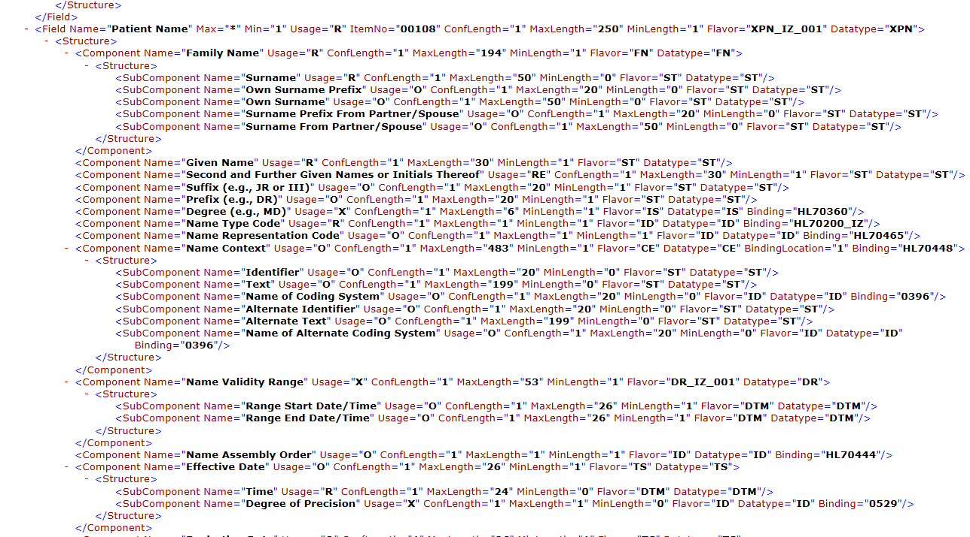
HL7 v2 Profile XML Format
Notes:
NIST HL7 v2 XML format. To be submitted to HL7 to standardize. The NIST format adds additional conformance constructs.

Slide 59
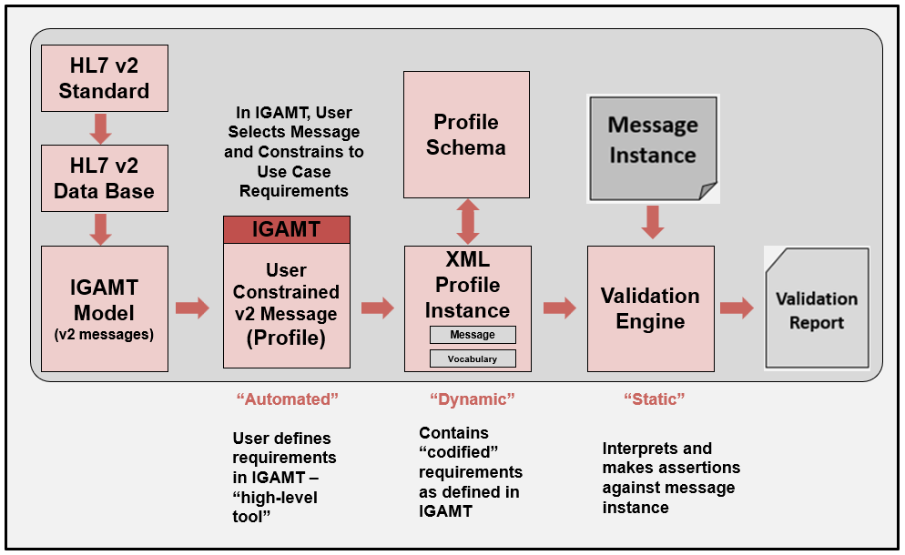
Validation Process

Slide 60
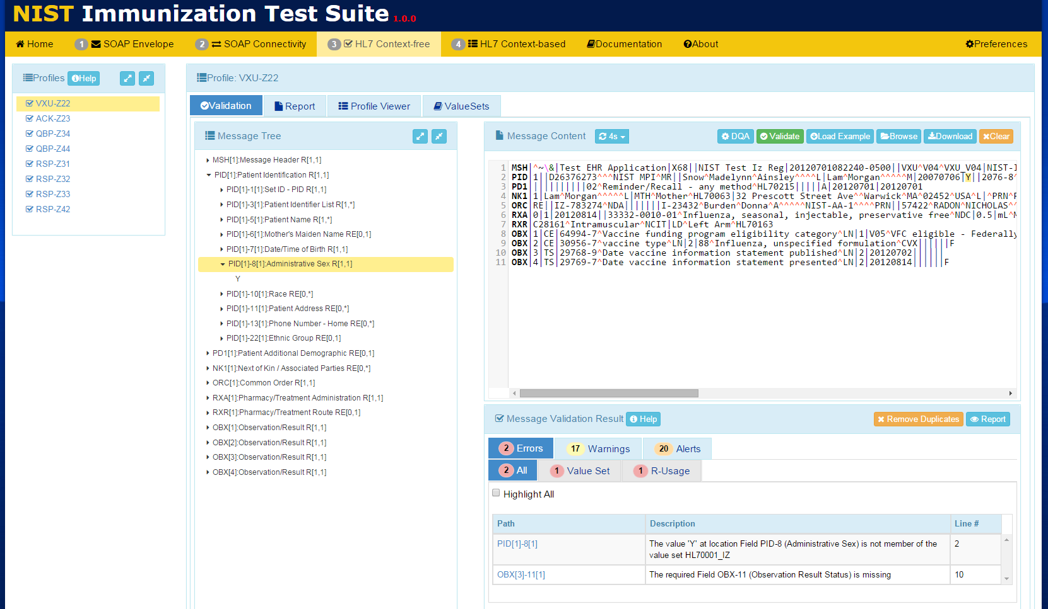
Context-free Validation

Slide 61
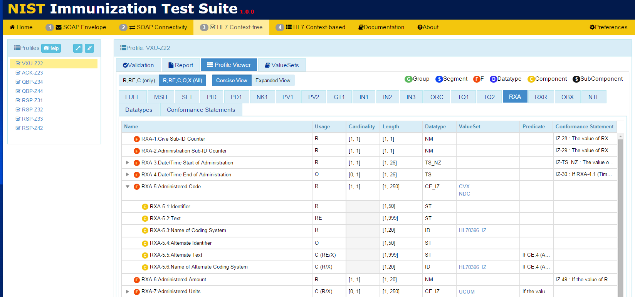
View Messaging Requirements

Slide 62
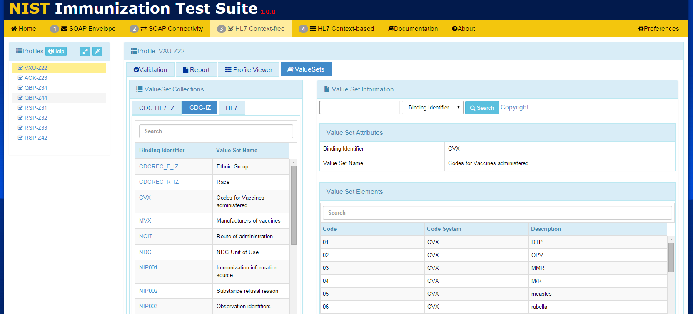
View Vocabulary Requirements

Slide 63
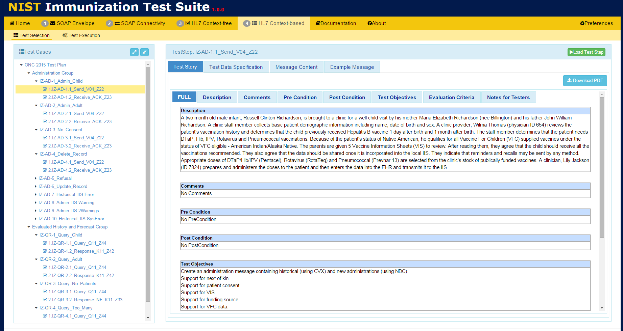
Context-based Validation

Slide 64
How do we achieve Interoperability?
Standards must be created and adopted
Not just standards, but well-defined standards (they must be understandable)
Standards must be specific (profiled for use)
Standards should/must be represented in a computable format
Implementations must be tested for conformance
Systems must be tested for interoperability
Notes:
Creating well-defined standard is one of the main purposes of this tutorial (and what a well-defined standard means).
Conformance provides the principles for understanding and the foundation for testable requirements.
Normative standards should not be published unless reference/pilot implementations are created and conformance test tools available.

Slide 65
Summary: Towards Interoperability
Use Cases
Trading Partner A
Trading Partner B
Reduced Negotiations &
Translations
Requirements
Requirements
Standards
Profiling
Implementation
Testing
Need quality data exchange standards
Be precise, and demand it from SDOs
Profile, Modularize, and Reuse
Use existing tools (profiling and testing)
Non-conformance should not prevent useful exchange of data
Plan for testing, and test (at all layers)
Notes:
Implementers/Specifiers can decide how far to go—profiling mechanisms should provide capabilities for a precise specification.
THERE ARE NO SHORT CUTS—YOU HAVE TO DO IT ONE WAY OR THE OTHER!
These tools help us manage and leverage/reuse existing models.
Think about now Trading Partner C with the same needs.
Improves Patient Safety
Better Data Sharing
Saves Time and Money
Reasonable confidence that the product meets the conformance requirements stated in the standard
Closer to achieving interoperability
Don’t expect “out-of-the-box” interoperability
Local adaptation and testing is necessary
Most likely each integration will still require translation
Reasonable scope
Based on what standards are part of the certification
E.g., if no usability standards, don’t set unrealistic expectations

Slide 66
Thank You Questions
Contact: robert.snelick@nist.gov
https://hl7v2tools.nist.gov

Slide 67
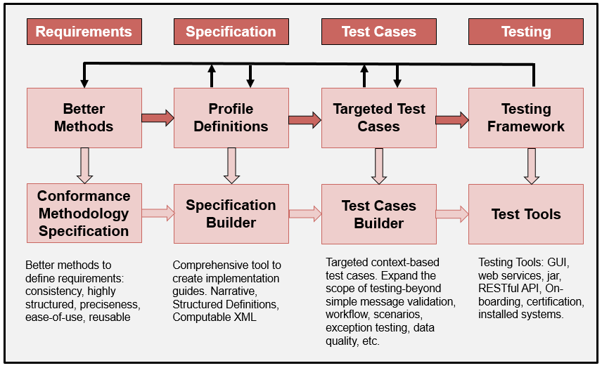
Development Phases/Cycle
Strive for computability and common interpretations
Notes:
Applicable to any standard product family.

Slide 68
Real Success
Measures of Immunization Submissions and Acknowledgement Messages
Source: American Immunization Registry Association, August 2019
Notes:
Implementers/Specifiers can decide how far to go—profiling mechanisms should provide capabilities for a precise specification.
THERE ARE NO SHORT CUTS—YOU HAVE TO DO IT ONE WAY OR THE OTHER!
These tools help us manage and leverage/reuse existing models.
Think about now Trading Partner C with the same needs.
Improves Patient Safety
Better Data Sharing
Saves Time and Money
Reasonable confidence that the product meets the conformance requirements stated in the standard
Closer to achieving interoperability
Don’t expect “out-of-the-box” interoperability
Local adaptation and testing is necessary
Most likely each integration will still require translation
Reasonable scope
Based on what standards are part of the certification
E.g., if no usability standards, don’t set unrealistic expectations

