Slide 1
Cybersecurity Act of 2015
Section 405(d)
10/26/2018

Slide 2
Agenda
Purpose
Document Overview
Value and Benefits
Pretesting Findings
Next Steps

Slide 3
Purpose

Slide 4
Cybersecurity Act of 2015 (CSA): Legislative Basis
CSA Section 405
Improving Cybersecurity in the Health Care Industry
Section 405(b): Health care industry preparedness report
Section 405(c): Health Care Industry Cybersecurity Task Force
Section 405(d): Aligning Health Care Industry Security Approaches

Slide 5
CSA Section 405(d): Legislative Language
Authority: Cybersecurity Act of 2015 (CSA), Section 405(d), Aligning Health Care Industry Security Approaches
The Secretary shall establish, through a collaborative process with the Secretary of Homeland Security, health care industry stakeholders, the Director of the National Institute of Standards and Technology, and any Federal entity or non-Federal entity the Secretary determines appropriate, a common set of voluntary, consensus-based, and industry-led guidelines, best practices, methodologies, procedures, and processes that--
(A) Serve as a resource for cost-effectively reducing cybersecurity risks for a range of health care organizations;
(B) Support voluntary adoption and implementation efforts to improve safeguards to address cybersecurity threats;
(C) Are consistent with—
(i) The standards, guidelines, best practices, methodologies, procedures, and processes developed under section 2(c)(15) of the National Institute of Standards and Technology Act (15 U.S.C. 272(c)(15));
(ii) The security and privacy regulations promulgated under section 264(c) of the Health Insurance Portability and Accountability Act of 1996 (42 U.S.C. 1320d-2 note); and
(iii) The provisions of the Health Information Technology for Economic and Clinical Health Act (title XIII of division A, and title IV of division B, of Public Law 111-5), and the amendments made by such Act; and
(D) Are updated on a regular basis and applicable to a range of health care organizations.

Slide 6
Industry-Led Activity to Improve Cybersecurity in the Healthcare and Public Health (HPH) Sector
WHAT IS THE 405(d) EFFORT?
WHO IS PARTICIPATING?
An industry-led process to develop consensus-based guidelines, practices, and methodologies to strengthen the HPH-sector’s cybersecurity posture against cyber threats.
The 405(d) Task Group is convened by HHS and comprised of over 150 information security officers, medical professionals, privacy experts, and industry leaders.
HOW WILL 405(d) ADDRESS HPH CYBERSECURITY NEEDS?
WHY IS HHS CONVENING THIS EFFORT?
With a targeted set of applicable & voluntary guidance that seeks to cost-effectively reduce the cybersecurity risks of healthcare organizations.
To strengthen the cybersecurity posture of the HPH Sector, Congress mandated the effort in the Cybersecurity Act of 2015 (CSA), Section 405(d).
Notes:
Currently the healthcare sector lacks practical and useful guidance that establishes a set of recommended cybersecurity practices available free of charge to all large, mid-size, and small healthcare organizations and other interested stakeholders.
According to the statute, those security practices must be voluntary, consistent with the security and privacy regulations of HIPAA and HITECH, and updated on a regular basis. Section 405(d) essentially codifies HHS’s existing requirement to coordinate with health care organizations to develop guidance.
Category
Participants
Percentage
Healthcare InfoSec/IT Professionals
30
28%
HPH CIOs & CISOs
23
22%
Practitioners and Clinicians
9
9%
Federal InfoSec Professionals
15
14%
Healthcare Subject Matter Experts
29
27%
Total
106

Slide 7
Document Overview

Slide 8
Document Objective and Development
Objective
The CSA 405(d) document aims to raise awareness, provide vetted practices, and foster consistency in mitigating the most pertinent and current cybersecurity threats to the sector. It seeks to aid the HPH sector organizations to develop meaningful cybersecurity objectives and outcomes.
Development
Leverage Existing Information
HPH Sector Public-Private Collaboration
National Pretesting
Existing information and guidance (e.g., NIST Cybersecurity Framework) was leveraged across the public and private domains to provide a tailored approach for the healthcare industry. It does not create new frameworks, re-write specifications, or “reinvent the wheel.”
To ensure a successful outcome and a collaborative process, HHS reached out to a diverse set of healthcare and cybersecurity experts from the public and private sectors. Participation is open and voluntary.

Slide 9
Document Development Detail
Identified ~110 members.
Convened 6 times from May 2017 to March 2018
Task Group Recruitment & Management
Supporting the Authoring of 405(d) Guidance
Assess the Process: After Action Review
Assess the Input: Peer Review Roundtables
Co-Authoring & Design of 405(d) Guidance
Assess the Output: Nationwide Pretesting
Who Are They: Stakeholder Mapping & Analysis
Existing Attitudes: Medical Community Baselining
Administrative Support and Writing Counsel
Qualitative Research to Establish Level of Awareness and Prioritization
Version 1.0 Five Threats and Ten Practices
Writing Committee
Quantitative and qualitative knowledge-base for HPH Sector.
4 Subgroups collaboratively developed 96 page annotated outline
Group interviews with medical professionals and HPH CIOs/CISOs.
35 One-on-One Interviews with Task Group Members
Deliberation and consensus resulting in Writing Committee’s new 34 page format
3 Focus Group Assessments
19 total participants including healthcare and CIOs/CISOs

Slide 10
Document - Content Overview (1/2)
After significant analysis of the current cybersecurity issues facing the HPH Sector, the Task Group agreed on the development of three documents—a main document and two technical volumes:
The main document examines cybersecurity threats and vulnerabilities that affect the healthcare industry. It explores five (5) current threats and presents ten (10) practices to mitigate those threats.
Technical Volume 1 discusses these ten cybersecurity practices for small healthcare organizations.
Technical Volume 2 discusses these ten cybersecurity practices for medium and large healthcare organizations.
The 5 current threats identified in healthcare:
Email Phishing Attacks
Ransomware Attacks
Loss or Theft of Equipment or Data
Internal, Accidental, or Intentional Data Loss
Attacks Against Connected Medical Devices that May Affect Patient Safety

Slide 11
Document - Content Overview (2/2)
The document identifies ten (10) practices, which are tailored to small, medium, and large organizations and discussed in further detail in the technical volumes:
1
Email Protection Systems
2
Endpoint Protection Systems
3
Access Management
4
Data Protection and Loss Prevention
5
Asset Management
6
Network Management
7
Vulnerability Management
8
Incident Response
9
Medical Device Security
10
Cybersecurity Policies

Slide 12
Value and Benefits

Slide 13
Healthcare and Public Health (HPH) Sector Benefits
This joint HHS- and industry- led initiative aims to increase awareness and foster consistency with cybersecurity practices for a wide range of stakeholders.
Executives
Practitioners
InfoSec
Users
Sector Benefits
Aimed for use across varied audiences
Information sharing among differing cybersecurity maturity levels and needs
Cybersecurity Awareness
Enterprise Risk Management
Small, medium, and large healthcare organizations can vary in their level of cybersecurity maturity and needs
It is critical for uninterrupted care delivery and patient safety
Cybersecurity should be treated as an enterprise issue, not just an IT issue

Slide 14
Cybersecurity: An Enterprise Issue
HHS continues to institutionalize cybersecurity as a key priority and is actively advocating the culture shift to treat cybersecurity as an enterprise issue.
Information Security & Privacy
Leadership Engagement & Support
CFO Community Engagement
HHS has Healthcare and Public Health (HPH) Sector-Specific Agency responsibilities for all hazards including cybersecurity and public-private partnerships.
Continued engagement with the Enterprise Risk Management (ERM) community and senior/executive leadership on cybersecurity activities, strategies, and risk management.
As ERM matures within the healthcare industry, continued support is needed to operationalize cybersecurity and information security risks as part of our strategic, mission, and business risk management decisions across HHS and the HPH sector.
Notes:
CFO community impacts and relevance

Slide 15
Pretesting Findings

Slide 16
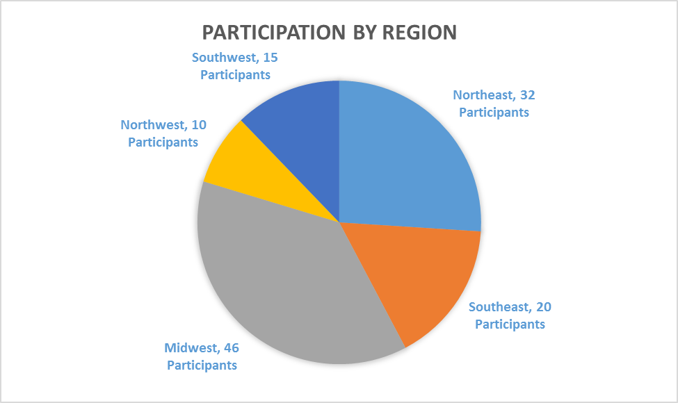
Pretesting: By Region
Pretesting of the 405(d) document consisted of facilitated focus group discussions assessing the practicality, usability, and what impact this document can have. Stakeholder groups included Medical Professionals, HPH CIOs/CISOs, and other HPH staff. Pretesting sessions were both in-person and virtual.
Notes:
Key Stats
In-Person – 87 participants
Virtual – 36 participants
Avg Per Group – 8 participants
Total – 123 participants
In-Person Pretests – 12 via roundtable discussion
Virtual Pretests – 4 via WebEx roundtable discussion
Totals Pretests – 16
Cities: Chicago, IL; Duluth, GA; Long Island, NY; NYC, NY; Ocala, FL; Seattle, WA; Columbus, OH
70+ Organizations
--------------------------------------
Position Breakdown
Practitioners – 12 participants
Hospital/Practice Admin – 10 participants
CIOs – 5 participants
CISOs – 13 participants
Executive Level – 18 participants
Medical Device Professionals – 8 participants
IT Professionals - 12 participants
InfoSec Professionals – 45 participants
---------------------------------------
Regions Represented
Northeast – 32 participants
Southeast – 20 participants
Midwest – 46 participants
Northwest – 10 participants
Southwest – 15 participants

Slide 17
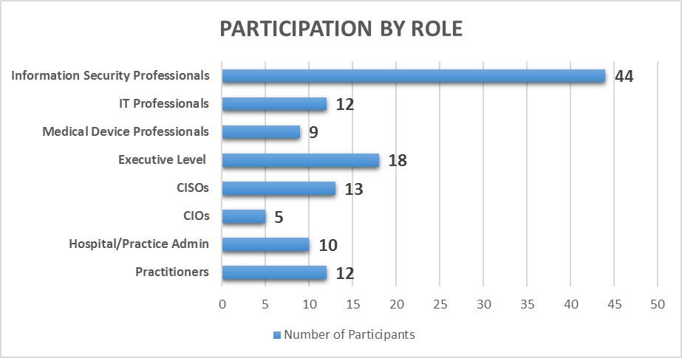
Pretesting: By Role
*123 Total Participants
Notes:
Key Stats
In-Person – 87 participants
Virtual – 36 participants
Avg Per Group – 8 participants
Total – 123 participants
In-Person Pretests – 12 via roundtable discussion
Virtual Pretests – 4 via WebEx roundtable discussion
Totals Pretests – 16
Cities: Chicago, IL; Duluth, GA; Long Island, NY; NYC, NY; Ocala, FL; Seattle, WA; Columbus, OH
70+ Organizations
--------------------------------------
Position Breakdown
Practitioners – 12 participants
Hospital/Practice Admin – 10 participants
CIOs – 5 participants
CISOs – 13 participants
Executive Level – 18 participants
Medical Device Professionals – 8 participants
IT Professionals - 12 participants
InfoSec Professionals – 45 participants
---------------------------------------
Regions Represented
Northeast – 32 participants
Southeast – 20 participants
Midwest – 46 participants
Northwest – 10 participants
Southwest – 15 participants

Slide 18
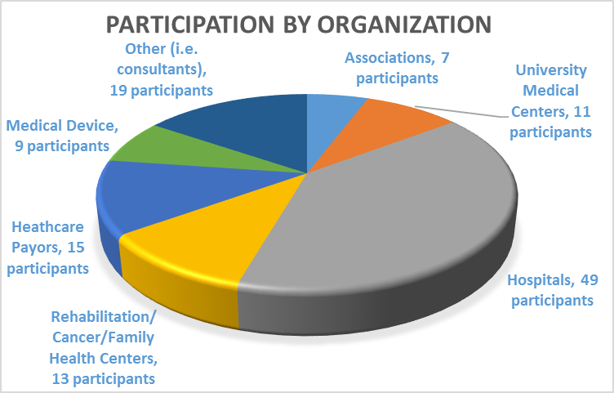
Pretesting: By Organization
Notes:
Key Stats
In-Person – 87 participants
Virtual – 36 participants
Avg Per Group – 8 participants
Total – 123 participants
In-Person Pretests – 12 via roundtable discussion
Virtual Pretests – 4 via WebEx roundtable discussion
Totals Pretests – 16
Cities: Chicago, IL; Duluth, GA; Long Island, NY; NYC, NY; Ocala, FL; Seattle, WA; Columbus, OH
70+ Organizations
--------------------------------------
Position Breakdown
Practitioners – 12 participants
Hospital/Practice Admin – 10 participants
CIOs – 5 participants
CISOs – 13 participants
Executive Level – 18 participants
Medical Device Professionals – 8 participants
IT Professionals - 12 participants
InfoSec Professionals – 45 participants
---------------------------------------
Regions Represented
Northeast – 32 participants
Southeast – 20 participants
Midwest – 46 participants
Northwest – 10 participants
Southwest – 15 participants

Slide 19
Next Steps

Slide 20
405(d) Stages*
Stage One: “Foundation”
May 22-23 2017: Session #1 (In-Person)
June 26 2017: Session #2 (WebEx)
Stage Two:
“How-To”/Subgroups
August 2017 – Early September 2017: Subgroups Convene and Address “Annotated Outline” and Topics
Stage Three:
“Assessment”
September 18-19: Session #4 (In-Person)
October 2017 – December 2017: 1. After Action Review 2. Peer Review Roundtables 3. Session #5 WebEx Sessions
July 17-18 2017: Session #3 (In-Person)
Stage Four:
“Initial Document”
Early 2018: 1. Writing Committee & First Draft of Version 1.0 of Guidance 2. Session #6 (Task Group ratification of First Draft of Version 1.0)
Stage Five:
“Pre-Testing”
Summer 2018 – Fall 2018: Assessing the Output: Nationwide Pre-Testing with Healthcare Professionals
Next Stages || Sustained Engagement: Winter-2018: Release to Industry; Informing and Educating; Moving to V2.0
* Dates Subject to Change

