Slide 1
The Framework for Improving Critical Infrastructure Cybersecurity
April 2018
cyberframework@nist.gov

Slide 2
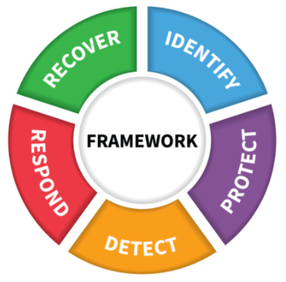
Objective and Agenda
Objective: Convey Cybersecurity Framework use, while explaining features added in Version 1.1
Charter
Users
Attributes, Components, & Approaches
Draft Roadmap Version 1.1
Framework Focus Areas
Web Site
Update Process

Slide 3
National Institute of Standards and Technology
About NIST
Agency of U.S. Department of Commerce
NIST’s mission is to develop and promote measurement, standards and technology to enhance productivity, facilitate trade, and improve the quality of life.
Federal, non-regulatory agency around since 1901
NIST Cybersecurity
Cybersecurity since the 1970s
Computer Security Resource Center – csrc.nist.gov
NIST Priority Research Areas
Forensic Science
Disaster Resilience
Advanced Manufacturing
Healthcare
IT and Cybersecurity
Cyber-physical Systems
Advanced Communications

Slide 4
Cybersecurity Framework Current Charter Improving Critical Infrastructure Cybersecurity
February 12, 2013
“It is the policy of the United States to enhance the security and resilience of the Nation’s critical infrastructure and to maintain a cyber environment that encourages efficiency, innovation, and economic prosperity while promoting safety, security, business confidentiality, privacy, and civil liberties”
Executive Order 13636
December 18, 2014
Amends the National Institute of Standards and Technology Act (15 U.S.C. 272(c)) to say:
“…on an ongoing basis, facilitate and support the development of a voluntary, consensus-based, industry-led set of standards, guidelines, best practices, methodologies, procedures, and processes to cost-effectively reduce cyber risks to critical infrastructure”
Cybersecurity Enhancement Act of 2014 (P.L. 113-274)

Slide 5
Cybersecurity Framework Users Framework for Improving Critical Infrastructure Cybersecurity
Notes:
And also:
Cisco
Motorola
IBM
Microsoft
Dell
CA Technologies
Emblem Health
AdvaMed
Merck
Kaiser Permanente
Sempra Energy
Boeing

Slide 6
Version 1.0 and 1.1 Are Fully Compatible Framework for Improving Critical Infrastructure Cybersecurity
Additions, including new categories and subcategories, do not invalidate existing V1.0 uses or work products
Component | Version 1.0 | Version 1.1 | Comments
Functions | 5 | 5
Categories | 22 | 23 | Added a new category in ID.SC – Supply Chain
Subcategories | 98 | 108 | Added 5 subcategories in ID.SC Added 2 subcategories in PR.AC Added 1 subcategory each to PR.DS, PR.PT, RS.AN Clarified language in 7 others
Informative References | 5 | 5

Slide 7
Key Framework Attributes Principles of the Current and Future Versions of Framework
Common and accessible language
Understandable by many professionals
It’s adaptable to many technologies^{1.1}, lifecycle phases^{1.1}, sectors and uses
Meant to be customized
It’s risk-based
A Catalog of cybersecurity outcomes
Does not provide how or how much cybersecurity is appropriate
It’s meant to be paired
Take advantage of great pre-existing things
It’s a living document
Enable best practices to become standard practices for everyone
Can be updated as technology and threats change
Evolves faster than regulation and legislation
Can be updated as stakeholders learn from implementation

Slide 8
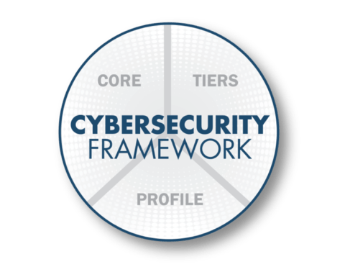
Cybersecurity Framework Components
Cybersecurity outcomes and informative references
Enables
communication
of cyber risk across
an organization
Describes how cybersecurity risk is managed by an organization and
degree the risk management
practices
exhibit key characteristics
Aligns industry standards and best practices to the Framework Core in an implementation scenario
Supports prioritization and measurement while factoring in business needs

Slide 9
Implementation Tiers
 | 1 Partial | 2 Risk Informed |  | 3 Repeatable |  | 4 Adaptive
Risk Management Process | The functionality and repeatability of cybersecurity risk management
Integrated Risk Management Program | The extent to which cybersecurity is considered in broader risk management decisions
External Participation | The degree to which the organization: monitors and manages supply chain risk^{1.1} benefits my sharing or receiving information from outside parties
9

Slide 10
Core A Catalog of Cybersecurity Outcomes
 | Function
What processes and assets need protection? | Identify | Understandable by everyone Applies to any type of risk management Defines the entire breadth of cybersecurity Spans both prevention and reaction
What safeguards are available? | Protect
What techniques can identify incidents? | Detect
What techniques can contain impacts of incidents? | Respond
What techniques can restore capabilities? | Recover

Slide 11
Core A Catalog of Cybersecurity Outcomes
 | Function | Category
What processes and assets need protection? | Identify | Asset Management
 |  | Business Environment
 |  | Governance
 |  | Risk Assessment
 |  | Risk Management Strategy
 |  | Supply Chain Risk Management^{1.1}
What safeguards are available? | Protect | Identity Management, Authentication and Access Control^{1.1}
 |  | Awareness and Training
 |  | Data Security
 |  | Information Protection Processes & Procedures
 |  | Maintenance
 |  | Protective Technology
What techniques can identify incidents? | Detect | Anomalies and Events
 |  | Security Continuous Monitoring
 |  | Detection Processes
What techniques can contain impacts of incidents? | Respond | Response Planning
 |  | Communications
 |  | Analysis
 |  | Mitigation
 |  | Improvements
What techniques can restore capabilities? | Recover | Recovery Planning
 |  | Improvements
 |  | Communications

Slide 12
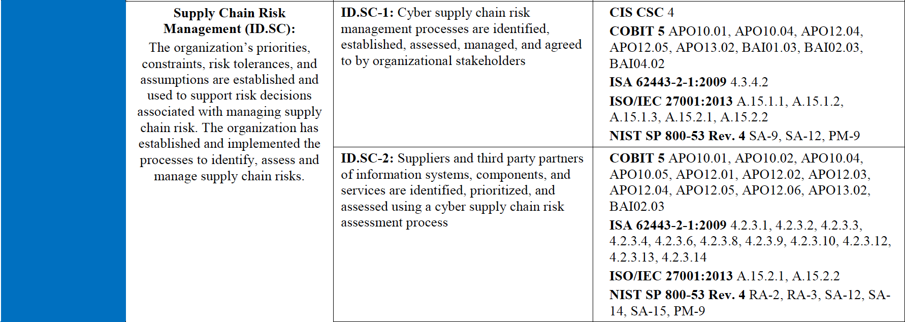
Core – Example^{1.1}
Cybersecurity Framework Component

Slide 13
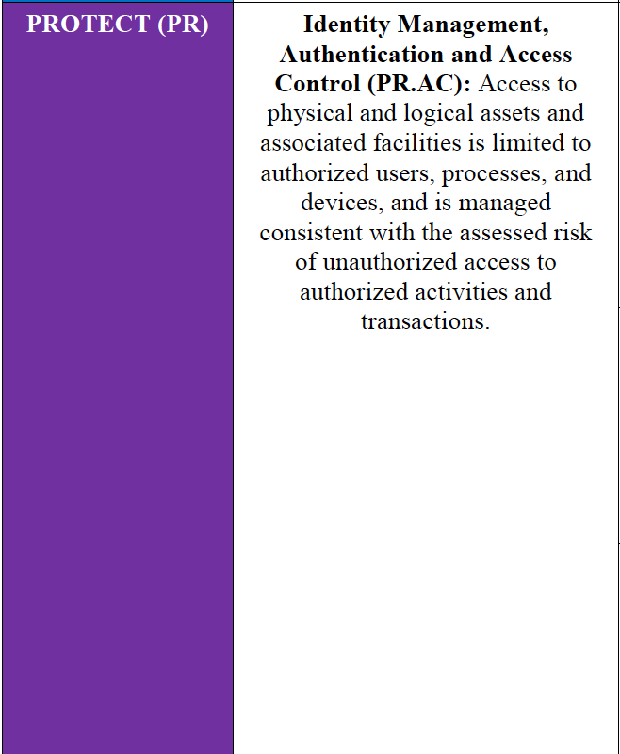
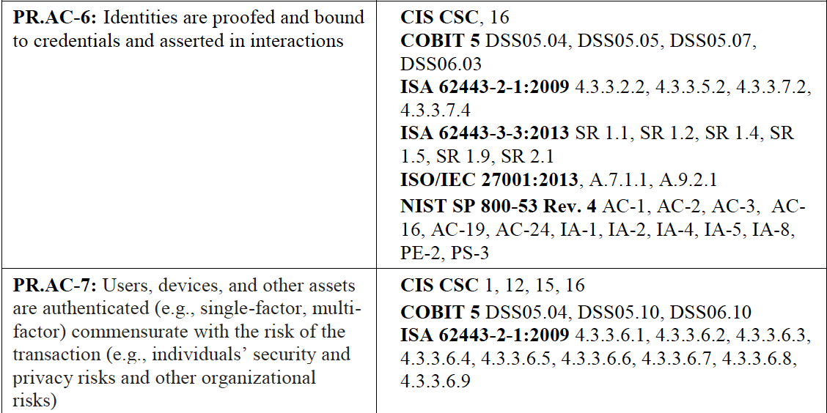
Core – Example^{1.1}
Cybersecurity Framework Component

Slide 14
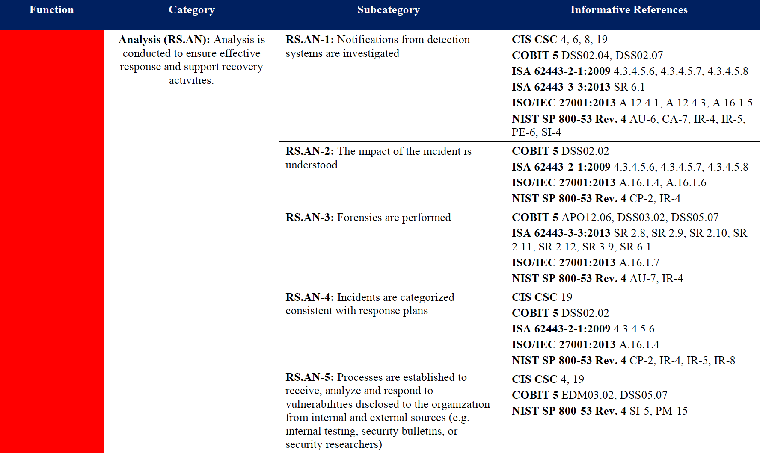
Core – Example
Cybersecurity Framework Component
1.1

Slide 15
Profile Customizing Cybersecurity Framework
Ways to think about a Profile:
A customization of the Core for a given sector, subsector, or organization
A fusion of business/mission logic and cybersecurity outcomes
Identify
Protect
Detect
Respond
Recover
An alignment of cybersecurity requirements with operational methodologies
A basis for assessment and expressing target state
A decision support tool for cybersecurity risk management

Slide 16
Profile Foundational Information A Profile Can be Created from Three Types of Information
1
Business Objectives
Objective 1
Objective 2
Objective 3
2
Cybersecurity
Requirements
Legislation
Regulation
Internal & External Policy
Technical Environment
Threats
Vulnerabilities
Subcategory
1
2
…
108
3
Operating
Methodologies
Controls Catalogs
Technical Guidance
Notes:
“…Framework has utility as a structure and language for organizing and expressing compliance with an organization’s own cybersecurity requirements. …phrases like “compliance with the Framework” can be confusing and mean something very different to various stakeholders.^{1.1}”

Slide 17
Framework Seven Step Process Gap Analysis Using Framework Profiles
Step 1: Prioritize and Scope
Implementation Tiers may be used to express varying risk tolerances^{1.1}
Step 2: Orient
Step 3: Create a Current Profile
Step 4: Conduct a Risk Assessment
Step 5: Create a Target Profile
When used in conjunction with an Implementation Tier, characteristics of the Tier level should be reflected in the desired cybersecurity outcomes^{1.1}
Step 6: Determine, Analyze, and Prioritize Gaps
Step 7: Implementation Action Plan

Slide 18
Resource and Budget Decisioning Framework supports operating decisions and improvement
As-Is
Year 1
To-Be
Year 2
To-Be
Sub- category | Priority | Gaps | Budget | Year 1 Activities | Year 2 Activities
1 | moderate | small | $$$ |  | X
2 | high | large | $$ | X
3 | moderate | medium | $ | X
… | … | … | …
108 | moderate | none | $$ |  | reassess

Slide 19
Resource and Budget Decisioning Framework supports operating decisions and improvement
As-Is
Year 1
To-Be
Year 2
To-Be
Step 5
Target Profile
Step 6
Step 7
Sub- category | Priority | Gaps | Budget | Year 1 Activities | Year 2 Activities
1 | moderate | small | $$$ |  | X
2 | high | large | $$ | X
3 | moderate | medium | $ | X
… | … | … | …
108 | moderate | none | $$ |  | reassess

Slide 20
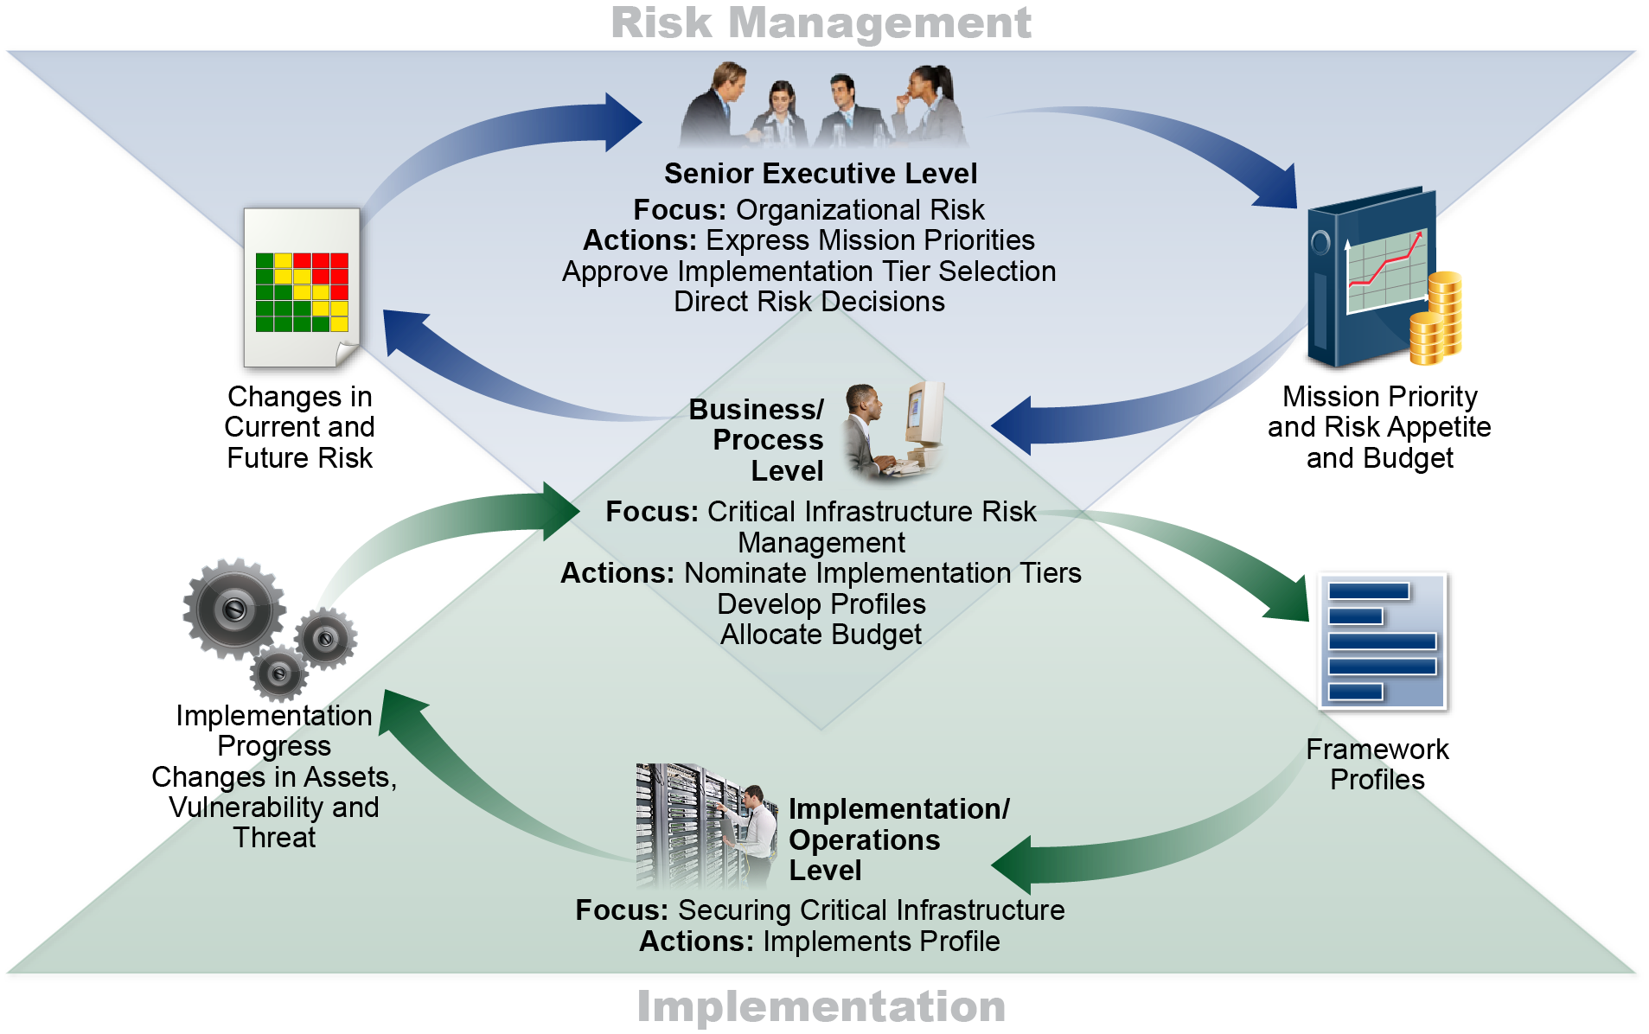
Supporting Risk Management with Framework Framework for Improving Critical Infrastructure Cybersecurity Version 1.1
1.1
1.1
Internal
Supply Chain

Slide 21
Operate Use Cybersecurity Framework Profiles to distribute and organize labor
Subcats | Reqs | Priorities | Who | What | When | Where | How
1 | A, B | High
2 | C, D, E, F | High
3 | G, H, I, J | Low
... | ... | ...
108 | XX, YY, ZZ | Mod

Slide 22
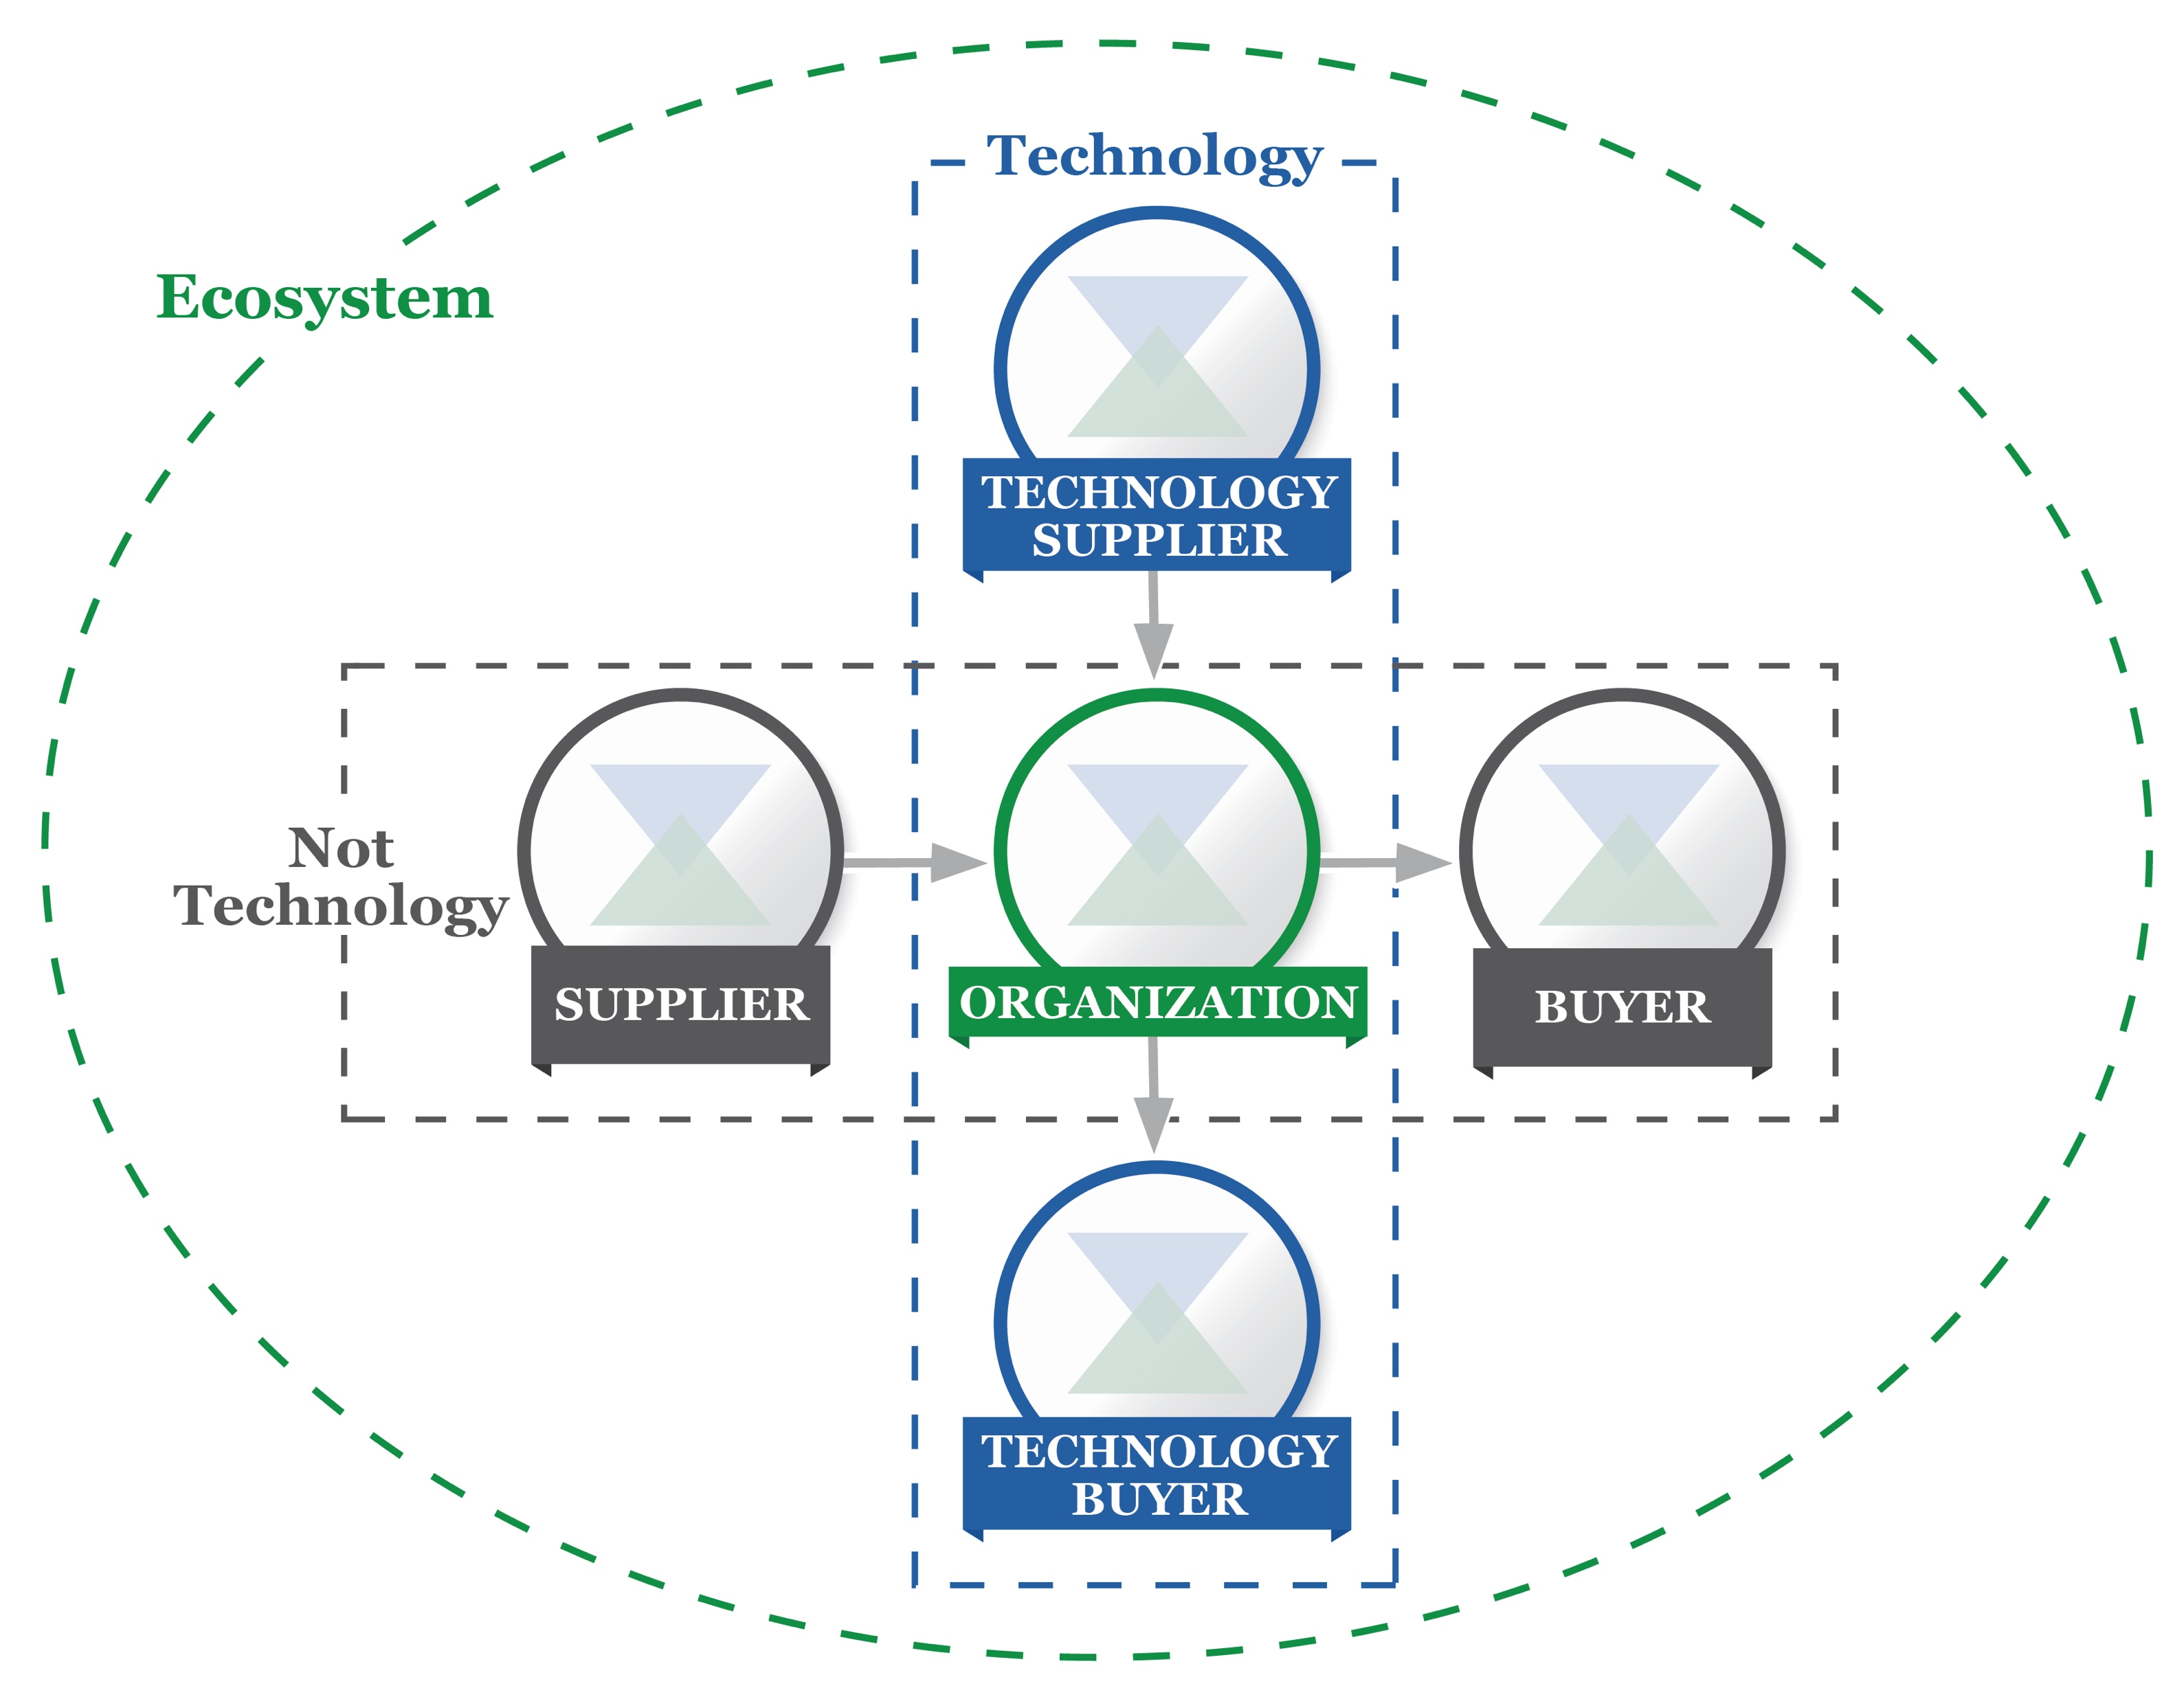
Cyber SCRM Taxonomy^{1.1} Framework for Improving Critical Infrastructure Cybersecurity Version 1.1
Simple Supplier-Buyer model
Technology minimally includes IT, OT, CPS, IoT
Applicable for public and private sector, including not-for-profits
Aligns with Federal guidance Supply Chain Risk Management Practices for Federal Information Systems and Organizations (Special Publication 800-161)

Slide 23
Self-Assessing Cybersecurity Risk^{1.1}
Framework for Improving Critical Infrastructure Cybersecurity Version 1.1
Emphasizes the role of measurements in self-assessment
Stresses critical linkage of business results:
Cost
Benefit
…to cybersecurity risk management
Continued discussion of this linkage will occur under Roadmap area – Measuring Cybersecurity

Slide 24
Roadmap Concepts Roadmap to Improving Critical Infrastructure Cybersecurity
The Roadmap:
identifies key areas of development, alignment, and collaboration
provides a description of activities related to the Framework
Roadmap items are generally:
Topics that are meaningful to critical infrastructure cybersecurity risk management
Focus areas of both private sector and the federal government
Related to Framework, but managed as separate efforts

Slide 25
Proposed Roadmap Topics Draft Roadmap for Improving Critical Infrastructure Cybersecurity Version 1.1
Original Roadmap 9 topics | Proposed Roadmap 12 topics
Conformity Assessment | Confidence Mechanisms
Automated Indicator Sharing | Cyber-Attack Lifecycle Includes Coordinated Vulnerability Disclosure
Data Analytics
Cybersecurity Workforce | Cybersecurity Workforce
Supply Chain Risk Management | Cyber Supply Chain Risk Management
Federal Agency Cybersecurity Alignment | Federal Agency Cybersecurity Alignment
 | Governance and Enterprise Risk Management
Authentication | Identity Management
International Aspects, Impacts, and Alignment | International Aspects, Impacts, and Alignment
 | Measuring Cybersecurity
Technical Privacy Standards | Privacy Engineering
 | Referencing Techniques
 | Small Business Awareness and Resources
Focus
Focus
Focus

Slide 26
Small Business Guidance and Initiatives Framework for Improving Critical Infrastructure Cybersecurity
Small Business Information Security: the Fundamentals
NIST Computer Security Resource Center
Small Business Center
NIST Computer Security Resource Center
CyberSecure My Business
National Cyber Security Alliance
Small Business Starter Profiles
NIST Framework Team

Slide 27
International Use Framework for Improving Critical Infrastructure Cybersecurity
Japanese translation by Information-technology Promotion Agency
Italian adaptation within Italy’s National Framework for Cybersecurity
Hebrew adaptation by Government of Israel
Bermuda uses it within government and recommends it to industry
Uruguay government is currently on Version 3.1 of their adaptation
Focus of International Organization for Standardization & International Electrotechnical Commission

Slide 28
Proposed U.S. Federal Usage NIST IR 8170 The Cybersecurity Framework: Implementation Guidance for Federal Agencies
Strengthening the Cybersecurity of Federal Networks and Critical Infrastructure
Executive Order 13800
1. Integrate enterprise and cybersecurity risk management
2. Manage cybersecurity requirements
3. Integrate and align cybersecurity and acquisition processes
4. Evaluate organizational cybersecurity
5. Manage the cybersecurity program
6. Maintain a comprehensive understanding of cybersecurity risk (supports RMF Authorize)
7. Report cybersecurity risks (supports RMF Monitor)
8. Inform the tailoring process (supports RMF Select)

Slide 29
FISMA Implementation Pub Schedule As of 8 February 2018, Subject to Change
NIST Special Publication 800-37, Revision 2: Risk Management Framework for Security and Privacy
Initial Public Draft: May 2018
Final Public Draft: July 2018
Final Publication: October 2018
NIST Special Publication 800-53, Revision 5: Security and Privacy Controls
Final Public Draft: October 2018
Final Publication: December 2018
NIST Special Publication 800-53A, Revision 5: Assessment Procedures for Security and Privacy Controls
Initial Public Draft: March 2019
Final Public Draft: June 2019
Final Publication: September 2019
FIPS Publication 200, Revision 1: Minimum Security Requirements
Initial Public Draft: October 2018
Final Public Draft: April 2019
Final Publication: July 2019
FIPS Publication 199, Revision 1: Security Categorization
Initial Public Draft: December 2018
Final Public Draft: May 2019
Final Publication: August 2019
Updates - https://csrc.nist.gov/Projects/Risk-Management/Schedule
Questions or comments - sec-cert@nist.gov

Slide 30
Supporting Healthy Regulatory Environments Framework for Improving Critical Infrastructure Cybersecurity
Bulk Liquid Transport Profile
U.S. Coast Guard
Financial Services Framework Customization and Profile
Financial Services Sector Coordinating Council
Connected Vehicle Profile
U.S. Department of Transportation Smart City Pilot
Cybersecurity Risk Management and Best Practices Working Group 4: Final Report
Communications Security, Reliability, and Interoperability Council

Slide 31
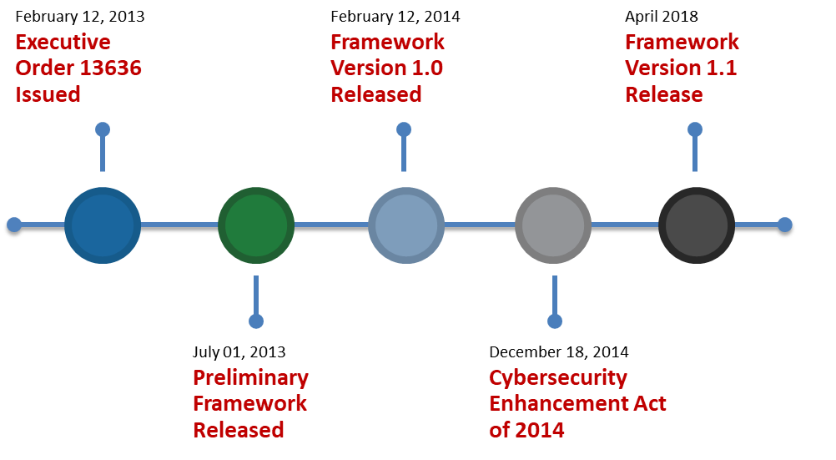
Eras of Cybersecurity Framework
31

Slide 32
The Framework Web Site www.nist.gov/cyberframework

Slide 33
Self-Help Web Materials www.nist.gov/cyberframework

Slide 34
Self-Help Web Materials www.nist.gov/cyberframework

Slide 35
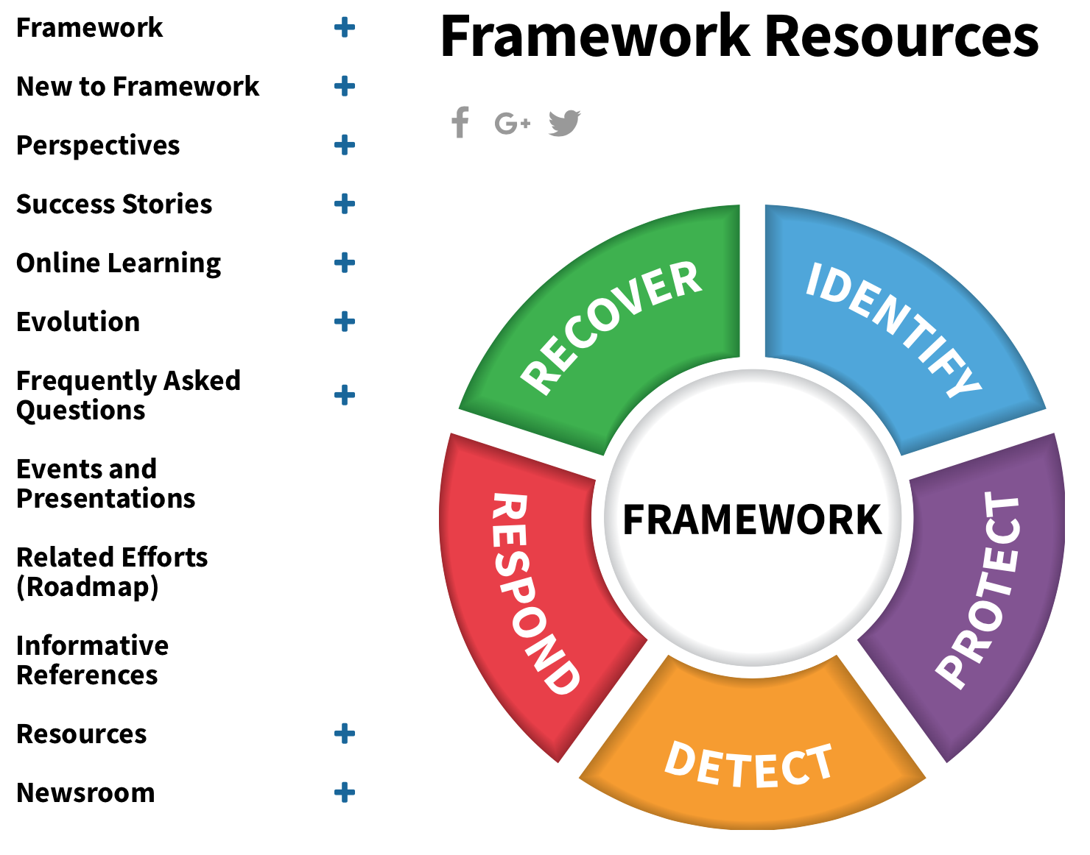
Resources https://www.nist.gov/cyberframework/framework-resources-0
General Resources sorted by User Group:
Critical Infrastructure
Small and Medium Business
International
Federal
State Local Tribal Territorial Governments
Academia
Assessments & Auditing
General
Over 150 Unique Resources for Your Understanding and Use!

Slide 36
Resources - State & Local https://www.nist.gov/cyberframework/state-local-tribal-and-territorial-resources
Texas, Department of Information Resources
Aligned Agency Security Plans with Framework
Aligned Product and Service Vendor Requirements with Framework
North Dakota, Information Technology Department
Allocated Roles & Responsibilities using Framework
Adopted the Framework into their Security Operation Strategy
Houston, Greater Houston Partnership
Integrated Framework into their Cybersecurity Guide
Offer On-Line Framework Self-Assessment
National Association of State CIOs
2 out of 3 CIOs from the 2015 NASCIO Awards cited Framework as a part of their award-winning strategy
New Jersey
Developed a cybersecurity framework that aligns controls and procedures with Framework

Slide 37
Recent NIST Work Products https://www.nist.gov/cyberframework/framework-resources-0
Manufacturing Profile NIST Discrete Manufacturing Cybersecurity Framework Profile
Self-Assessment Criteria Baldrige Cybersecurity Excellence Builder
Maritime Profile
U.S. Coast Guard Bulk Liquid Transport Profile

Slide 38
Resources https://www.nist.gov/cyberframework/framework-resources-0
NIST Special Publications
Computer Security Resource Center
800 Series @ csrc.nist.gov
National Cybersecurity Center of Excellence
1800 Series @ nccoe.nist.gov
Over 150 Unique Resources for Your Understanding and Use!

Slide 39
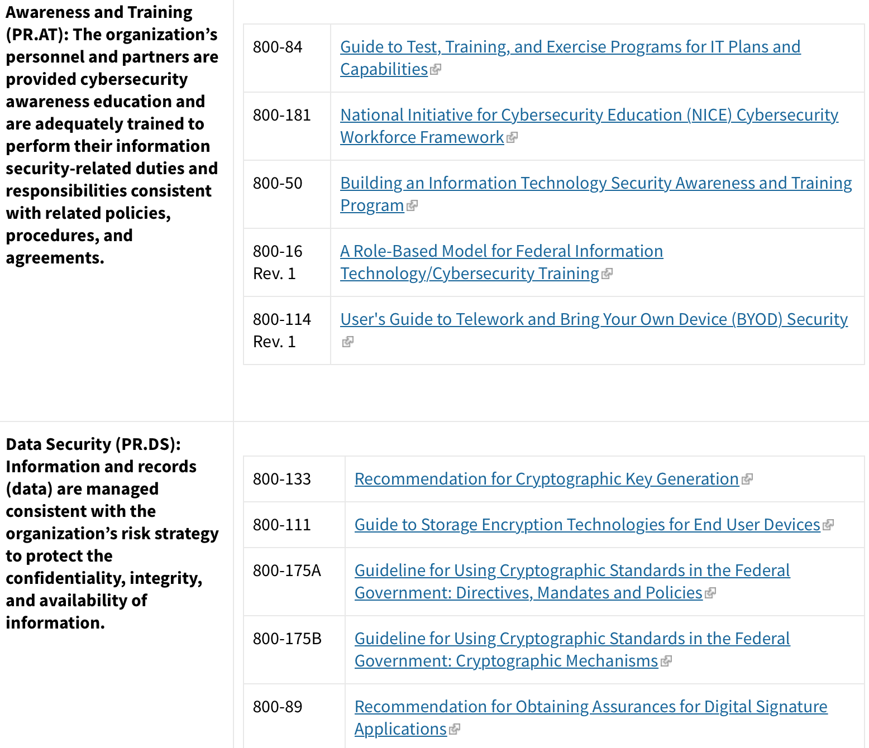
NIST Special Publications by Category https://www.nist.gov/cyberframework/protect

Slide 40
Online Informative References https://www.nist.gov/cyberframework/informative-references

Slide 41
Core – Example^{1.1}
Cybersecurity Framework Component

Slide 42
Relationship Types Online Informative References
Case 1
Case 2
Case 3
Case 4
Case 5
Subset of
Intersects with
Equivalent to
Superset of
Not related to
F
F
R
F
R
F & R
F
R
R
Key
Framework – blue
Reference Document - red

Slide 43
Continued Improvement of Critical Infrastructure Cybersecurity
Update Activities | Engagement
Request for Information – Views on the Framework for Improving Critical Infrastructure Cybersecurity – Dec 2015 | 105 Responses
7th Workshop – Apr 2016 | 653 Physical Attendees, 140 Online Attendees
Draft 1 – Framework Version 1.1 – Released Jan 2017 | Approx. 42,000+ downloads As of 4/27/18
Request for Comment – Proposed update to the Framework for Improving Critical Infrastructure Cybersecurity – Jan 2017 | 129 Responses
8th Workshop – May 2017 | 517 Physical Attendees, 1528 Online Attendees
Draft 2 – Framework Version 1.1 – Released Dec 2017 | Approx. 32,000+ downloads As of 4/27/18
Request for Comment – Cybersecurity Framework Version 1.1 – Draft 2 – Dec 2017 | 89 Responses
Framework Version 1.1 – Release April 2018 | Approx. 27,000+ downloads thus far

Slide 44
Continued Improvement Living Document Process https://www.nist.gov/cyberframework/online-learning/update-process
44

Slide 45
Milestones Three Year Minimum Update Cycle https://www.nist.gov/cyberframework/online-learning/update-process
New Version?
3 years from last Final Update
Features List
(Version A)
Major
Minor
Administrative
Features List
(Version B)
Major
Minor
Administrative
Features List
(Version C)
Major
Minor
Administrative
Draft Framework Update
Publish Framework Update
X
Annual Conference
Annual Conference
Annual Conference
Annual Conference
45

Slide 46
Ways to Help Stakeholder Recommended Actions
Create and share your Resources with others in coordination with NIST
Customize Framework for your sector or community
Publish a sector or community Profile or relevant Online Informative Reference
Publish Success Stories of your Framework implementation in coordination with NIST
Advocate for the Framework throughout your sector or community, with related sectors and communities.
Submit an idea for the NIST Call for Speakers
cyberframework@nist.gov for all NIST
coordination and communication

Slide 47
Upcoming
15-16 May 2018 | Federal Computer Security Managers Forum https://csrc.nist.gov/Events/2018/Federal-Computer-Security-Managers-Forum-2-day
Spring 2018 | Publication of Roadmap for Improving Critical Infrastructure Cybersecurity
Spring 2018 | Publication of NIST Interagency Report 8170
Summer 2018 | Spanish Language Framework Version 1.1
6-8 November 2018 | NIST Cybersecurity Risk Management Conference - Call for Speakers
Winter 2018-19 | Small Business Starter Profiles
47

Slide 48
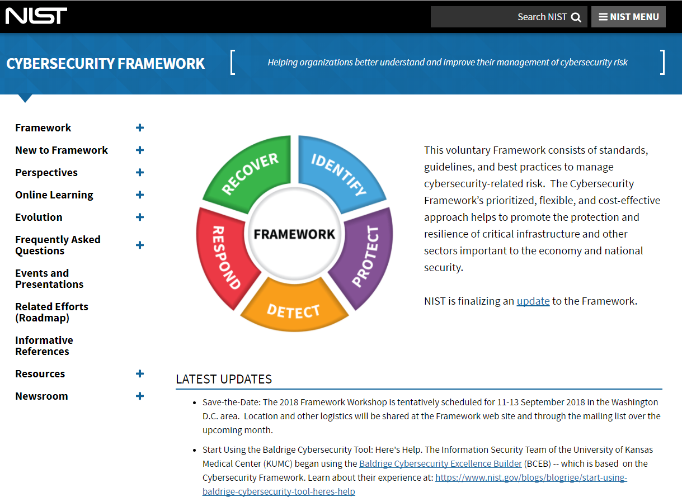
Resources
Framework for Improving Critical Infrastructure Cybersecurity and related news and information:
www.nist.gov/cyberframework
Additional cybersecurity resources:
http://csrc.nist.gov/
Questions, comments, ideas:
cyberframework@nist.gov
48

Slide 49
Questions?
49

