Slide 1
HL7 v2 Conformance and Testing: An overview of conformance, specification development, testing strategies, and tools
IHIC 2019 Warsaw, Poland
October 22nd, 2019
Robert Snelick (Sznilik), NIST

Slide 2
NIST
U.S. Federal Agency under the Dept. of Commerce—”Standards and Measurement”
Developed the conformance test method (test procedures, test data, and test tools) for ONC 2011, 2014, and 2015 Edition certification
Developed conformance test tools for CDC, IHE, HL7, ONC, AIRA, ISDS, HIMSS, …)
Supports SDOs via guidance; and assessment and certification programs via tools, but does not perform certification

Slide 3
Speaker
Robert Snelick
Project Manager and System Architect - National Institute of Standards and Technology (NIST)
Co-chair – HL7 Conformance Working Group
Architect and lead of the NIST Testing Infrastructure for conformance test tools including those for the CDC, IHE, and ONC Certification
Co-author – Healthcare Interoperability Standards Compliance Handbook, Springer 2016
robert.snelick@nist.gov

Slide 4
HL7 v2 Seminar Content
How to specify and interpret requirements
Understanding HL7 v2 conformance
What’s new in HL7 v2
How to organize implementation guides
HL7 v2 Profiling
NIST HL7 v2 Platform
Tool to create implementation guides
Tool to create test plans
Conformance validation tools

Slide 5
Motivation and Overview

Slide 6
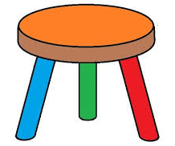
Foundation for Interoperability
Well-defined Standards
Testing
Implementation
Standards Development Lifecycle
Standards
Testing
Implementation
HIT Interoperability
Implementation
Well-defined Standards
Conformance Testing
Notes:
“well-defined standards” → having and using conformance constructs correctly.
Standards must be created and adopted
Not just standards, but well-defined standards (they must be understandable)
Standards must be specific (profiled for use)
Standards should/must be represented in a computable format
Send good acknowledgements
Implementations must be tested for conformance
Systems must be tested for interoperability

Slide 7
Failure happens when:
One or more components are omitted or are not sufficient
Standards
Testing
Implementation
HIT
ability
Inter
oper
Implementation
Well-defined Standards
X
Conformance Testing

Slide 8
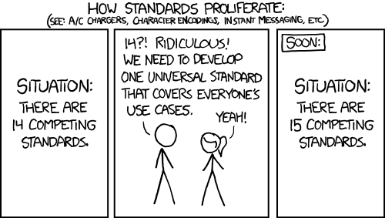
Lessons Learned: Standards
Ambiguous
Inadequate investment
Not specific enough for use cases
Lack of verification (Implementations and Testing)
Not written to a desired state
Complex
Evolving
Timeliness
Not complete
Too many
Impact
Standards Investment
Used with permission. http://xkcd.com/927
Notes:
Ambiguous—a factor is that standards are written natural languages
Evolving—new versions, like, IHE for some every year. Some terminologies constantly changed.
Because they are consensus based, often will be written to a current—inadequate state, not to a desired state—I’ve actually standard include multiple solutions because of competing vendors products implemented a capability differently.
HL7 v2 IGs, but different
Ambiguous
Not the responsibility of testers to fill in the gaps—testers can and should request clarification, SDO needs to respond
Is FHIR heading in same direction?
The use of APIs and RESTful services in FHIR is a powerful paradigm, but it does not and cant not mask the inherent complexity in healthcare data exchange. We must still pay attention to how we specify requirements in FHIR, we can’t make the same mistakes we have made in the past, or we will only make incremental change instead of transformative change.
Under specified
Multiple solutions
Conflation of requirements (requirement scoping)
Document current state—not desired state
Not specific enough—e.g., code system binding
Too specific
Poor documentation and typos
Lack of a consistency
Incomplete Use Cases
Absence of harmonized requirement specification methodology
Insufficient requirement specification mechanisms
Lack of reference and pilot implementations
Lack of testing
Improper scoping

Slide 9
Lessons Learned: Realities of Testing
Bound to the quality of the standards
Tolerance for comprehensiveness
Time
Budgets
Inadequate Investments
What to Test?
Boundless instances
Adequate test coverage
What are the priorities?
Test Cases
Realistic
Data
“Getting it right”
Impact
Testing Investment

Slide 10
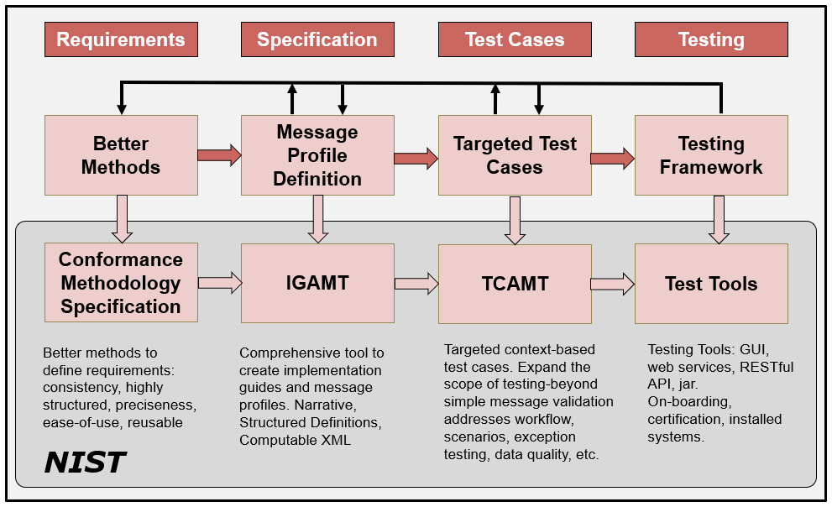
HL7 v2 Development Phases/Cycle

Slide 11
Fundamental Terms
Conformance
Interoperability
Compliance
Compatibility
Alert: Not everyone will agree on these definitions
Alert: Some use these terms interchangeably
Alert: Terms are overloaded in use

Slide 12
Conformance
Defined as the fulfillment of a product, process, or service of specified requirements [1,2].
The concept of conformance is essential to any standard for providing an objective measure of how closely implementations satisfy the requirements defined in the standard [1,2].
Specification
Does the system implement the requirements as stated in the specification?
Conformance
Implementation
[1] ISO Reference - ISO/IEC 17000 Conformity assessment - Vocabulary and general principles, first edition 2004-11-02.
[2] Glossary of Conformance Terminology, Interoperability and Conformance Technical Committee, OASIS. http://www.oasis-open.org/committees/ioc/glossary.htm
Notes:
Conformance is determined based on a claim of conformance to a particular specification (which can be a national implementation guide or a local specification).

Slide 13
Interoperability
“is the ability of two or more systems or components to exchange information and to use the information that has been exchanged.” [1]
Two Key Parts:
1) information must be exchanged, which refers to the technical/functional/syntactical characteristic;
2) but the more important part is the correct semantic interpretation allowing for use of the exchanged information [2].
Implementation
Implementation
Interoperability
Can two interconnected systems exchange data and use that data to perform a business function as both intended?
[1] [IEEE-1990] Institute of Electrical and Electronics Engineers. IEEE Standard Computer Dictionary: A Compilation of IEEE Standard Computer Glossaries. New York, NY: 1990.
[2] Benson T. Principles of Health Interoperability HL7 and SNOMED. Health Informatics Series, Springer-Verlag, London Limited 2010.

Slide 14
Compliance
Is the degree to which a derived specification adheres to the requirements defined in the foundational specification (standard)
In other words, are the rules for adding constraints or extending the specification faithfully followed
Specification
Does a derived specification apply constraints to a base specification in accordance to the constraint model?
Compliance
Derived Specification
Notes:
That is, is the derived specification a proper set of requirements on the base specification (If an element is Required in the base, a derived specification can’t change it to Optional and be considered compliant).
Compliance is often a term used in place of conformance—hard to argue that it is wrong, conformance is the better term for describing if systems implement requirements and we will put a stake in the ground and use these terms as defined here. We will use ISO’s definition of conformance.
In order to determine conformance of a system, complete documentation is necessary. This however is often not the case. Compliance of the complete documentation of the interface can be assessed with the higher level profile. Missing documentation hinders conformance and compliance assessment.

Slide 15
Compatibility
Declares whether two specifications define sets of requirements that are harmonized with each other, allowing systems that implement them to work together, i.e., interoperate
Compatibility is a prerequisite for interoperability
Specification
Compatibility
Specification
Do the specifications define a set of harmonized requirements?
Notes:
Compatibility is a concept that is determined from the receiver perspective. The receiver is the “party” that needs to perform a certain function with the data received. If data is not available to perform a function then the sending/receiving pair is non-compatible. Compatibility is a pre-requisite for interoperability. More on this topic later in this tutorial.

Slide 16
Relationships
Specification
Compliance
Derived
Specification
Compatibility
Derived
Specification
Conformance
Implementation
Implementation
Interoperability
Source: F. Oemig, R. Snelick [2016]
10/18/2019
Notes:
Key Terms (white boxes) as they related to specifications and implementations (rose boxes).
Specification is the standard that contain the requirements. Specifications can be profiled (i.e., constrained further) to meet the needs of a refined use case. The result is a derived specification.
Specifications are implemented.

Slide 17
How is Profiling Related?
We must profile in a consistent manner using “rich” conformance constructs.
Profiling
Profiling
Specification
Compliance
Derived
Specification
Compatibility
Derived
Specification
Conformance
Implementation
Implementation
Interoperability
Source: F. Oemig, R. Snelick [2016]
10/18/2019
Notes:
Profiling: Refinements of the standard via constraints and extension.
NOTE: Can implement to the same profiled standard (which is often the goal when the same expectations are the same for sender and receiver).
NOTE 2: A derived specification is a profile, but documentation of an interface is also considered a “derived specification”.

Slide 18
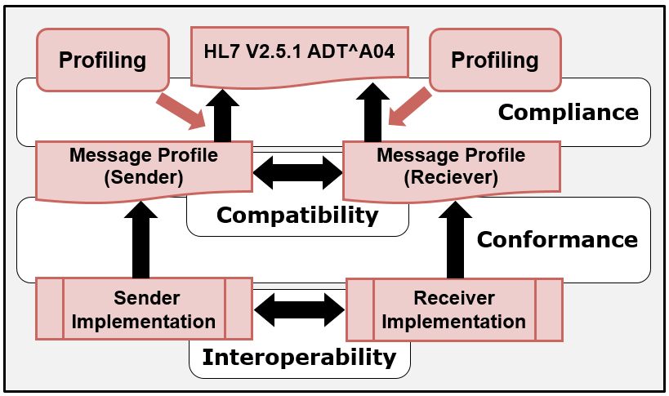
In the Context of HL7 v2
10/18/2019
Notes:
Profiling: Refinements of the standard via constraints and extension.
NOTE: Can implement to the same profiled standard (which is often the goal when the same expectations are the same for sender and receiver).
NOTE 2: A derived specification is a profile, but documentation of an interface is also considered a “derived specification”.

Slide 19
Implementation Guides and Profiling

Slide 20
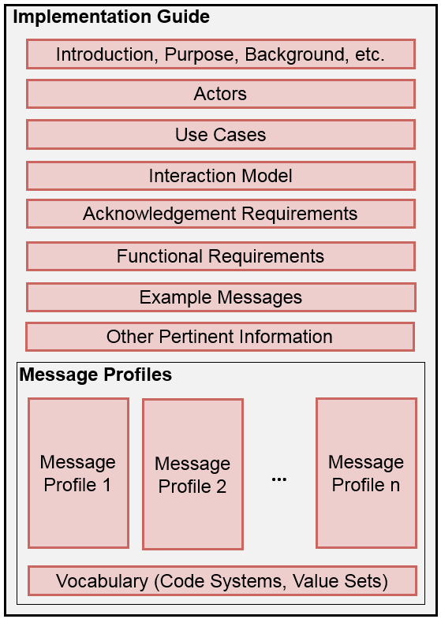
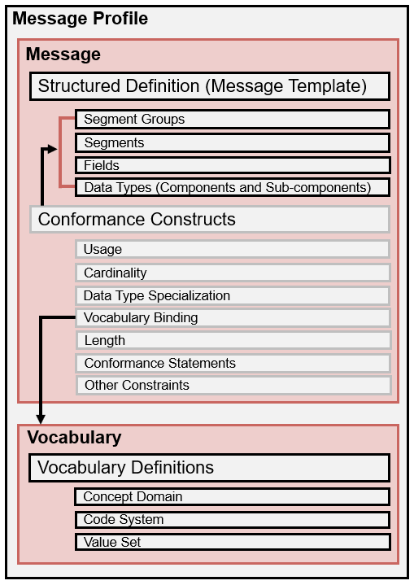
HL7 v2 Implementation Guide and Message Profiles

Slide 21
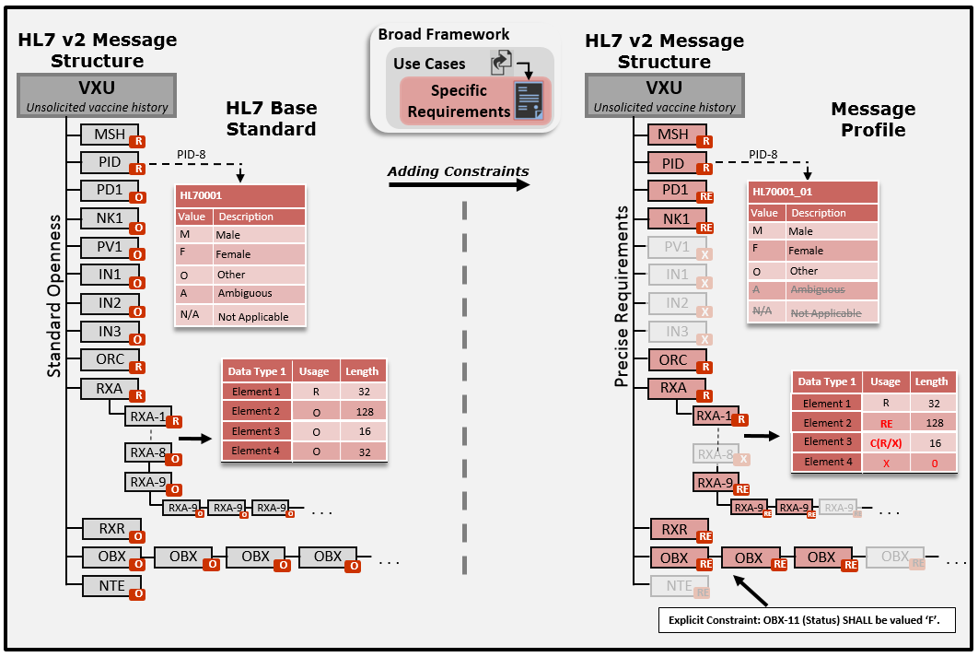
HL7 v2 Profiling Overview
10/18/2019

Slide 22
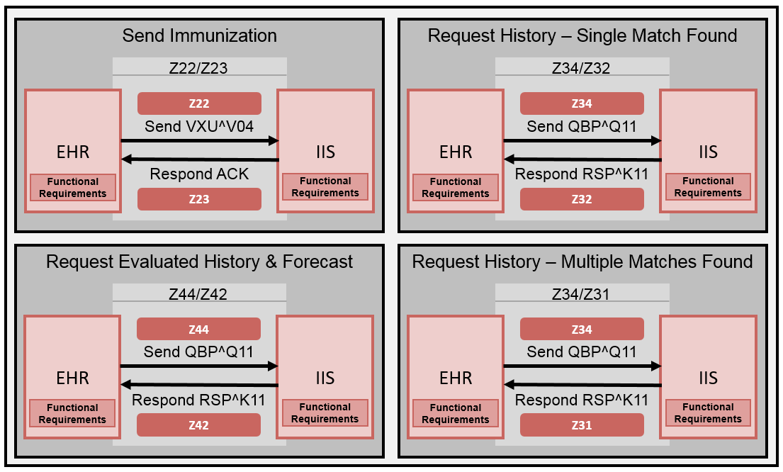
Representative Immunization IG
10/18/2019

Slide 23
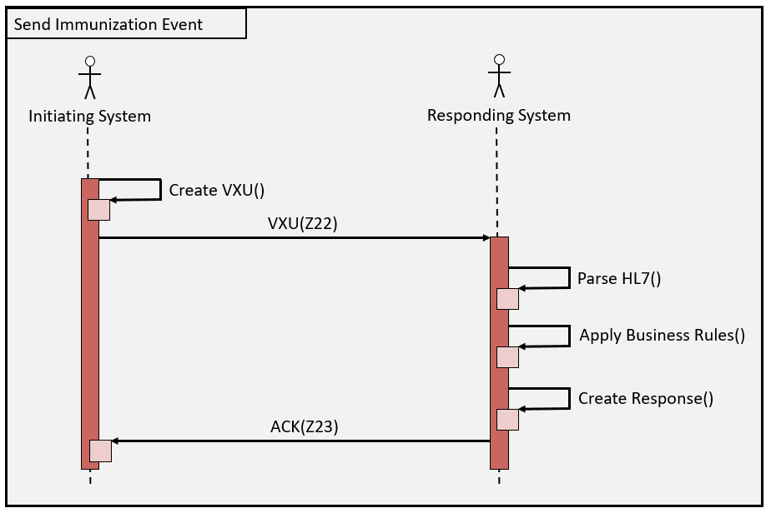
Example Interaction Diagram
10/18/2019

Slide 24
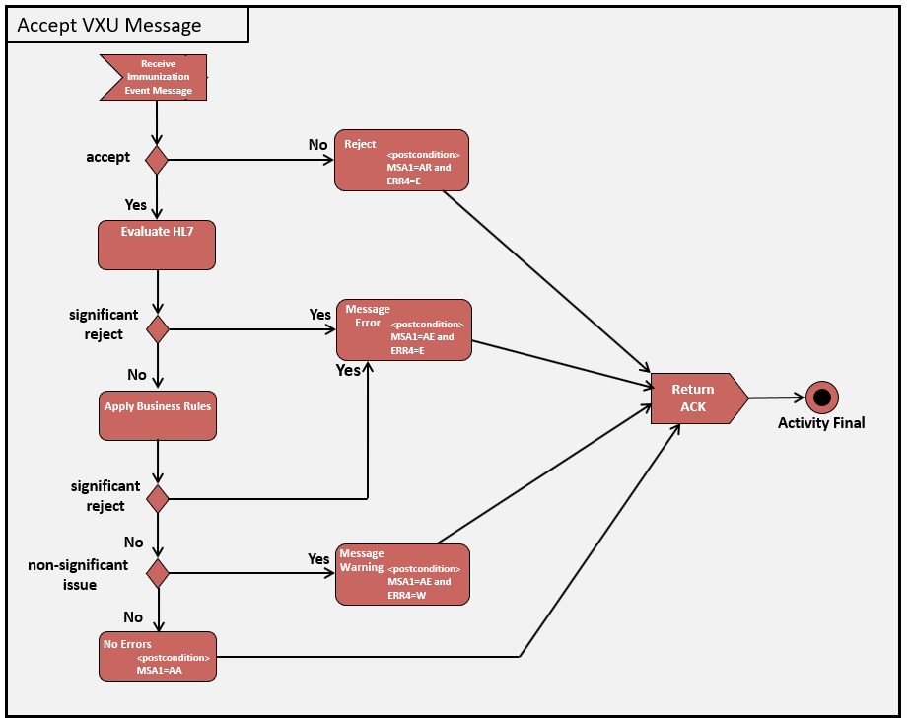
Acknowledgement Responsibilities
10/18/2019
Notes:
Important for Data Quality and Completeness
Use of acknowledgements is a tool—use it correctly
Systems may be rejecting messages but sender never knows about it

Slide 25
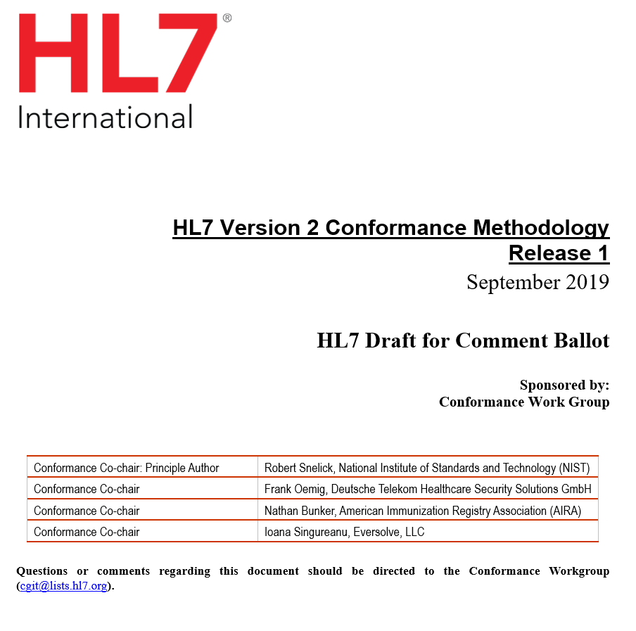
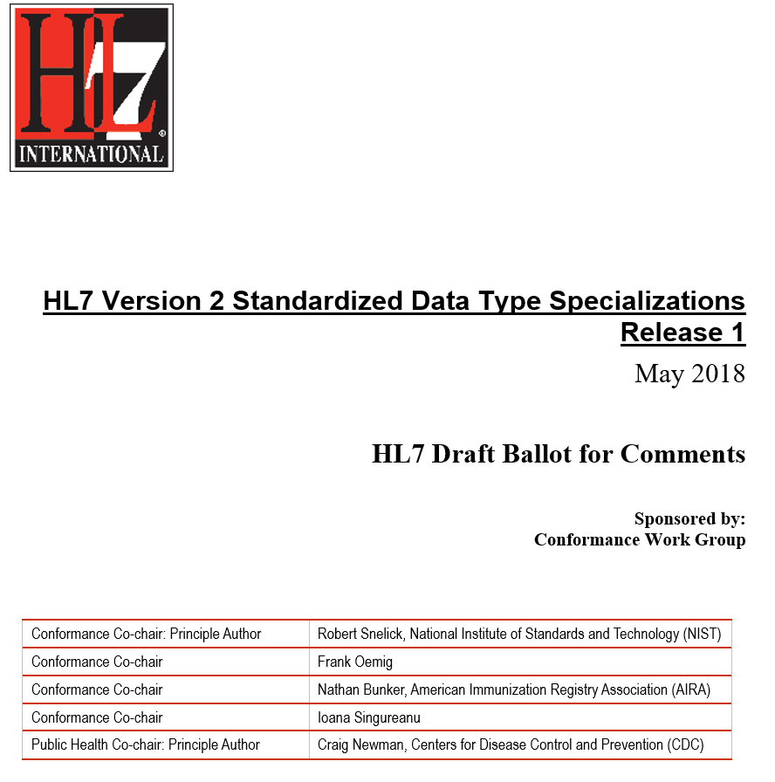
New HL7 v2 Specifications
Ballot Schedule
September 2019 1st Ballot
January 2020 Normative Ballot
Ballot Schedule
May 2020 2nd Ballot
September 2020 Normative Ballot
Notes:
Allows for precise requirement specification using high-level conformance constructs
Completely revised (From Chapter 2B)
Expanded content
Ballot Schedule
September 2019 1st Ballot
January 2020 Normative Ballot
On-line Version
https://v2.hl7.org/conformance
Additional content

Slide 26
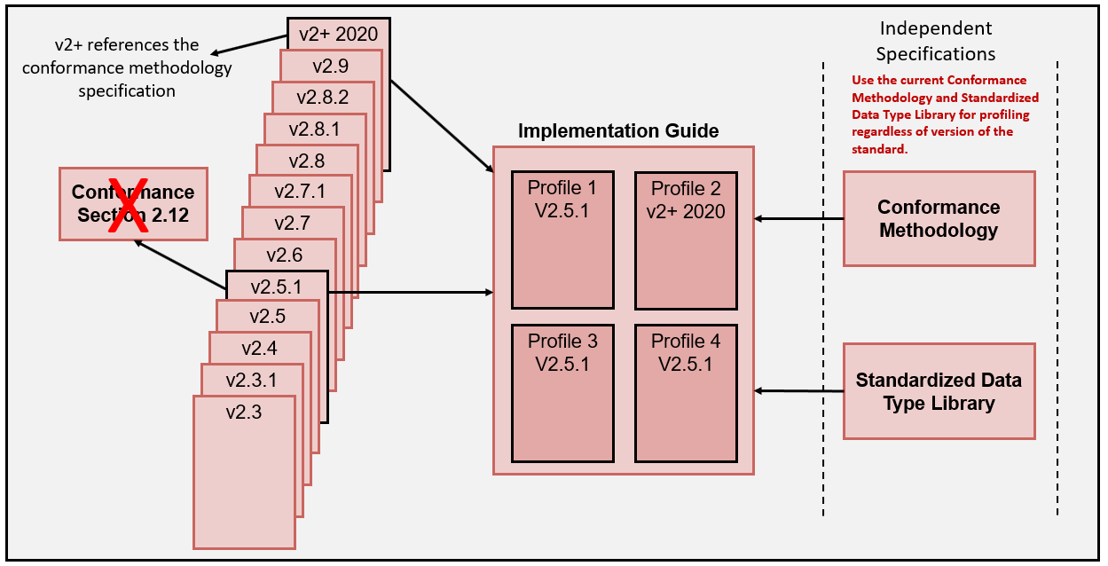
HL7 v2 IG Development
Notes:
These are the common terms that we will start with. More will be added as we move along.

Slide 27
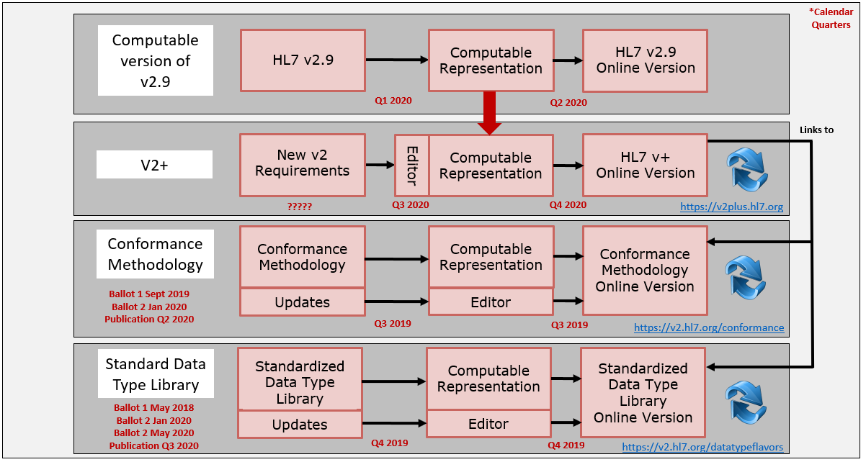
HL7 v2 Moving Forward

Slide 28
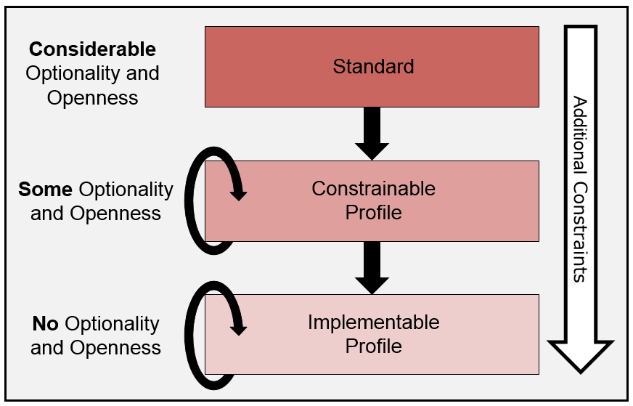
Basic Profile-Level Hierarchy
10/18/2019

Slide 29
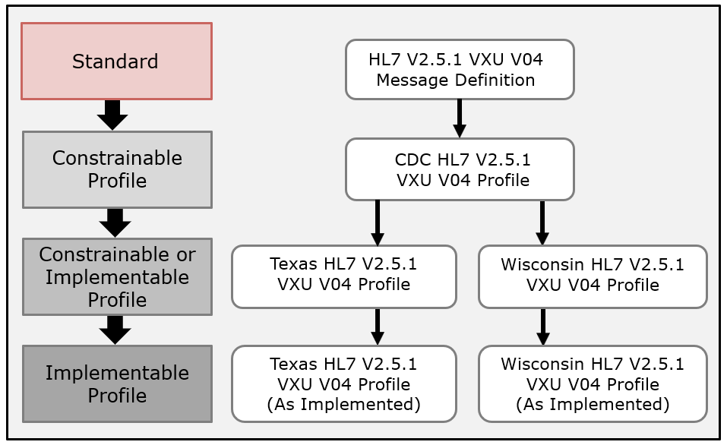
U.S. Immunization Profiles
10/18/2019

Slide 30
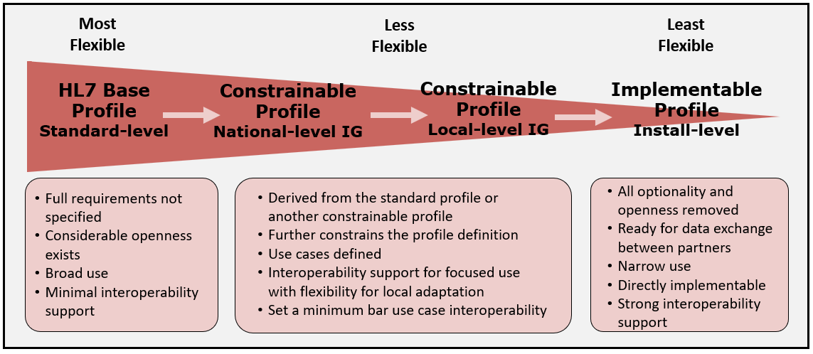
HL7 v2 Profile Spectrum
Notes:
These are the common terms that we will start with. More will be added as we move along.

Slide 31
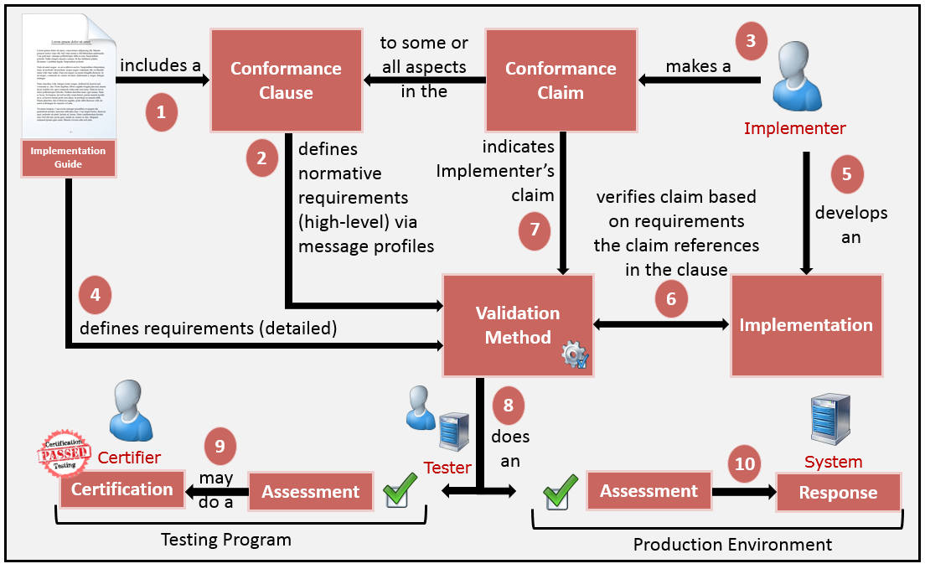
IGs in the Context of use
10/18/2019
Notes:
Comments for response to conformance violation of assessment in the production environment:
Should a receiver process a message, document, resource, etc., if a non-conformity is found? “It depends”
Non-conformity with valid data is better than no data at all
Partial data is most cases is better than no data at all
The severity of the non-conformity must be considered
Conformity assessment is not an end-all, it is a useful tool for initial assessment of data quality

Slide 32
Non-conformity Case Studies
Case 1: Missing Set ID in the PID segment
Process entirely, report informational exception
Case 2: Missing vaccine code (in the RXA segment) in the 2nd of 3 vaccine groups
Process the 2 other valid groups, report error exception
Case 3: Missing patient name and identifier in the PID segment (and any other ID information)
Don’t process message, report error/reject exception
Non-conformity should not prevent the exchange and processing of useful information, in fact, not processing in many cases is the wrong response to non-conformities
Notes:
These are HL7 v2 immunization examples.
These are possible responses, business rules and exchange agreements dictates the processing actions and response exceptions.
Case 3: may not just be limited to these fields, also include other information that could be used to identify patient such as Patient Visit Number in PV1-19.

Slide 33
Conformance Constructs for Applying Constraints

Slide 34
Conformance Constructs
A means in which to formally, unambiguously, and consistently define requirements (constraints)
Constructs provide a formal (“structured”) mechanism for specifying requirements
Provides a shorthand notation for expressing explicit statements of requirements
Key mechanism used for constraining a standard for a specific use case (= profiling)
The “richness” of conformance constructs varies across standards—v2 has a “rich” set
Notes:
For example, HL7 v2 has a very rich set of conformance constructs that allow for precise definition (although often they are not used to their full capacity in many implementation guides. On the other hand, NCPDP SCRIPT provides a limited set of conformance constructs.

Slide 35
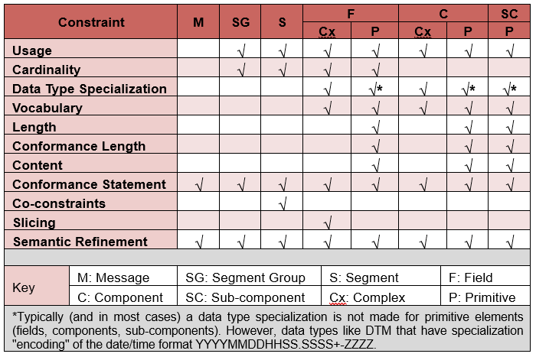
Conformance Constructs

Slide 36
Applying Constraints Rules
Constraints are applied using the conformance constructs
Must follow Compliance rules
Constraints can only be “tightened”, not “loosened”
Provides detailed requirements for data elements necessary for the use case
Eliminate data elements not pertinent to use case
Examples of Compliant and Non-compliant Constraints
Type | Compliant? | Example 1 | Example 2
Usage | Yes | O → R | RE → R
Usage | No | R → X | R → RE
Explicit | Yes | MAY → SHALL | SHOULD → SHALL
Explicit | No | SHALL → SHOULD | SHALL → MAY
Cardinality | Yes | [0..n] → [1..1] | [0..*] → [0..5]
Cardinality | No | [1..1] → [0..1] | [1..5] → [0..5]

Slide 37
Usage (Sender Perspective)
Indicates the support and presence (or non-presence) of an element
Support → Implementation Requirement
Presence → Operational Requirement
Also referred to as Appearance or Optionality indicator
Concept | Usage | Definition
Support and Presence | R | Required. The element SHALL be supported and SHALL be present in the instance
Support | RE | Require, but may be empty. The element SHALL be supported and MAY be present in the instance
Prohibited | X | Not-supported. The element SHALL NOT be present in the instance
Undeclared Conditional | C | Undeclared Conditional. The element is conditional and is based on the outcome of a predicate that may not be defined initially. The usage indicator does not define an exact usage for the true and false outcomes and does not define an explicit predicate.
Declared Conditional | C(a/b) | Declared Conditional. The element is conditionally Supported, Present, or Prohibited and is based on the outcome of a predicate. The usage indicator defines exactly the usage for the true and false outcomes and defines an explicit predicate that determines the true and false outcomes.
Optional | O | Optional. The usage of the element is subsequently determined in a derived specification (profile)—is a placeholder Usage indicator
Notes:
From an implementation perspective whether or not the element must be supported, and therefore possible to appear in an instance. For an operational viewpoint (i.e., runtime), usage indicates whether or not the element may appear.
That is a “Fuzzy” MAY because in essence it is a SHALL but depends on data available and or other conditions. It is not all that clear in standards. Bottom line though it is a MAY in the fact that in a given instance (without context) it MAY or MAY NOT be present in the message instance.
R
Required
The element is required and must be present in the message instance.
RE
Require, but may be Empty
The element is required to be supported and may be present in the message instance.
C
Undeclared Conditional
The usage of the element is conditional and is based on the outcome of a predicate that may not be defined initially. The usage indicator does not define an exact usage for the true and false outcomes and does not define an explicit predicate. Although the definition may be informative, the definition is incomplete and must be further defined. The undeclared conditional usage is the predominate form of conditional usage in the base standard. At this level, the specific context may not be known completely, therefore, precise constraints can’t be specified. In constrainable message profiles, a “C” usage may be used and is interpreted as a “passthrough” from the base standard (i.e., the specifier is indifferent). The “C” usage indicates implementation requirements are yet to be determined and, in this sense, behaves much like the “O” usage indicator, except the condition associated with the element is known. For an implementation profile, all elements designated as undeclared conditional usage must be constrained to R, RE, C(a/b), or X.
C(a/b)
Declared Conditional
The usage of the element is conditional and is based on the outcome of a predicate. The usage indicator defines exactly the usage for the true and false outcomes and defines an explicit predicate that determines the true and false outcomes. The declared conditional defines explicit implementation requirements. The declared conditional usage construct must not be nested.
O
Optional
The usage requirements for the element have not been defined at this stage of specification. For an implementation profile, all elements designated as optional usage must be constrained to R, RE, C(a/b), or X.
X
Not-supported
The element is not supported and must not be present in the message instance.
B
Backward Compatible
The element has been designated for removal from a future version of the standard, and current use is discouraged.

Slide 38
Condition Usage and Predicate
C(a/b): The operational usage designation for the element is determined based on the outcome of an associated predicate at runtime.
If predicate is true follow requirements for “a”, which must be one of “R”, “RE”, “O”, or X”.
If predicate is true follow requirements for “b”, which must be one of “R”, “RE”, “O”, or X”.
Condition Predicates Examples
Location | Usage | Predicate
RXA-7 | C(R/X) | If RXA-6(Administered Amount) does not contain the value '999'.
RXA-9 | C(R/O) | If RXA-20(Completion Status) contains one of the values in the list: {CP,PA}.
RXA-10 | C(RE/O) | If RXA-9.1(Identifier) contains the value '00' AND RXA-20(Completion Status) contains one of the values in the list: {CP,PA}.
RXA-15 | C(R/O) | If RXA-9.1(Identifier) contains the value '00' AND RXA-20(Completion Status) contains one of the values in the list: {CP,PA}.
RXA-16 | C(RE/O) | If RXA-9.1(Identifier) contains the value '00' AND RXA-20(Completion Status) contains one of the values in the list: {CP,PA}.
RXA-17 | C(R/O) | If RXA-9.1(Identifier) contains the value '00' AND RXA-20(Completion Status) contains one of the values in the list: {CP,PA}.
RXA-18 | C(R/X) | If RXA-20(Completion Status) contains the value 'RE'.
RXA-21 | C(R/X) | If RXA-5.1(Identifier) does not contain the value '998'.
Write explicit computable conditional predicates.

Slide 39
Usage Compliance
Usage Code | Base-to-Constrainable | Constrainable-to-Constrainable | Base-to-Implementation | Constrainable-to-Implementation | Implementation-to-Implementation
R | R | R | R | R | R
RE | R, RE | R, RE | R, RE | R, RE | R, RE
O | R, RE, C(a,b), O, X | R, RE, C(a,b), O, X | R, RE, C(a,b), X | R, RE, C(a,b), X | N/A
C | R, RE, C, C(a,b), X | R, RE, C, C(a,b), X | R, RE, C(a,b), X | R, RE, C(a,b), X | N/A
C(a/b) | R, RE, C(a,b), C(a’/b’), X | R, RE, C(a,b), C(a’/b’), X | R, RE, C(a,b), C(a’/b’), X | R, RE, C(a,b), C(a’/b’), X | R, C(a,b), C(a’/b’)
X | X | X | X | X | X
B | R, RE, C(a,b), O, X, B | R, RE, C(a,b), O, X | R, RE, C(a,b), X | R, RE, C(a,b), X | N/A
W | X | N/A | X | N/A | N/A
Compliance assessment for elements with conditional usage (i.e., C(a/b)) is dependent on the respective true and false usage code specification. For example, if conditional usage for an element is specified as C(RE/O), the true usage code “RE” can be profiled to “RE” or “R” in a derived profile.

Slide 40
Usage Compatibility
Sender | Receiver | Compatible | Comment
R | R | Yes | Sender and Receiver have the same expectations.
R | RE | Yes | Receiver supports this element but is not always expecting it.
R | X | Yes | Receiver doesn’t support this element.
RE | R | No | Receiver is not guaranteed to get required data.
RE | RE | Yes | Sender and Receiver have the same expectations.
RE | X | Yes | Receiver doesn’t support this element.
X | R | No | Receiver will not get required data.
X | RE* | No | Receiver will not get the data it needs for certain use cases. Note: a data value must be needed in at least one instance; otherwise, the element should not be profiled to RE. On the other hand, RE is the only construct that expresses the capability of the receiving system to handle the data.
 |  | Yes | The element is not necessary for operation.
X | X | Yes | Sender and Receiver have the same expectations.
*In this combination, compatibility depends on the use case. If the data are important in order to perform the use case, then this combination is not compatible. But if RE only declares the capability of the system, then this pair is compatible.
Notes:
Compatibility is a concept with respect to the receiver. Higher level use cases will indicate needs/expectations of the sender.
Outside the context of a use case, compatibility is determined from the perspective of the receiver.

Slide 41
Cardinality
Identifies the minimum and maximum number of occurrences that must be supported for an element and the number of instances of an element that can appear
Cardinality Construct: [x..y]
[ ]: defined as a range, x: minimum number of occurrences, y: maximum number of occurrences
* → indicates that the maximum cardinality is yet to be defined or unlimited
Cardinality | Interpretation | Valid Usage
[0..0] | Element is never present | X
[0..1] | Element may be omitted, and it can have at most one occurrence | RE, C(a/b), O
[1..1] | Element must have exactly one occurrence | R
[0..n] | Element may be omitted or may have up to n occurrences | RE, C(a/b), O
[1..n] | Element must appear at least once and may have up to n occurrences | R
[0..*] | Element may be omitted or may have an unlimited number of occurrences | RE, C(a/b), O
[1..*] | Element must appear at least once and may have an unlimited number of occurrences | R
[m..n] | Element must have at least m occurrences and may have at most n occurrences. Except in the case where the usage code is RE, the element may also be omitted (“zero occurrences”). | R, RE
[m..*] | Element must have at least "m" occurrences and may have an unlimited number of occurrences. Except in the case where the usage code is RE, the element may also be omitted (“zero occurrences”). | R, RE
^{[1]} m must be greater than 1 and n must be greater than or equal to m; the case where m equals 1 is addressed separately.
^{[2]} m must be greater than 1; the case where m equals 1 is addressed separately.
Notes:
A natural relationship exists between the usage and cardinality

Slide 42
Content: Co-Constraints
Used to express dependencies among a set of data values
Observations typically have co-constraints
Co-constraints can be expressed in a table format, as shown below (preferred) or with explicit complex conformance statements
MSH|^~\&|NISTIISAPP|NISTIISFAC|NISTEHRAPP|NISTEHRFAC|20141031145233-0500||RSP^K11^RSP_K11|NIST-IZ-QR-2.2_Response_K11_Z42|P|2.5.1|||NE|NE|||||Z42^CDCPHINVS|NISTIISFAC^^^^^NIST-AA-1^XX^^^100-3322|NISTEHRFAC^^^^^NIST-AA-1^XX^^^100-6482
MSA|AA|NIST-IZ-QR-2.1_Query_Q11_Z44
QAK|IZ-2.1-2015|OK|Z44^Request Evaluated History and Forecast^CDCPHINVS
QPD|Z44^Request Evaluated History and Forecast^CDCPHINVS|IZ-2.1-2015|648286^^^NIST-MPI-1^MR|Stanley^Clement^S^^^^L|Bell^^^^^^M|19500214|M|1642 Bear Run^^Bozeman^MT^59715^USA^P|^PRN^PH^^1^406^5552020
PID|1||648286^^^NIST-MPI-1^MR^MR~34500907^^^NIST-IIS-MPI^SR||Stanley^Clement^S^^^^L||19500214|M|||1642 Bear Run^^Bozeman^MT^59715^USA^P
ORC|RE||193337027^NIST-AA-IZ-2||||||||||||||
RXA|0|1|20151029||140^seasonal flu^CVX|0.5|mL^^UCUM||00^new immunization record^NIP001|5111^Sticker^Nurse^^^^^^NIST-PI-1^L^^^PRN|^^^NIST-Clinic-1||||||CSL^bioCSL^MVX|||CP
RXR|C28161^IM^NCIT
OBX|1|CE|30956-7^vaccine type^LN|1|88^influenza NOS^CVX||||||F
OBX|2|CE|59779-9^Immunization Schedule used^LN|1|VXC16^ACIP^CDCPHINVS||||||F|||20151029
OBX|3|ID|59781-5^dose validity^LN|1|Y||||||F|||20151029
ORC|RE||9999^NIST-AA-IZ-2||||||||||||||NISTEHRFAC^NISTEHRFacility^HL70362
RXA|0|1|20151029||998^no vaccine admin^CVX|999||||||||||||||NA
OBX|4|CE|30956-7^vaccine type^LN|1|152^pcv NOS^CVX||||||F
OBX|5|CE|59779-9^Immunization Schedule used^LN|1|VXC16^ACIP^CDCPHINVS||||||F
OBX|6|DT|30980-7^Date vaccination due^LN|1|20600101||||||F
OBX|7|DT|30981-5^Earliest Date to give^LN|1|20600101||||||F
OBX|8|CE|30956-7^vaccine type^LN|2|88^influenza NOS^CVX||||||F
OBX|9|CE|59779-9^Immunization Schedule used^LN|2|VXC16^ACIP^CDCPHINVS||||||F
OBX|10|DT|30980-7^Date vaccination due^LN|2|20160901||||||F
OBX|11|DT|30981-5^Earliest Date to give^LN|2|20160901||||||F
OBX|12|CE|30956-7^vaccine type^LN|3|03^MMR^CVX||||||F
OBX|13|CE|59779-9^Immunization Schedule used^LN|3|VXC16^ACIP^CDCPHINVS||||||F
OBX|14|DT|30980-7^Date vaccination due^LN|3|19960101||||||F
OBX|15|DT|30981-5^Earliest Date to give^LN|3|19960101||||||F

Slide 43
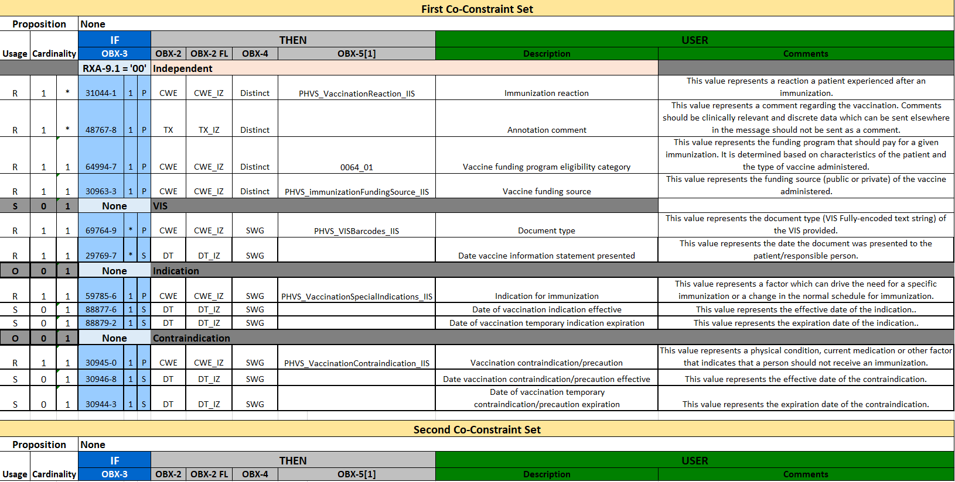
Co-Constraints Example
Notes:
In U.S Case Notification
One generic profile
Many Message Mapping Guides that are essentially profiling a set of observations.

Slide 44
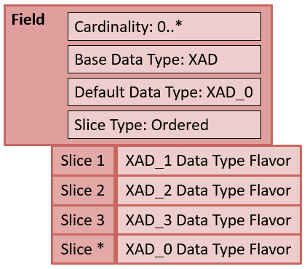
Slicing
Slicing is a concept that allows for occurrences of a field to be defined with different constraints.
Field | Min Cardinality | Max Cardinality | Base Datatype | Default Datatype | Discriminator (Position)
PID-11 (Patient Address) | 1 | * | XAD | XAD_0 | 7 (Address Type)
Discriminator Value | Slice Datatype | Slice Min | Slice Max | Comment
“H” (Home) | XAD_1 | 1 | 1 | If PID-11.7 = “H”, then the requirements for this field slice are defined by XAD_1 data type flavor. A field of this definition must appear once and only once.
“M” (Mailing) | XAD_2 | 0 | * | If PID-11.7 = “M”, then the requirements for this field are defined by the XAD_2 data type flavor. The field slice need not appear or may appear an unlimited number of times.
Notes:
shows the field definition for PID-11 (Patient Address). The cardinality is defined as 0..*. The base data type is XAD and the default slice data type is set to the XAD_0 data type flavor. The discriminator is 7 (Address Type), which indicates a component position within the field.
shows the definition for each slice. The discriminator indicates the actual value that triggers and defines a “slice”. The first row in the table indicates that when (if) the discriminator contains the value of “H” then the field must conform to the requirements defined by the XAD_1 data type flavor. The field slice with these characteristics must appear in the message instance and only can appear once in the message instance. The requirements that dictate whether the field slice must appear are specified by the slice minimum and slice maximum parameters. Likewise, if the discriminator value contains “M” then the field instance follows the requirement indicated by the XAD_2 data type flavor. The field slice with this definition need not appear in the message (Slice Min = 0) or can appear more than once (Slice Max = *). Other discriminator values can also apply, but, since they are not explicitly listed, the default data type flavor defines the requirement for such field instances; in this case, XAD_0 is the data type flavor

Slide 45
Conformance Statements
Explicit Constraints defined using the Conformance Keywords (or formal language)
“Catch-all” Construct
Conformance Verbs
SHALL, SHOULD, MAY, SHALL NOT, etc.
Defined Language for HL7 v2
Conformance Statements
IZ-207 | If RXA-20 (Completion Status) contains the value 'RE' then RXA-5.1 (Identifier) SHALL NOT contain the value '998'.
IZ-30 | RXA-4 (Date/Time End of Administration) SHALL be identical RXA-3(Date/Time Start of Administration).
IZ-32 | If RXA-18 (Substance/Treatment Refusal Reason) is valued then RXA-20 (Completion Status) SHALL contain the value 'RE'.
IZ-48 | If RXA-20 (Completion Status) contains the value 'RE' then RXA-6 (Administered Amount) SHALL contain the value '999'.
IZ-49 | If RXA-5.1 (Identifier) contains the value '998' then RXA-6 (Administered Amount) SHALL contain the value '999'.

Slide 46
Data Type Flavors
Base
Flavor 1
CWE DATA TYPE
SEQ | Name | DT | Usage | Vocab
1 | Identifier | ST | O
2 | Text | ST | O
3 | Name of Coding System | ID | O
4 | Alternate Identifier | ST | O
5 | Alternate Text | ST | O
6 | Name of Alternate Coding System | ID | O
7 | Coding System Version ID | ST | C
8 | Alternate Coding System Version ID | ST | O
9 | Original Text | ST | O
CWE_01 DATA TYPE
SEQ | Name | DT | Usage | Vocab
1 | Identifier | ST | R
2 | Text | ST | RE
3 | Name of Coding System | ID | R
4 | Alternate Identifier | ST | O
5 | Alternate Text | ST | O
6 | Name of Alternate Coding System | ID | O
7 | Coding System Version ID | ST | R
8 | Alternate Coding System Version ID | ST | O
9 | Original Text | ST | RE
Flavor 3
Flavor 2
CWE_03 DATA TYPE
SEQ | Name | DT | Usage | Vocab
1 | Identifier | ST | R
2 | Text | ST | RE
3 | Name of Coding System | ID | R
4 | Alternate Identifier | ST | RE
5 | Alternate Text | ST | RE
6 | Name of Alternate Coding System | ID | C(R/X)
7 | Coding System Version ID | ST | C(R/X)
8 | Alternate Coding System Version ID | ST | O
9 | Original Text | ST | RE
CWE_02 DATA TYPE
SEQ | Name | DT | Usage | Vocb
1 | Identifier | ST | RE
2 | Text | ST | C(R/RE)
3 | Name of Coding System | ID | C(R/X)
4 | Alternate Identifier | ST | O
5 | Alternate Text | ST | O
6 | Name of Alternate Coding System | ID | O
7 | Coding System Version ID | ST | R
8 | Alternate Coding System Version ID | ST | O
9 | Original Text | ST | C(R/RE)

Slide 47
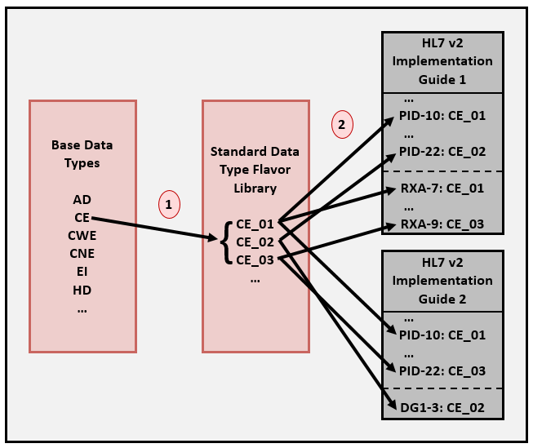
Data Type Flavors Use

Slide 48
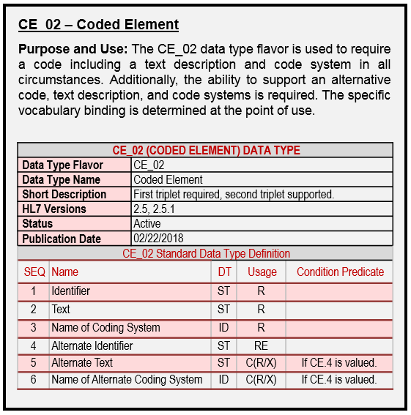
Data Type Flavors Definition
Consistency
Reusability
Select “off-the-shelf” data type definitions

Slide 49
Segment Level Profiling
RXA_IZ_01
SEQ | ELEMENT NAME | Data Type | Usage | Card. | Vocab | B.Str | LEN | C.L
1 | Give Sub-ID Counter | NM | R | 1..1 |  |  |  | 1
2 | Administration Sub-ID Counter | NM | R | 1..1 |  |  |  | 1
3 | Date/Time Start of Administration | DTM_IZ02 | R | 1..1
4 | Date/Time End of Administration | DTM_IZ02 | R | 1..1
5 | Administered Code | CWE_IZ01 | R | 1..1 | CVX_01 | R
6 | Administered Amount | NM | R | 1..1 |  |  | 1..16
7 | Administered Units | CWE_IZ01 | C(R/X) | 0..1 | UCUM_01 | R
8 | Administered Dosage Form | CWE | O | 0..1
9 | Administration Notes | CWE_IZ01 | C(R/O) | 0..1 | NIP001_01 | R
10 | Administering Provider | XCN_IZ01 | C(RE/O) | 0..1
11 | Administered-at Location |  | X | 0..0 |  |  | 0..0
12 | Administered Per (Time Unit) | ST | C | 0..1
13 | Administered Strength | NM | O | 0..1
14 | Administered Strength Units | CWE | O | 0..1 | 9999 | S
15 | Substance Lot Number | ST | C(R/O) | 0..* |  |  |  | 20=
16 | Substance Expiration Date | DTM_IZ03 | C(RE/O) | 0..1
17 | Substance Manufacturer Name | CWE_IZ01 | C(R/O) | 0..1 | MVX | R
18 | Substance/Treatment Refusal Reason | CWE_IZ01 | C(R/X) | 0..* | 9999 | R
19 | Indication | CWE | O | 0..1 | 9999 | S
20 | Completion Status | ID | RE | 0..1 | 0322 | R | 2..2
21 | Action Code – RXA | ID | C(R/X) | 0..1 | 0206 | R | 1..1
… | … | … | … | … | … |  | … | …

Slide 50
Segment Level Profiling
RXA_IZ_01
Condition Predicates
Location | Usage | Predicate
RXA-7 | C(R/X) | If RXA-6(Administered Amount) does not contain the value '999'.
RXA-9 | C(R/O) | If RXA-20(Completion Status) contains one of the values in the list: {CP,PA}.
RXA-10 | C(RE/O) | If RXA-9.1(Identifier) contains the value '00' AND RXA-20(Completion Status) contains one of the values in the list: {CP,PA}.
RXA-15 | C(R/O) | If RXA-9.1(Identifier) contains the value '00' AND RXA-20(Completion Status) contains one of the values in the list: {CP,PA}.
RXA-16 | C(RE/O) | If RXA-9.1(Identifier) contains the value '00' AND RXA-20(Completion Status) contains one of the values in the list: {CP,PA}.
RXA-17 | C(R/O) | If RXA-9.1(Identifier) contains the value '00' AND RXA-20(Completion Status) contains one of the values in the list: {CP,PA}.
RXA-18 | C(R/X) | If RXA-20(Completion Status) contains the value 'RE'.
RXA-21 | C(R/X) | If RXA-5.1(Identifier) does not contain the value '998'.
Conformance Statements
IZ-207 | If RXA-20 (Completion Status) contains the value 'RE' then RXA-5.1 (Identifier) SHALL NOT contain the value '998'.
IZ-30 | RXA-4 (Date/Time End of Administration) SHALL be identical RXA-3(Date/Time Start of Administration).
IZ-32 | If RXA-18 (Substance/Treatment Refusal Reason) is valued then RXA-20 (Completion Status) SHALL contain the value 'RE'.
IZ-48 | If RXA-20 (Completion Status) contains the value 'RE' then RXA-6 (Administered Amount) SHALL contain the value '999'.
IZ-49 | If RXA-5.1 (Identifier) contains the value '998' then RXA-6 (Administered Amount) SHALL contain the value '999'.

Slide 51
Message Level Profiling
Segment | Segment Flavor | Description | Usage | Cardinality | Chap
MSH | MSH_IZ | Message Header Segment | R | [1..1] | 2
[{SFT}] | SFT | Software | X | [0..0] | 2
[UAC] | UAC | User Authentication Credential | O | [0..1] | 2
PID | PID_IZ | Patient Identification Segment | R | [1..1] | 3
[PD1] | PD1_IZ_01 | Additional Demographics | RE | [0..1] | 3
[{NK1}] | NK1_IZ | Next of Kin/Associated Parties | RE | [0..1] | 3
...
[{ |  | --- ORDER begin | R | [1..*] | 7
ORC | ORC_IZ_01 | Common Order | R | [1..1] | 2
[{PRT}] | PRT | Participation (for ORC) | O | [0..1] | 3
[{ |  | --- TIMING begin | O | [0..1] | 3
TQ1 | TQ1 | Timing/Quantity | R | [1..1] | 7
[{TQ2}] | TQ2 | Timing/Quantity Order Sequence | O | [0..*] | 7
}] |  | --- TIMING end
RXA | RXA_IZ_01 | Pharmacy Administration Segment | R | [1..1] | 4
[RXR] | RXR_IZ | Pharmacy Route | RE | [0..1] | 4
[{ |  | --- OBSERVATION begin | RE | [0..*]
OBX | OBX_IZ_02 | Observation/Result | R | [1..1] | 7
[{PRT}] | PRT | Participation (for Observation) | O | [0..*] | 7
[{NTE}] | NTE | Notes (Regarding Immunization) | O | [0..1] | 3
}] |  | --- OBSERVATION end
}] |  | --- ORDER end

Slide 52
Vocabulary Concepts and Profiling

Slide 53
Vocabulary Relationships
Concept Domain
Code System
Value Set
Vocabulary
Postal Codes
US ZIP Codes
State of Alaska ZIP Codes
A specific set of codes is given for generally a broader use case. All US ZIP codes. Code → 15846 Concept → ZIP code for Kersey, PA
No specific codes given; the semantics of the concept is given. General postal code concept—the specifics are not given—could be for US, Germany, Canada, etc.
A specific set of codes is given for generally a specific use case. All Alaska ZIP codes. Code → 99829 Concept → ZIP code for Hoonah, AK
Levels of specificity and use—tied to specificity of the specification
Any levels can be bound to a data element
Profiling adds constraints which further defines the semantics of the bound data element
Notes:
Note, US Postal code system could also be a value set.

Slide 54
Creating Value Sets
A value set “draws” codes from the code system for a specific use.
Code System
LOINC Code System
Code | Concept
… | …
27129-6 | Lead in Red Blood Cells
5671-3 | Lead in Blood
10368-9 | Lead in Capillary Blood
30424-6 | Macrocytes in Blood
19123-9 | Magnesium (Methodless)
… | …
30963-3 | Vaccine funding source
30956-7 | Vaccine type
38890-0 | Component vaccine type
31044-1 | Reaction
59785-6 | Indications to immunize
69764-9 | Document type
30979-9 | Vaccines due next
59781-5 | Dose validity
… | …
Pick only codes that are relevant for the use case and for the specific data element it is bound to
Value Set
NIP Observation Identifiers Value Set
Code | Concept | Code System
30963-3 | Vaccine funding source | LN
30956-7 | Vaccine type | LN
38890-0 | Component vaccine type | LN
31044-1 | Reaction | LN
59785-6 | Indications to immunize | LN
69764-9 | Document type | LN
30979-9 | Vaccines due next | LN
59781-5 | Dose validity | LN
NIP=National Immunization Program
Notes:
Note, description of LOINC code have been shorten for readability.
Value Set and Code System is referring to the entire table; Concept Domain is referring to the “NIP …” only.

Slide 55
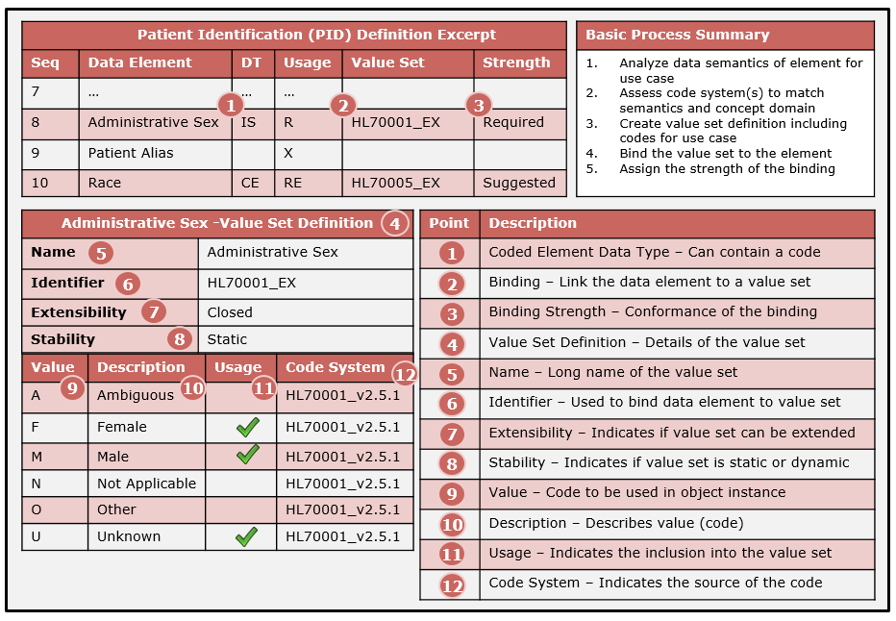
Vocabulary Mechanics
Notes:
#5: Is the Concept Domain as well.
#2 and #6 are used to bind the value set to the data element (model element)
#10: Is also the Concept
#12: Code System of HL70001_v2.5.1 → a little loose with the facts here since this is a table and not really a code system (but acts as one)

Slide 56
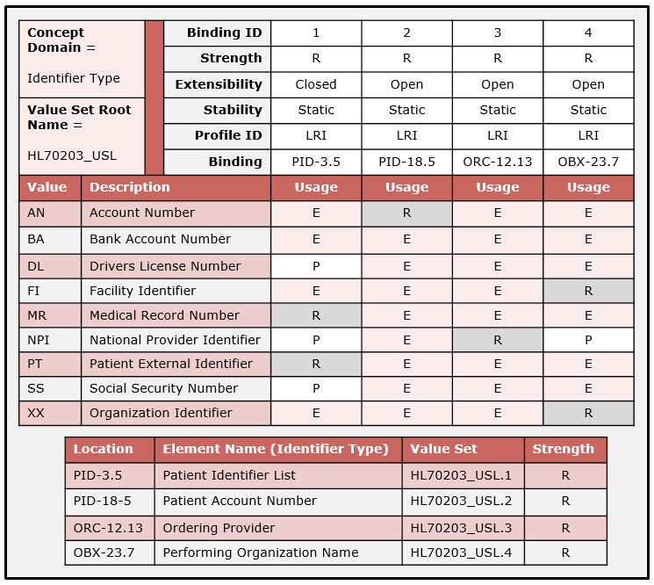
Value Set Collection
Most IGs assign the entire code system to the data element
This method indicates a precise value set definition and binding specification
Provides implementers the tools to be specific

Slide 57
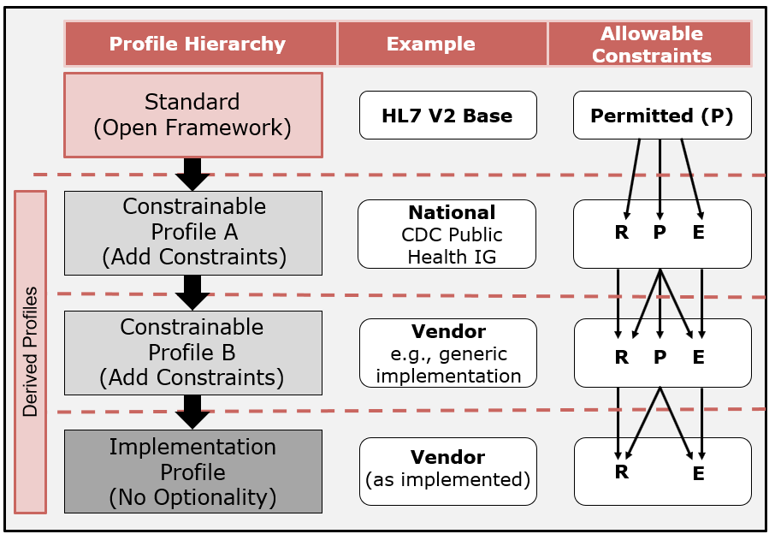
Vocabulary Usage
Profiling to create value sets
Vocabulary usage indicators can be used to narrow code sets (i.e., create value sets)
V3 uses min/max/ignore
Value sets are defined for a particular use and data element
Usage | Name | Conformance | Allowable Usage
R | Required | The code SHALL be supported | R
P | Permitted | None; to be specified | R, P, E
E | Excluded | The code SHALL not be supported. | E
Permitted (P) applicable to constrainable profiles only; not allowed in an implementation profile

Slide 58
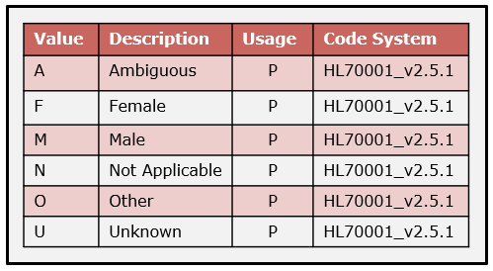
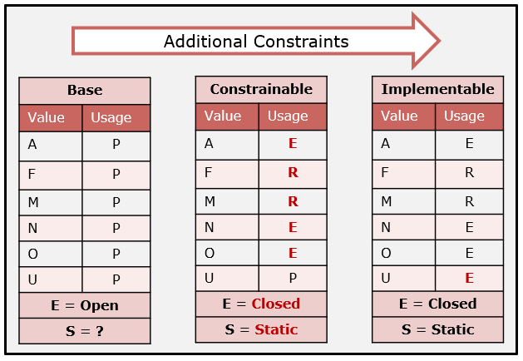
Vocabulary Profiling Example 1
Initial code system (HL7 v2 table)
Profile for a specific use
IG Authors “Closed” the value set at constrainable level
Becomes fully specified at implementation level

Slide 59
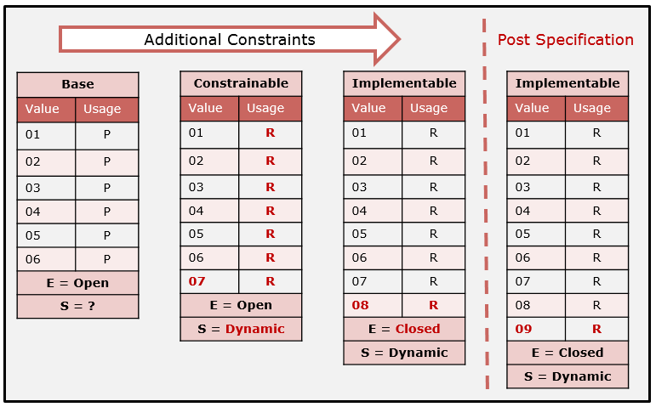
Vocabulary Profiling Example 2
Profiling adds codes at the constrainable and implementable levels
The code system steward adds a code post specification (Dynamic)
Implementers must be aware that such updates can be made
Notes:
Value Set Expansion
Pointer to a URL
Important for validation

Slide 60
Profiling Construction

Slide 61
Profile Construction
Profile Component
Defines a part of a profile and is used to differentiate requirements from another profile or profile component
Can be applied to any construct or section of a profile
A profile component in a family of profiles can be used to:
identify different levels of requirements for the same use case
or to identify the differences in requirements for different, but closely related, use cases
Can be thought of as “building blocks”
Concept | Definition
Profile | A message definition and a complete set of constraints applied to the message definition for a use case at the desired profile level.
Core Profile Component | A message definition and an incomplete set of constraints applied to the message definition for a use case at the desired profile level.
Profile Component | A set of individual independent constraints linked to elements in a message definition.
Composite Profile | The composition of the profile or a core profile component and one or more profile components.

Slide 62
Profile Design and Management
Use as Building Blocks
Reuse and Replacement
Requirement Substitution
Notes:
The design principle is to develop a common or base profile component that applies across a family of profiles with the intention of using the profile component concept to specify complete profiles.

Slide 63
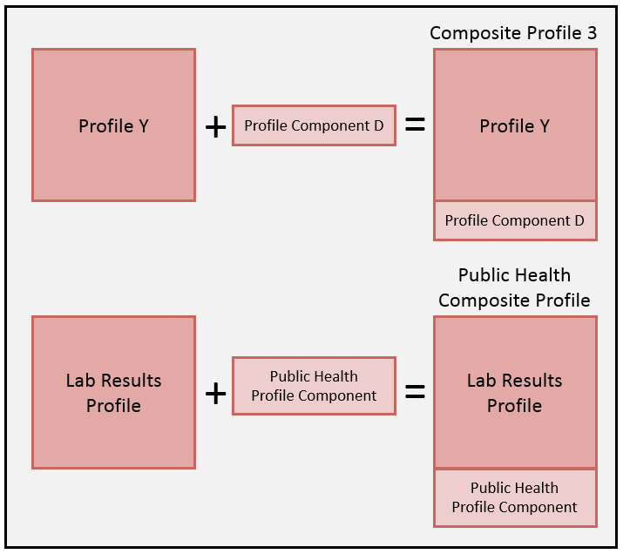
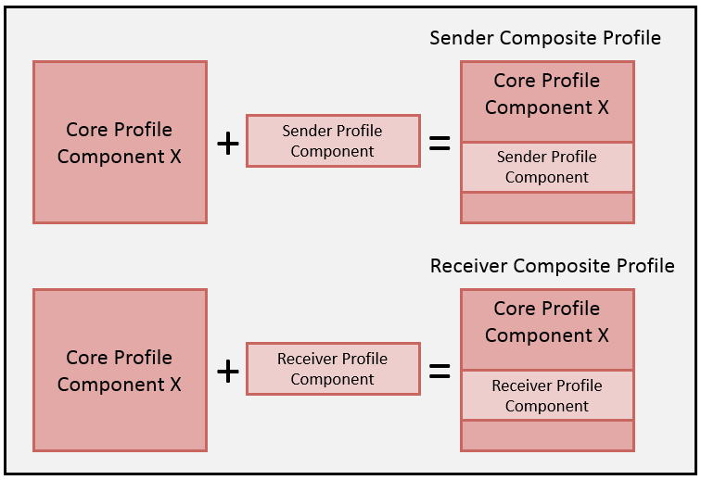
Profile Design and Management
Expanding a Use Case
Sender Receiver Profiles
Notes:
The design principle is to develop a common or base profile component that applies across a family of profiles with the intention of using the profile component concept to specify complete profiles.

Slide 64
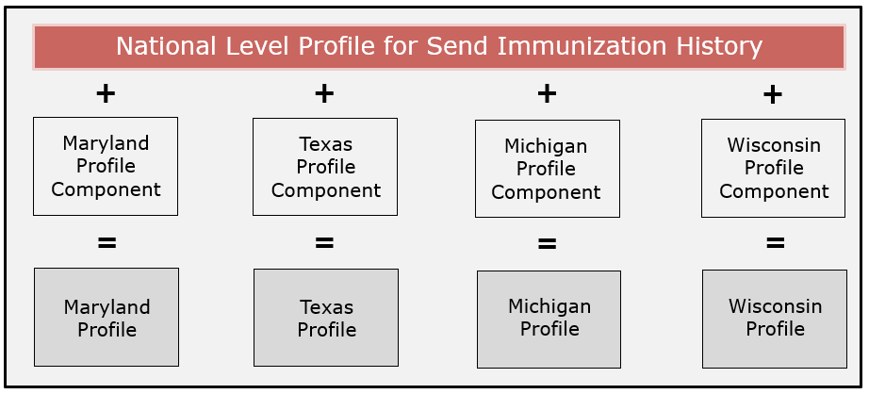
Local Customization
Use Profile Components to express differentials
Notes:
The design principle is to develop a common or base profile component that applies across a family of profiles with the intention of using the profile component concept to specify complete profiles.

Slide 65
Tools and Validation
NIST HL7 v2 Platform
Authoring IGs and Profiles
Authoring Test Plans
Conformance Testing

Slide 66
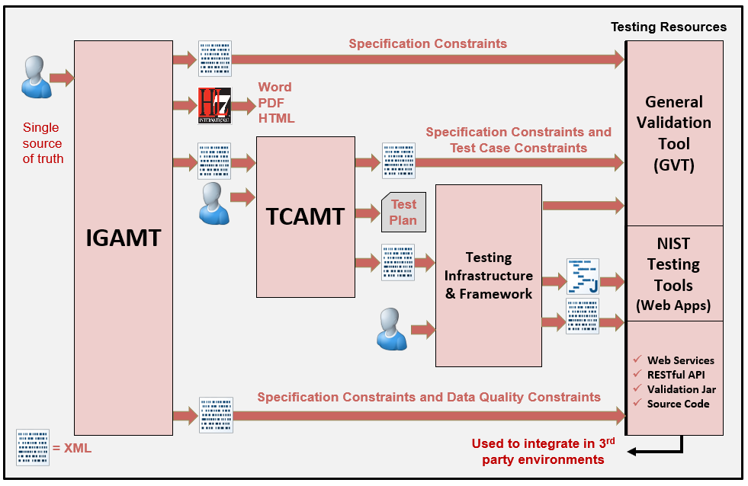
NIST HL7 v2 Platform

Slide 67
IGAMT
Tool to create implementation guides
Narrative + Message Definition
Built-in template
Supports current conformance constructs
Enforces compliance rules
Promotes consistency in requirements
Single source of truth
New profile schema (for XML profile instances)
XML export is bridge to services (e.g.,validation)
Constraints for context-free testing

Slide 68
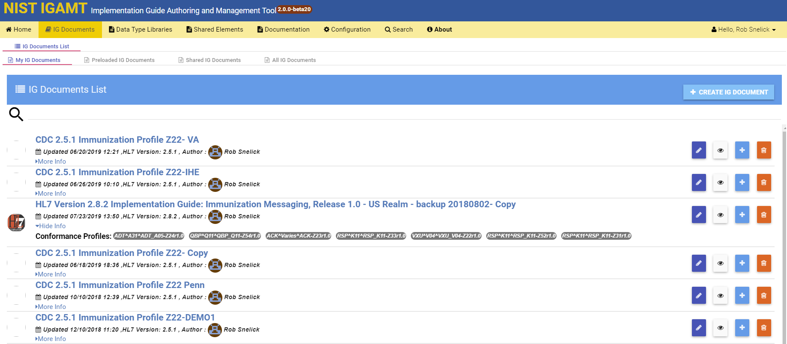
IGAMT: User’s Implementation Guide List
Create Implementation Guides
Shared Implementation Guides
Clone pre-loaded “National Level” Implementation guides for localization
Export as XML, HTML, or WORD
Testing Tool built directly from XML and Test Framework (immediately)

Slide 69
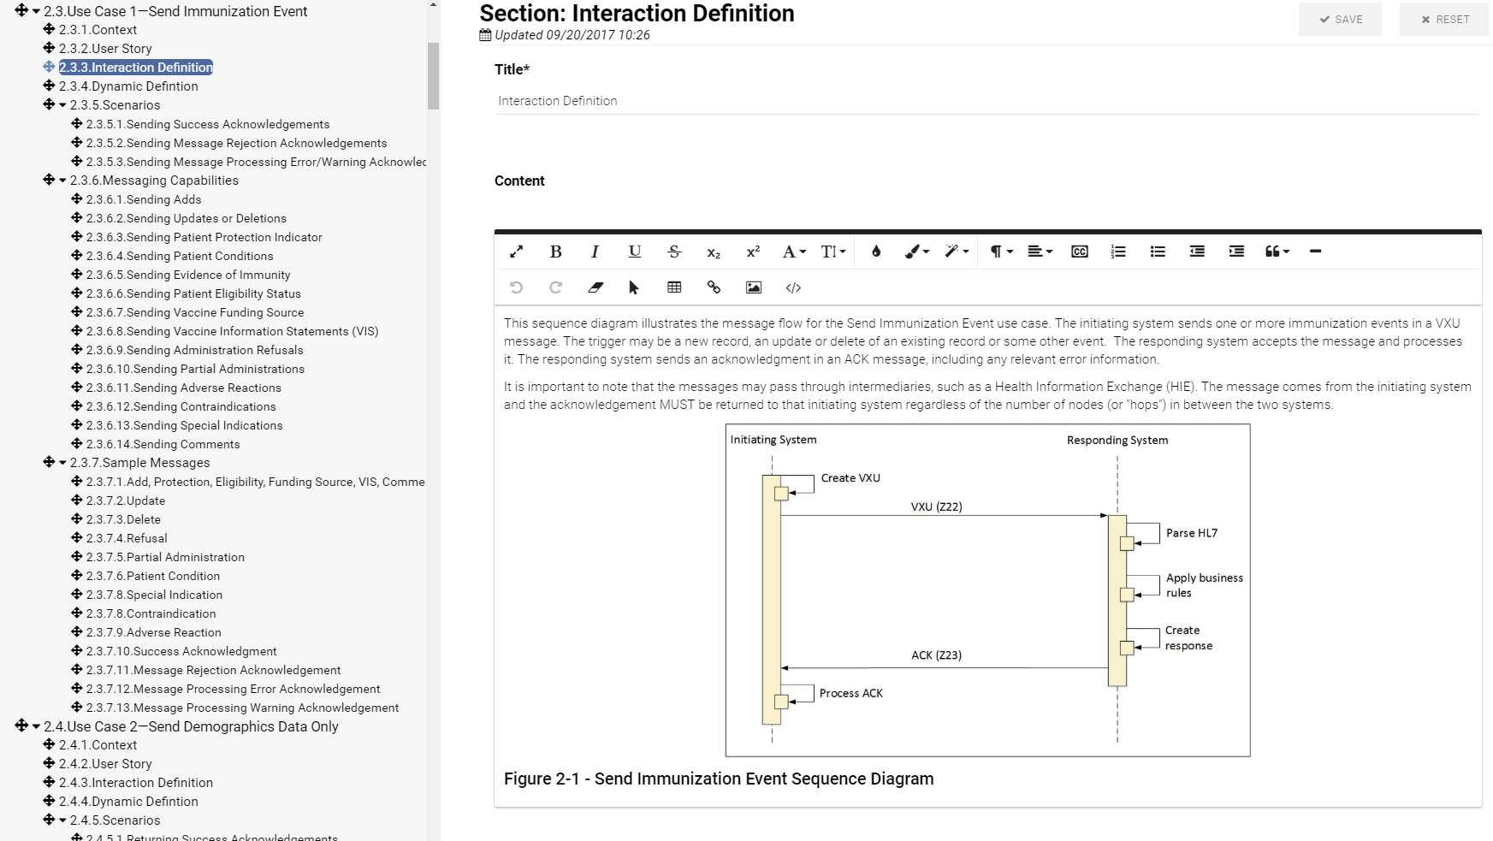
IGAMT: Narrative with Editing Capabilities

Slide 70
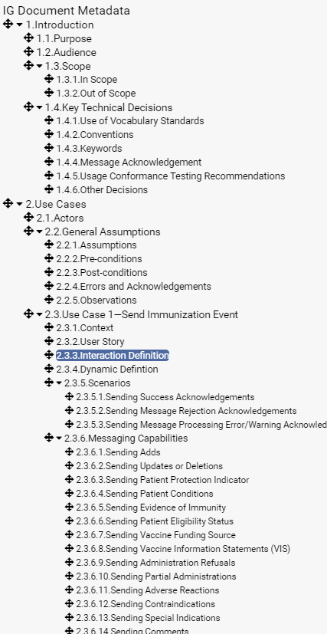
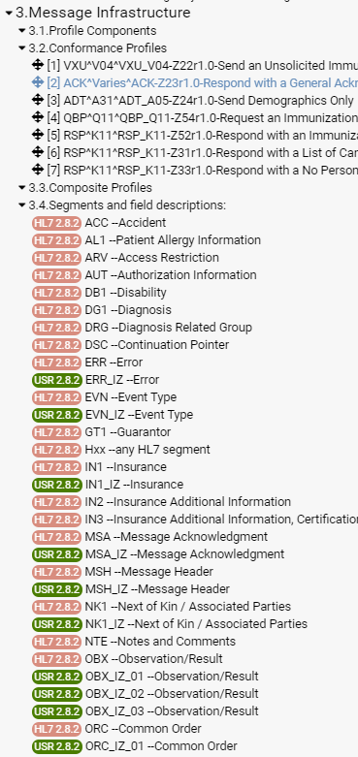
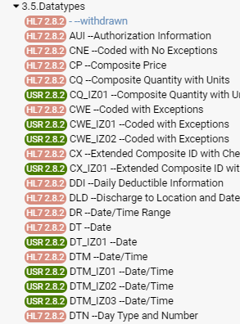
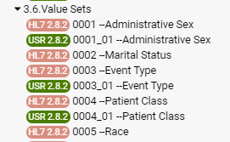
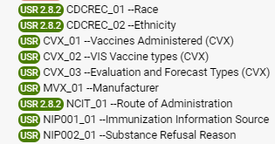
IGAMT: Table of Contents
Narrative
Profiles and Segments
Data Types
Value Sets

Slide 71
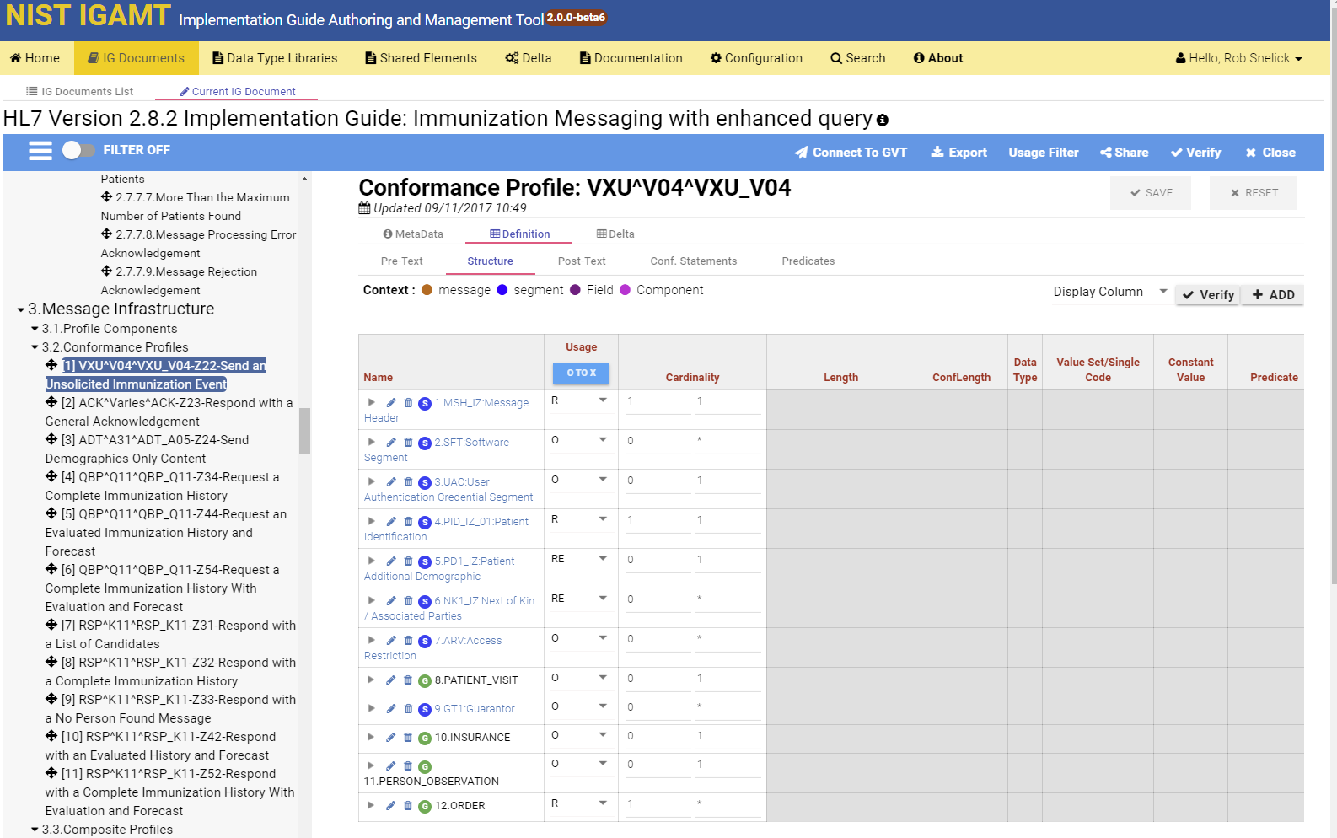
Message Level Profiling

Slide 72
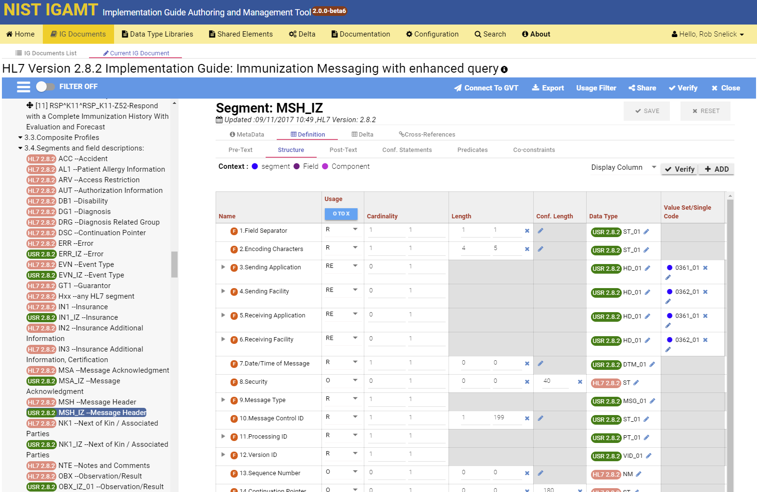
Segment Profiling

Slide 73
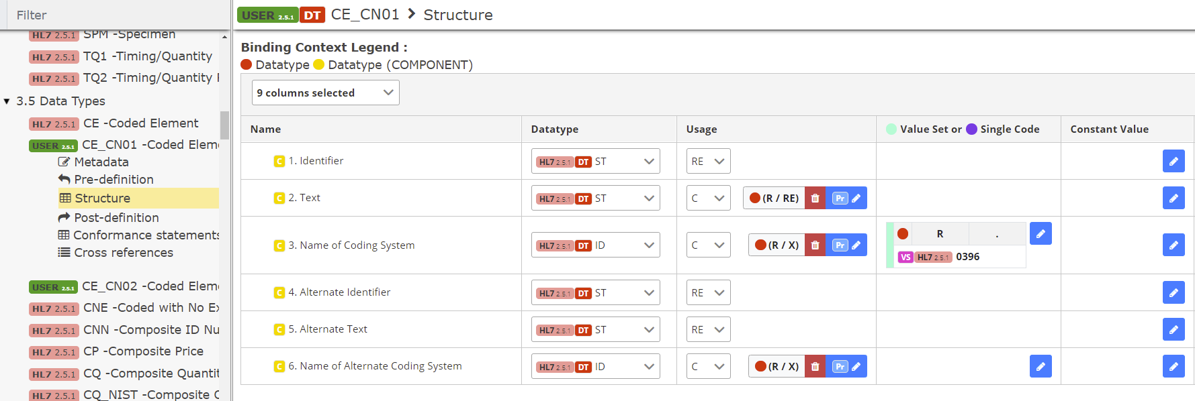
Data Type Flavor
1. Clone and constrain (Create CE_CN01 Data Type Flavor)
2. Bind to element (Bind to OBX-3 Field)

Slide 74
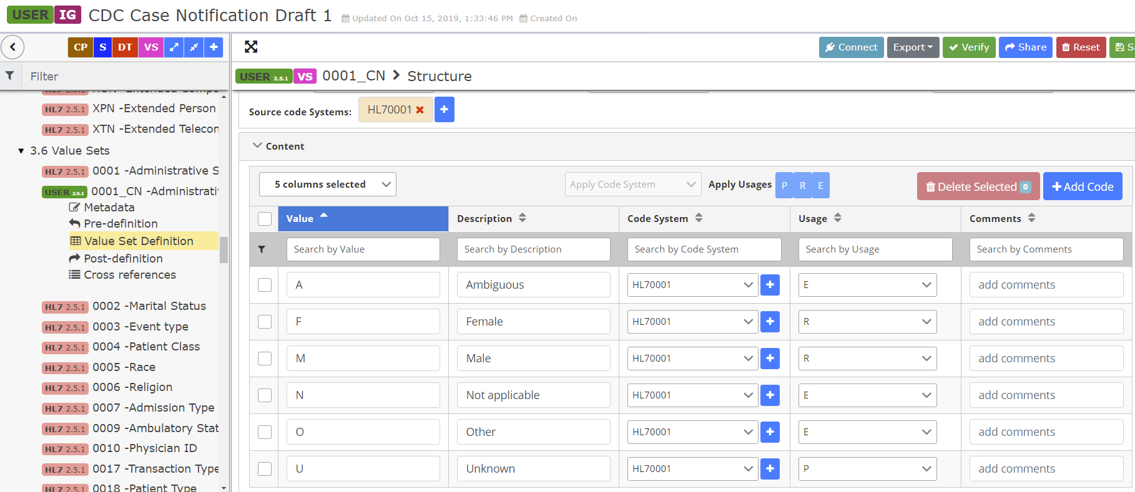
Value Set Profiling and Binding
1. Clone and constrain (Create Value Set HL70001_CN for Table HL70001)
2. Bind to element (Bind to PID-8 Field)

Slide 75
Co-Constraints

Slide 76
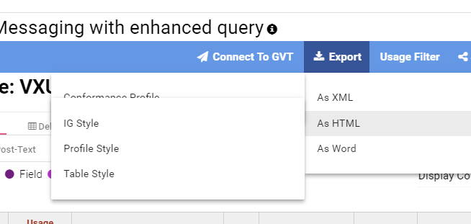
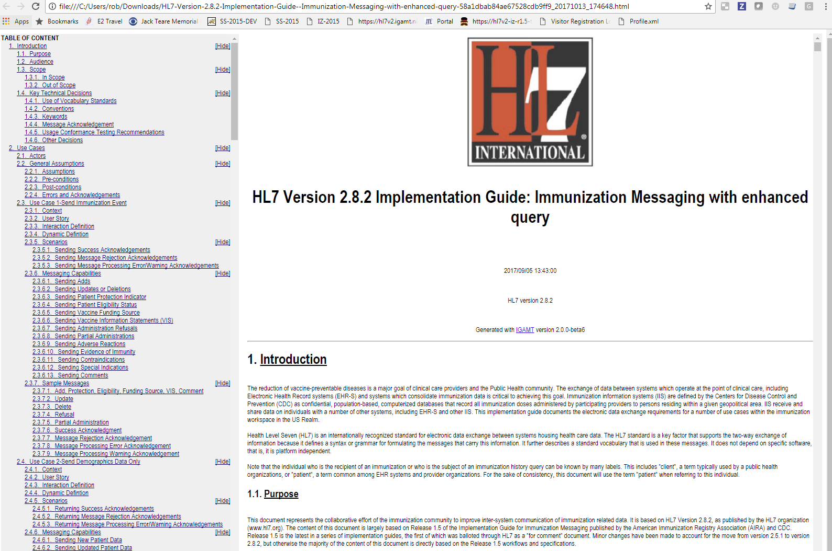
IGAMT: Export
Export in HTML, WORD, and XML
Multiple Styles

Slide 77
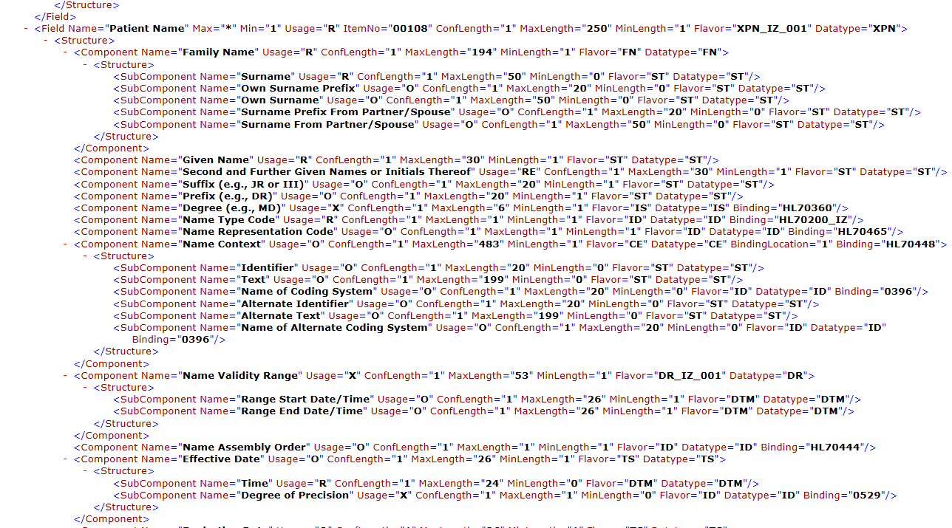
HL7 v2 Profile XML Format
Notes:
NIST HL7 v2 XML format. To be submitted to HL7 to standardize. The NIST format adds additional conformance constructs.

Slide 78
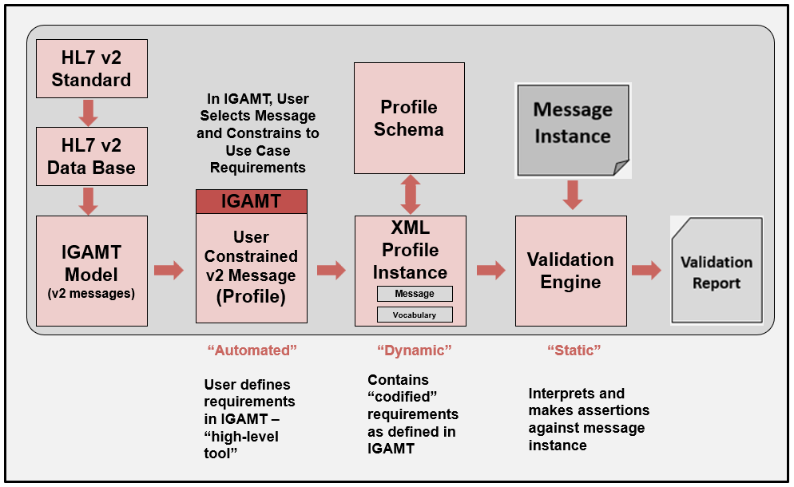
Validation Process

Slide 79
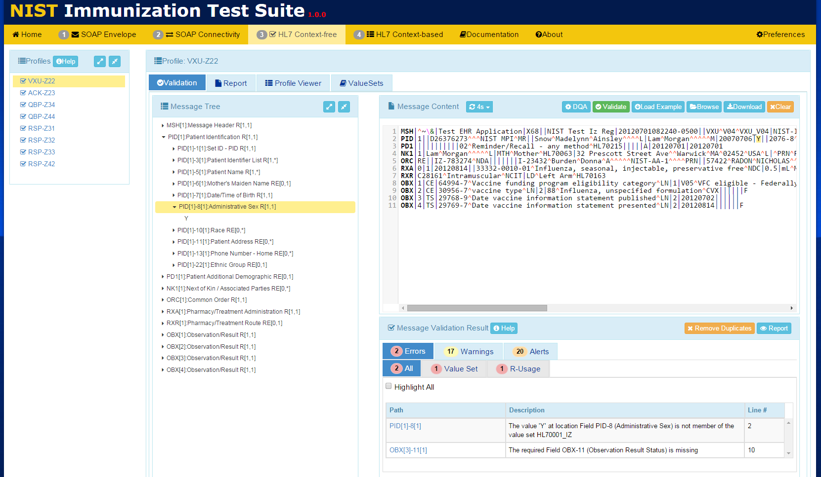
Context-free Validation

Slide 80
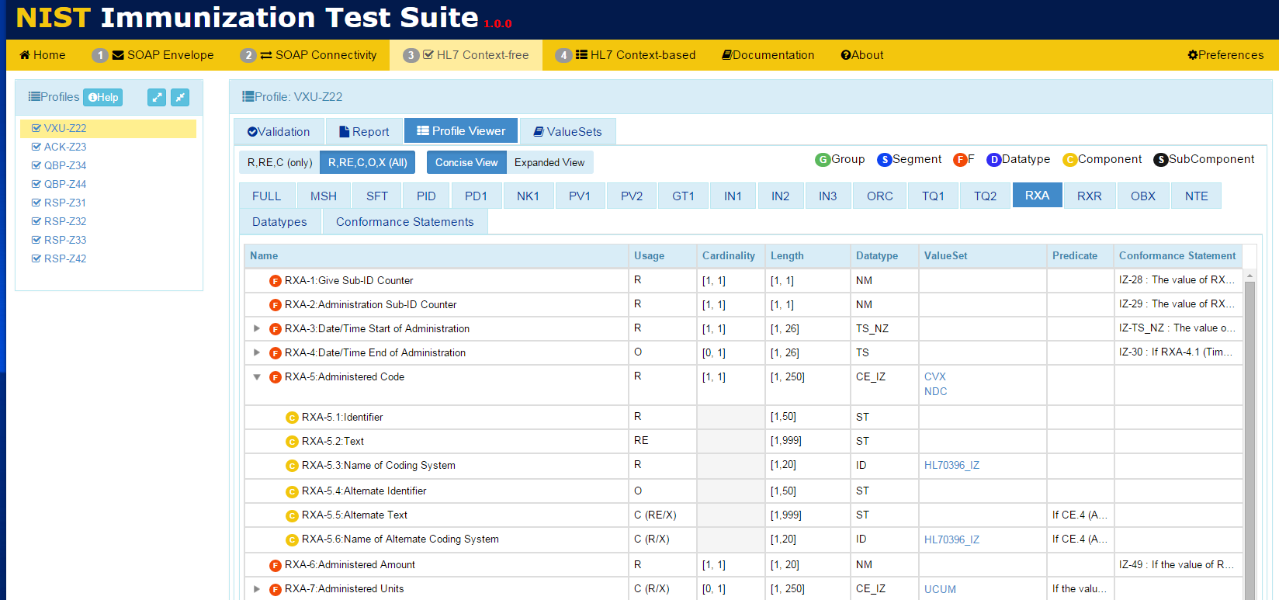
View Messaging Requirements

Slide 81
View Vocabulary Requirements

Slide 82
TCAMT
Tool Test Plans and Test Cases
Narrative + Test Case Definitions
Import XML profiles in IGAMT format
XML profiles provide underlying model
NIST-built constraint mechanism
Expands testing capabilities
Example/test messages ← Powerful notion
Single source of truth
XML export is gateway to other services
Constraints for context-based testing

Slide 83
Context-based Testing
Test Story
Test Data
Content Assertions
Test Story gives the test scenario
Test Data indicates the real-world data
Content Assertions indicates how content will be validated

Slide 84
Context-based Testing
Example: Conformity Assessment for Context-based Testing
Element | Usage | Test Data | Test Category | Conformity Assessment | Data in Message | Validation Result
PID-5.3 (Middle Name)* | RE | Donna | Presence-Content-Indifferent | Required | <Empty> | Fail
PID-5.3 (Middle Name) | RE | Donna | Presence-Content-Indifferent | Required | Donna | Pass
PID-5.3 (Middle Name) | RE | Donna | Presence-Content-Indifferent | Required | Sue | Pass
PID-5.3 (Middle Name) | RE | Donna | Presence-Length-Content-Indifferent | Required Min Length = 5 | Victoria | Pass
PID-5.3 (Middle Name) | RE | Donna | Presence-Length-Content-Indifferent | Required Min Length = 5 | Sue | Fail
PID-5.3 (Middle Name) | RE | Donna | Value-Test Case Fixed | Required Value = Donna | Donna | Pass
PID-5.3 (Middle Name) | RE | Donna | Value-Test Case Fixed | Required Value = Donna | Sue | Fail
MSH-9.2 (Trigger Event) | R | V04 | Value-Profile Fixed | Required Value = V04 | V04 | Pass

Slide 85
TCAMT: Creating Test Cases and Context-based Testing

Slide 86
TCAMT: Creating Test Cases and Context-based Testing

Slide 87
TCAMT: Creating Test Cases and Context-based Testing

Slide 88
TCAMT

Slide 89
TCAMT: Creating Test Cases and Context-based Testing

Slide 90
TCAMT: Creating Test Cases and Context-based Testing

Slide 91
Context-based Validation

Slide 92
Context-based Validation

Slide 93
Platform Status
All tools in use for years
Public Domain—Free for use
Tools hosted by NIST
IGAMT-1
Used to ballot HL7 IGs, Local Use
IGAMT-2
Beta Testing—advanced features
TCAMT
Test Plans for ONC, CDC, HIMSS, etc.
Validation Tools
Specific (NIST Created) and General (User Created)
ONC, CDC, HIMSS, IHE, etc.

Slide 94
Real Success
Measures of Immunization Submissions and Acknowledgement Messages
Source: American Immunization Registry Association, August 2019
Notes:
Implementers/Specifiers can decide how far to go—profiling mechanisms should provide capabilities for a precise specification.
THERE ARE NO SHORT CUTS—YOU HAVE TO DO IT ONE WAY OR THE OTHER!
These tools help us manage and leverage/reuse existing models.
Think about now Trading Partner C with the same needs.
Improves Patient Safety
Better Data Sharing
Saves Time and Money
Reasonable confidence that the product meets the conformance requirements stated in the standard
Closer to achieving interoperability
Don’t expect “out-of-the-box” interoperability
Local adaptation and testing is necessary
Most likely each integration will still require translation
Reasonable scope
Based on what standards are part of the certification
E.g., if no usability standards, don’t set unrealistic expectations

Slide 95
Summary: Towards Interoperability
Use Cases
Trading Partner A
Trading Partner B
Reduced Negotiations &
Translations
Requirements
Requirements
Standards
Profiling
Implementation
Testing
Need quality data exchange standards
Be precise, and demand it from SDOs
Profile, Modularize, and Reuse
Use existing tools (profiling and testing)
Non-conformance should not prevent useful exchange of data
Plan for testing, and test (at all layers)
Notes:
Implementers/Specifiers can decide how far to go—profiling mechanisms should provide capabilities for a precise specification.
THERE ARE NO SHORT CUTS—YOU HAVE TO DO IT ONE WAY OR THE OTHER!
These tools help us manage and leverage/reuse existing models.
Think about now Trading Partner C with the same needs.
Improves Patient Safety
Better Data Sharing
Saves Time and Money
Reasonable confidence that the product meets the conformance requirements stated in the standard
Closer to achieving interoperability
Don’t expect “out-of-the-box” interoperability
Local adaptation and testing is necessary
Most likely each integration will still require translation
Reasonable scope
Based on what standards are part of the certification
E.g., if no usability standards, don’t set unrealistic expectations

Slide 96
Thank You Questions
Contact: robert.snelick@nist.gov
https://hl7v2tools.nist.gov

