Slide 1
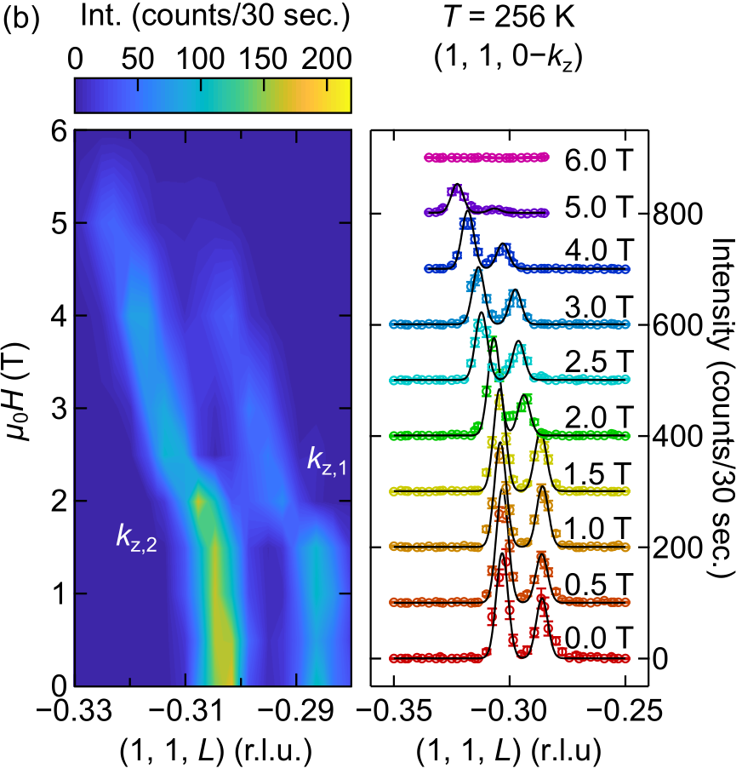
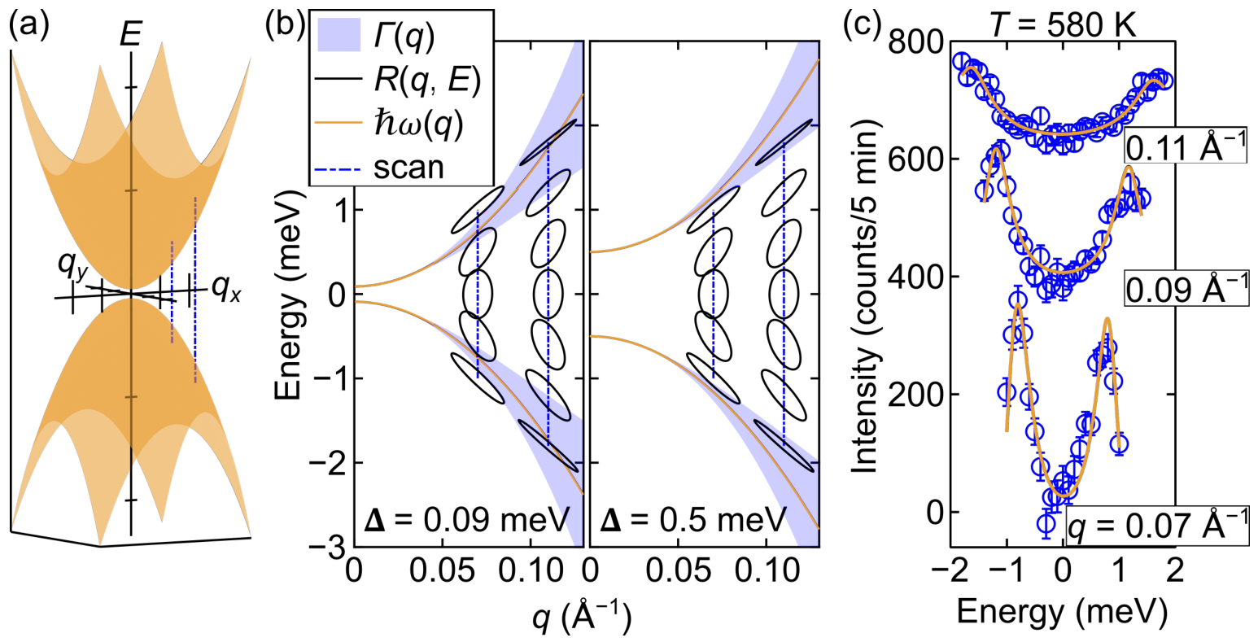
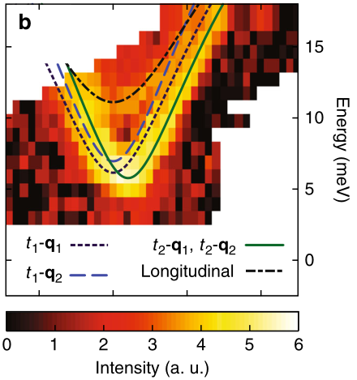
Introduction to triple-axis spectrometers
Rebecca Dally
NIST Center for Neutron Research
rebecca.dally@nist.gov

Slide 2
What do you do with diffraction and scattering of thermal or cold neutrons?
Neutron diffraction to solve crystal structures or magnetic structures; discern between nuclear and magnetic scattering (polarized neutrons)
Look for short-range and/or long-range order; study critical scattering
Inelastic neutron scattering probes excitations (e.g. phonons or magnons)
Study all of the above in variety of sample environments
temperature
pressure
magnetic field
electric field
stress/strain

Slide 3
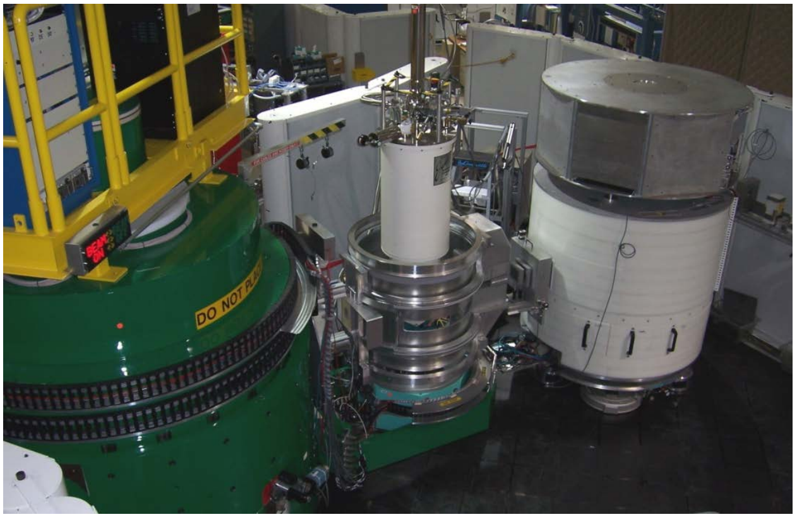
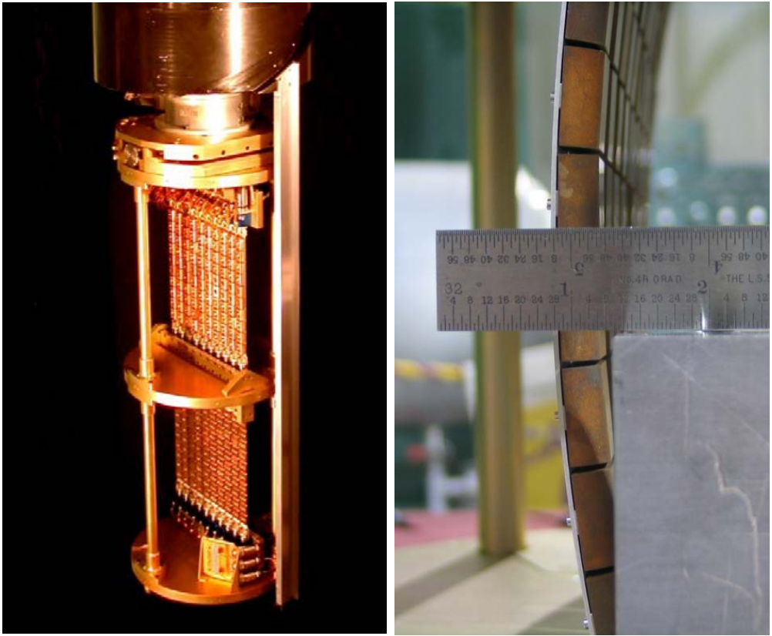
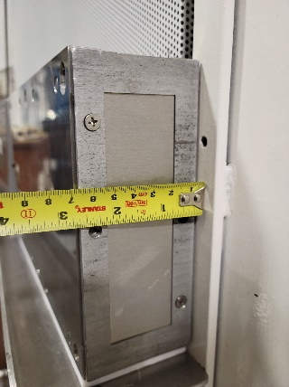
Triple-axis spectrometer (TAS) basics: components
neutron beam
collimator
monochromator
sample
analyzer
detector
$$2θ_{S}$$
6
4
2
$$θ$$
$$2θ_{A}$$
2
2
5
2
$$2θ_{M}$$
1
BT-7
3
collimator
monochromator

Slide 4
Triple-axis spectrometer (TAS) basics: monochromator
Bragg’s Law
$$Q=\frac{4π}{λ}\sin\left(\frac{2θ}{2}\right)$$
$$\frac{2π}{d}=\frac{4π}{λ}\sin\left(\frac{2θ}{2}\right)$$
$$2θ_{M}=2\sin^{−1}\left(\frac{λ}{2d_{PG(002)}}\right)$$
neutron beam
collimator
monochromator
sample
analyzer
detector
$$2θ_{S}$$
6
4
2
$$θ$$
$$2θ_{A}$$
2
2
5
2
$$2θ_{M}$$
1
3
Variable incident energy
$λ=2.359 Å$ (14.7 meV)
$$d_{PG(002)}=3.3542 Å$$
$$2θ_{M}=41.1764°$$
Works for picking out detected energy using analyzer, too

Slide 5
Triple-axis spectrometer (TAS) basics: samples
YMn₆Sn₆
$$a^{∗}=2π\frac{b×c}{V}$$
$$b^{∗}=2π\frac{c×a}{V}$$
$$c^{∗}=2π\frac{a×b}{V}$$
TAS studies usually study one 2D plane at a time: what do you want to study?
b
b*
crystal
c||c*
a*
a

Slide 6
Thinking in reciprocal space: hexagonal unit cell example
Real (direct) space
HK0 plane
Reciprocal space
$$K||b^{∗}$$
$$\hat{y}$$
b
$$\left|b^{∗}\right|$$
(0,1,0)
b*
(0,0,0)
c*
c,$\hat{z}$
$$\hat{x}$$
(1,0,0)
$$\left|a^{∗}\right|$$
a*
a
$$H||a^{∗}$$
nuclear Bragg peak

Slide 7
Things in reciprocal space have meaning in real space!
Infinite repeating planes in real space are a point in reciprocal space.

Slide 8
Things in reciprocal space have meaning in real space!
https://www.grandmetric.com/topic/4-waveforms-frequencies-bandwidth/

Slide 9
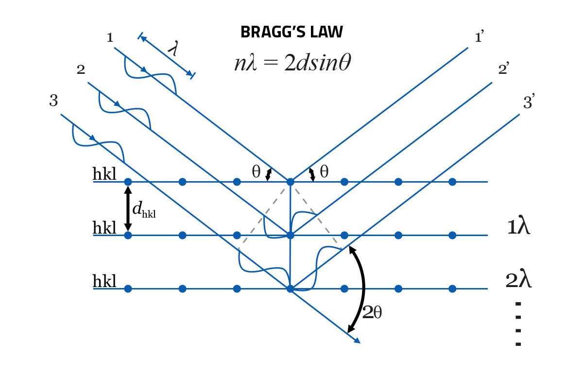
Bragg’s Law, neutron diffraction, geometry, and the scattering vector
$$k_{f}$$
$$k_{i}$$
$$k_{i}$$
$${−k}_{f}$$
$$Q$$
$$Q=k_{i}−k_{f}$$
https://www.veqter.co.uk/residual-stress-measurement/x-ray-diffraction

Slide 10
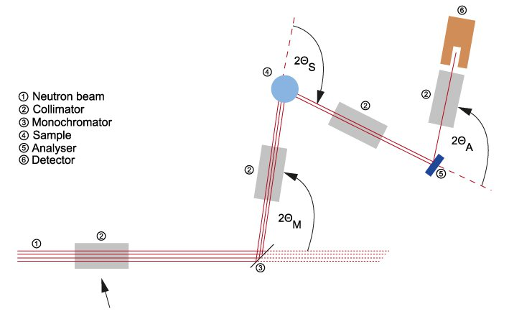
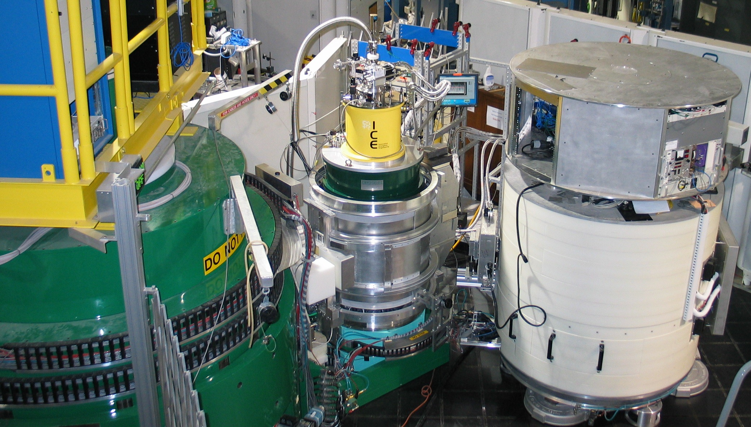
Triple-axis spectrometer for diffraction experiments
$${−k}_{f}$$
Triple-axis geometry
Control E_{i} (equivalently $λ_{i}$, $k_{i}$)
Control E_{f} (equivalently $λ_{f}$, $k_{f}$)
Control sample orientation
$$k_{i}$$
$$k_{f}$$
$$Q$$
https://www.nist.gov/ncnr/bt-7-photos
https://nmi3.eu/neutron-research/techniques-for-/dynamics/three-axis-spectroscopy.html
$$Q=k_{i}−k_{f}$$
scattering vector determined by instrument

Slide 11
Bragg’s Law, neutron diffraction, geometry, and the scattering vector
$$k_{f}$$
$$k_{i}$$
$$k_{i}$$
$${−k}_{f}$$
$$Q$$
$$Q=k_{i}−k_{f}$$
https://www.veqter.co.uk/residual-stress-measurement/x-ray-diffraction

Slide 12
Bragg’s Law, neutron diffraction, geometry, and the scattering vector
$$k_{f}$$
$$k_{f}$$
$$k_{i}$$
$$k_{i}$$
$$k_{i}$$
$${−k}_{f}$$
$$Q$$
$$Q$$
$$Q=k_{i}−k_{f}$$
https://www.veqter.co.uk/residual-stress-measurement/x-ray-diffraction

Slide 13
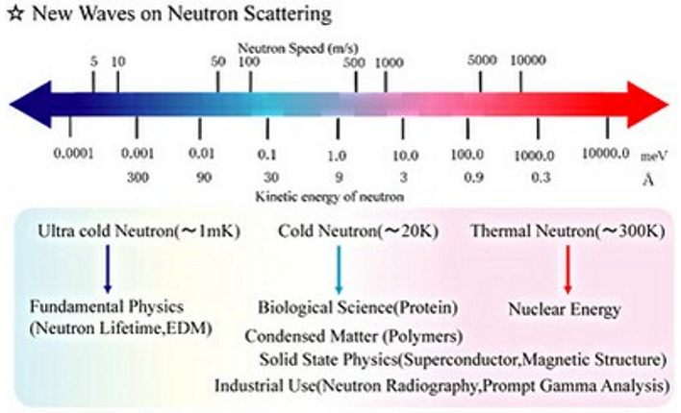
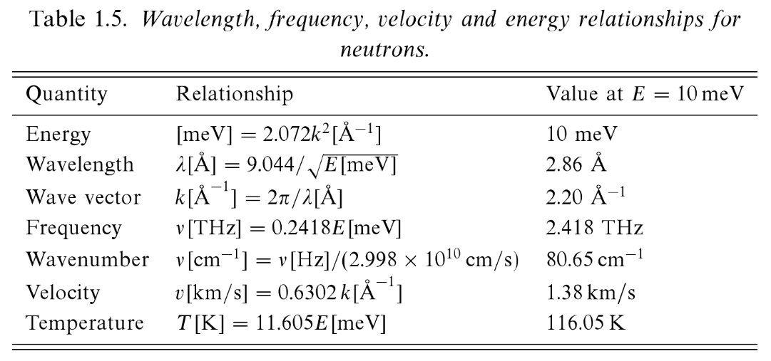
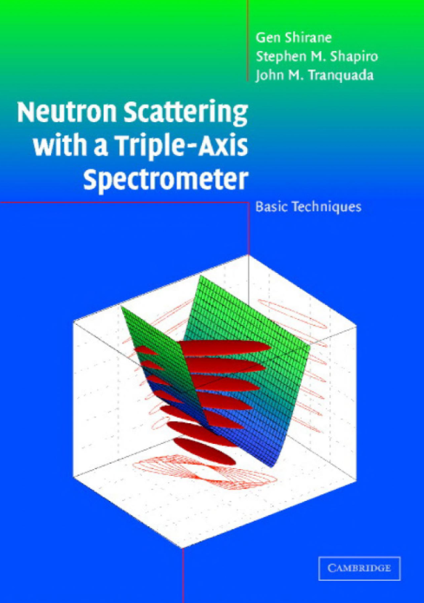
Thermal and cold neutrons for structural and magnetic studies
K → meV (Boltzmann constant)
https://universe-review.ca/I15-27-SPapp.png

Slide 14
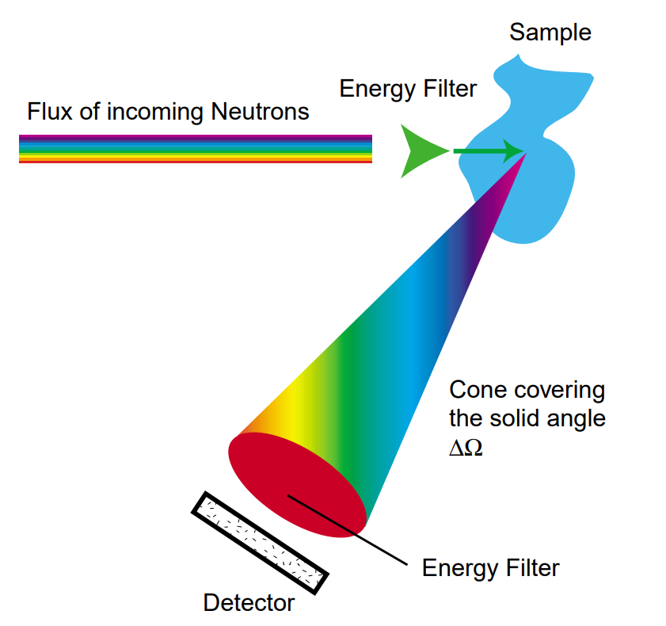
What is being measured in a neutron scattering experiment?
The double differential cross-section
$$\frac{dσ^{2}}{dΩdE_{f}}=\frac{k_{f}}{k_{i}}\sum_{λ_{i},λ_{f}}{p_{λ_{i}}{\left|\left\langle k_{f}λ_{f} | V | k_{i}λ_{i}\right\rangle \right|}^{2}δ\left(ℏω+E_{i}−E_{f}\right)}$$
Conservation of energy
Normalization to incident flux
Born approximation
Thermodynamic factor
http://www-llb.cea.fr/ecns2003/lectures/schober/ECNS2003_Schober_NeutronScattering.pdf

Slide 15
Neutron-nuclear interaction and the scattering length
$${\left|\left\langle k_{f}λ_{f} | V | k_{i}λ_{i}\right\rangle \right|}^{2}$$
Interaction between neutron and nucleus is due to strong force – extremely short range
$$\left\langle k_{f}λ_{f} | V | k_{i}λ_{i}\right\rangle =constant∝b_{i}$$
$$V=\frac{2πℏ^{2}}{m}\sum_{i}{b_{i}δ^{3}(r)}$$
Scattering length – element specific
https://www.ncnr.nist.gov/resources/n-lengths/
Cross section, $σ_{t}=4π\left\langle \overline{b^{2}}\right\rangle$

Slide 16
The scattering potential between the neutron and unpaired electrons
$V\left(r\right)$due to magnetic interaction between a neutron and a moving electron of momentum $p$ and spin $s$
Magnetic moments
neutron: $−γμ_{N}σ$
electron: $−2μ_{B}s$
$$V\left(r\right)=−γμ_{N}2μ_{B}σ∙\left[curl\left(\frac{s×\hat{R}}{R^{2}}\right)+\frac{1}{ℏ}\frac{p×\hat{R}}{R^{2}}\right]$$
Due to electron spin
Due to electron orbital motion
https://byjus.com/physics/electron-spin/
https://cnx.org/contents/i1ZdCc7x@3/Orbital-Magnetic-Dipole-Moment-of-the-Electron

Slide 17
The scattering potential between the neutron and unpaired electrons
$$\left\langle k_{f}λ_{f} | V | k_{i}λ_{i}\right\rangle =4πγμ_{N}2μ_{B}σ∙\sum_{i}{\left\{\hat{Q}×\left(s_{i}×\hat{Q}\right)+\frac{i}{ℏQ}\left(p_{i}×\hat{Q}\right)\right\}exp⁡(iQ∙r_{i})}$$
Neutron only “sees” component of $s$ which is perpendicular to $\hat{Q}$
Can get directional information about magnetic moments
What are you really measuring?
Fourier transform of the real space magnetization density
https://www.slideserve.com/may/neutron-and-x-ray-scattering-studies-of-spin-charge-and-orbital-order-in-tm-oxides

Slide 18
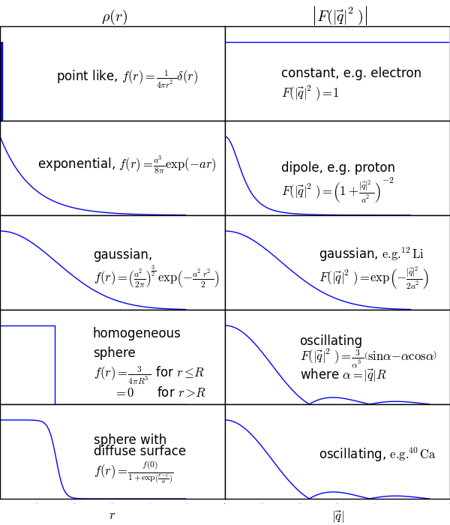
Potentials in real and Fourier space
Potential coming from sample nuclei
$$V(r)=\frac{2πℏ^{2}}{m}\sum_{i}{b_{i}δ^{3}(r)}$$
https://notes.dmaitre.phyip3.dur.ac.uk/npp/notes/Nuclear+Form+Factors.html

Slide 19
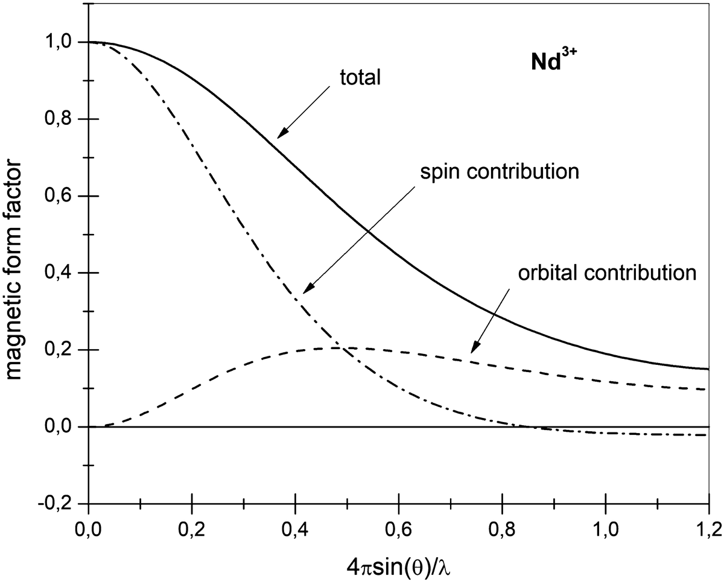
Potential distribution from magnetism much more complicated
Form factors:
https://www2.cpfs.mpg.de/~rotter/homepage_mcphase/manual/node137.html
https://link.springer.com/chapter/10.1007/978-3-319-92955-2_1
https://notes.dmaitre.phyip3.dur.ac.uk/npp/notes/Nuclear+Form+Factors.html

Slide 20
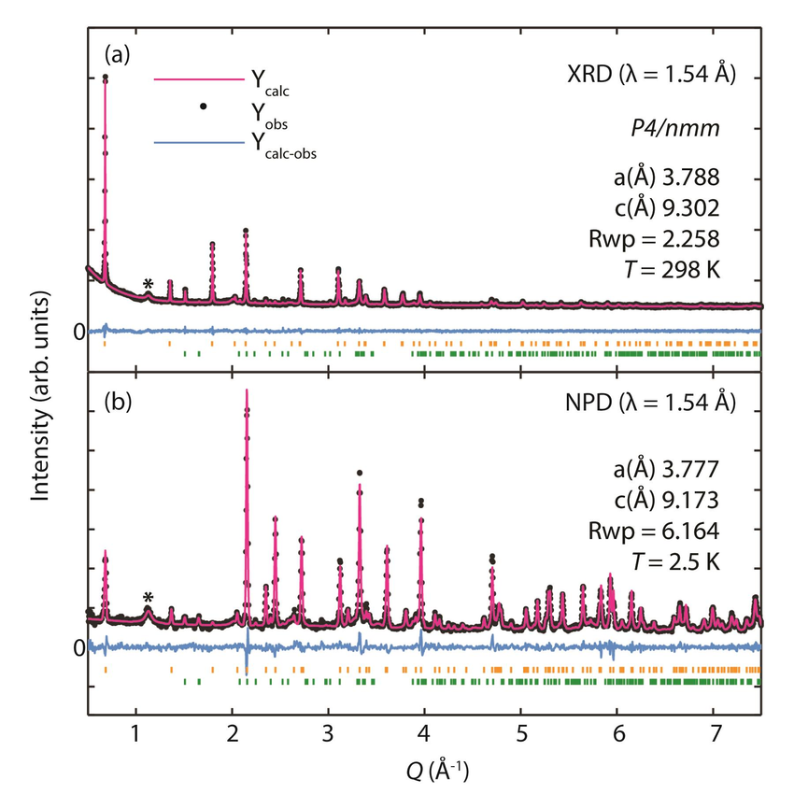
Potentials in real and Fourier space
(⁷Li_{1−x}Fe_{x}OD)FeSe
https://notes.dmaitre.phyip3.dur.ac.uk/npp/notes/Nuclear+Form+Factors.html
https://doi.org/10.1039/C5TC04041H

Slide 21
Reduce problem to sample-dependent structure factor
$$\frac{dσ^{2}}{dΩdE_{f}}=\frac{k_{f}}{k_{i}}\sum_{λ_{i},λ_{f}}{p_{λ_{i}}{\left|\left\langle k_{f}λ_{f} | V | k_{i}λ_{i}\right\rangle \right|}^{2}δ\left(ℏω+E_{i}−E_{f}\right)}$$
Scattering function or dynamic structure factor
$$Q=k_{i}−k_{f}$$
$$\text{ℏ}ω=E_{i}−E_{f}$$
$$\frac{dσ^{2}}{dΩdE_{f}}=\frac{k_{f}}{k_{i}}\frac{N}{4π}S\left(Q,ω\right)$$
Let’s make things a lot simpler… $ω=0$ (elastic scattering)
$$\frac{dσ^{2}}{dΩdE_{f}}→\frac{dσ}{dΩ}$$
Structure factor – easy to calculate!
$$S\left(Q,ω\right)→S\left(Q\right)$$

Slide 22
An example of what you can do with neutron diffraction: GaV₄S₈
Neutron diffraction to solve crystal structures or magnetic structures (…and study transitions of each, e.g. first or second order)

Slide 23
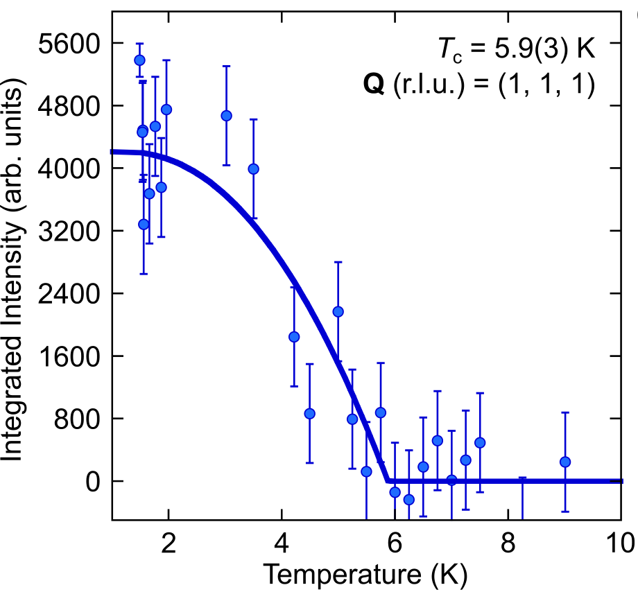
An example of what you can do with neutron diffraction: GaV₄S₈
Neutron diffraction to solve crystal structures or magnetic structures (…and study transitions of each, e.g. first or second order)

Slide 24
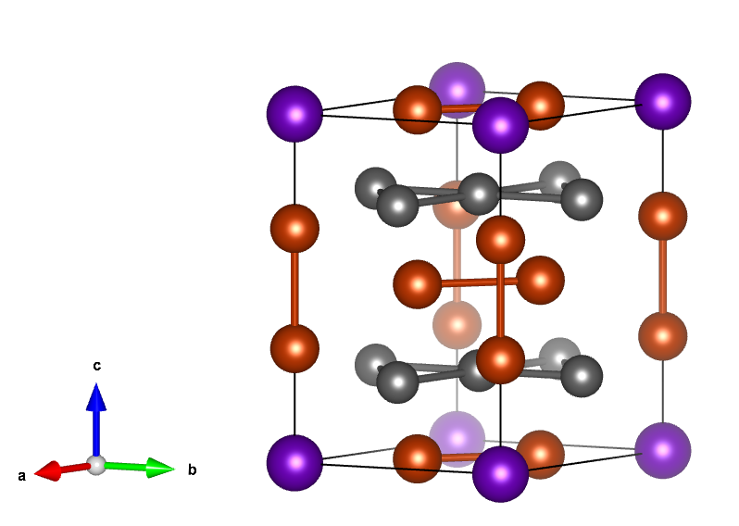
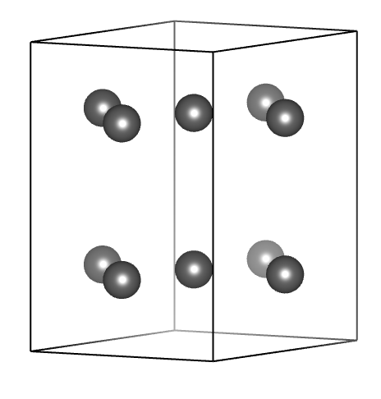
How is a unit cell defined? What is the minimum repeating unit?
YMn₆Sn₆
magnetic atoms only (Mn)
Mn
Sn
Y

Slide 25
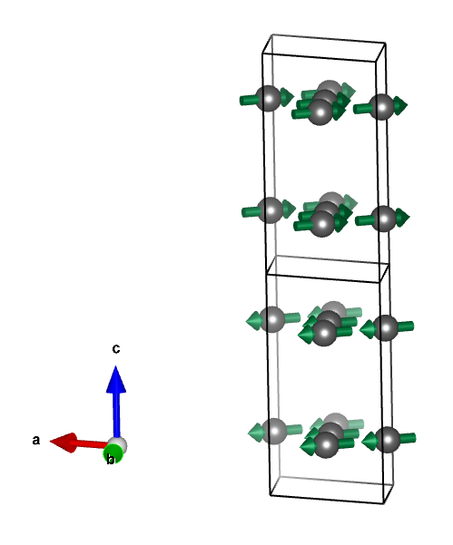
How is a unit cell defined? What is the minimum repeating unit?
T_{N} ~ 340 K
paramagnetic to antiferromagnet at Néel temperature
strong ferromagnetic exchange coupling between in-plane Mn atoms
magnetic unit cell is doubled along the c-axis when compared to the nuclear unit cell

Slide 26
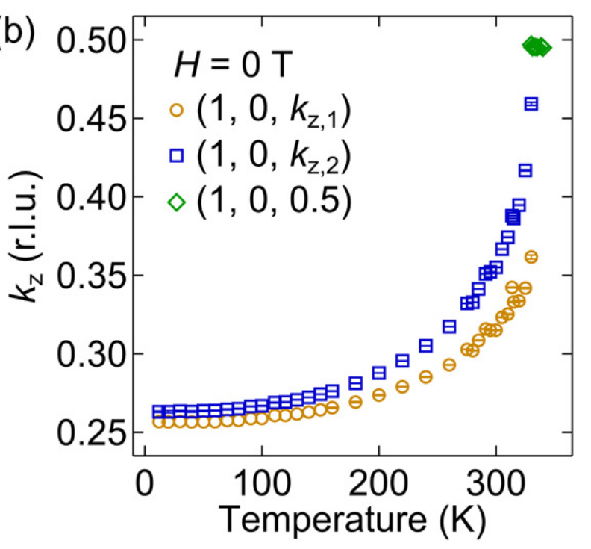
The magnetic propagation vector in YMn₆Sn₆
$$k=(0, 0, k_{z})$$
$$k=(0, 0, 0.5)$$
https://doi.org/10.1103/PhysRevB.103.094413

Slide 27
The magnetic propagation vector, $k$ (a.k.a. wave vector or $q$)
https://www.sciencedirect.com/science/article/pii/B978012802049400004X

Slide 28
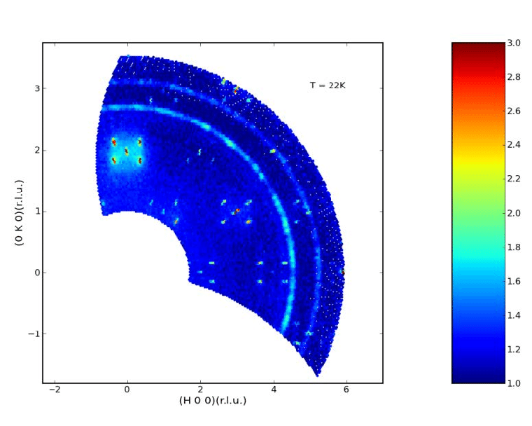
Working with single crystals in diffraction

Slide 29
Working with single crystals in diffraction: theta-2theta scans
(HK0) plane
K
Q
(3,3,0)
$$\left|Q\right|=\frac{4π}{λ}sin\left(\frac{2θ}{2}\right)$$
(2,2,0)
(1,1,0)
H
Q
(1,1,0)
(2,2,0)
(3,3,0)

Slide 30
Working with single crystals in diffraction: theta-2theta scans
(HK0) plane
K
Q
(3,3,0)
Real (direct) space
(2,2,0)
Reciprocal space
(1,1,0)
b₁
b₂*
b₂
b₁*
H
a₁
a₂*
a₂
a₁*

Slide 31
Working with single crystals in diffraction: theta-2theta scans
(HK0) plane
K
Q
(3,3,0)
(2,2,0)
(1,1,0)
H
Q
(1,1,0)
(2,2,0)
(3,3,0)

Slide 32
Working with single crystals in diffraction: theta scans
Theta scans (constant Q scans) give information on crystal quality (mosaic)
(1,1,0)
Q
θ
θ
(1,1,0)

Slide 33
Working with single crystals in diffraction: theta scans
Real (direct) space
Reciprocal space
b₂
b₂*
b₁*
b₁
a₂
a₂*
a₁
a₁*
constant Q lines

Slide 34
Working with single crystals in diffraction: theta scans
Real (direct) space
Reciprocal space
b₂
b₂*
b₁*
b₁
a₂
a₂*
a₁
a₁*
constant Q lines

Slide 35
Working with single crystals in diffraction: theta scans
Aluminum powder lines

Slide 36
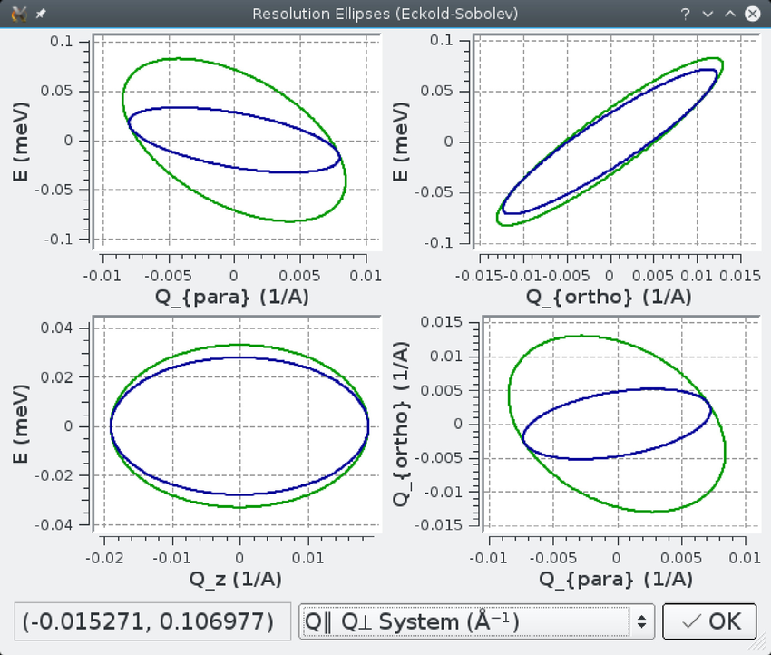
Working with single crystals in diffraction: resolution function
Neutron beam not perfectly monochromatic + divergence along path
https://nmi3.eu/neutron-research/techniques-for-/dynamics/three-axis-spectroscopy.html
10.1016/j.softx.2016.06.002

Slide 37
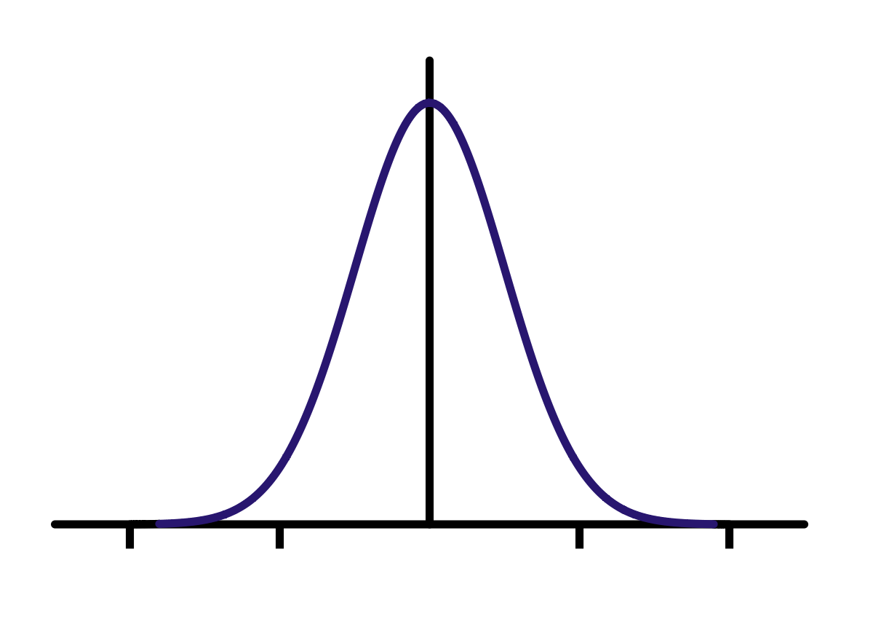
Working with single crystals in diffraction: resolution function
(1,1,0)
Q
θ
θ
(1,1,0)

Slide 38
Working with single crystals in diffraction: resolution function
(1,1,0)
Q
θ
θ
(1,1,0)

Slide 39
Working with single crystals in diffraction: resolution function
(1,1,0)
Q
θ
θ
(1,1,0)

Slide 40
Working with single crystals in diffraction: resolution function
(1,1,0)
Q
θ
θ
(1,1,0)

Slide 41
Working with single crystals in diffraction: resolution function
(1,1,0)
Q
θ
θ
(1,1,0)

Slide 42
Working with single crystals in diffraction: theta scans
Q
θ
θ
θ
(1,1,0)
constant Q lines

Slide 43
Working with single crystals in diffraction: resolution function
Resolution-limited
Can’t have peak narrower than resolution
Peaks broader than resolution give info about:
Crystal quality
Range or time scale information (short-range or short-lived gives Lorentzian shape)
$S\left(Q,ω\right)$ is $S\left(r,t\right)$ in real space
θ
(1,1,0)

Slide 44
Thank you for your attention!
Rebecca Dally
NIST Center for Neutron Research
rebecca.dally@nist.gov

Slide 45
Thinking in reciprocal space: hexagonal unit cell example
b
Mn
crystal
c
Sn
a
Y

Slide 46
Thinking in reciprocal space: hexagonal unit cell example
$$\hat{y}$$
b
Mn
crystal
$$\hat{x}$$
c,$\hat{z}$
Sn
a
Y

Slide 47
Thinking in reciprocal space: hexagonal unit cell example
Real (direct) space
Reciprocal space
$$a=\frac{a}{2}\hat{x}−\frac{a\sqrt{3}}{2}\hat{y}$$
$$b=\frac{a}{2}\hat{x}+\frac{a\sqrt{3}}{2}\hat{y}$$
$$c=c\hat{z}$$
$$V=\frac{a^{2}c\sqrt{3}}{2}$$
$$a^{∗}=2π\frac{b×c}{V}$$
$$b^{∗}=2π\frac{c×a}{V}$$
$$c^{∗}=2π\frac{a×b}{V}$$
$$V^{∗}=\frac{{\left(2π\right)}^{3}}{V}$$
$$\hat{y}$$
b
$$\hat{x}$$
c,$\hat{z}$
a

Slide 48
Thinking in reciprocal space: hexagonal unit cell example
Real (direct) space
Reciprocal space
$$a=\frac{a}{2}\hat{x}−\frac{a\sqrt{3}}{2}\hat{y}$$
$$b=\frac{a}{2}\hat{x}+\frac{a\sqrt{3}}{2}\hat{y}$$
$$c=c\hat{z}$$
$$V=\frac{a^{2}c\sqrt{3}}{2}$$
$$a^{∗}=\frac{2π}{a}\left(\hat{x}−\frac{1}{\sqrt{3}}\hat{y}\right)$$
$$b^{∗}=\frac{2π}{a}\left(\hat{x}+\frac{1}{\sqrt{3}}\hat{y}\right)$$
$$c^{∗}=\frac{2π}{c}\hat{z}$$
$$V^{∗}=\frac{{\left(2π\right)}^{3}}{V}$$
$$\hat{y}$$
b
$$\hat{x}$$
c,$\hat{z}$
a

Slide 49
Thinking in reciprocal space: hexagonal unit cell example
Miller indices are in reciprocal lattice units (r.l.u.), such that:
$Q_{x}=a^{∗}H$ ($H||a^{∗}$)
$Q_{y}=b^{∗}K$ ($K||b^{∗}$)
$Q_{z}=c^{∗}L$ ($L||c^{∗}$)
Reciprocal space
$$a^{∗}=\frac{2π}{a}\left(\hat{x}−\frac{1}{\sqrt{3}}\hat{y}\right)$$
$$b^{∗}=\frac{2π}{a}\left(\hat{x}+\frac{1}{\sqrt{3}}\hat{y}\right)$$
$$c^{∗}=\frac{2π}{c}\hat{z}$$
$$V^{∗}=\frac{{\left(2π\right)}^{3}}{V}$$
Units are $Å^{−1}$ (momentum)

Slide 50
Thinking in reciprocal space: hexagonal unit cell example
Real (direct) space
HK0 plane
Reciprocal space
$$K||b^{∗}$$
$$\hat{y}$$
b
$$\left|b^{∗}\right|$$
(0,1,0)
b*
(0,0,0)
c*
c,$\hat{z}$
$$\hat{x}$$
(1,0,0)
$$\left|a^{∗}\right|$$
a*
a
$$H||a^{∗}$$
nuclear Bragg peak

Slide 51
Thinking in reciprocal space: hexagonal unit cell example
Real (direct) space
HK0 plane
(-1,2,0)
Reciprocal space
(-1,1,0)
(0,2,0)
$$\hat{y}$$
b
(-1,0,0)
(0,1,0)
(1,2,0)
b*
(-1,-1,0)
(0,0,0)
(1,1,0)
(2,2,0)
c*
c,$\hat{z}$
$$\hat{x}$$
(0,-1,0)
(1,0,0)
(2,1,0)
a*
(1,-1,0)
(2,0,0)
a
nuclear Bragg peak
(2,-1,0)

Slide 52
Thinking in reciprocal space: hexagonal unit cell example
Real (direct) space
HHL plane
Reciprocal space
(1,1,2)
c*,c, $\hat{z}$
(0,0,1)
(1,1,1)
a*b*
ab
(-1,-1,0)
(0,0,0)
(1,1,0)
(2,2,0)
$$\hat{x}$$
-a*b*,
-ab,$\hat{y}$
(1,1,-1)
(1,1,-2)
nuclear Bragg peak

Slide 53
Thinking in reciprocal space: magnetic structure in hexagonal unit cell
Real space magnetic unit cell
Recip. space magnetic cell
$$a_{M}^{∗}=\frac{2π}{a}\left(\hat{x}−\frac{1}{\sqrt{3}}\hat{y}\right)$$
$$b_{M}^{∗}=\frac{2π}{a}\left(\hat{x}+\frac{1}{\sqrt{3}}\hat{y}\right)$$
$$c_{M}^{∗}=\frac{2π}{c_{M}}\hat{z}=\frac{π}{c}=\frac{c^{∗}}{2}$$
$$V_{M}^{∗}=\frac{{\left(2π\right)}^{3}}{V_{M}}$$
$$a_{M}=\frac{a}{2}\hat{x}−\frac{a\sqrt{3}}{2}\hat{y}$$
$$b_{M}=\frac{a}{2}\hat{x}+\frac{a\sqrt{3}}{2}\hat{y}$$
$c_{M}=c_{M}\hat{z}$ ($c_{M}=2c$)
$$V_{M}=\frac{a^{2}c_{M}\sqrt{3}}{2}$$
$$\hat{y}$$
b
$$\hat{x}$$
c,$\hat{z}$
a

Slide 54
Thinking in reciprocal space: magnetic structure in hexagonal unit cell
Real (direct) space
HHL plane
Reciprocal space
c*,c, $\hat{z}$
(0,0,1)
(0,0,0.5)
(1,1,0.5)
a*b*
ab
(1,1,0)
$$\hat{x}$$
-a*b*,
-ab,$\hat{y}$
nuclear Bragg peak
magnetic Bragg peak

