Slide 1
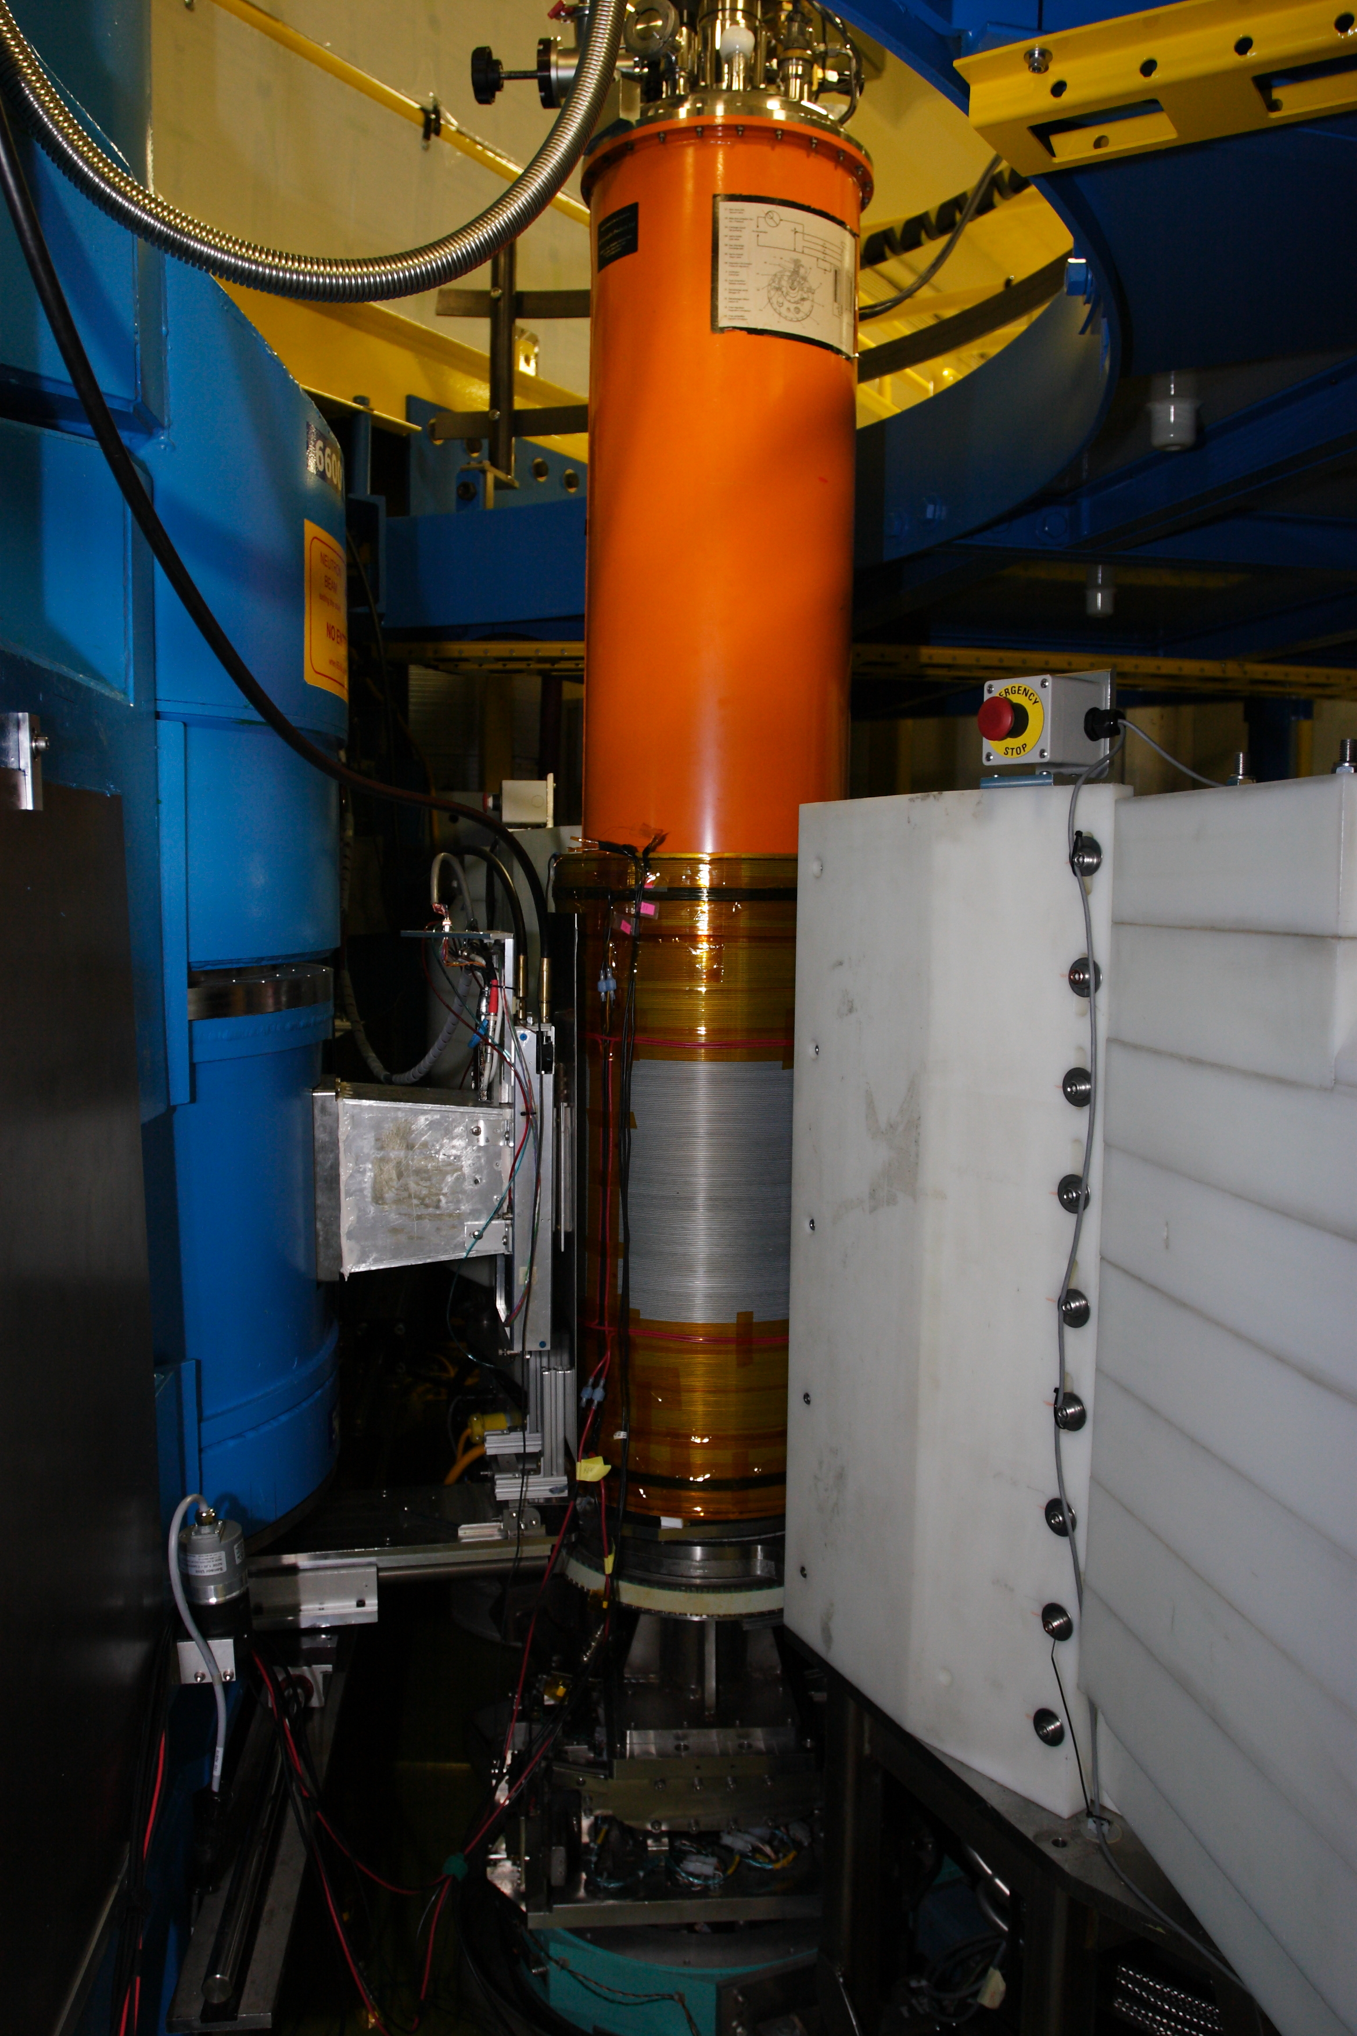
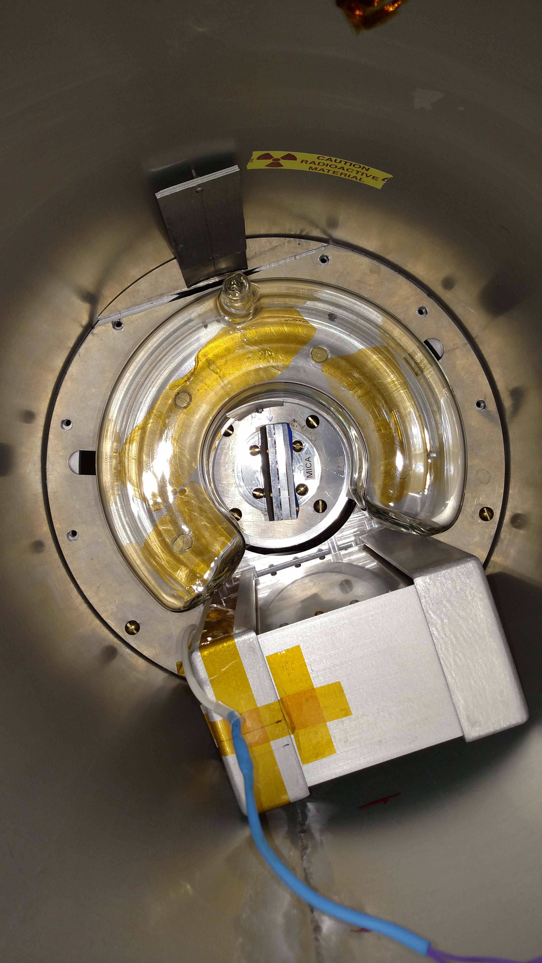
High intensity instrument with wide-angle PA on MACS
Instrument highlights
³He polarizer and analyzer(s)
High polarized flux, 1x10⁸ n/cm²/s at 10 meV
Angular coverage for polarization analysis of 240°
Elastic and inelastic measurements, with E_{i} between 2.5 meV and 16 meV and E_{f} between 2.5 meV and 5 meV
2 - 4 spin-dependent cross section measurements
Sample field: < 40 G, and P ⊥ Q
³He polarizations: up to 85%, and relaxation times: up to 400 hrs
Initial flipping ratio of 45 with overall transmission of 0.13
Cell swap time period: every 2 - 4 days
Toroid Analyzer Cell
Solenoid
RF Box
W.C. Chen et al, J. Phys. Conf. Ser. 746, 012016 (2016)
Q. Ye et al, Physics Procedia 42, 206 (2013)
C.B. Fu et al, Physica B 406, 2419 (2011)
http://www.ncnr.nist.gov/equipment/he3nsf/index.html
n beam
Beam
Stop
Polarizer
Cell
Sample

