Slide 2
VA Organization
Department of
Veterans Affairs
(VA)
Veteran’s Benefits
Administration
(VBA)
Veteran’s Health
Administration
(VHA)
National Cemetery
Administration
(NCA)
Courtesy of Kevin Meldrum

Slide 3
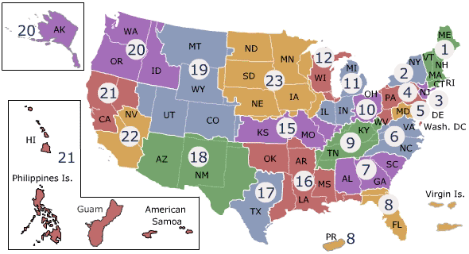
Veterans Affairs - VHA
Notes:
The Department of Veterans Affairs (VA) is the largest health care system in the United States, providing care to approximately 6 million veterans at over 1,400 points of care. At the core of virtually all care processes is a broadly scoped and extensively used electronic health record system known as the Veterans Information System Technology Architecture (VistA). VistA provides a longitudinal view for patients receiving care nationwide including diagnosis, procedures, pharmacy, orders, labs, microbiology, physiologic measurements, and text documents. The data from patient encounters is collected in more than 20 different VA Integrated Service Network (VISN) regions. Each VISN individually grants data access for IRB-approved studies to VA-affiliated researchers.
There are approximately 6 million veterans receiving care in the VA system and more than 20 million patient records (for both living and deceased veterans).
The population of the VA reflects an older, mostly male set of persons who served as US soldiers.
Mean age: 64.5
5.1% female
69.5% Caucasian
Females are the fastest growing demographic in the VA, representing 15.8% of patients under the age of 50 and 18.3% of patients under the age of 40.

Slide 4
VHA Facilities
163 Hospitals
800 Clinics
135 Nursing Homes
43 Domiciliaries
180,000 Healthcare Professionals
Serving 6 Million Veterans per Year
Courtesy of Kevin Meldrum

Slide 5
VHA Volume
Hospital sizes vary from 100 to 1000 beds.
Outpatient visits vary at each facility from 30,000 to 450,000 visits per year
46.5 million outpatient visits per year
564,000 inpatient admissions per year
167 million prescription-months filled
Courtesy of Kevin Meldrum

Slide 6
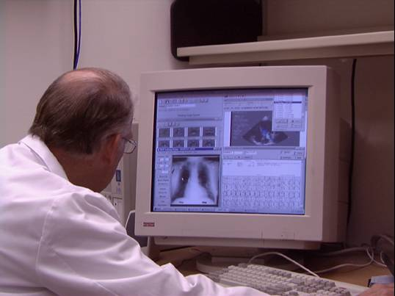
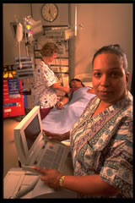
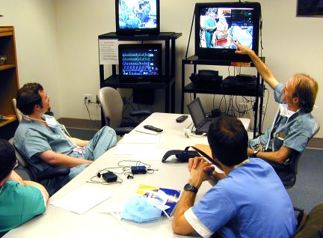
VistA: In Every VA Medical Center For >15 years!
Notes:
NOW has been in EVERY…for 15 years

Slide 7
2006 – Innovation Award for VistA VA’s Electronic Health Record (EHR)
Notes:
Thank
Honor to be here
Share the story of VA’s award winning EHR

Slide 8
Achievements
The VA’s EMR been estimated to improve efficiency by 6% per year
Pharmacy prescription accuracy has improved to 99.997%
VA hospitals only 1/13 systems that have achieved HIMSS stage 7, the highest level of record integration
Public domain software available through the freedom of information act directly from the VA’s website or network of distributors

Slide 9
History of VistA
1977 – 1981 “The Underground”
1980s – Service Focused Software
1990s – Physician Focused Software
1997 – Release of Computerized Patient Record System (CPRS)
www.hardhats.org
Courtesy of Kevin Meldrum

Slide 10
Database
Developed using M or MUMPS language/database
Runs on InterSystems Cache version of MUMPS
Open source engine called GT.M for Linux and Unix computers is available

Slide 11
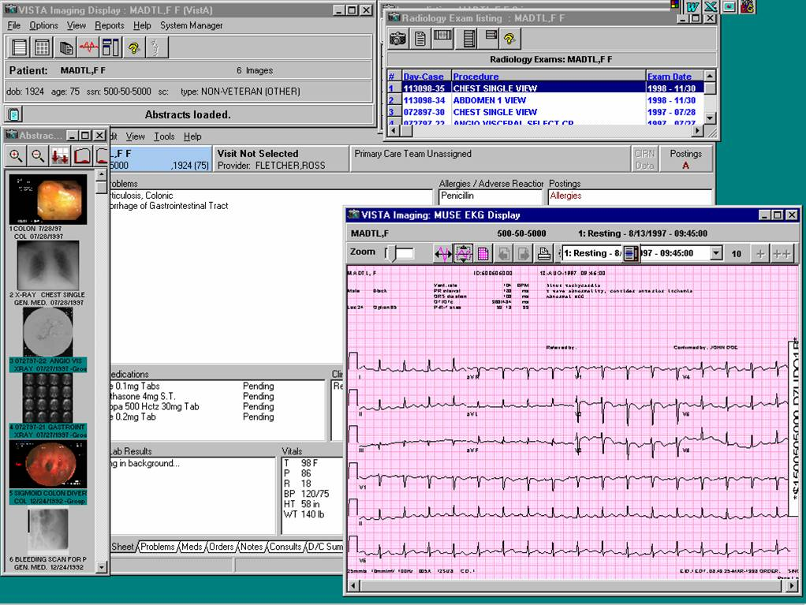
VistA: A Chart Metaphor Combining Text and Images
000-50-5000
Single longitudinal health record is immediately available in
Outpatient
Inpatient &
Long-term care settings
000-50-5000
Notes:
Known as VistA, .. Combines text and MULTI-MEDIA IMAGES of all types – For the first time, on their Clinical DESKTOP, clinicians NOT only had could access a patient’s b&w radiology xrays and CT’s, but also color images of pathology slides, pictures of lesions from colonoscopy exams, images of abnormalities of their eye and retina, wounds photos from home visits – and even video clips of their cardiac catheterization.
Other medical centers that had EHRs at that time used different brands in their ambulatory, inpatient, and long-term care settings that did not talk to one another***
CPRS – the “clinical desktop”
VistA Imaging – a broad range of multi-media medical images
X-rays, pathology slides, video views, scanned documents, cardiology exam results, wound photos, endoscopies, etc.
Patient’s data retrievable from any VA facilities where they received treatment

Slide 12
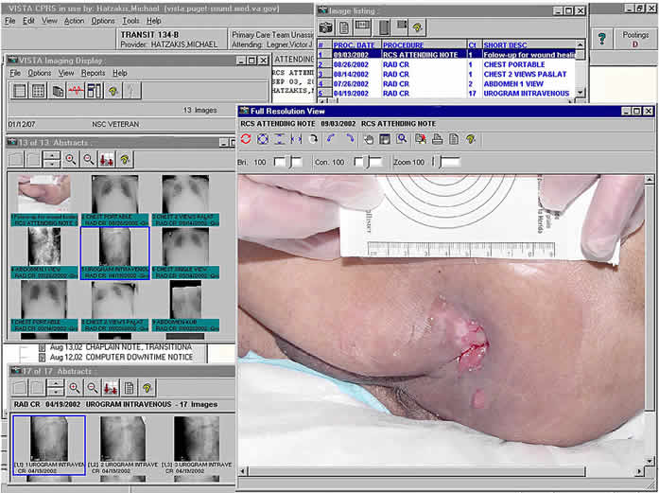
VistA Imaging
Integrates images with the electronic medical record
Can be used independently or integrated into VistA
Includes
Radiology
EKG’s
Pathology
GI lab
Dermatology
Wound Care
Scanned Documents

Slide 13
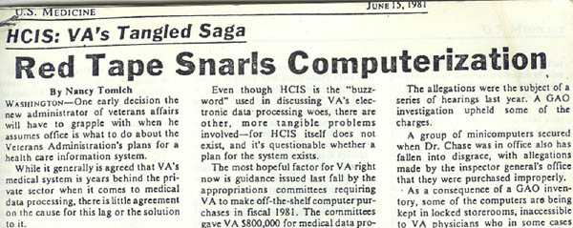
From A Few Sites To The Largest Health Care System In The U.S. Under One Management
In The Beginning
NIST (Then NBS) was asked to turn the existing systems-technology strategy into a systems-architecture design
Dr. John Chase, the VA’s Medical Director agreed to deploy the system at the VA Hospitals
Dr. Robert Kolodner (later the National Health Information Technology Coordinator) and George Timson were involved since 1977
1978 - Minicomputers sent to about 20 VA Medical Centers
1979 - “Underground Railroad” formed referred to as conspirators against the enemy

Slide 14
DHCP - Hospital Information System – 1981
Congressman Sunny Montgomery arranged for DHCP to be written into law as a program at the VA
1982 - Official deployment of core applications
1993 - Order Entry / Results Reporting
The four major adopters of VistA (VA, DoD, HIS, and the Finnish Consortium) each took VistA in a slightly different direction
The Finns actually were the first major adopter

Slide 15
VistA
Electronic Health Record (EHR) – The name was adopted in 1994 under Ken Kizer
1996-99 - CPRS (“Clinical Desktop”)
2000 - Bar Code Medication Administration
2004 – My HealtheVet (Personal Health Record – PHR)
2010 – Blue Button (Data Download)

Slide 16
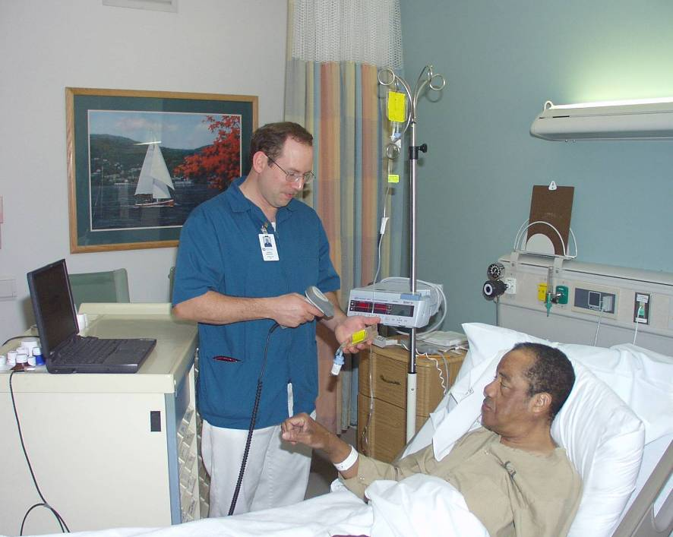
Bar Code Medication Administration (BCMA)
Virtually Eliminates Errors at the Point of Administration
BCMA Assures the:
Right Medication
Right Dose
Right Patient
Right Provider
Right Time

Slide 17
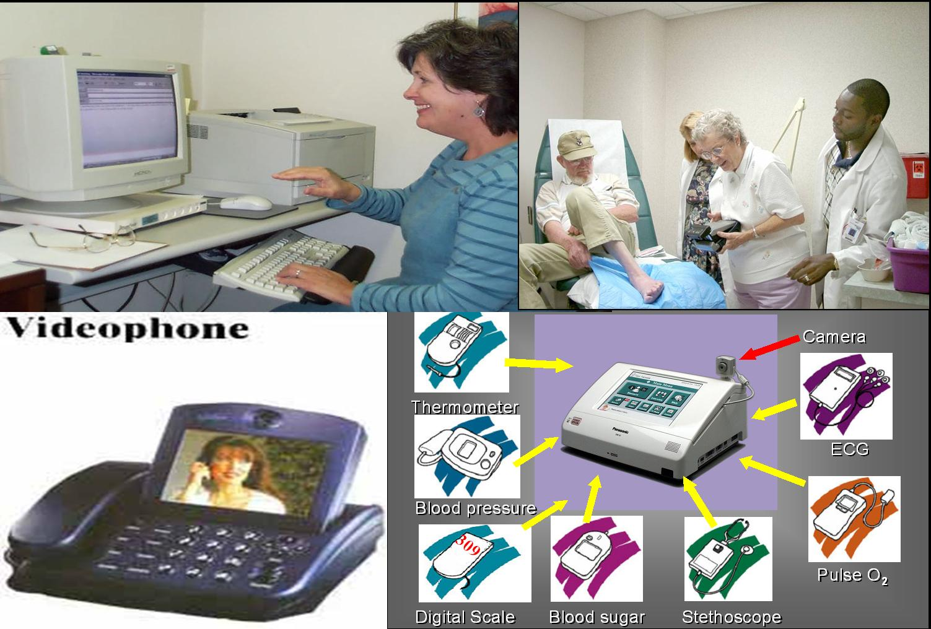
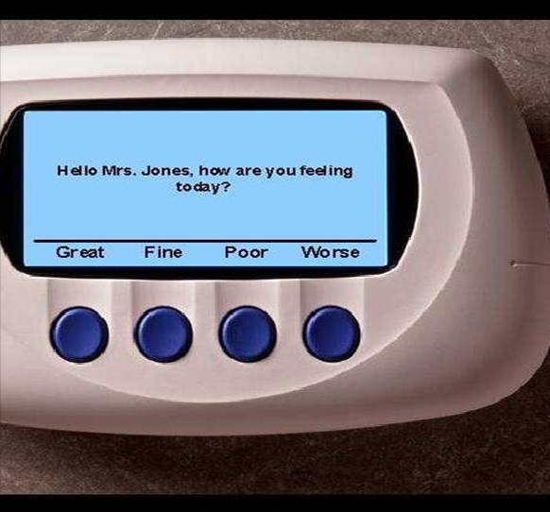
Home Telehealth
Largest telehealth program in the world
60,000 veterans received telehealth services in 2011
Notes:
90% non-video, message-based service
PTSD Coach app – PTSD, Mental Health lead

Slide 18
VA Provides My HealtheVet: A Personal Health Record For Veterans

Slide 19
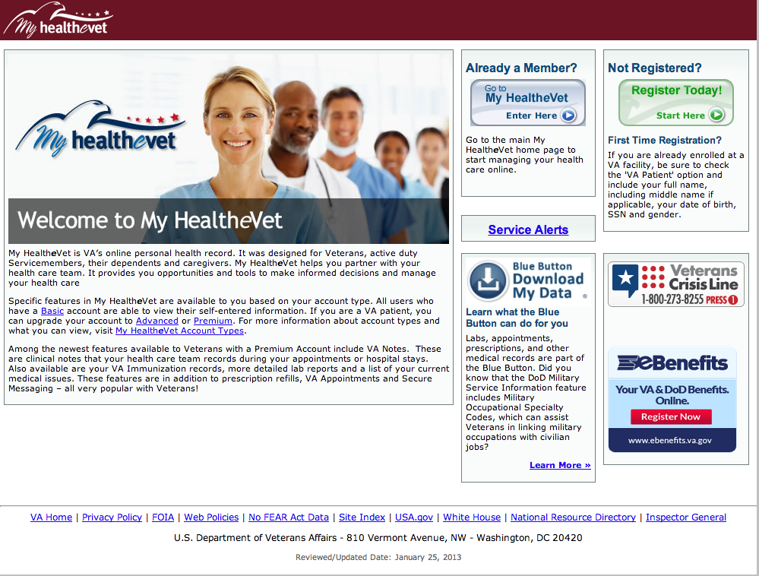

Slide 20
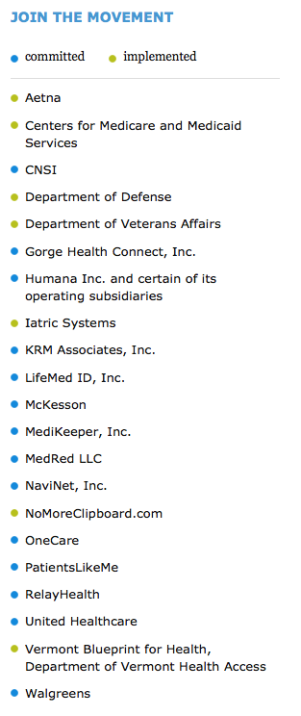
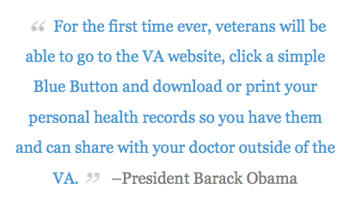
VA Conceived of and Provides: “Blue Button”

Slide 23
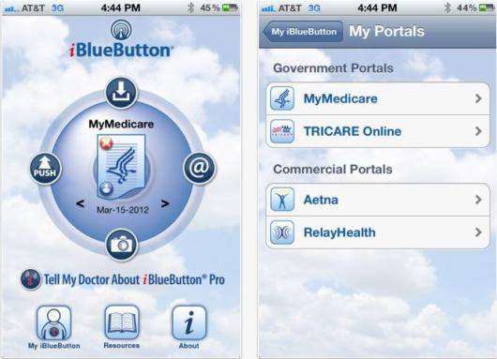
Blue Button Apps Competition

Slide 24
VISTA Layered Approach
Courtesy of Kevin Meldrum

Slide 25
CLINICAL PATIENT RECORD
VISTA SOFTWARE PACKAGES
VOLUNTARY
SERVICE
REHAB
MEDICINE
ACCOUNTS
RECEIVABLE
Vista
IMAGING
MEDICAL
LIBRARY
RECORDS
NURSING
ADMISSION
DISCHARGE
TRANSFER
TRACKING
INTEGRATED DATABASE
RADIOLOGY
PATIENT
FUNDS
PERSONS
BLOOD BANK
PATIENTS
PROBLEM
LIST
DRUGS
MAILMAN
RPC
BROKER
SOCIAL WORK
LABORATORY
COMPUTERIZED
PATIENT
RECORD
SYSTEM
(CPRS)
TASK
MANAGER
DEVICE
MENTAL
HEALTH
WARDS
KERNEL
MANAGER
LAB
RESULTS
DENTAL
MENU
MANAGER
USER
ENGINEERING
SURGERY
VA
FILEMAN
SECURITY
ONCOLOGY
HEALTH
SUMMARY
BAR CODE
MEDICATION
ADMINISTRATION
PRESCRIPTIONS
INVENTORY
DIETETICS
IMAGES
INPATIENT
PHARMACY
TEXT
INTEGRATION
UTILITIES (TIU)
MEDICINE
WOMEN’S
HEALTH
OUTPATIENT
PHARMACY
INTEGRATED
FUNDS CONTROL
ACCOUNTING &
PROCUREMENT
SCHEDULING
MEDICAL CARE
COST RECOVERY
CONSULTS /
RESULT
TRACKING
AUTHORIZATION SUBSCRIPTION
UTILITY (ASU)
CLINICAL
REMINDERS
Courtesy of Kevin Meldrum

Slide 26
http://www.ehealth.va.gov/EHEALTH/CPRS_Demo.asp

Slide 27
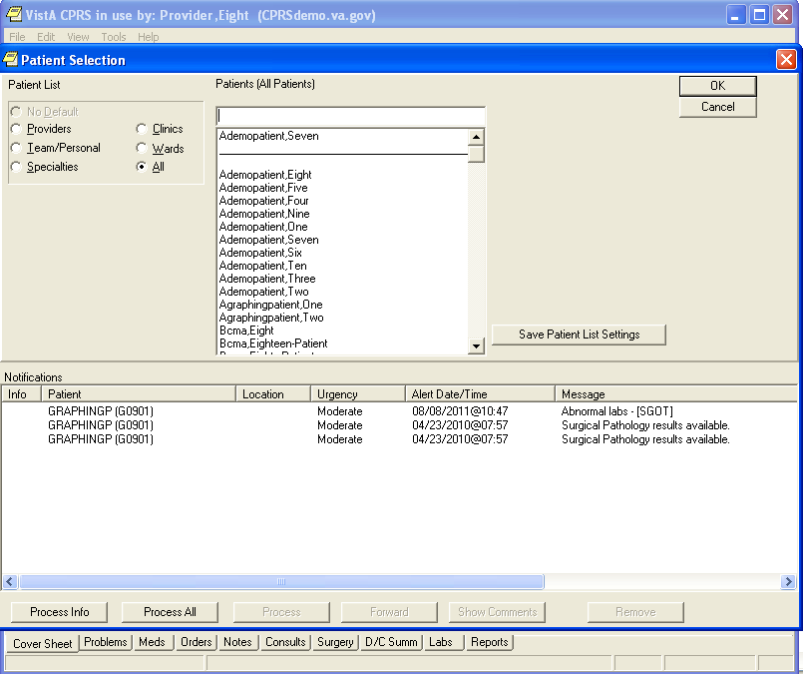

Slide 28
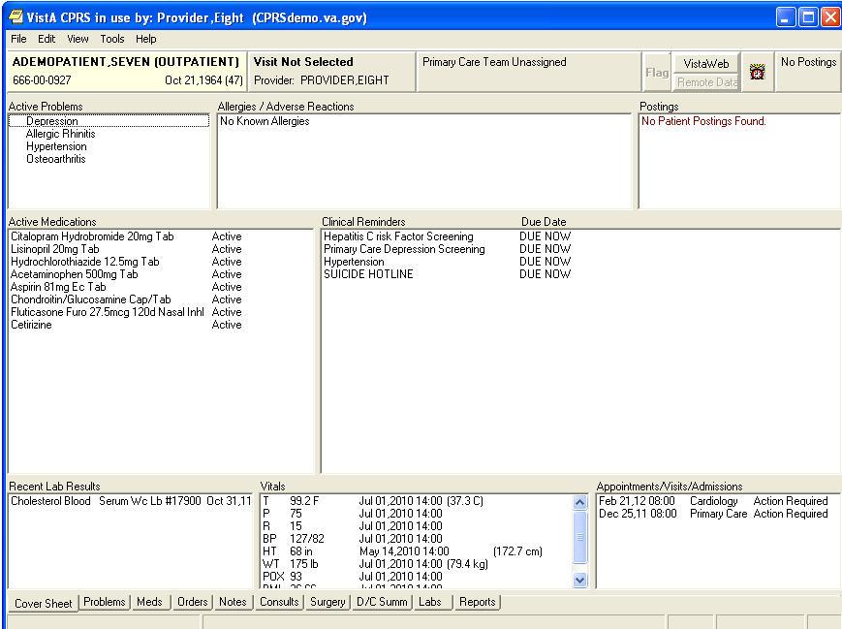

Slide 29
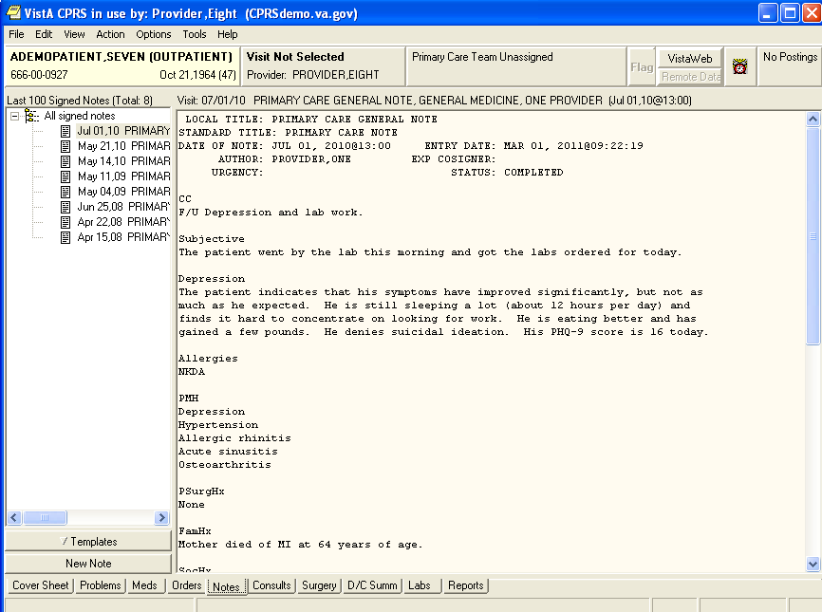

Slide 30
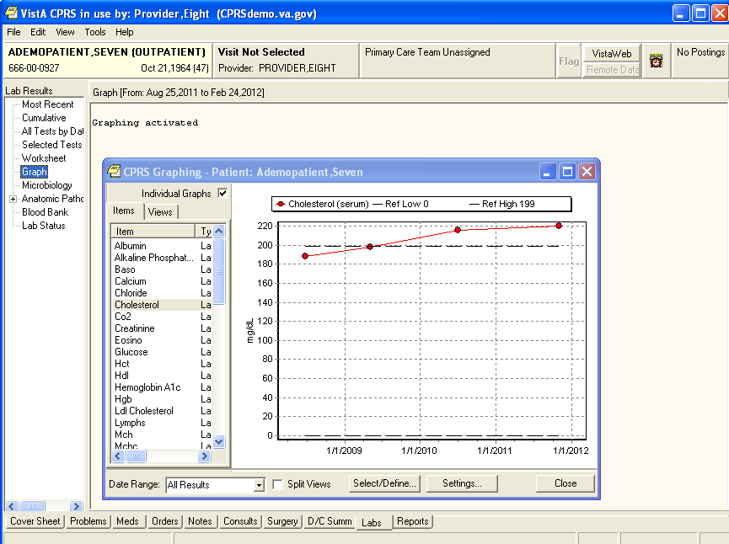

Slide 31
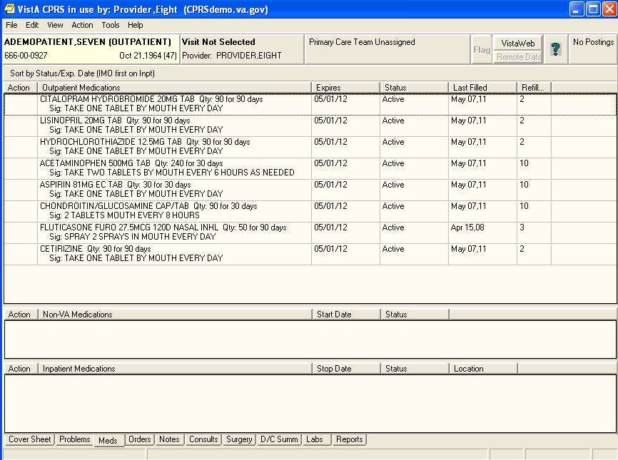

Slide 32
Lessons Learned
User Involvement is ESSENTIAL
Discover major innovations by front line users/developers
Learn from the “Positive Deviants”
Start with the Early Adopters
Include users at all stages
Notes:
NOT a technology problem
A Socio-technical problem

