Slide 1
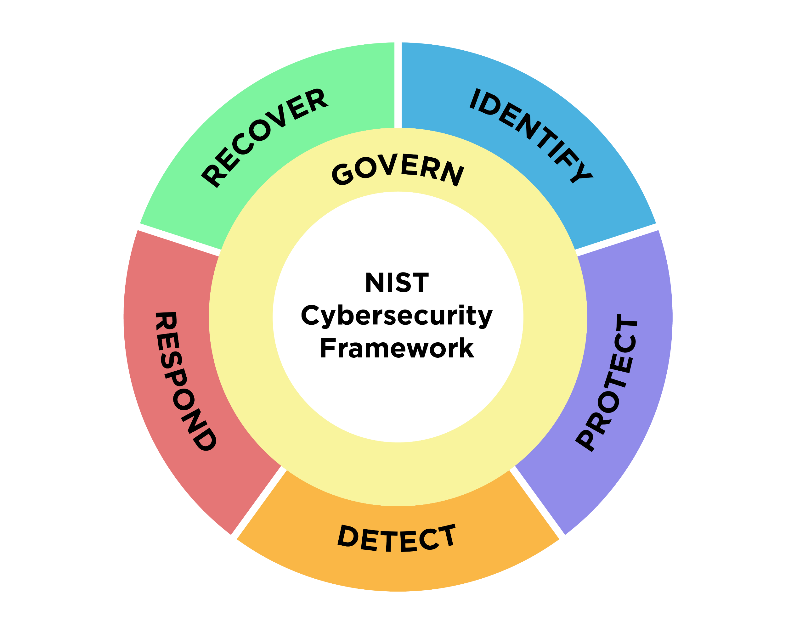
NIST Cybersecurity Framework 2.0: Small Business Quick-Start Guide
Purpose
This guide provides small-to-medium sized businesses (SMB), specifically those who have modest or no cybersecurity plans in place, with considerations to kick-start their cybersecurity risk management strategy by using the NIST Cybersecurity Framework (CSF) 2.0. The guide also can assist other relatively small organizations, such as non-profits, government agencies, and schools. It is a supplement to the NIST CSF and is not intended to replace it.
What is the NIST Cybersecurity Framework?
The NIST Cybersecurity Framework is voluntary guidance that helps organizations —regardless of size, sector, or maturity— better understand, assess, prioritize, and communicate their cybersecurity efforts. The Framework is not a one-size-fits-all approach to managing cybersecurity risks. Businesses must consider their own risk tolerances, priorities, threats, vulnerabilities, requirements, etc., when using this supplement and the full CSF 2.0.
Getting Started with the Cybersecurity Framework
The CSF organizes cybersecurity outcomes into six high-level Functions: Govern, Identify, Protect, Detect, Respond, and Recover. These Functions, when considered together, provide a comprehensive view of managing cybersecurity risk. The activities listed for each Function within this guide may offer a good starting point for your business. If there are activities contained within this guide that you do not understand or do not feel comfortable addressing yourself, this guide can serve as a discussion prompt with whomever you have chosen to help you reduce your cybersecurity risks, such as a managed security service provider (MSSP).
EXPLORE MORE CSF 2.0 RESOURCES
Quickly find what you need, including:
A suite of NEW Quick Start Guides
Search tools
Concept papers
FAQs
nist.gov/cyberframework
February 2024

Slide 2
Govern
The Govern Function helps you establish and monitor your business’s cybersecurity risk management strategy, expectations, and policy.
Actions to Consider
Understand Understand how cybersecurity risks can disrupt your business’s mission. (GV.OC-01) Understand your legal, regulatory, and contractual cybersecurity requirements. (GV.OC-03) Understand who within your business will be responsible for developing and executing the cybersecurity strategy. (GV.RR-02) Assess Assess the potential impact of a total or partial loss of critical business assets and operations. (GV.0C-04) Assess whether cybersecurity insurance is appropriate for your business. (GV.RM-04) Prioritize Prioritize managing cybersecurity risks alongside other business risks. (GV.RM-03) Communicate Communicate leadership’s support of a risk-aware, ethical, and continually improving culture. (GV.RR-01) Communicate, enforce, and maintain policies for managing cybersecurity risks. (GV.PO-01)
Getting Started with Cybersecurity Governance
You can use these tables to begin thinking about your cybersecurity governance strategy.
Technical Deep Dive: Staging Cybersecurity Risks for Enterprise Risk Management and Governance Oversight
Setting Organizational Context
Our business mission Statement:
What cybersecurity risks may prevent us from achieving these goals?
Documenting Cybersecurity Requirements
List your legal requirements:
List your regulatory requirements:
List your contractual requirements:
Questions to Consider
As our business grows, how often are we reviewing our cybersecurity strategy?
Do we need to engage a managed security service provider to help us establish and manage our cybersecurity plan?
Do we have acceptable use policies in place for business and employee-owned devices accessing business resources? Have employees been educated on these policies?
Related Resources
Securing Small and Medium-Sized Supply Chains Resource Handbook
Choosing A Vendor/Service Provider
View all NIST CSF 2.0 Resources Here

Slide 3
identify
The Identify Function helps you determine the current cybersecurity risk to the business.
Actions to Consider
Understand Understand what assets your business relies upon by creating and maintaining an inventory of all hardware, software, systems, and services. (ID.AM-01/02/04) Assess Assess your assets (IT and physical) for potential vulnerabilities. (ID.RA-01) Assess the effectiveness of the business's cybersecurity program to identify areas that need improvement. (ID.IM-01) Prioritize Prioritize inventorying and classifying your business data. (ID.AM-07) Prioritize documenting internal and external cybersecurity threats and associated responses using a risk register. (ID.RA) Communicate Communicate cybersecurity plans, policies, and best practices to all staff. (ID.IM-04) Communicate to staff the importance of identifying needed improvements to cybersecurity risk management processes, procedures, and activities. (ID.IM)
Getting Started with Identifying Current Cybersecurity Risk to Your Business
Before you can protect your assets, you need to identify them. Then, you can determine the appropriate level of protection for each asset based upon their sensitivity and criticality to your business mission. You can use this sample table to get started on your IT asset inventory. As your business matures, you might consider using an automated asset inventory solution or a managed security services provider to help you manage all your business assets. Technical Deep Dive: Integrating Cybersecurity and Enterprise Risk Management
Software/ hardware/ system/ service | Asset's official use | Asset administrator or owner | System or device access to sensitive data | Is multi-factor authentication enabled to access this asset? | Risk to business if we lose access to this asset
Questions to Consider
What are our most critical business assets (data, hardware, software, systems, facilities, services, people, etc.) we need to protect?
What are the cybersecurity and privacy risks associated with each asset?
What technologies or services are personnel using to accomplish their work? Are these services or technologies secure and approved for use?
Related Resources
NIST Risk Register Template
Common Cybersecurity Risks and Threats to Small Businesses
Take Stock. Know What Sensitive Information You Have
Evaluating Your Operational Resilience and Cybersecurity Practices
View all NIST CSF 2.0 Resources Here

Slide 4
protect
The Protect Function supports your ability use safeguards to prevent or reduce cybersecurity risks.
Actions to Consider
Understand Understand what information employees can access and restrict that access only to those employees who need it to do their jobs. (PR.AA-05) Assess Assess the timeliness, quality, and frequency of your company’s cybersecurity training for employees. (PR.AT-01/02) Prioritize Prioritize requiring multi-factor authentication on all accounts that offer it and consider using password managers to help you and your staff generate and protect strong passwords. (PR.AA-03) Prioritize changing default manufacturer passwords. (PR.AA-01) Prioritize regularly updating and patching software & operating systems. Enable automatic updates to help you remember. (PR.PS-02) Prioritize regularly backing up your data and testing backups. (PR.DS-11) Prioritize configuring your tablets and laptops to enable full-disk encryption to protect data. (PR.DS-01) Communicate Communicate to your staff how to recognize common attacks, report attacks or suspicious activity, and perform basic cyber hygiene tasks. (PR.AT-01/02)
Getting Started with Protecting Your Business
Enabling multi-factor authentication (MFA) is one of the fastest, cheapest ways you can protect your data. Start with accounts that can access the most sensitive information. Use this checklist to give you a head start, but remember your own list will be longer than this:
Technical Deep Dive: NIST Digital Identity Guidelines
Account | MFA Enabled (Y/N)
Banking Account(s)
Accounting and Tax Account(s)
Merchant Account(s)
Google, Microsoft, and/or Apple ID Account(s)
Email Account(s)
Password Manager(s)
Website Account(s)
Questions to Consider
Are we restricting access and privileges only to those who need it? Are we removing access when they no longer need it?
How are we securely sanitizing and destroying data and data storage devices when they’re no longer needed?
Do employees possess the knowledge and skills to perform their jobs with security in mind?
Related Resources
Cybersecurity Training Resources
Enabling Multi-Factor Authentication
Protecting Your Business from Phishing
View all NIST CSF 2.0 Resources Here

Slide 5
detect
The Detect Function provides outcomes that help you find and analyze possible cybersecurity attacks and compromises.
Actions to Consider
Understand Understand how to identify common indicators of a cybersecurity incident. (DE.CM) Assess Assess your computing technologies and external services for deviations from expected or typical behavior. (DE.CM.06/09) Assess your physical environment for signs of tampering or suspicious activity. (DE.CM-02) Prioritize Prioritize installing and maintaining antivirus and anti-malware software on all business devices—including, but not limited to, servers, desktops and laptops. (DE.CM-09) Prioritize engaging a service provider to monitor computers and networks for suspicious activity if you don't have the resources to do it internally. (DE.CM-01/09) Communicate Communicate with your authorized incident responder, such as an MSSP, about the relevant details from the incident to help them analyze and mitigate it. (DE.AE-07)
Getting Started with Detecting Incidents
Some common indicators of a cybersecurity incident are:
Loss of usual access to data, applications, or services.
Sluggish network.
Antivirus software alerts when it detects that a host is infected with malware.
Multiple failed login attempts from an unfamiliar remote system.
An email administrator sees many bounced emails with suspicious content.
A network administrator notices an unusual deviation from typical network traffic flows.
Technical Deep Dive: NIST Computer Security Incident Handling Guide
Questions to Consider
Do devices that are used for our business, whether business-owned or employee-owned, have antivirus software installed?
Do employees know how to detect possible cybersecurity attacks and how to report them?
Is our business monitoring audits and alerts to see potential cyber incidents?
Related Resources
Ransomware Protection and Response
Detecting a Potential Intrusion
Cybersecurity Training Resources
View all NIST CSF 2.0 Resources Here

Slide 6
respond
The Respond Function supports your ability to take action regarding a detected cybersecurity incident.
Actions to Consider
Understand Understand what your incident response plan is and who has authority and responsibility for implementing various aspects of the plan. (RS.MA-01) Assess Assess your ability to respond to a cybersecurity incident. (RS.MA-01) Assess the incident to determine its severity, what happened, and its root cause. (RS.AN-03) Prioritize Prioritize taking steps to contain and eradicate the incident to prevent further damage. (RS.MI) Communicate Communicate a confirmed cybersecurity incident with all internal and external stakeholders (e.g., customers, business partners, law enforcement agencies, regulatory bodies) as required by laws, regulations, contracts, or policies. (RS.CO-02/03)
Getting Started with an Incident Response Plan
Before an incident occurs, you want to be ready with a basic response plan. This will be customized based on the business, but should include:
A business champion: Someone who is responsible for developing and maintaining your incident response plan.
Who to call: List all the individuals who may be part of your incident response efforts. Include their contact information, responsibilities, and authority.
What/when/how to report: List your business's communications/reporting responsibilities as required by laws, regulations, contracts, or policies.
Technical Deep Dive: NIST Computer Security Incident Handling Guide
Contact | Phone
Business Leader:
Technical Contact:
State Police:
Legal:
Bank:
Insurance:
Questions to Consider
Do we have a cybersecurity incident response plan? If so, have we practiced it to see if it is feasible?
Do we know who the key internal and external stakeholders and decision-makers are who will assist if we have a confirmed cybersecurity incident?
Related Resources
Incident Response Plan Basics
FBI’s Internet Crime Complaint Center
Data Breach Response: A Guide for Business
Best Practices for Victim Response and Reporting of Cyber Incidents
View all NIST CSF 2.0 Resources Here

Slide 7
recover
The Recover Function identifies activities to restore assets and operations that were impacted by a cybersecurity incident.
Actions to Consider
Understand Understand who within and outside your business has recovery responsibilities. (RC.RP-01) Assess Assess what happened by preparing an after-action report—on your own or in consultation with a vendor—that documents the incident, the response and recovery actions taken, and lessons learned. (RC.RP-06) Assess the integrity of your backed-up data and assets before using them for restoration. (RC.RP-03) Prioritize Prioritize your recovery actions based on organizational needs, resources, and assets impacted. (RC.RP-02) Communicate Communicate regularly and securely with internal and external stakeholders. (RC.CO)
Getting Started with a Recovery Playbook A playbook typically includes the following critical elements:
A set of formal recovery processes.
Documentation of the criticality of organizational resources (e.g., people, facilities, technical components, external services).
Documentation of systems that process and store organizational information, particularly key assets. This will help inform the order of restoration priority.
A list of personnel who will be responsible for defining and implementing recovery plans.
A comprehensive recovery communications plan.
Technical Deep Dive: NIST Guide for Cybersecurity Event Recovery
Questions to Consider
What are our lessons learned? How can we minimize the chances of a cybersecurity incident happening in the future?
What are our legal, regulatory, and contractual obligations for communicating to internal and external stakeholders about a cybersecurity incident?
How do we ensure that the recovery steps we are taking are not introducing new vulnerabilities to our business?
Related Resources
Cybersecurity Training Resources
Creating an IT Disaster Recovery Plan
Backup and Recover Resources
View all NIST CSF 2.0 Resources Here

Slide 8
Profiles and Additional Resources
Using Profiles to Implement the Cybersecurity Framework
A CSF Profile describes an organization’s current or target cybersecurity posture in terms of the CSF Core’s cybersecurity outcomes. There are two types of CSF Profiles:
A Current Profile specifies the outcomes an organization is currently achieving (or attempting to achieve) and characterizes how or to what extent each outcome is being achieved.
A Target Profile specifies the outcomes an organization has selected and prioritized for achieving its cybersecurity risk management objectives.
You can also use a Community Profile as the basis for your Target Profile. Community Profiles are published Target Profiles for particular sectors, technologies, threat types, or other use cases.
You can also choose to use the CSF Tiers to inform your Profile creation. Tiers characterize the current or targeted rigor of an organization’s Functions or Categories. See the CSF Tiers Quick Start Guide for more information on Tiers and their use.
View the CSF 2.0 Creating and Using Profiles Quick Start Guide for more detailed information on how to get started creating Current and Target Profiles for your organization.
Additional Resources
The NIST Cybersecurity Framework Reference Tool allows users to explore the full CSF 2.0 Core in human and machine-readable versions (in JSON and Excel), while also maintaining resources with information to help you achieve your desired outcomes, such as:
Mapping: Informative references are mappings indicating relationships between the Core and various standards, guidelines, regulations, and other content. They hep inform how an organization may achieve the Core’s outcomes.
Implementation examples provide examples of concise, action-oriented steps to guide organizations in achieving the CSF Subcategories. The examples are not a comprehensive list of all actions that could be taken by an organization, nor are they a baseline of required actions; they are a set of helpful examples to get organizations thinking about concrete steps.
NIST Cybersecurity and Privacy Reference Tool (CPRT) provides a simple way to access reference data from various NIST cybersecurity and privacy standards, guidelines, and Frameworks– downloadable in common formats (XSLS and JSON).
NIST SP 800-53 provides a catalog of security and privacy controls you can choose from. The controls are flexible, customizable, and implemented as part of an organization-wide process to manage risk. View and export from the Cybersecurity and Privacy Reference Tool (CPRT).

