Slide 1
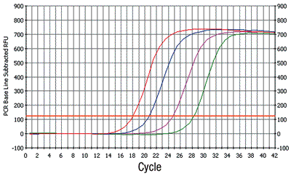
Development and Performance of NIST SRM 2917 for Molecular Recreational Water Quality Testing
Orin C. Shanks, Jessica Willis, Mano Sivaganesan, Jason Kralj, Stephanie Servetas, Monique E. Hunter, Blaza Toman, and Scott Jackson
Disclaimer: The views expressed in this presentation are those of the author[s] and do not necessarily represent the views or policies of the U.S. Environmental Protection Agency. Mention of trade names or commercial products does not constitute endorsement or recommendation for use.

Slide 2
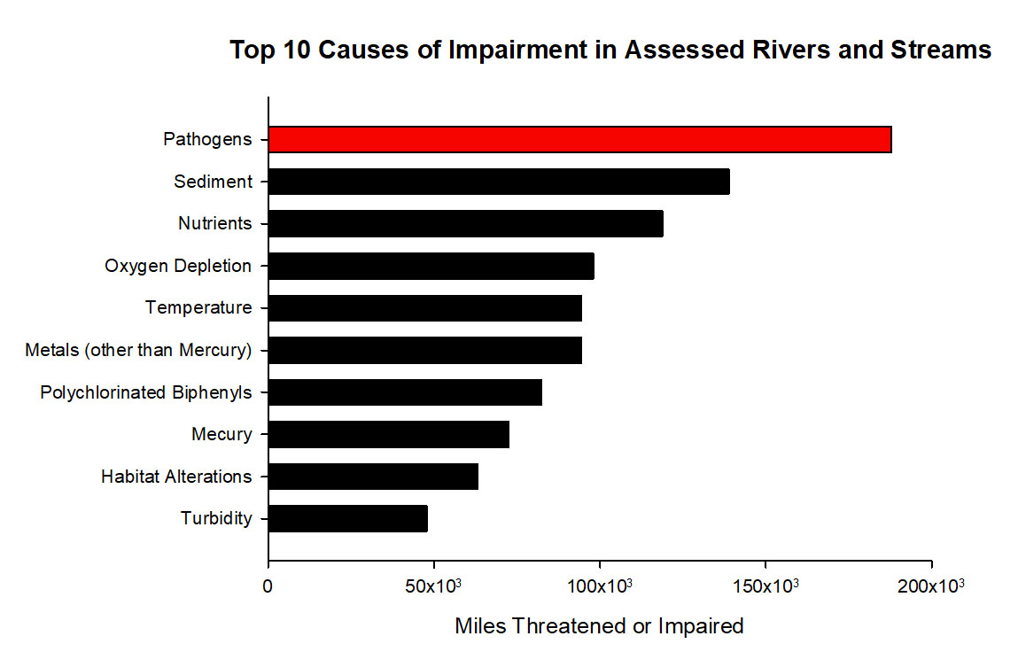
Surface Water Fecal Pollution is a National Challenge
Fecal microbes
most common
biological
contaminant
Public health, economic, and ecological impacts
https://ofmpub.epa.gov/waters10/attains_nation_cy.control#causes

Slide 3
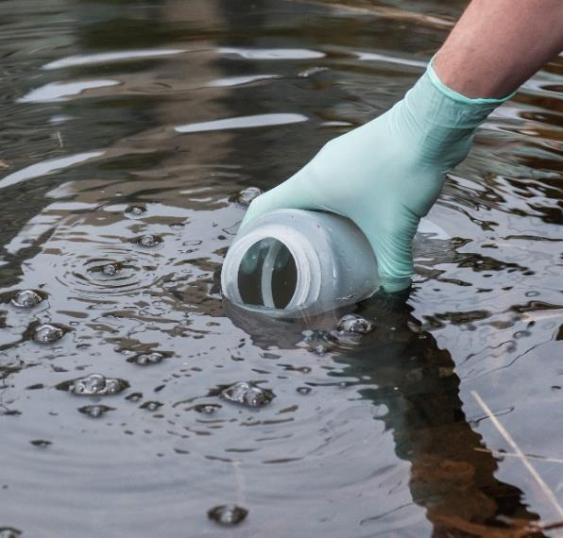
EPA Research to Improve Water Quality Testing
Key research areas:
Method development
Performance assessment
Implementation
Successfully developed molecular
tools for:
Same day water quality results
Identification of fecal pollution sources
Nationally validated standardized
protocols available:
EPA Methods 1609 and 1611
EPA Methods 1696 and 1697
https://www.epa.gov/cwa-methods/other-clean-water-act-test-methods-microbiological

Slide 4
The Need for a Standard Reference Material
qPCR methods use standard curves
to interpret results
National implementation requires:
High quality standard material
Available on large scale
Strong quality assurance program
Not feasible for EPA to manufacture
and distribute

Slide 5
EPA and NIST Partnership Solution
NIST specializes in development,
manufacture, and distribution of
reference materials
Partnership initiated by EPA in 2018
Funded by EPA and NIST
Goal to develop a standard reference
material for recreational water quality
testing

Slide 6
Reference Material Design
Composite DNA Target Strategy
5’
Target 1
Target 2
Target 3
Target 4
Target 5
Target 6
Target 7
Target 8
Target 9
Target 10
Target 11
Target 12
Target 13
3’
Single DNA construct
Functions with 13 qPCR assays
Purified, linearized plasmid DNA
Five expected concentrations
(10, 10², 10³, 10⁴, and 10⁵ copies/2µL)
1,000+ dilutions sets
Long term storage at 4˚C

Slide 7
qPCR Assay Targets
qPCR Assay | Developed by EPA | Organism | Pollution Source | Reference
HF183/BacR287 | Yes | Bacteroides spp. | Human | (Green et al. 2014)
HumM2 |  |  |  | (Shanks et al. 2009)
Rum2Bac | No | Prevotella spp. | Ruminant | (Mieszkin et al. 2010a)
Pig2Bac |  | Bacteroides spp. | Pig | (Mieszkin et al. 2010b)
CowM2 | Yes |  | Cattle | (Shanks et al. 2009)
CowM3
DG3 |  |  | Dog | (Green et al. 2014)
DG37
GFD | No | Helicobacter spp. | Avian | (Green et al. 2012)
CPQ_056 | Yes | CrAssphage | Human | (Stachler et al. 2017)
CPQ_064
Entero1a |  | Enterococcus spp. | General | (Siefring et al. 2008)
EC23S857 |  | E. coli |  | (Chern et al. 2011)
11 Fecal Source Identification Tools
2 General Fecal Indicator Assays

Slide 8
Reference Material Development
Conducted by NIST
Construct sequence verification
Purity assessment with NGS
Automated bottling
Absolute concentration assignments
Homogeneity demonstration
Stability testing at 4˚C
See Poster
https://swwsworkshop.virtualpostersession.org/

Slide 9
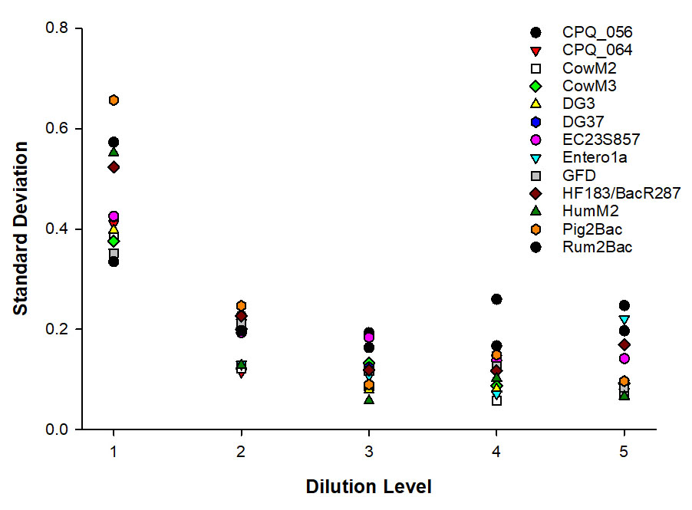
Single Laboratory Performance
Performed by EPA
13 qPCR assays
Repeated testing
Key findings:
Linearity (r²) range 0.996
to 0.999
Amplification efficiency (E) range 0.95 to 0.99
Quantification cycle (C_{q}) variability higher at level 1 compared to levels 2-5

Slide 10
Multiple Laboratory Performance
Participating Laboratories
University of Illinois at Chicago
University of South Florida
State University of New York
Michigan State University
New York University
Stanford University
Grand Valley University
Centers for Disease Control and Prevention
EPA Office of Research and Development (1)
EPA Office of Research and Development (2)
EPA Office of Research and Development (3)
EPA Region 2 Laboratory
EPA Region 7 Laboratory
Oregon Department of Agriculture
County of Santa Cruz Health Services
Maryland Department of Health & Mental Hygiene
Conducted by EPA
16 laboratories
12 qPCR assays
Standardized protocols
Same reagent lots
Repeated measurements
Status: Data analysis
VOLUNTEERS – THANK YOU!

