Slide 1
The ideal infection prevention hospital: air handling
Shelly L. Miller
University of Colorado Boulder, Mechanical Engineering
Nothing to Disclose
Notes:
My remarks today are from the perspective of an urban air pollution engineer with research expertise in air pollution exposure assessment and engineering control technologies and strategies.
I am one of the US experts in using ultraviolet germicidal irradiation for infection control

Slide 2
Objectives of Presentation
Understand how design of hospitals air handling affects nosocomial infection risk
Appreciate potential benefits of newer and innovative strategies to reduce infection risk from air handing system
Notes:
CDC 2011 - 4% of patients in acute-care hospitals had at least one health care-associated infection, more than half of which were not associated with devices or operative procedures [17].
648 000 patients with 721 800 HAIs in 2011
median interval of 6 days between hospital admission and the onset of HAI symptoms.
Greater patient age, longer duration of hospital stay, larger hospital size, and the insertion of a central catheter were found to be the greatest risk factors in the contraction of HAIs.
routes of transmission, include physicians’ and nursing staff’s clothing [18–20], stethoscopes [21], personal phones [22–25], and computer keyboards [26].

Slide 3
Indoor Microbiome…
Diverse indoor microbiome good for limiting potential pathogenic organisms
Diversity increases with air flow, better in naturally ventilated buildings
2. Outdoor Air Ventilation
Increased rates decrease communicable respiratory infections
Increased rates decrease airborne microbial loading
3. Natural Ventilation
Used as effective ventilation with low levels of traffic-related air pollution
Better to enhance microbiome diversity
Higher air exchange rates, lower risk of airborne infection
4. UVGI in Air Handlers
UVGI air treatment excellent strategy for high risk infectious areas
In room upper UVGI important tool in locations with high occupancy and unsuspected transmission
5. Negative Pressure Ward
Ventilation can be used to increase surge capacity in a hospital
Notes:
Perspective of an urban air quality engineer
Ventilation is supposed to provide fresh air to a building
What is “fresh”? Doesn’t contain toxic air pollutants, odors, infectious airborn particles
Where does this clean air come from? Mostly outside in a hospital…
If outside air is not “clean” we can treat with UV and filtration
Is mechanical ventilation good for hospitals?
A recent review suggests that it reduced bioaeorosol concentrations. Is this a good metric for healthy?
The indoor microbiome research suggests that mechanical ventilation decreases diversity indoors
Perhaps increased diversity doesn’t lead to over growth of pathogens
Higher ventilation rates are better, can be achieved with natural ventilation

Slide 4
1. Indoor Microbiome…

Slide 5
Indoor and outdoor environments increasingly isolated from each other
PRO: Reduces likelihood of negative air exchange with outside
PRO: Increases energy efficiency, reduces costs to maintain T And RH
X
Outside air
OPERABLE?
Save energy=$$$$
Lax and Gilbert 2015
Notes:
Lax and Gilbert
Technological advances in our ability to control air circulation have led to increased isolation between the indoor and outdoor environments, so that in many buildings it is not possible to open windows.
This serves two core purposes.
First, it reduces the likelihood of negative air exchange with the outside, reducing the potential escape or ingress of pathogens or pollutants.
Second, it makes control of the building environment’s temperature and humidity significantly more efficient, increasing energy efficiency and reducing the cost of running these facilities.
In many ways, almost inadvertently the built environment has been developed over the past 120 years to become increasingly inhospitable to microbial life. Environments are kept dry and surfaces are often covered with antimicrobial materials.

Slide 6
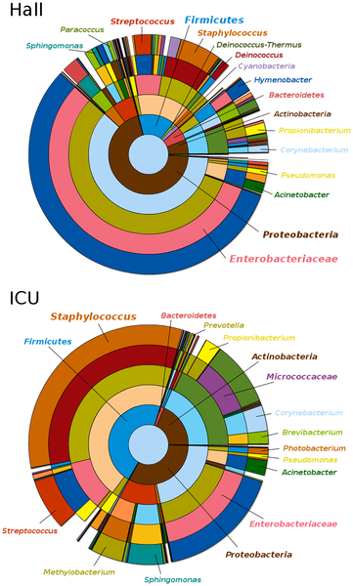
6
NICU:
More microbial diversity
Similar taxonomic profiles to offices/restrooms
Dominant source: human skin
Hewitt et al. 2013
Hospitals unfavorable to microbial life
Surfaces dry, antimicrobial
Intense cleaning
Reduced spread of communicable diseases
Lack of microbial diversity may worsen certain conditions, influence patient outcomes, allow pathogens on surfaces to dominate…
Poza et al. 2012
Lax and Gilbert 2015
Notes:
The Built environment has become increasingly inhospitable to microbial life
In hospitals, surfaces are dry, covered in antimicrobials, intense cleaning
This has reduced spread of communicable diseases but also changed our microbial relationship to environment
In the hospital, patients being exposed to ecosystems with limited microbial diversity may be a good thing
It also may be possible that lack of exposure to a diverse microbiome may exacerbate certain conditions, influence patient outcomes.
In the absence of a diverse microbial community, surface environments could play host to communicable pathogens that would otherwise be outcompeted by a diverse microbiota
There is surprisingly high microbial diversity in hospitals.
A recent study of two San Diego NICUs found far more microbial diversity than revealed by earlier culture-based studies of NICU surfaces [36].
Interestingly, comparison with other built environment surfaces, such as those in offices and restrooms, revealed similar taxonomic profiles dominated by the genera Streptococcus, Staphylococcus, Pseudomonas, Enterobacter, and Neisseria.
the dominant source of NICU microorganisms was human skin. Hewitt et al. 2013
Surprisingly, great diversity inhabits a space that is constantly being sanitized and treated with antibiotics (Poza et al. 2012).
Compared to the entrance hall, ICU diversity was lower.
can be explained by its confined character and by the existence of antimicrobial selective pressure.

Slide 7
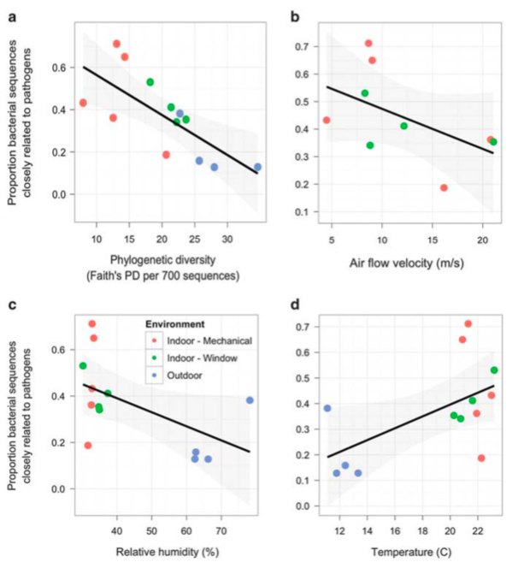
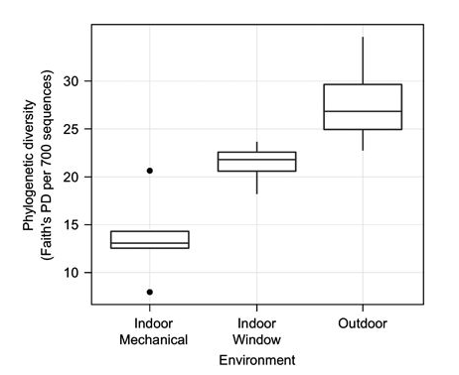
Kembel et al. 2012
Notes:
Kembel et al 2012
indoor air passed through mechanical ventilation was less diverse but more enriched in organisms closely related to human pathogens (Kembel et al.)
Airborne microbial communities and environmental conditions were sampled six times at Providence Milwaukie Hospital,
diversity of airborne bacterial communities was lower indoors than outdoors,
mechanically ventilated rooms contained less diverse microbial communities than did window-ventilated rooms.
Bacterial communities in indoor environments contained many taxa that are absent or rare outdoors, including taxa closely related to potential human pathogens.
The relative abundance of bacteria closely related to human pathogens was higher indoors than outdoors,
higher in rooms with lower airflow rates and lower relative humidity.
Our finding that increased airflow rates decreased the potential pathogen load is consistent with the hypothesis that ventilation is beneficial to human health

Slide 8
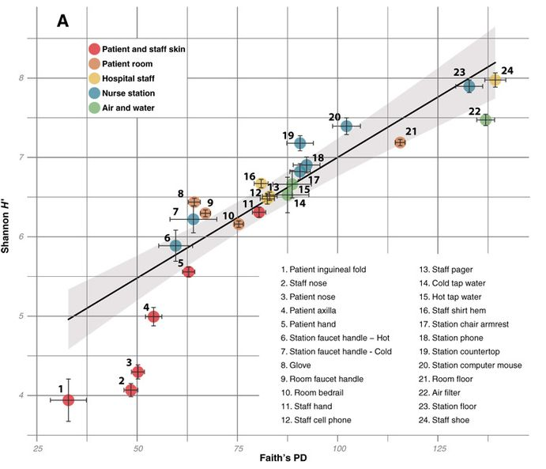
Lax et al. 2017
Skin microbiota
Temporal correlations
Antimicrobial resistance genes on surfaces
Hospital staff likely source
Sites interact with outdoors most diverse
Notes:
The bacteria in patient rooms, resembled the skin microbiota of the patient occupying the room.
patients initially acquired room-associated taxa that predated their stay but that their own microbial signatures began to influence the room community structure over time.
Metagenomic analyses revealed that genes conferring antimicrobial resistance were consistently more abundant on room surfaces than on the skin of the patients inhabiting those rooms.
analysis suggested that hospital staff were more likely to be a source of bacteria on the skin of patients than the reverse but that there were no universal patterns of transmission across patient rooms
sample sites most likely to interact with the outdoors, such as shoes, floors, and recirculated indoor air (which originated largely from high-efficiency particulate air–filtered outdoor air) (21), were the most diverse

Slide 9
2. Outdoor Air Ventilation
Increased Rates Decrease communicable respiratory infections
Increased rates decrease airborne microbial loading

Slide 10
Rates matter
0.9 L/s/p OA
Modern
CO₂
Risk of infection
6.8 L/s/p OA
Older
Brundage et al. 1988
=
2.7 L/s/p
Vol OA
Hoge et al. 1994
Notes:
Hoge et al 1994
Pneumonia
Attack rate highest among inmates in cells with highest CO2 (12---2300 ppm), lowest volume of outside air (1.8 – 7.0 L/s/p) – caused by overcrowding, inadequate ventilation
Median ventilation rate 2.7 L/s/p
Brundage et al 1988
Febrile acute respiratory disease
Modern ~3 ACH, low rates of OA <5%, 0.9 L/s/p OA and 17 L/s/p total
Older – windows operable, ceiling exhaust, leaky, higher rates of OA 40% 6.8 L/s/p OA

Slide 11
Location and ventilation type matter
Stockwell et al. 2019
Bioaerosol (CFU/m3)
Notes:
Stockwell et al did a recent review of concentrations and compositions of indoor bioaerosols in different areas within hospitals and the effects of different ventilation system.
The mean total bioaerosol concentrations in the different areas of the hospitals were highest in the inpatient facilities compared with the restricted and public areas.
Hospital areas with natural ventilation had the highest total bioaerosol concentrations compared with areas using conventional mechanical ventilation systems. Hospital areas using sophisticated mechanical ventilation systems (such as increased air changes per hour, directional flow and filtration systems) had the lowest total bioaerosol concentrations.

Slide 12
3. Natural Ventilation
High air exchange rates can be achieved
Microbial diversity is higher

Slide 13
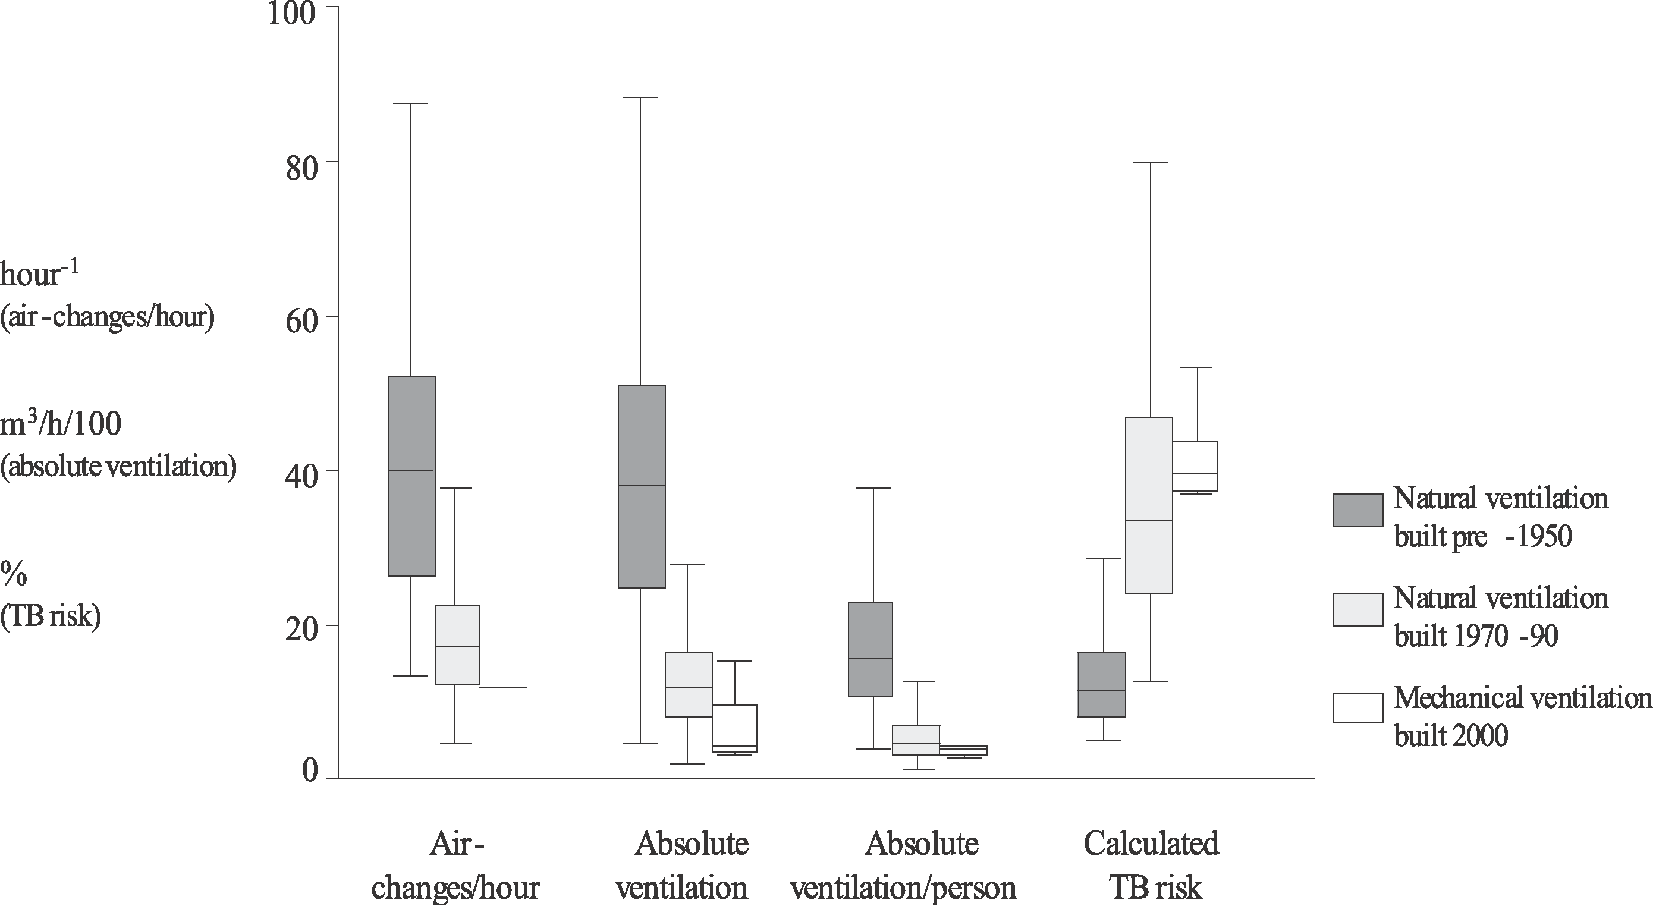
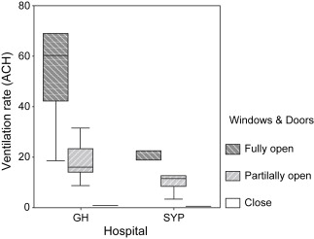
Qian et al. 2009
Escombe et al. 2007
Higher ventilation rates achieved with natural ventilation
Notes:
Escombe et al. 2007
eight hospitals in Lima, Peru; five were hospitals of “old-fashioned” design built pre-1950, and three of “modern” design, built 1970–1990. In these hospitals 70 naturally ventilated clinical rooms where infectious patients are likely to be encountered were studied. These rooms were compared with 12 mechanically ventilated negative-pressure respiratory isolation rooms built post-2000.
Facilities built more than 50 years ago, characterised by large windows and high ceilings, had greater ventilation than modern naturally ventilated rooms (40 versus 17 ACH; p < 0.001).
Even within the lowest quartile of wind speeds, natural ventilation exceeded mechanical (p < 0.001).
The Wells-Riley airborne infection model predicted that in mechanically ventilated rooms 39% of susceptible individuals would become infected following 24 h of exposure to untreated TB patients of infectiousness characterised in a well-documented outbreak.
This infection rate compared with 33% in modern and 11% in pre-1950 naturally ventilated facilities with windows and doors open
Qian et a. 2009
field measurement of 2 naturally ventilated hospital wards in Hong Kong
natural ventilation could achieve high ventilation rates especially when both the windows and the doors were open in a ward

Slide 14
4. UVGI in Air Handlers
UVGI treatment within a patient room excellent strategy for high risk infectious Areas
In room upper UVGI important tool in locations with high occupancy and unsuspected transmission

Slide 15
Kujundzic et al. 2006 In-Duct UVGI Single Pass Efficiency
91%
80%
Single pass Efficiency
75%
Duct velocity = 2.2 m/s
No inactivation at velocity of 5.1 m/s

Slide 16
Ryan et al. 2011
Reduction in aerobic colony counts and C. difficile spores on contaminated surfaces
Tracheal microbial loads decreased
Fewer patients became colonized
Ventilator-associated pneumonia fell from 74% to 39%
Antibiotic use decreased 62%
Notes:
NICU application, intubated, infants < 30 weeks gestation, ventilated for > 14 days
Showed significant reduction in aerobic colony counts and C. difficile spores on contaminated surfaces
Tracheal microbial loads decreased
Fewer patients became colonized
Ventilator-associated pneumonia fell from 74% to 39%
Antibiotic use decreased 62%
During enhanced ultraviolet germicidal irradiation (eUVGI), the proportion of high-risk patients (<30 weeks gestation and ⩾14 days ventilator support) who developed ventilator-associated pneumonia (VAP), as well as the number of episodes of VAP and the number of antibiotics per patient in this population decreased. pt, patient; Abx, antibiotics.

Slide 17
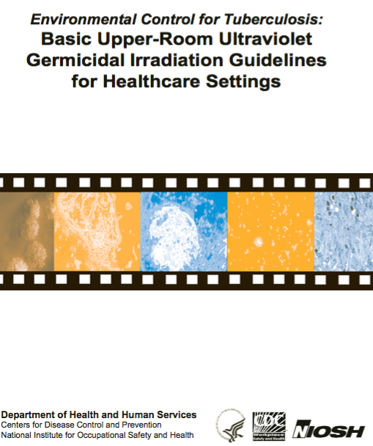
Upper Room UVGI Systems
Need even placement around room
Operate best in moderate humidity
Room air should be well mixed
The installation of UVGI fixtures in rooms with approximately 2.4 m (8 ft) ceilings that provide
a UV-C irradiance of 1.87 W/m² (0.17 W/ft²)
30 W/18 m², one 30-W fixture for every 18 m2 (200 ft²) of floor area, or for every seven people in a room, whichever is greater (Macher, 1993; Riley, 1988)
a UV-C power distribution of 6 W/m³ (0.18 W/ft³) in the upper UVGI zone
design UV installations based on the volume of the room that is irradiated and the total UV-C wattage applied
For our test room, the UV-C wattage volume power distribution was 5.5 W × 12 lamps/10.4 m³
UVGI reduces culturable concentrations by 40-95%
Effectiveness depends on microorganism (Xu et al., 2003)

Slide 18
7. Negative Pressure Ward
Ventilation can be used to create surge capacity in A Hospital

Slide 19
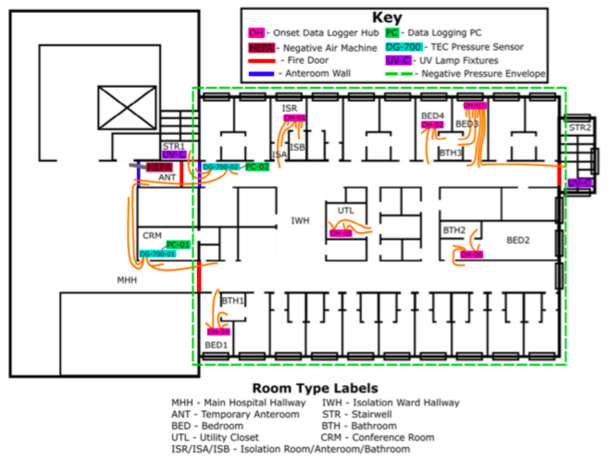
Clements et al. 2017
A 30-bed negative pressure isolation ward
Reduced supply to 60% of normal
Pressure of -29 Pa established
No pressure reversal at entrance
Pressures on the ward slightly positive
personal protective equipment
Notes:
A 30-bed negative pressure isolation ward was established on a functioning hospital
The pressure relative to the main hospital was -29 Pa by adjusting the ventilation
No occurrences of pressure reversal occurred at ward entrance
Pressures on the ward changed to slightly positive
Healthcare personnel should wear personal protective equipment on the ward
Clements et al. 2017
Smoothed pressure timeseries of outer envelope and isolation room pressure differentials. Vertical lines split pretest, ramp up, demonstration, ramp down, and post test time periods. ANT, temporary anteroom; MHH, main hospital hallway; 1, 2 are duplicate data sets.

Slide 20
Indoor Microbiome…
Diverse indoor microbiome good for limiting potential pathogenic organisms
Diversity increases with air flow, better in naturally ventilated buildings
2. Outdoor Air Ventilation
Increased rates decrease communicable respiratory infections
Increased rates decrease airborne microbial loading
3. Natural Ventilation
Used as effective ventilation with low levels of traffic-related air pollution
Better to enhance microbiome diversity
Higher air exchange rates, lower risk of airborne infection
4. UVGI in Air Handlers
UVGI air treatment excellent strategy for high risk infectious areas
In room upper UVGI important tool in locations with high occupancy and unsuspected transmission
5. Negative Pressure Ward
Ventilation can be used to increase surge capacity in a hospital
Notes:
Perspective of an urban air quality engineer
Ventilation is supposed to provide fresh air to a building
What is “fresh”? Doesn’t contain toxic air pollutants, odors, infectious airborn particles
Where does this clean air come from? Mostly outside in a hospital…
If outside air is not “clean” we can treat with UV and filtration
Is mechanical ventilation good for hospitals?
A recent review suggests that it reduced bioaeorosol concentrations. Is this a good metric for healthy?
The indoor microbiome research suggests that mechanical ventilation decreases diversity indoors
Perhaps increased diversity doesn’t lead to over growth of pathogens
Higher ventilation rates are better, can be achieved with natural ventilation

Slide 21
Brundage, J.F., Scott, R.M., Lednar, W.M., Smith, D.W. and Miller, R.N. (1988) Building-associated risk of febrile acute respiratory diseases in army trainees, J. Am. Med. Assoc., 259, 2108–2112.
Hoge, C.W., Reichler, M.R., Dominguez, E.A., Bremer, J.C., Mastro, T.D., Hen- dricks, K.A., Musher, D.M., Elliott, J.A., Facklam, R.R. and Breiman, R.F. (1994) An epidemic of pneumococcal disease in an overcrowded, inadequately ventilated jail, N. Eng. J. Med., 331, 643–648.
Escombe, A.R., Oeser, C.C., Gilman, R.H., Navincopa, M., Ticona, E., Pan, W., Martínez, C., Chacaltana, J., Rodríguez, R., Moore, D.A. and Friedland, J.S., 2007. Natural ventilation for the prevention of airborne contagion. PLoS medicine, 4(2), p.e68.
Qian, H., Li, Y., Seto, W.H., Ching, P., Ching, W.H. and Sun, H.Q., 2010. Natural ventilation for reducing airborne infection in hospitals. Building and Environment, 45(3), pp.559-565.
Kembel, S.W., Jones, E., Kline, J., Northcutt, D., Stenson, J., Womack, A.M., Bohannan, B.J., Brown, G.Z. and Green, J.L., 2012. Architectural design influences the diversity and structure of the built environment microbiome. The ISME journal, 6(8), p.1469.
Lax, S. and Gilbert, J.A., 2015. Hospital-associated microbiota and implications for nosocomial infections. Trends in molecular medicine, 21(7), pp.427-432.
Stockwell, R.E., Ballard, E.L., O'Rourke, P., Knibbs, L.D., Morawska, L. and Bell, S.C., 2019. Indoor hospital air and the impact of ventilation on bioaerosols: a systematic review. Journal of Hospital Infection.
Lax, S., Sangwan, N., Smith, D., Larsen, P., Handley, K.M., Richardson, M., Guyton, K., Krezalek, M., Shogan, B.D., Defazio, J. and Flemming, I., 2017. Bacterial colonization and succession in a newly opened hospital. Science translational medicine, 9(391), p.eaah6500.
Ciencewicki, J. and Jaspers, I., 2007. Air pollution and respiratory viral infection. Inhalation toxicology, 19(14), pp.1135-1146.
Miller, F.J., Illing, J.W. and Gardner, D.E., 1978. Effect of urban ozone levels on laboratory-induced respiratory infections. Toxicology letters, 2(3), pp.163-169.
Hyttinen, M., Pasanen, P., Salo, J., Björkroth, M., Vartiainen, M. and Kalliokoski, P., 2003. Reactions of ozone on ventilation filters. Indoor and Built Environment, 12(3), pp.151-158.
Gibbons, S.M., Schwartz, T., Fouquier, J., Mitchell, M., Sangwan, N., Gilbert, J.A. and Kelley, S.T., 2015. Ecological succession and viability of human-associated microbiota on restroom surfaces. Appl. Environ. Microbiol., 81(2), pp.765-773.
Weschler, C.J., Shields, H.C. and Naik, D.V., 1994. Ozone-removal efficiencies of activated carbon filters after more than three years of continuous service. ASHRAE transactions, 100(2), pp.1121-1129.
Zhao, P., Siegel, J.A. and Corsi, R.L., 2007. Ozone removal by HVAC filters. Atmospheric environment, 41(15), pp.3151-3160.
Poza M, Gayoso C, Gómez MJ, Rumbo-Feal S, Tomás M, et al. (2012) Exploring Bacterial Diversity in Hospital Environments by GS-FLX Titanium Pyrosequencing. PLOS ONE 7(8): e44105. https://doi.org/10.1371/journal.pone.0044105
https://journals.plos.org/plosone/article?id=10.1371/journal.pone.0044105
Hewitt KM, Mannino FL, Gonzalez A, Chase JH, Caporaso JG, et al. (2013) Bacterial Diversity in Two Neonatal Intensive Care Units (NICUs). PLOS ONE 8(1): e54703. https://doi.org/10.1371/journal.pone.0054703
https://journals.plos.org/plosone/article?id=10.1371/journal.pone.0054703
Ryan et al. 2011. Effect of enhanced ultraviolet germicidal irradiation in the heating ventilation and air conditioning system on ventilator-associated pneumonia in a neonatal intensive care unit. Journal of Perinatology 31:607-614.
Miller, S.L., Clements, N., Elliott, S.A., Subhash, S.S., Eagan, A. and Radonovich, L.J., 2017. Implementing a negative-pressure isolation ward for a surge in airborne infectious patients. American journal of infection control, 45(6), pp.652-659.
Kujundzic, E., Hernandez, M., and Miller, S. L. 2007. Ultraviolet germicidal irradiation inactivation of airborne fungal spores and bacteria in upper-room air and in-duct configurations, Journal of Environmental Engineering and Science, 6:1-9, 2007
Di, Q., Wang, Y., Zanobetti, A., Wang, Y., Koutrakis, P., Choirat, C., Dominici, F. and Schwartz, J.D., 2017. Air pollution and mortality in the Medicare population. New England Journal of Medicine, 376(26), pp.2513-2522.
Di, Q., Wang, Y., Zanobetti, A., Wang, Y., Koutrakis, P., Choirat, C., Dominici, F. and Schwartz, J.D., 2017. Air pollution and mortality in the Medicare population. New England Journal of Medicine, 376(26), pp.2513-2522.

